Slide 1
EEB 504 and EEB 607 - Spring 2021 - Careers in Academia: How to Enhance your Chances for Success
Instructor: Louis J. Gross
Chancellor’s Professor, Departments of Ecology and Evolutionary Biology and Mathematics
Moving after the First Position, Moving Later in your Career, Moving Outside Academia, Mentoring: Getting it and Giving it
March 22, 2021

Slide 2
Outline of course topics:
Types of higher education institutions;
How colleges and universities work;
Where the money comes from and where it goes;
Various roles of a faculty member and prioritizing among them;
Stages of a career;
Planning for transitions in career stages;
Position searches and how to apply;
Mentoring - getting it and giving it;
Enhancing your teaching;
Building your communication capabilities;
Administrators and how they impact your career;
Effectively preparing for evaluations at various levels;
Funding your scholarship;
Participating in the broader academic community in your field;
Building effective collaborations;
Combining your personal life and academic expectations;
Time management.

Slide 3
Moving after the First Position:
There are several reasons why you may consider moving from your first position: Promises made to you were not fulfilled, leadership (of department or institution) has changed and is no longer supportive, colleagues are not supportive, compensation has not lived up to your expectations, your career objectives have changed, new personal/family goals, a new institution offers potential for major career advancement that is not available at our current position.
Reasons not to try to move: Potentially negatively impacts relationships with colleagues, it requires a lot of effort to apply for positions, deciding between options if you are given an offer and your institution counter-offers is stressful, the grass-is-greener syndrome may not lead to a position that is significantly better, trying to move to improve your current salary may backfire and you are told “fine, go ahead and leave”

Slide 4
Moving after the First Position:
What might you be able to get from a new institution: Better compensation, changed responsibilities (e.g. teaching, service loads may change), better lab, early tenure/promotion, sabbatical/leave options, a more prestigious unit that could improve your career options (e.g. access to awards, leadership opportunities), an endowed position with enhanced resources you control, better options for partner/spouse, an institution that better aligns with your values, colleagues who better suit your research objectives.
Assessing the above is not trivial: They will be putting a very positive outlook on what they offer so talk as much as possible with the new colleagues you would mostly likely interact with, have frank discussions with those there who would be potential mentors
Trust your intuition: You can never be certain about a move, but if the “feel” isn’t positive, don’t move

Slide 5
Moving Later in your Career:
Why you might consider this: Ambition – opportunities through a new affiliation could enhance your ability to pursue major funding/awards, higher salary, endowed chair position, desire to move to an administrative position (e.g. Dean), new collaboration opportunities as your research shifts.
How to enhance the potential of being offered such a move: Work your butt off, be very successful in publications and external support, take on national professional leadership roles, take a leave to serve at a funding agency, for administrative positions gain some experience in administration at your institution (e.g. getting a Dean position requires experience as Head or Institute leader in which you managed a staff and faculty), build a set of professional references inside and outside your institution.

Slide 6
Moving Outside Academia:
Why you might consider this: You are tired of the academic rat-race, you want more administrative support (e.g. help with the onslaught of emails and other distractions from your main career objectives), higher salary and benefits, desire to “consult” rather than publish, you desire explicit achievable short-term goals rather than being totally self-motivated, you are no longer motivated by interactions with students
Where you might move and why: Industry – offers higher salaries, project-driven goals, extensive professional support so you don’t have to do it all yourself. Government – offers long-term position stability, potential to impact policy/regulation, publications still valued. NGOs – offer potential to interact directly with diverse stakeholders including volunteers, values may align with yours, potential for direct action

Slide 7
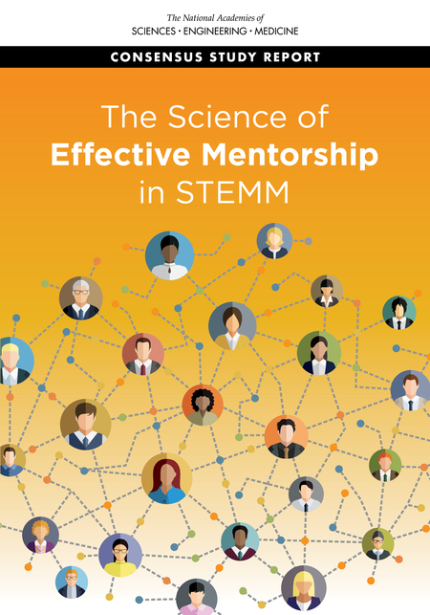
Mentoring: Getting and Giving:
There are a variety of guides – the course website has a brief listing: A recent one focused on institution-level processes is The Science of Effective Mentorship in STEMM: Online Guide https://www.nap.edu/resource/25568/interactive/
The underlying report is
The Science of Effective Mentorship in STEMM
https://www.nap.edu/catalog/25568/the-science-of-effective-mentorship-in-stemm/

Slide 8
Mentoring: Getting and Giving:
Components of effective mentorship:
Support Functions. Effective mentorship provides psychosocial and career support, as well as networking opportunities tailored to the needs, interests, and priorities of mentees.
Trust. Trust develops when mentors and mentees work together to identify and respond to their mutual goals, needs, and priorities, which can change over time and thus require adjustment.
Self-reflection. Effective mentorship entails critical and honest self-reflection at multiple stages of the mentorship process.
Expectations. Effective mentorship involves mentors stating expectations explicitly and the creation of a safe space for mentees to make their expectations explicit.
Education. Mentorship is a learned skill, and mentorship education influences mentor and mentee attitudes, self-efficacy, and behaviors.

Slide 9
Mentoring: Getting it:
Having effective mentoring in your career: One of the NAP report recommendations is: “Institutional leadership should support policies, procedures, and other infrastructure that allow mentees to engage in mentoring relationships with multiple individuals within and outside of their home department, program, or institution, such as professional societies, external conferences, learning communities, and online networks, with the ultimate goal of providing more comprehensive mentorship support.”
So you should expect an institution to help you by having a mentor or mentoring committee from your Department/College, have cross-institution mechanisms to share concerns with peers and with those with differing experiences, and support time to participate in formal and informal professional society mentoring activities (e.g. Project NeXT, SMB Mentoring, ESA mentoring chains).
Project NExT – MAA https://www.maa.org/programs-and-communities/professional-development/project-next
SMB - https://www.smb.org/mentorship-program/
ESA - https://www.esa.org/earlycareer/resources-2/early-career-mentoring-program/

Slide 10
Mentoring: Getting it:
Having effective mentoring in your career: A mentor from your department is one way to help with challenges of a first position. What you should expect from this is regular feedback on grant proposals, teaching plans, dealing with others in the unit, prioritizing your effort. It may be appropriate to ask for comments on articles you plan to submit, depending upon the mentor’s expertise.
Being careful with your mentors: They are in a potentially uncomfortable situation in both providing guidance and at the same time being required to be honest with colleagues. So do not place them in situations that might cause them concern (e.g. regularly bitching about problems they have no capacity to address, such as personal interactions with others in the unit). You need to keep them as your advocate.

Slide 11
Mentoring: Giving it:
One of the criteria you will be evaluated upon as a faculty member is how effectively you mentor students (and colleagues). Much of the guidance on this applies outside academia too.
Graduate.asu.edu/mentoring

Slide 12
Mentoring: Giving it:

