Slide 1
EEB 504 and EEB 607 - Spring 2021 - Careers in Academia: How to Enhance your Chances for Success
Instructor: Louis J. Gross
Chancellor’s Professor, Departments of Ecology and Evolutionary Biology and Mathematics
Mentoring: Getting it and Giving it, Enhancing your Teaching
March 29, 2021

Slide 2
Outline of course topics:
Types of higher education institutions;
How colleges and universities work;
Where the money comes from and where it goes;
Various roles of a faculty member and prioritizing among them;
Stages of a career;
Planning for transitions in career stages;
Position searches and how to apply;
Mentoring - getting it and giving it;
Enhancing your teaching;
Building your communication capabilities;
Administrators and how they impact your career;
Effectively preparing for evaluations at various levels;
Funding your scholarship;
Participating in the broader academic community in your field;
Building effective collaborations;
Combining your personal life and academic expectations;
Time management.

Slide 3
Mentoring: Giving it:
One of the criteria you will be evaluated upon as a faculty member is how effectively you mentor students (and colleagues). Much of the guidance on this applies outside academia too.
Graduate.asu.edu/mentoring

Slide 4
Mentoring: Giving it:

Slide 5
Mentoring: Giving it:
Mentoring undergrads has three main routes (aside from formal classroom instruction, in which you may have a mentoring role with some small number of students in a class):
As an academic advisor – you are generally expected to provide overall guidance on curricular requirements, provide career options, and be their advocate in disputes with others at the institution. Doing this effectively means investing time in understanding the curriculum, the processes for analyzing the student’s progress, and coordination with any other advisors (such as professional ones at the College).
As an instructor in a course-based undergraduate research experience (CURE) – for this you are often providing some oversight of group or individual projects that connect to the course content. As one of the main routes to research experiences for undergraduates (others are REU summer programs and in a faculty member’s lab), a CURE may be the only research a student experiences.
In a faculty member’s lab – this may be funded research, work-study supported by the institution, or an un-paid internship. Combining the skills and experiences of undergraduates, graduate students and postdocs in an effective lab is challenging due to the different individual objectives and levels of maturity involved, the differing levels of individual investment, and the differences in compensation. A key to success is developing a lab ethos in which all involved have “ownership” of the ongoing projects by ensuring all are aware of the overall goals, how they contribute, the expectations for each individual and sharing successes

Slide 6
Mentoring: Giving it:
Undergraduate students differ from graduate students and postdocs:
Often new to science, undergraduates likely have limited experience working within the scientific process and may be wholly unfamiliar with academic research and culture.
Undergrads may be juggling many outside demands on their time including classes, work, extracurricular activities, and/or family obligations that prevent them from dedicating significant time to research.
While graduate students have committed themselves full‐time to scientific research, undergraduates are likely still figuring out what career they want to pursue. Thus, they may justifiably question whether research will help them in their long‐term goals.
These unique characteristics of undergraduate researchers reinforce the importance of being flexible, patient and cognizant of students’ individual needs when developing one's mentoring approach.
Emery, N. et al. 2019. Students as ecologists: Strategies for successful mentorship of undergraduate researchers.
Ecology and Evolution, Volume: 9, Issue: 8, Pages: 4316-4326. DOI: (10.1002/ece3.5090)

Slide 7
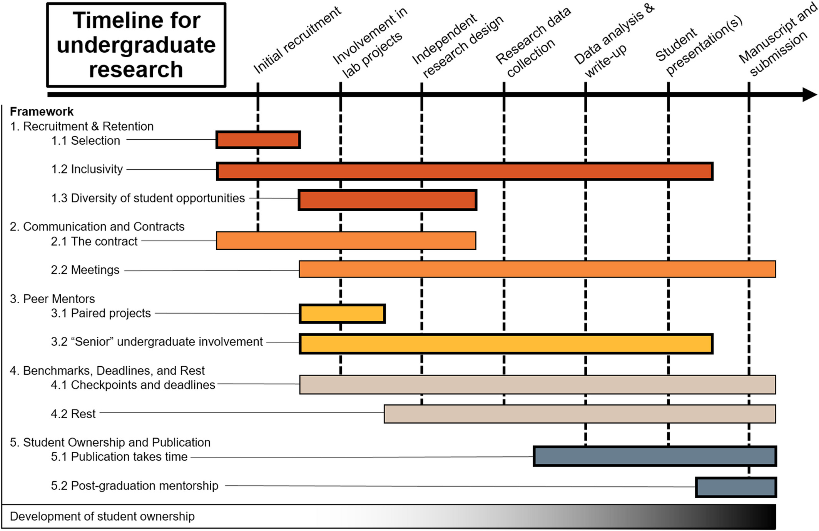
Mentoring: Giving it:
Mentoring students effectively in your lab is critical to both their career success and the success of your research program
Students as ecologists: Strategies for successful mentorship of undergraduate researchers
Emery, N. et al. 2019. Students as ecologists: Strategies for successful mentorship of undergraduate researchers.
Ecology and Evolution, Volume: 9, Issue: 8, Pages: 4316-4326. DOI: (10.1002/ece3.5090)
Notes:
How mentors are involved in the undergraduate research experience over time. Each color represents a different topic described in the text, and the bars indicate when a given mentoring effort generally overlaps with the undergraduate research timeline. The gradient at the bottom represents the development of student ownership over time
IF THIS IMAGE HAS BEEN PROVIDED BY OR IS OWNED BY A THIRD PARTY, AS INDICATED IN THE CAPTION LINE, THEN FURTHER PERMISSION MAY BE NEEDED BEFORE ANY FURTHER USE. PLEASE CONTACT WILEY'S PERMISSIONS DEPARTMENT ON PERMISSIONS@WILEY.COM OR USE THE RIGHTSLINK SERVICE BY CLICKING ON THE 'REQUEST PERMISSIONS' LINK ACCOMPANYING THIS ARTICLE. WILEY OR AUTHOR OWNED IMAGES MAY BE USED FOR NON-COMMERCIAL PURPOSES, SUBJECT TO PROPER CITATION OF THE ARTICLE, AUTHOR, AND PUBLISHER.

Slide 8
Mentoring: Giving it:
Assessment – how good a mentor are you?
Activity/Strategy | Question/Task
Appreciating individual differences | Give an example of an incident that illustrates your acknowledgement of individual difference
Availability | Give an example of the strategy you use to be available to your students/staff
Self-direction | Do you micromanage or promote self-independence
Questioning | Describe how you last used active questioning to lead a mentee towards a solution
Celebration | When did you last celebrate a student/staff member’s achievement? How did you celebrate?
Nature's guide for mentors https://www.nature.com/articles/447791a

Slide 9
Mentoring: Giving it:
Assessment – how good a mentor are you?
Activity/Strategy | Question/Task
Building a scientific community | Describe a deliberate strategy you use to build a scientificcommunity in your group
Building a social community | Describe a deliberate strategy you use to build your group as a social community
Skill development | Describe steps you take to develop the critical, writing and presentation skills of your students/staff
Networking | Describe one example of how you have introduced each of your students/staff into the scientific network of your research area
Mentor for life | How many of your past students/staff are you in contact with?
Nature's guide for mentors https://www.nature.com/articles/447791a

Slide 10
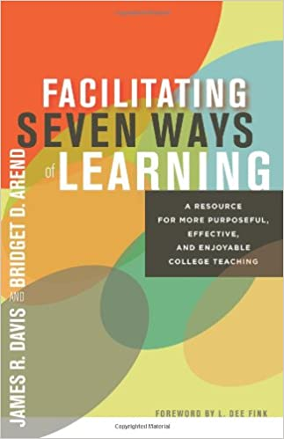
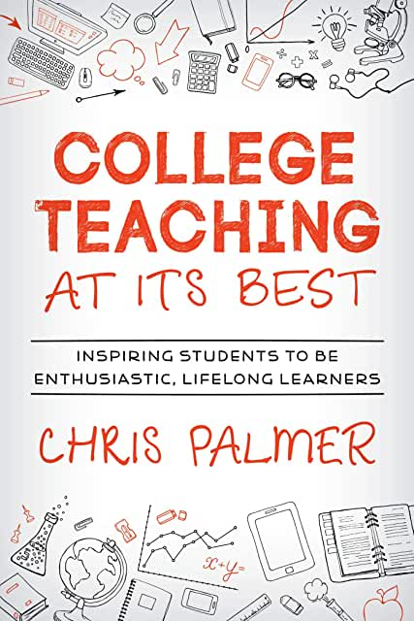
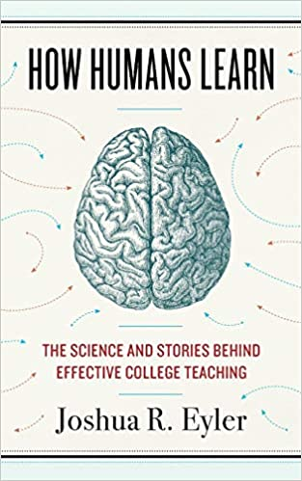
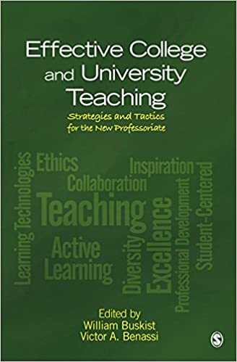
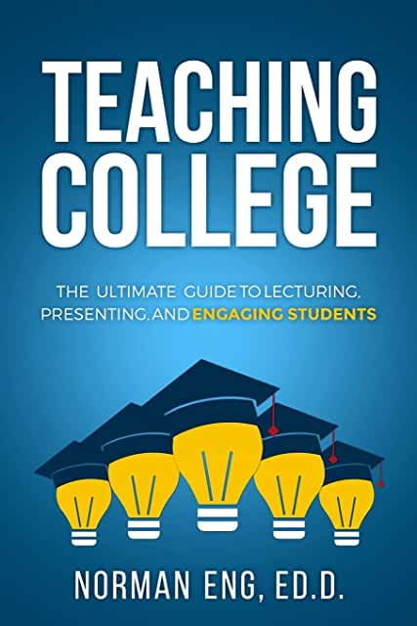
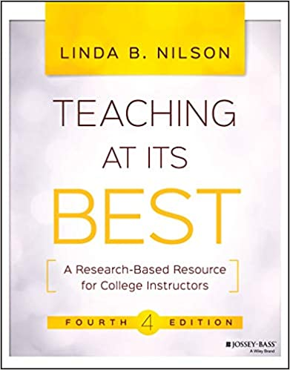
Enhancing Your Teaching:
There is a lot of guidance:

Slide 11
Enhancing Your Teaching:
This is important assuming that you have an academic position that somehow connects to students. Even if your position is mostly research, extension or consulting, if you interact with students, you should consider it part of your responsibility to assist their learning.
Use the resources available to you – every institution has some teaching and learning center, there are regular workshops about various aspects of classroom instruction, professional societies have workshops specific to the discipline, there are education research journals in every discipline, professional journals often have sections on teaching

Slide 12
Enhancing Your Teaching:
Six Things That Make College Teachers Successful:
Study the knowledge based of teaching and learning - there are extensive publications in education research in every STEM discipline
Accept all who enter the classroom door - students enter with different experiences and models for how to learn and behave, so be prepared to assist all
Plan for instructional management - put policies in place, explain them on the syllabus, and help keep students regularly aware of the topics and expectations of them
Mary Clement. Six Things That Make College Teachers Successful. The Teaching Professor, 27.7 (2013): 5

Slide 13
Enhancing Your Teaching:
Six Things That Make College Teachers Successful:
Teach with a variety of strategies - there are multiple routes to a successful classroom and not all students learn similarly - consider alternatives and a mixture - learner-centered teaching, guided inquiry, active learning, lecture, group work, peer evaluation and online discussion.
Use assessment to inform students of their achievement - have clear grading schemes and regularly inform students where they stand - make sure they are aware that assessment helps them to understand their achievement and helps teachers meet their needs
Keep the passion - you became a faculty member in part because you had a passion to assist others learn - remind yourself that you are teaching to shape the future of your disciplines and influence the larger world through your disciplines.
Mary Clement. Six Things That Make College Teachers Successful. The Teaching Professor, 27.7 (2013): 5

Slide 14
Enhancing Your Teaching:
Teaching and Success in Tenure/Promotion:
Do something unique for your department: develop a new course, implement a new set of practices in an existing course, develop new materials to help Teaching Assistants in a standard course, organize a journal club on education research in your discipline, collaborate with an education researcher on papers, help revise the curriculum
Be involved in activities that indicate you value the importance of teaching: attend workshops at your institution, become a “teaching fellow” if these exist, participate in (or even better organize) an education workshop/special session at your professional society, become a leader in the education section of your professional society
Get a grant that involves education - this can be one that focuses on education perhaps in collaboration with an education researcher, it could be taking the lead on the education/broader impacts of an award for which you are not the lead investigator, it could be developing a tutorial or other training as part of a research grant

Slide 15
Enhancing Your Teaching:
Teaching and Success in Tenure/Promotion:
Tenure documents:
In your portfolio you will be asked to provide a teaching section. If you have done any of the above they should be highlighted in this section along with anything you have done on a regular basis to make your classes more effective. In reviewing tenure cases, external reviewers are mostly not specifically tasked with saying much about teaching, however if you have done any of the above it makes it easier for a reviewer (as well as the local Tenure Committee) to state something positive about your teaching.
About student evaluations of teaching: these are held essentially everywhere but there are major problems with them (e.g. various biases). Take them seriously but consider supplementing them with questions you ask the students in classes (anonymously) to help you improve as the course goes along (e.g. don’t wait til the end of the term) and keep these to potentially add to your department file. Ask a colleague to sit in on your classes occasionally to provide feedback either informally, or formally as part of the peer review process.

