Slide 1
EEB 504 and EEB 607 - Spring 2021 - Careers in Academia: How to Enhance your Chances for Success
Instructor: Louis J. Gross
Chancellor’s Professor, Departments of Ecology and Evolutionary Biology and Mathematics
Participating in the broader academic community in your field; Building effective collaborations; Building balance in your life; Time management.
May 4, 2021

Slide 2
Outline of course topics:
Types of higher education institutions;
How colleges and universities work;
Where the money comes from and where it goes;
Various roles of a faculty member and prioritizing among them;
Stages of a career;
Planning for transitions in career stages;
Position searches and how to apply;
Mentoring - getting it and giving it;
Enhancing your teaching;
Building your communication capabilities;
Administrators and how they impact your career;
Effectively preparing for evaluations at various levels;
Funding your scholarship;
Participating in the broader academic community in your field;
Building effective collaborations;
Combining your personal life and academic expectations;
Time management.

Slide 3
Preparing for Evaluations
The Review Process: We already discussed the tenure review and promotion process. There are additional annual reviews typically expected to be carried out by Heads for all the faculty. There may be explicit formats for documents you supply for this rather than just turning in a cv. It will help in completing these if you keep careful records of everything you have done, including all your formal courses, any other teaching you have done (e.g. running a tutorial for a professional society, giving guest lectures for classes of other faculty, journal clubs or seminars you have participated in, etc.), your mentoring activities, efforts for any professional societies, talks you have given, external funding proposals submitted, editing/reviewing for journals, reviewing for funding agencies, etc. Make it as easy as possible for your Head to complete a review by including in your annual report a “summary” that they can lift and use to laud you.

Slide 4
Preparing for Evaluations
The Review Process: While your Head is the primary individual involved in your evaluation as a faculty member, the colleagues in your department also have a role for promotions and awards. Typically, the pre-tenure faculty are all reviewed annually by either a subcommittee of the tenured faculty or the complete group of tenured faculty. The tenured faculty may then make a recommendation to the Head (or Dean) on retention of the pre-tenured faculty. For promotion reviews, Associate Professors are reviewed by Full Professors. Departments (and the College, and University) have award committees who take nominations for whatever honors/awards are available, and then review these to make a recommendation to the administrator making the final decision. Sometimes these award committees are made up of recent or current winners of the awards. Professional societies also have awards – be aware of those in your field so if appropriate you can ask a colleague to nominate you. Be pro-active about these – awards are a typical method to assess the success of faculty.

Slide 5
Participating in the broader academic community:
What does this mean? In your academic field it could mean participating in professional societies, editing for journals, attending or organizing workshops/tutorials, reviewing for grant agencies. In a wider sense it refers to participating in the professoriate at your institution (e.g. being a good colleague when someone in another field asks for writing for your input), serving on advisory boards for local, regional or national organizations that may not directly relate to your academic discipline, giving outreach presentations, writing for the public.
Why does this matter? It helps you expand your network. It can provide different perspectives than those available in your home institution. It builds your reputation. It can indicate that you have the “altruism gene” that may eventually lead to being recognized as an officer of your professional society or editor of a main journal. All this reflects positively on you and your institution .

Slide 6
Participating in the broader academic community:
How do you bring this about? Join appropriate professional societies (they often have lower rates for junior researchers), determine whether they have sub-groups that directly align with your interests and join these. The subgroups often are much more readily open to having new researchers take on leadership/volunteer roles than the larger overall society, so start there. If you publish in a particular journal you are already likely already on their potential reviewer list but if you don’t get requests and wish to, look at the editorial board and send a note to one of the board members whose area is most closely aligned with yours and volunteer to review. At your institution there is likely an outreach office which manages requests for faculty speakers – you can get on their list. Look at local organizations that you could feel connected to, attend some activities and volunteer for them if you are drawn to their efforts.

Slide 7
Participating in the broader academic community:
Is this really necessary? No, there are highly successful faculty who don’t invest time and effort in this. They “hunker down” and focus on their own scholarship. Or they limit their connections to those activities that are directly beneficial to their careers. However, among the leading researchers I’ve known, the really top ones (e.g. ones who win the major awards such as Medal of Science, National Academy membership, etc.) typically are known for their efforts outside the strictly research ones. One advantage of participating as described in the academic community is finding these folks and interacting with them. This can be professionally and personally rewarding.

Slide 8
Building Effective Collaboration:
What counts as effective? Each person involved has shared responsibility to carry out the effort, everyone contributes though not necessarily in “equal” ways, there is consensus about who is doing what, there is mutual respect, there are products that all agree upon
Why this matters? Effective collaborations are like “leveraging” in that they allow you to both hone your skills by learning from others with different skill sets, while being more effective yourself in getting scholarship accomplished. Particularly for problems crossing disciplinary boundaries, having a diversity of skills ensures that no single approach limits the methods utilized. In many particular areas there can be disagreement by experts on key approaches, as well as the particular methods to employ. Having diverse collaborators to call upon reduces the likelihood that the research becomes “canalized” along a particular path when other routes may be more productive

Slide 9
Building Effective Collaboration:
How to bring this about? The “Science of Team Science” has provided guidance on effective collaboration, though there is no single route to build these. Some arise from acknowledgement up-front that various skills are needed to analyze a problem, some arise only after a research effort has started and it is determined new perspectives are necessary to really address the main problems. There are organizations (KnowInnovation is one) that agencies such as NSF rely upon to foster collaborations ( e.g. this group coordinates the NSF “IDEAS Labs”) through formal facilitation. The NSF Synthesis Centers were designed to foster team science.
Baron, J. S. et al. 2017. Synthesis Centers as Critical Research Infrastructure, BioScience, Volume 67, Issue 8, August 2017, Pages 750–759, https://doi.org/10.1093/biosci/bix053
Hall, K. E. et al.,. 2018. The Science of Team Science: A Review of the Empirical Evidence and Research Gaps on Collaboration in Science. American Psychologist 2018, Vol. 73, No. 4, 532–548.

Slide 10
Fostering Interdisciplinary Collaboration: My Tips
Hubris is the enemy of collaboration - you don’t know as much as you think you do.
Trust your colleagues - they know more than you do.
Don’t feel obliged to collaborate with assholes, even if they are brilliant.There are great non-assholes out there - find them.
Spice up your life - marry a poet.

Slide 11
Fostering Interdisciplinary Collaboration: My Tips
Don’t judge other disciplines based upon their students.
Find ways to explain your passion for your field to others.
Be patient - don’t expect to learn the language of another field easily.
The status quo arose from disciplinary silos - don’t be afraid to challenge it and modify or throw out the “rules”
Find mechanisms to ensure everyone benefits from a collaboration - individuals, their students, their department - share the wealth in order to generate new resources.

Slide 12
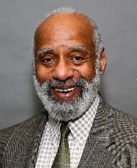
Building Balance in your Life:
Remembering a Conversation:
When visiting Morehouse College several years ago, I had a fascinating conversation with J.K. (as he is known) not about biology though there was that too) but about what drove us. In all my many visits to higher education institutions, J.K. was the only person who asked the deep questions of “What drives you”, “What really matters to you”, “What do you do for yourself”, “How do you contribute to the world”. This led to a discussion of family, art, music and educating students to “build a life they can look back on without regret”.
This seems to relate today to YOLO – You only live once
J.K. Haynes – Professor of Biology and Dean of Science and Math, Morehouse College

Slide 13
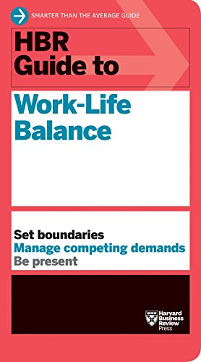
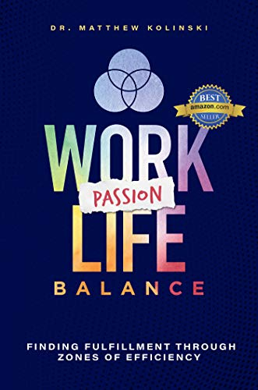
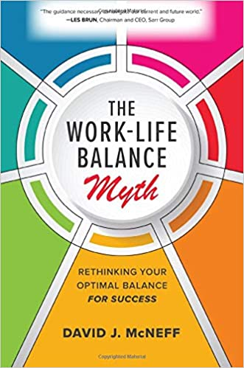
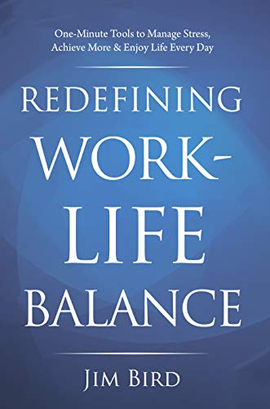
Building Balance in your Life:
There’s hosts of books on work-life balance:

Slide 14
Building Balance in your Life:
The Typical Suggested Steps include:
Prioritize and redo this regularly
Set firm boundaries between work and life
Be consistent about your time for each
Find time everyday to do something other than work
Learn to separate and focus on work there but not at home
Find people who are supportive
The academic life is rather different from other “jobs” though. In academia, rather than having a “boss” who manages you, much of what you do is self-motivated. If you do not heavily prioritize your scholarship, frankly you are simply not going to be successful (brilliance is not sufficient – you have to work very hard to be successful – just the effort to publish a single paper is substantial).

Slide 15
Building Balance in your Life:
So there is the danger:
Creative effort in scholarship may well not be readily separable from the rest of your life. Indeed, that are many stories/books about self-absorbed artists whose life is destructive, and scientific work can be just as self-absorbing as artistic efforts.
Avoiding this:
Look at the values in the IDP you chose – add to these values a set of items that are not on the list that really matter to you now, that you look forward to having time to spend on in the future (e.g. family activities, playing music, running, sports, etc.) and make sure that these make it into your IDP and revise the IDP and career plan accordingly

Slide 16
Building Balance in your Life:
My suggestion:
Have something outside your professional career and responsibilities that you want to be able to say you are really good at, maybe that you are the “best” at among some selected group. Then allocate time and effort to getting to that point. Like playing a musical instrument, it may require years of effort, and there may be plateau’s where you want to evaluate whether you want to try something else to focus on (this is typical of certain physical activities that are more difficult to be as competitive at as you age). So resetting and reevaluating these, particularly as your family responsibilities may change, is needed.
In the end, have something outside academia that allows you to build a different cohort of friends and to be proud of your accomplishments is healthy.

Slide 17
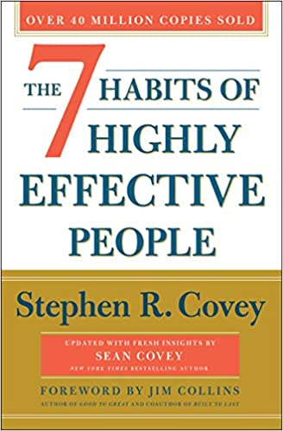
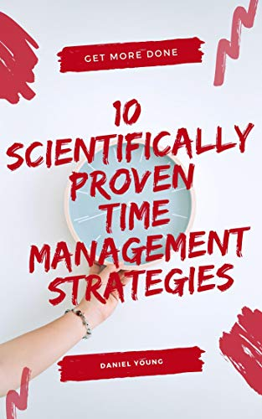
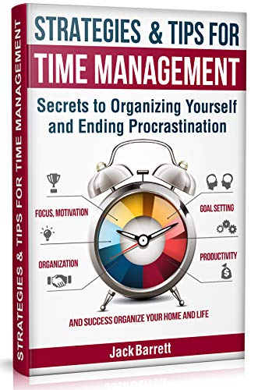
Time Management:
Again there are many books with suggestions:

Slide 18
Time Management:
Example of the tips (from Steven Covey’s book):
Be proactive
Begin with the end in mind
Put first things first
Think win/win
Seek first to be understanding (of others), then to be understood
Synergize (seek creative cooperation)
Sharpen the saw – improve yourself mentally, in value seeking, socially/emotionally, physically
A key in the time management literature is making lists, formalizing these, establishing a schedule and setting rules for yourself to follow the schedule.

Slide 19
Time Management:
Some tips:
Prioritize (how will this help my career goals, how much effort will it take) – view it as a cost/benefit analysis even if you don’t know the exact values
Give higher priority if it is “fun”
Learn to say “No”
Plan and make time for the “big issues” that you hope to look back on and say you chose to work on problems that matter
Use a “time matrix” placing tasks on Urgent/Not urgent and Important/Less important
Set goals on different time scales – short/medium/long that align with phases of your career plan
Learn to “triage” and discard (or don’t agree to) tasks that don’t align with your career plan
Avoid procrastination

