Slide 1
Modeling Cognitive Processes for Human Risk Perception: A Climate Change Example
Louis J. Gross
Chancellor’s Professor Emeritus
Departments of Ecology and Evolutionary Biology and Mathematics
University of Tennessee, Knoxville
Supported by NSF Awards EF-0832858, DBI-1300426 to NIMBioS, DBI-1052875 to SESYNC
Legacy.NIMBioS.org
SESYNC.org

Slide 2
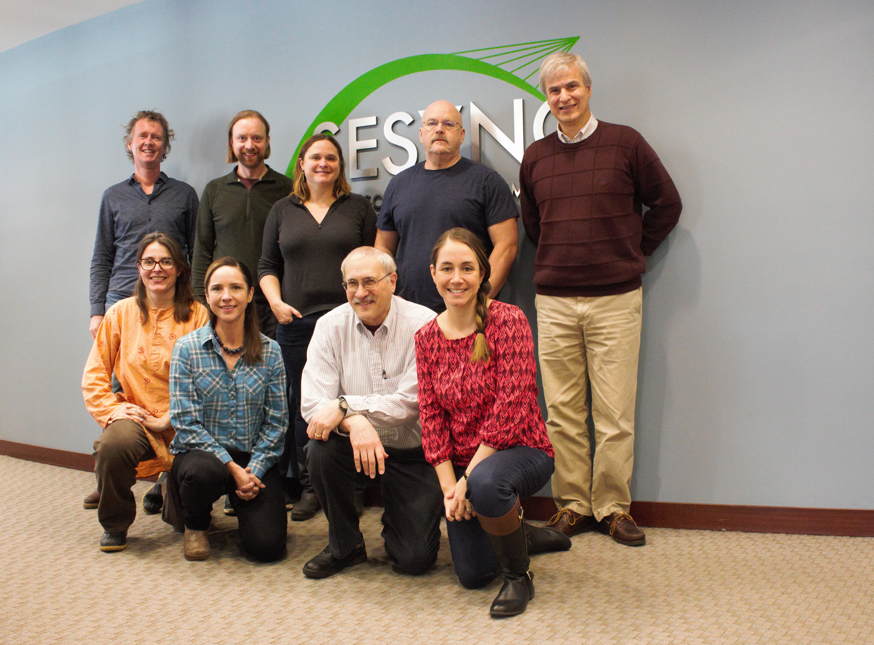
SESYNC Theme: Putting People into Climate Models
Sara Constantino - Stanford
Sara Metcalf, University at Buffalo
Louis Gross, University of Tennessee
Wander Jager, University of Groningen
Katharine Mach, University of Miami
Fran Moore, University of California, Davis
Travis Franck, Climate Interactive
Karim Chichakly, isee systems
Dale Rothman, George Mason University
Ann Kinzig, Arizona State University
Dale Rothman – George Mason
Supported by NSF Award DBI-1052875 to SESYNC

Slide 3
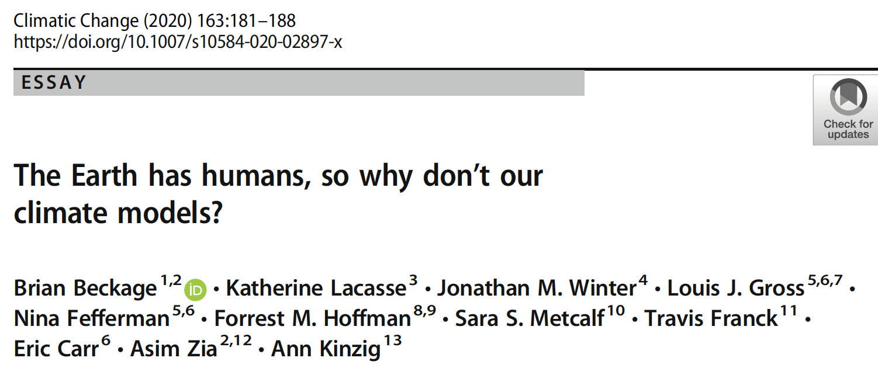
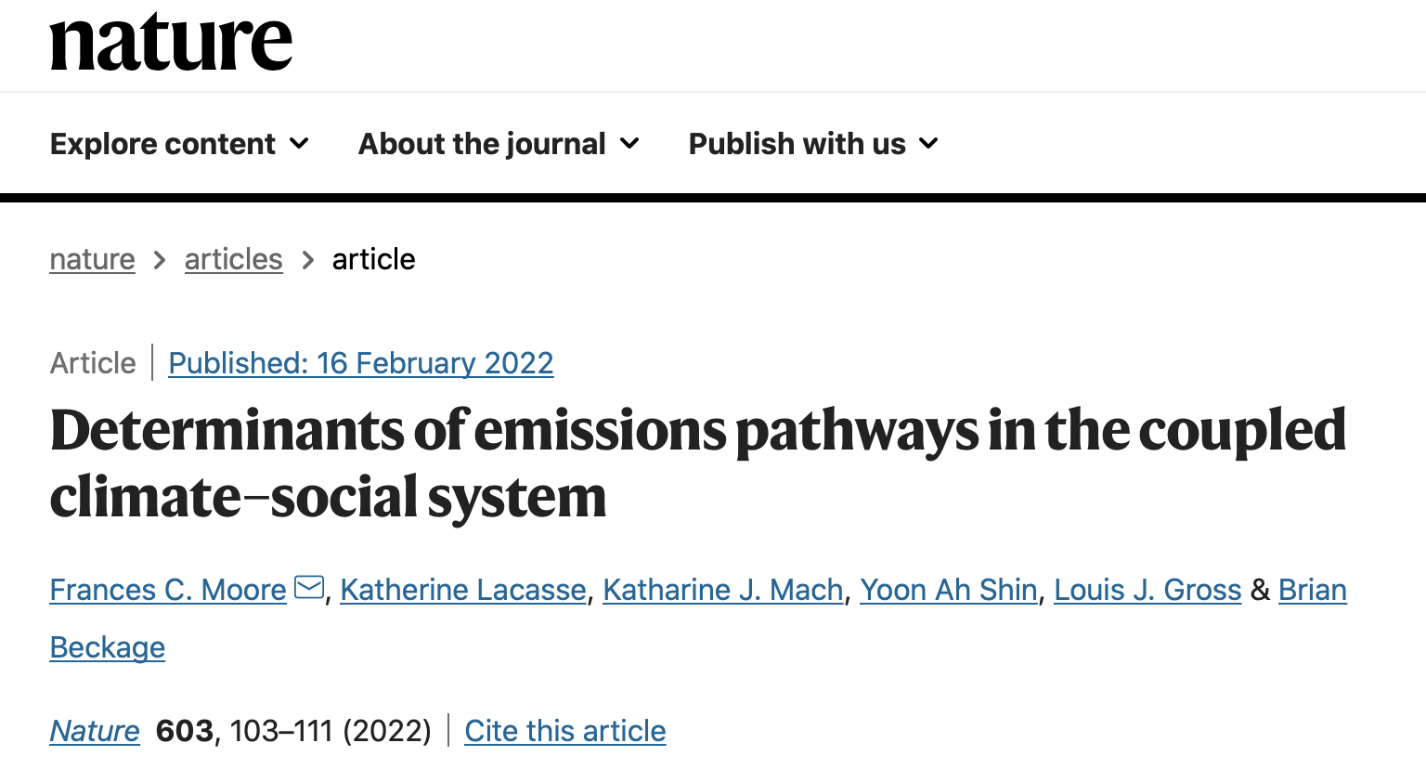

Slide 4
Background on Climate Social Systems Models
Models of climate change have largely focused on physical processes
Social components have generally been external - scenarios that drive the biophysical models. This limits the ability to observe dynamic interactions between humans and the climate system.
Standard economic growth model (DICE) uses an intertemporal optimization assuming perfect information about future climate change and economic impacts to estimate risk and make decisions.
Impacts of climate change are likely to alter human perceptions of climate change risks and associated greenhouse gas (GHG) emission behaviors that feedback to influence climate change
Key driver of interactions between human and climate systems are risk perceptions emerging from experiencing changes to weather patterns, extreme events, and changes that lead to economic damage, mortality and migration.

Slide 5
Major Questions We Address
What models might be used to analyze how human risk perception impacts climate projections?
How might we analyze feedbacks between the dynamics of human response and climate dynamics?
Are there major impacts on climate projections when human behavior feedbacks are included?
How might the various psychological and social theories of human behavior be modeled to link to climate?
How consistent are the resulting impacts of incorporating human behavior across different psycho-social models?

Slide 6
Theory of Planned Behavior
In psychology, this theory links one's beliefs and behavior.
Ajzen, I. (1991). The theory of planned behavior. Organizational behavior and human decision processes, 50(2), 179-211.
Considers how attitudes, perceived social norm (PSN), and perceived behavioral control (PBC) interact to influence behaviors
Attitudes are people’s positive or negative evaluation of behaviors and policies related to climate change mitigation, comprised of both
(1) risk perception of the adverse effects of climate change and
(2) perceived efficacy, defined by the extent to which people believe a behavior will influence GHG emissions.

Slide 7
CSM (Climate Social Model)
Beckage, B., L. J. Gross, K. Lacasse, E. Carr, S. S. Metcalf, J. M. Winter, P. D. Howe, N. Fefferman, T. Franck, A. Zia, A. Kinzig and F. M. Hoffman. 2018. Linking models of human behavior and climate alters projected climate change. Nature Climate Change 8, 79–85

Slide 8
Model dynamics of change in global temperature from preindustrial under different model assumptions

Slide 9
Regression tree partitioning of variation in mean global temperature in 2100 across 766,000 model simulations varying functional form and parametersfor mitigation mode

Slide 10
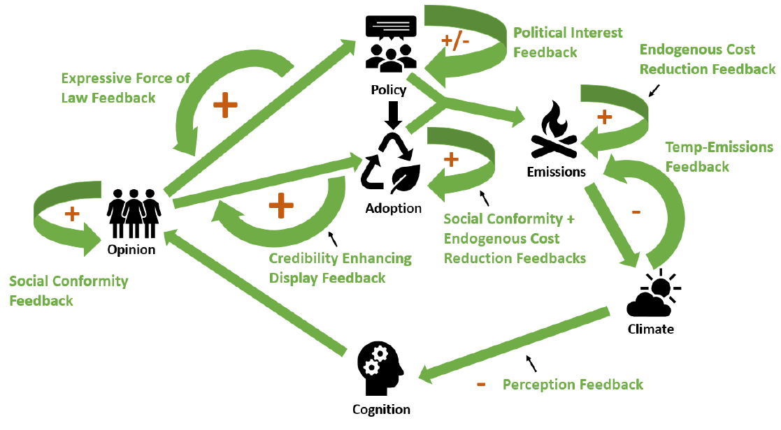
For this presentation we do not consider social interaction or contagion processes which describe how information and beliefs flows between individuals, but instead focus on how individuals process this information once received. Previous work included contagion processes.
Moore, F.C., K. Lacasse, K. J. Mach, Y. A. Shin, L. J. Gross and B. Beckage. 2022. Determinants of emissions pathways in the coupled climate–social system. Nature 603: 103–111

Slide 11
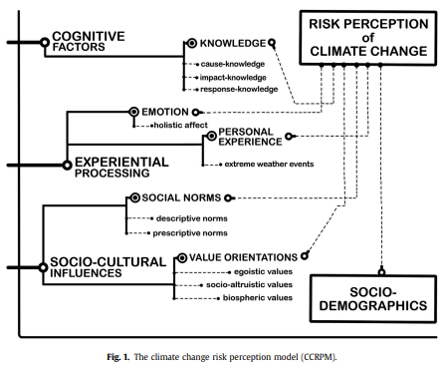
Van der Linden, S. (2015). The social-psychological determinants of climate change risk perceptions: Towards a comprehensive model. Journal of Environmental Psychology, 41, 112-124

Slide 12
Van der Linden, S. (2015). The social-psychological determinants of climate change risk perceptions: Towards a comprehensive model. Journal of Environmental Psychology, 41, 112-124

Slide 13
Cognitive Processes
Social science identifies a range of processes to explain how people react to new experiential information - some information is weighed more or less and associated to stronger or weaker climate risk perception.
Initial theory of risk perception assumed people were making “rational choices”, weighing the probability of available information about negative and positive outcomes and using these to come to conclusions. It is now clear that humans instead make decisions about risk in a boundedly rational way, utilizing emotional feelings, heuristics, social information along with knowledge, with experiential processes of particular importance.
People’s experiences with changing climate can strengthen perceived climate risk, mediated by how humans perceive and process information about the environment. This information processing is cognition - describing how humans sense, forget, and process signals from the environment, translating these signals into responses.

Slide 14
Cognitive Processes
Social science identifies a range of processes to explain how people react to new experiential information - some information is weighed more or less and associated to stronger or weaker climate risk perception.
Initial theory of risk perception assumed people were making “rational choices”, weighing the probability of available information about negative and positive outcomes and using these to come to conclusions. It is now clear that humans instead make decisions about risk in a boundedly rational way, utilizing emotional feelings, heuristics, social information along with knowledge, with experiential processes of particular importance.
People’s experiences with changing climate can strengthen perceived climate risk, mediated by how humans perceive and process information about the environment. This information processing is cognition - describing how humans sense, forget, and process signals from the environment, translating these signals into responses.
Daniel Kahneman

Slide 15
Cognitive Processes Terminology:
How likely is it?
A factor that matters when people are gauging risks as to how likely something is to occur is how easily it is to bring instances of that risky event to mind - the availability heuristic. Risks may more quickly come to mind if someone has personal experience of that risk, either to themselves or within their social network or if it is widely reported in the media or elaborated by “influencers”.
More recent events also may be more easily brought to mind. The recency effect describes how more recent experiences receive greater weight than earlier ones when receiving repeated information with which to make a judgment or shape a belief. Personal experiences with different extreme events such as flooding can lead people to perceive that they are at higher risk for future flooding.

Slide 16
Cognitive Processes Terminology:
What is normal?
How do people determine the baseline against which the current experiences should be compared? Climate change analyses often compare current temperature or weather events to pre-industrial or to the past 30 years. There is evidence that people typically use a smaller, more recent window for making comparisons - that the baseline they are using to make comparisons is shifting on a shorter time scale.
Risk perception is a process of adjustment to and acceptance of a new state of the environment. Habituation can be represented as a ‘shifting baseline’ - whether events are considered extreme is relative to a baseline average of recent past events. People seem to compare current temperature anomalies (hot or cold) to those experienced in the past 5 years (a reference point for normal ranges from 2 - 8 years ago). People can habituate to consistent risks in their environment - as the risk becomes more familiar, the sense of risk decreases. Consistent events may start to seem less risky over time.

Slide 17
Cognitive Processes Terminology:
How scary is it?
Specific large events that were especially damaging or costly can continue to have an impact on perceptions of risk for longer periods of time. These events may be particularly emotionally evocative, and strong emotional reactions can influence the perception of risk. The affect heuristic (“risk as feelings”) explains that judgements of risk are impacted by the affective meaning associated with a hazard - how much dread, fear, or general negative affect it evokes. Salience refers to this affect aspect of risk perception - how important an event is in impacting risk perception.

Slide 18
Cognitive Processes Terminology:
Is it due to climate change?
Biased assimilation (‘motivated reasoning’) describes the process by which people more easily accept and overweight information that supports their preexisting beliefs while they are more hesitant to accept and underweight evidence that is inconsistent with these beliefs. Having such a belief-supporting goal leads to directional bias, where the prior beliefs influence information processing in a Bayesian framework. This process impacts whether or not people attribute extreme weather events to climate change. Those with initial strong beliefs (or lack of belief) regarding climate change tend to report that they experienced more (less) extreme events over time.
People’s degree of climate skepticism alters how they interpret extreme cold weather. Those less skeptical are more likely to report it as evidence for climate change while those more skeptical are more likely to find it as evidence against climate change

Slide 19
How do we model these Cognitive Processes?
There is no one agreed-upon way to do so. Our model takes an environmental signal, processes it, and returns a perception of risk.
In doing this, there are many options for each of the key cognitive processes and so we maintain a set of switches to turn on and turn off various components of cognition. This allows us to determine circumstances under which one or more of the cognitive components may be less consequential in the variance of risk perception than others. The model structure is a dynamical system driven by a statistical model for the environmental drivers (extreme events), so the entire model is a non-stationary, non-Markov stochastic process, due to history dependence and non-linear feedbacks between the cognitive components. We intend to use a regression tree analysis, as we have done for past models with uncertainty of model structure, to analyze factorial experiments to determine the impact of assumptions about cognitive components.

Slide 21
Population Heterogeneity
We assume there are three groups in the population with potentially different risk perceptions. We denote these are “Green”, ”Grey” and ”Red” which can be thought of as supporting climate change mitigation, neutral on mitigation or opposed to mitigation. So through most of the model, the state variable is a 3-vector and at this stage we assume that there is a fixed total population size.

Slide 22
Example of model component formulation - events
Number of events each time step is chosen from a Poisson distribution with mean determined as one of (i) stationary mean; (ii) linear increase over time from a stationary mean; (iii) a step up from stationary level to a new one; (iv) a step up from stationary level to a new one and then step down back to stationary level over a time period.
Sizes of events are chosen from a lognormal with median set similarly to the cases for number of events. Sizes impact the model because we assume that there are differences between groups in how readily extreme events of different sizes are perceived and potentially impact risk perception for the group.

Slide 23
Example of model component formulation - salience
Salience is of 2 types - both modeled for three population groups (green, grey and red).
Size salience is included by modifying separately for each group the median of the lognormal distribution of size of events as well as a threshold above which an event is considered significant to impact that group’s memory of events.
Recency salience takes account of how each group ”remembers” recent past events. This is modeled using two alternatives for how recent events affect behavioral response (i) sum events perceived by a population group over a fixed past time period, accounting for differences in salience for each group, or (ii) assume an exponential weighting of number of perceived events for a population group over the past. Biased assimilation applies a relative bias for each population group that increases or decreases the number of perceived events for that group.

Slide 24
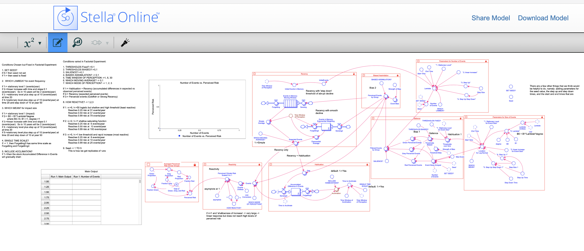
Model is implemented in Stella, has 8 “switches” for alternative model formulations/assumptions, about 30 parameters associated with these switches, and is designed to run factorial experiments.

Slide 25
How do we evaluate such a model?
First, we ensure the coded model is behaving as designed for the key drivers – e.g. the code is correctly representing the desired model – by checking each component output.
Second, we establish general qualitative expectations – e.g. risk perception should increase as mean number of events increases and as mean size of events increases.
Third, we choose subsets of switched cases for which we have general guidance from our psychology collaborators and data from various publications as to how risk perception will respond.
Fourth, we carry out an uncertainty analysis for key parameters and model components to determine whether model output response is highly sensitive to certain model components.

Slide 26
Take home lessons
Linkages to economic and policy models are still somewhat limited and political systems have not been accounted for much at all in coupled models
Comparisons of alternative modeling methods are limited – multiple models are good
Given the host of different behavior theories, compare behavior processes to identify those with most impact
Model evaluation for all types of behavioral models is relatively rare -tie evaluation criteria to model objectives.
There is benefit from collaboration with psychologists and cognitive scientists to incorporate alternative theories for human behavior

