Slide 1
NIMBioS Songwriter-in-Residence Program
https://legacy.nimbios.org/songwriter
http://www.bababrinkman.com

Slide 2
A Rational Basis for Hope: Human Behavior Modeling and Climate Change
Louis J. Gross
Chancellor’s Professor Emeritus
Departments of Ecology and Evolutionary Biology and Mathematics
University of Tennessee, Knoxville
Supported by NSF Awards EF-0832858, DBI-1300426 to NIMBioS, DBI-1052875 to SESYNC
Legacy.NIMBioS.org
SESYNC.org

Slide 3
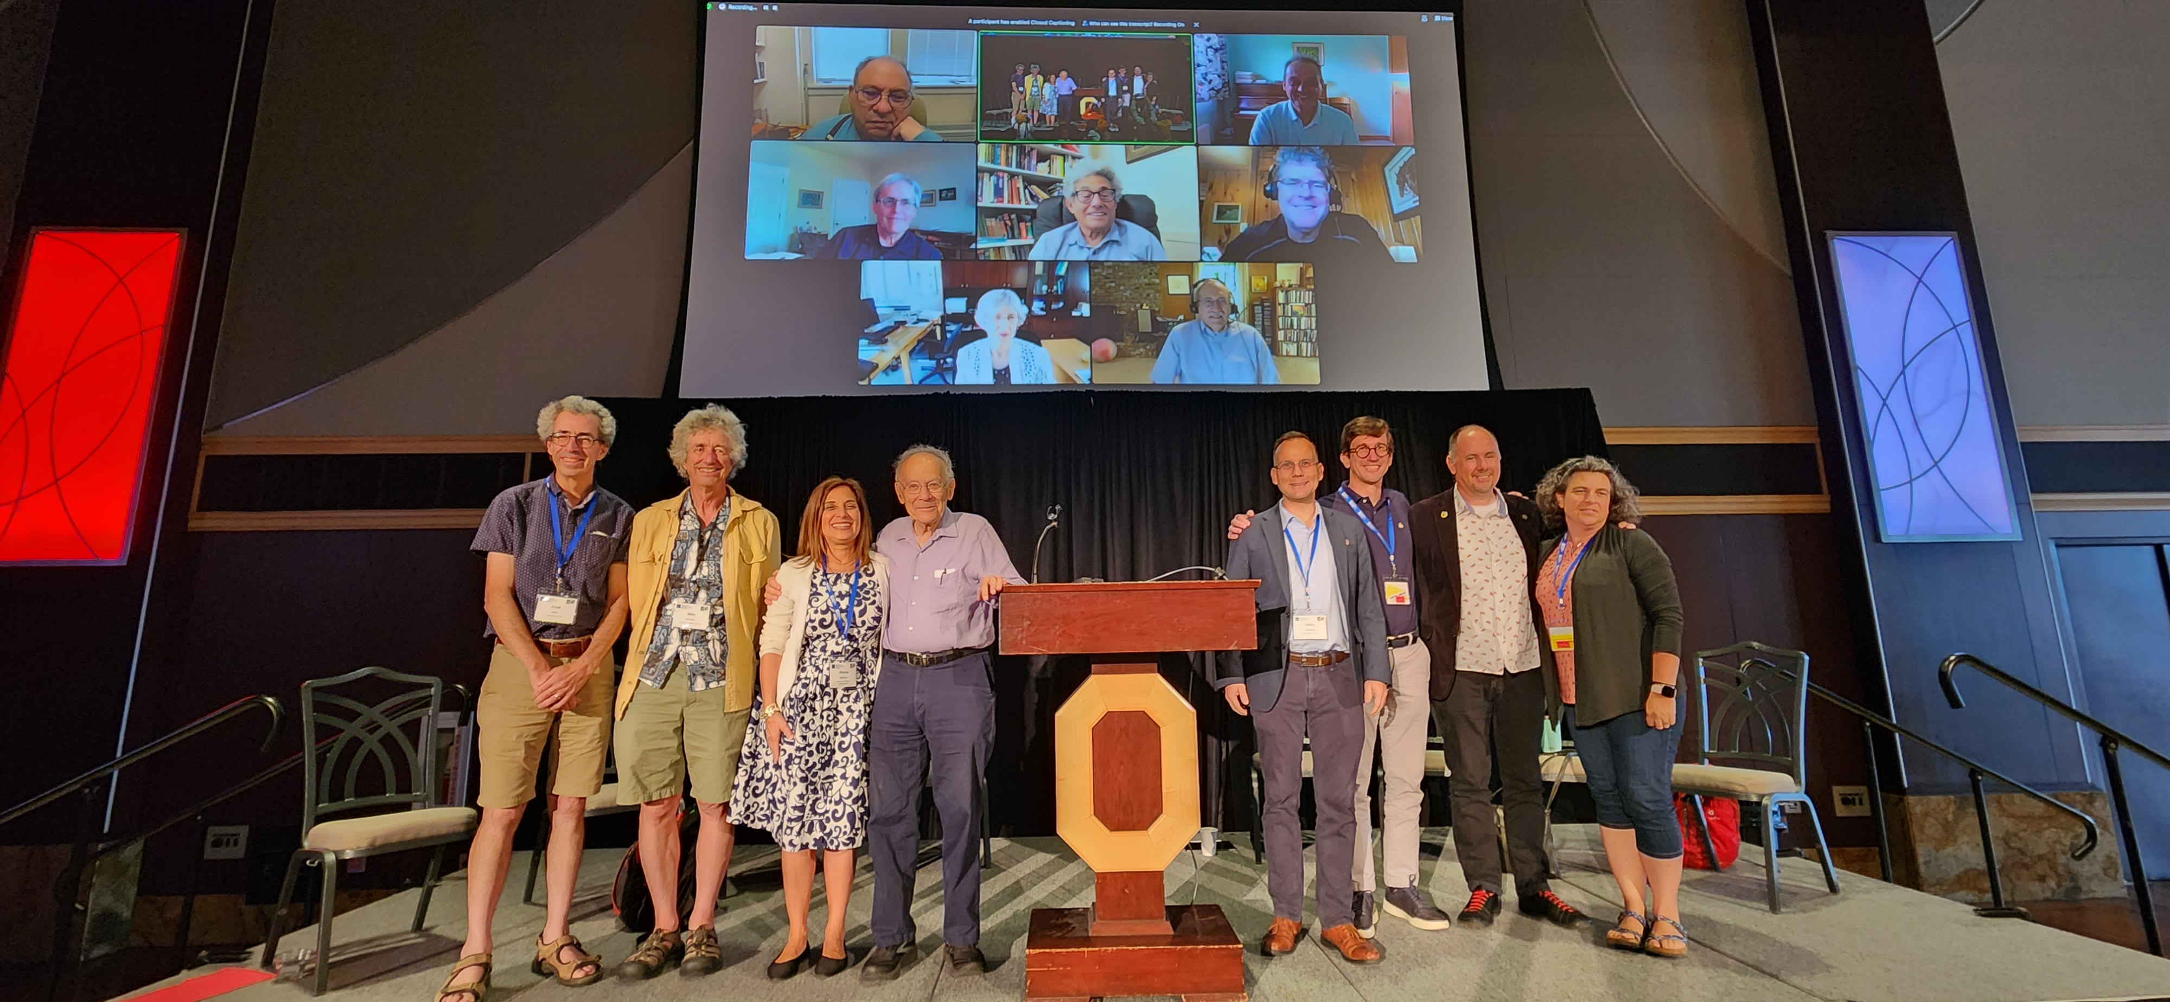

Slide 4
A Rational Basis for Hope: Human Behavior Modeling and Climate Change
Louis J. Gross
Chancellor’s Professor Emeritus
Departments of Ecology and Evolutionary Biology and Mathematics
University of Tennessee, Knoxville
Supported by NSF Awards EF-0832858, DBI-1300426 to NIMBioS, DBI-1052875 to SESYNC
Legacy.NIMBioS.org
SESYNC.org

Slide 5
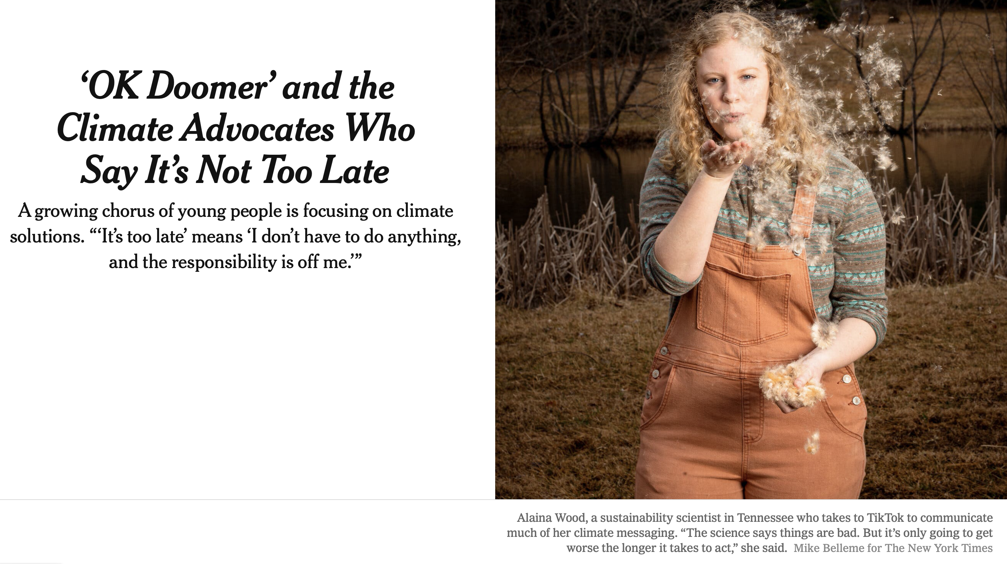
New York Times March 22, 2022

Slide 6
CNH must include analyses of: (1) the dynamics of a natural system; (2) the dynamics of a human system; (3) the processes through which the natural system affects the human system; and (4) the processes through which the human system affects the natural system.
Doing this is challenging:
Mismatch between the temporal and spatial scales of the different organizational levels
Main conceptual models for human systems are not as agreed upon as they are for natural systems
Rules for the coupling are unclear
Shin, Y-A., K. Lacasse, L. Gross, B. Beckage. 2022. How coupled is coupled human-natural systems research? Ecology and Society 27 (3):4
Dynamics of Coupled Natural and Human Systems (CNH)https://www.nsf.gov/pubs/2018/nsf18503/nsf18503.htm

Slide 7
Can we measure how challenging it is to link human and natural systems?
Get the Data!
Yoon Ah Shin
SESYNC
Katherine Lacasse
Rhode Island College
Brian Beckage
University of Vermont
Shin, Y-A., K. Lacasse, L. Gross, B. Beckage. 2022. How coupled is coupled human-natural systems research? Ecology and Society 27 (3):4.

Slide 8
Objectives:
Evaluate the degree to which interdisciplinary research teams studying coupled natural-human systems publish research that displays two-way linkages between systems.
What academic disciplines of team leaders and members are important predictors for achievement of two-way linkages in the research?
What analysis methods most affect achievement of two-way linkages?
Data:
Sampled 14% of all CNH funded projects from each year between 2001 and 2018 (44 of 310 projects)
Analyze publications from these projects (241 total) for author attributes, presence/absence of 2-way linkages, analysis methods used in publication

Slide 9
Results:
13% of the total articles analyzed included 2-way linkages
13% of articles had a 1-way linkage from the natural to the human system, 26% had a 1-way linkage from the human to the natural system, and 47% had no linkage between systems.
37% of the projects published at least one article with 2-way linkages
Impact on presence of 2-way linkages:
Social science and/or interdisciplinary authors
Biological and/or physical science authors
Statistical or spatial analysis methods
Conceptual/reviews and computational simulation

Slide 10
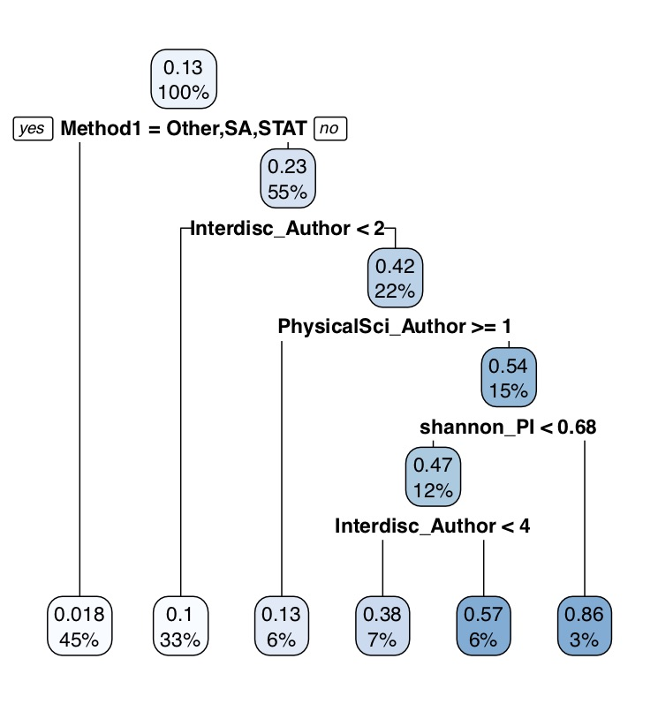
Presence of 2-way linkages

Slide 11
Take away:
Even for projects explicitly charged to link human and environmental systems, success in having complete linkages is rare
There is some indication that success in linking human and environmental systems depends upon team characteristics
Presence of interdisciplinary individuals as PI or authors increases the likelihood of success

Slide 12
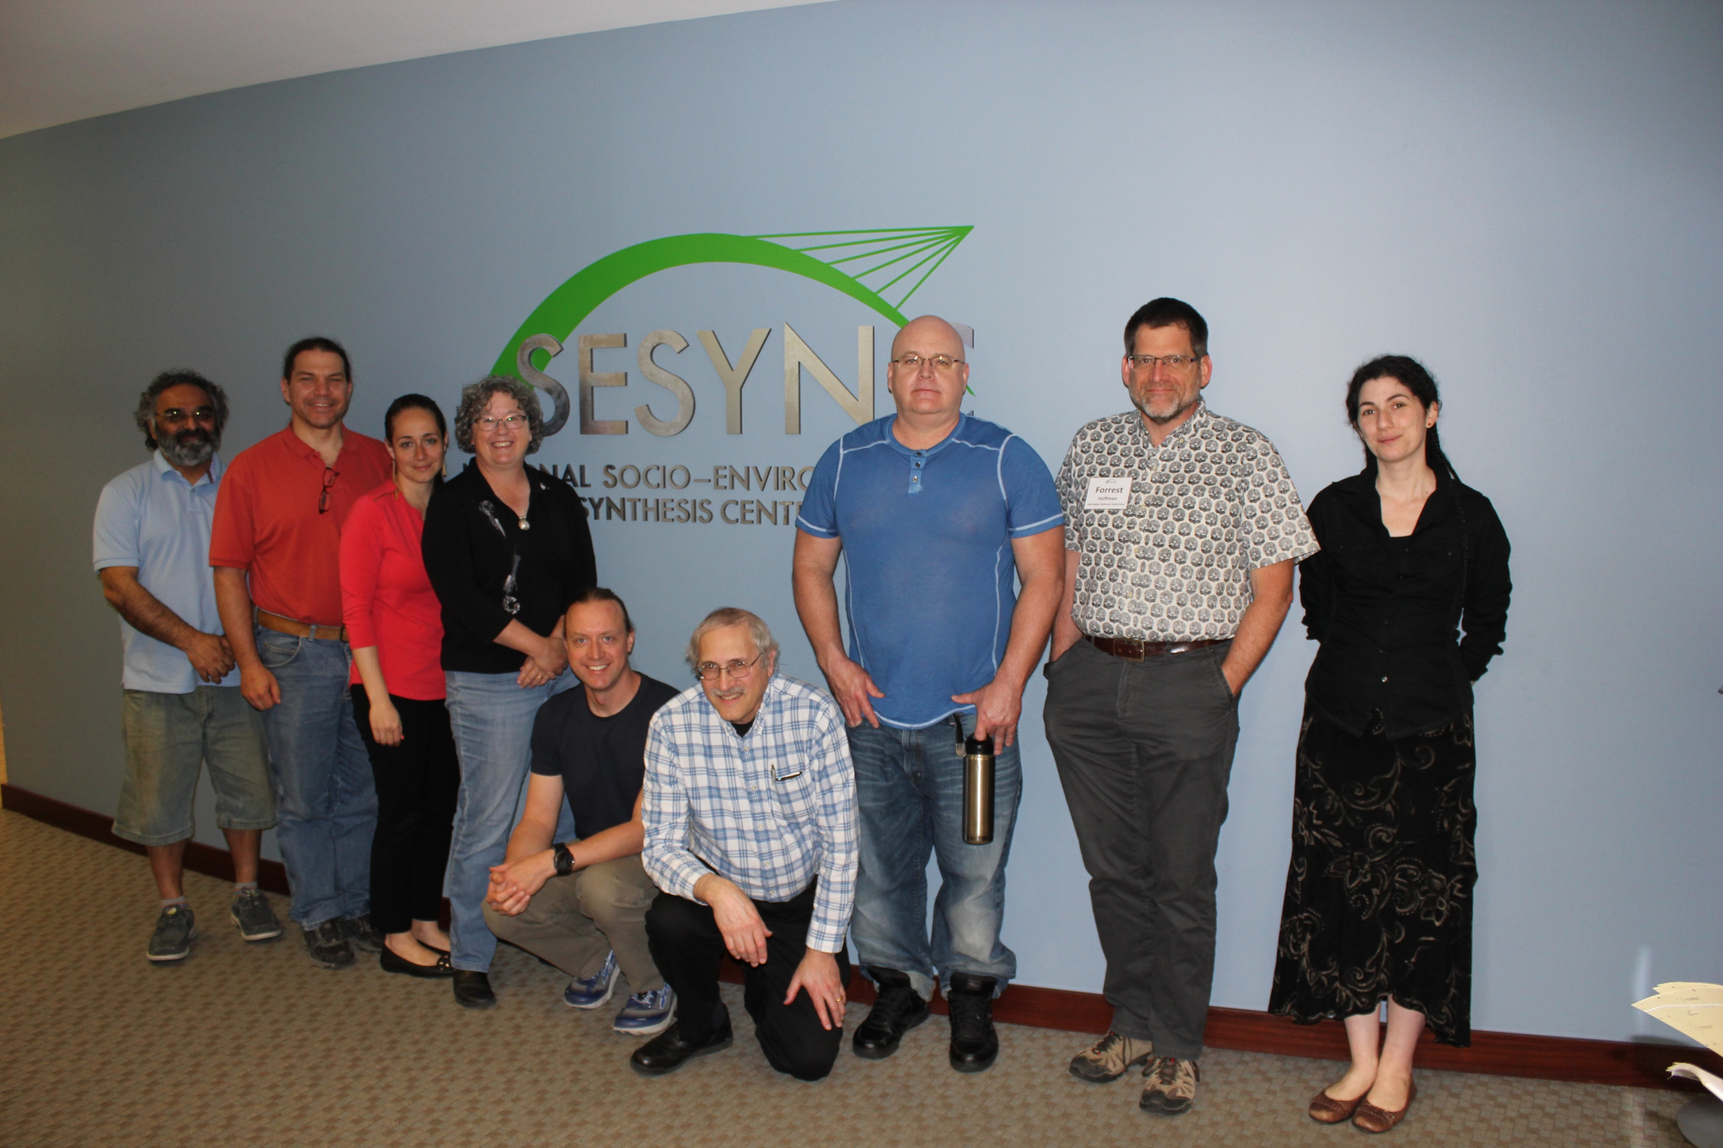
NIMBioS/SESYNC Working Group on Integrating Human Risk Perception of Global Climate Change into Dynamic Earth System Models
Brian Beckage, University of Vermont
Louis Gross, University of Tennessee
Katherine Lacasse, Rhode Island College
Eric Carr, University of Tennessee
Sara Metcalf, State University of New York
Jonathan Winter, Dartmouth College
Peter Howe, Utah State University
Nina Fefferman, University of Tennessee
Travis Franck, Climate Interactive
Asim Zia, University of Vermont
Ann Kinzig, Arizona State University
Forrest Hoffman, Oak Ridge National Lab
0:00-:30
Supported by NSF Awards EF-0832858, DBI-1300426 to NIMBioS, DBI-1052875 to SESYNC
Notes:
W

Slide 13
SESYNC Theme: Putting People into Climate Models
Sara Metcalf, University at Buffalo
Louis Gross, University of Tennessee
Wander Jager, University of Groningen
Katharine Mach, University of Miami
Fran Moore, University of California, Davis
Travis Franck, Climate Interactive
Karim Chichakly, Worcester Polytechnic Institute
Dale Rothman, George Mason University
Ann Kinzig, Arizona State University
Supported by NSF Award DBI-1052875 to SESYNC

Slide 14
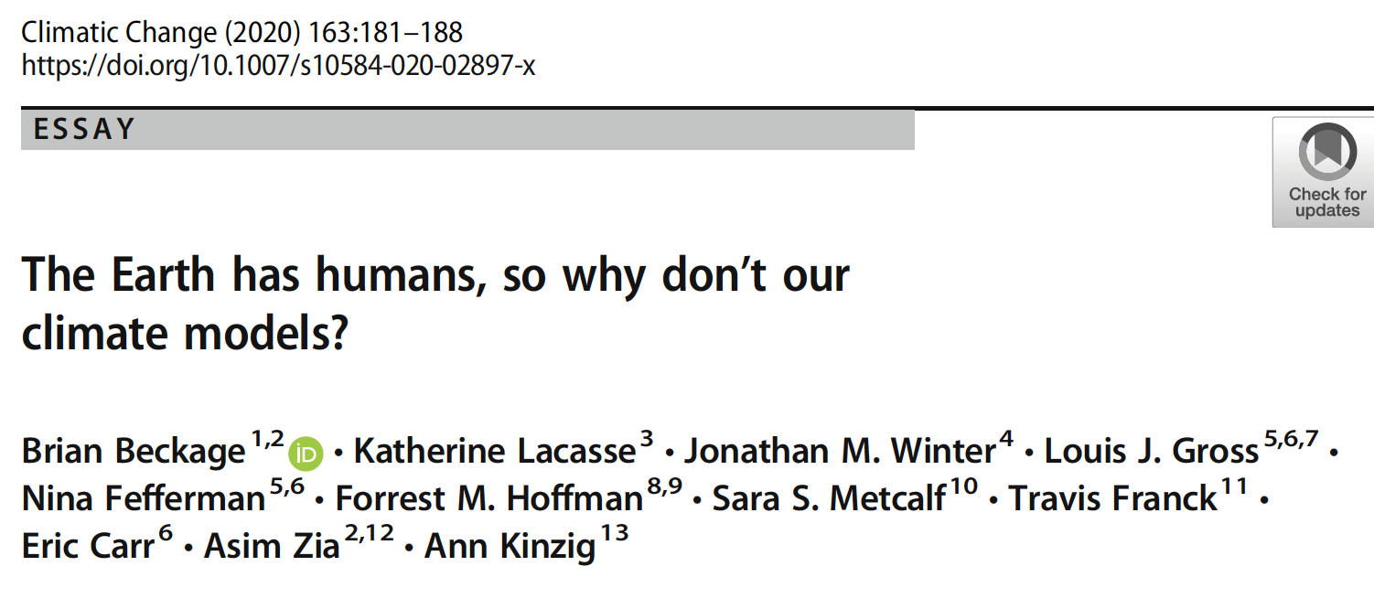

Slide 15
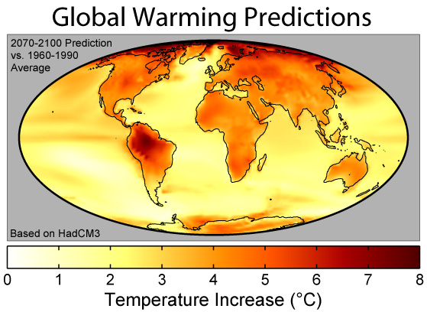
https://commons.wikimedia.org/wiki/File:Global_Warming_Predictions_Map.jpg

Slide 16
Overview
Quick summary of climate models
Models for human behavior
Theory of Planned Behavior
Linking a human risk perception model to a climate model
Projected impact of human system model feedbacks on GHG emissions and global temperature.
Model formation of climate policy as the outcome of more fundamental social, political, and technical processes

Slide 17
Human activities are interconnected with earth systems and associated projections for future climate. Our objective is to consider how human risk perception and behaviors arising from this might impact and interact with climate change.
Of particular interest is whether the potential feedbacks from human systems are sufficient to significantly, in some appropriate metric, push earth system response to a different state. That is, are there circumstances in which risk perception, perhaps arising from major events, shifts in a manner that causes behavioral changes and policy responses that could measurably impact future climate?

Slide 18
Types of Climate Models
Energy balance models (EBMs)
One dimensional radiative-convective models (RCMs);
Two-dimensional statistical-dynamical models (SDMs)
Three-dimensional general circulation models (GCMs).
Integrated assessment models (IAMs)

Slide 19
Climate models, including the most complicated GCMs developed to date, do not take into account feedbacks from human social system changes – they simply include some assumed fixed mitigation or adaptation strategy, worldwide, that reduces or enhances current anthropogenic GHG emissions. Alternative models are compared in the CMIP process.
Integrated assessment models (IAMs) take into account various human activities (e.g. demography, agricultural production, energy use) and their feedbacks to GHG emissions, but also assume some fixed scenario for these human activities.

Slide 21
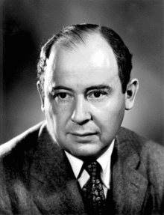
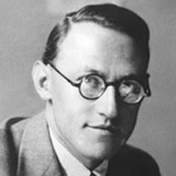
Modeling Human Behavior
There are many approaches that could be taken – I make no attempt to summarize all of these.
https://en.wikipedia.org/wiki/John_von_Neumann
https://oskar-morgenstern-medaille.univie.ac.at/en/oskar-morgenstern/

Slide 22
Isaac Asimov
https://medium.com/personal-growth/isaac-asimov-how-to-never-run-out-of-ideas-again-b7bf8e09cc91

Slide 24
TV.Apple.com/show/Foundation

Slide 25
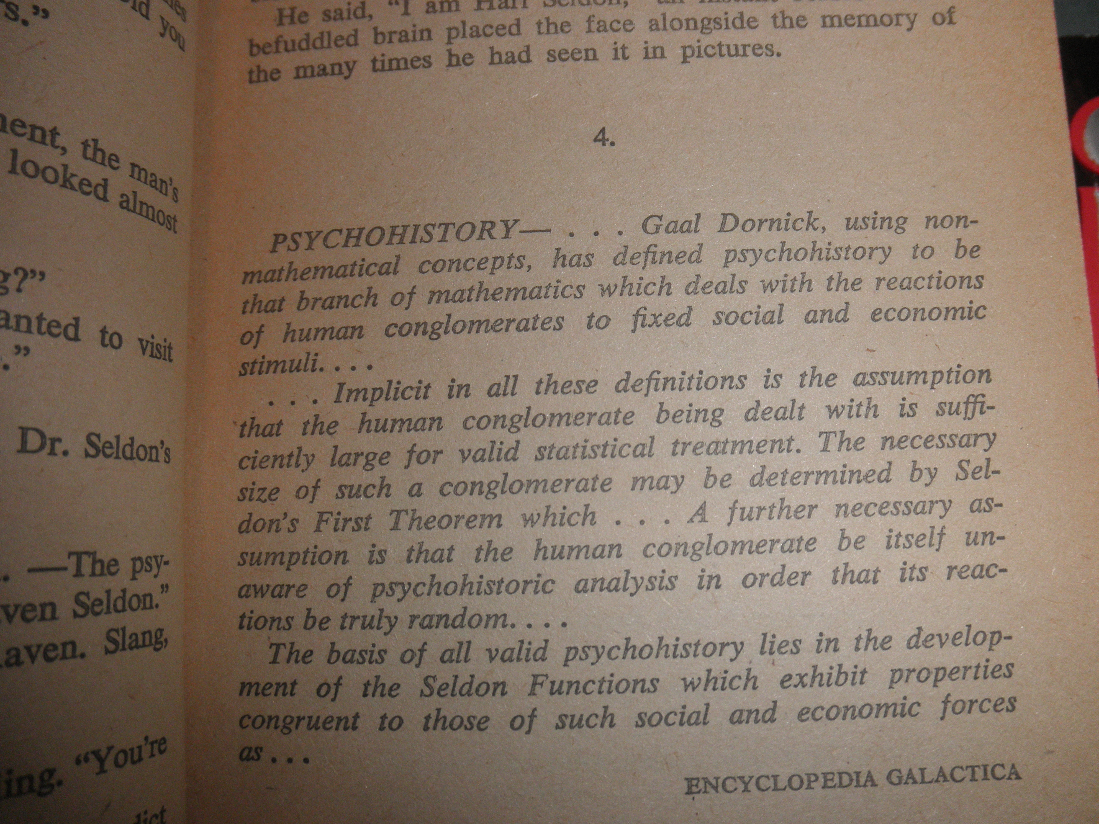
Hari Seldon
http://foundationseries.wikia.com/wiki/File:Hari-seldon.jpg

Slide 26
Agent-Based Models and Human Behavior
For a summary of alternative approaches to human behavior modeling see: Schlüter, M. et al. 2017. A framework for mapping and comparing behavioural theories in models of social-ecological systems. Ecological Economics 131:21-35. MoHuB

Slide 27
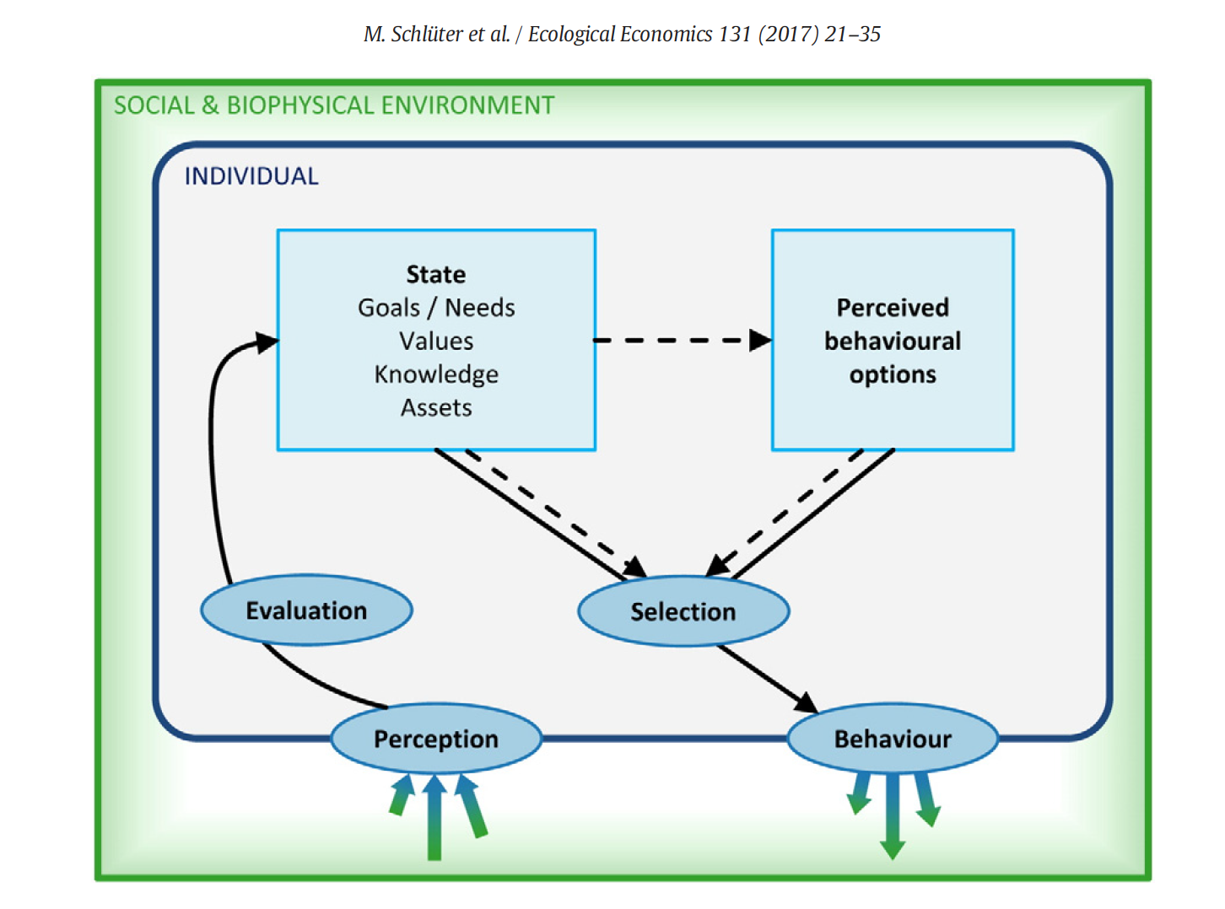
Schlüter, M. et al. 2017. A framework for mapping and comparing behavioural theories in models of social-ecological systems. Ecological Economics 131:21-35. MoHuB

Slide 28
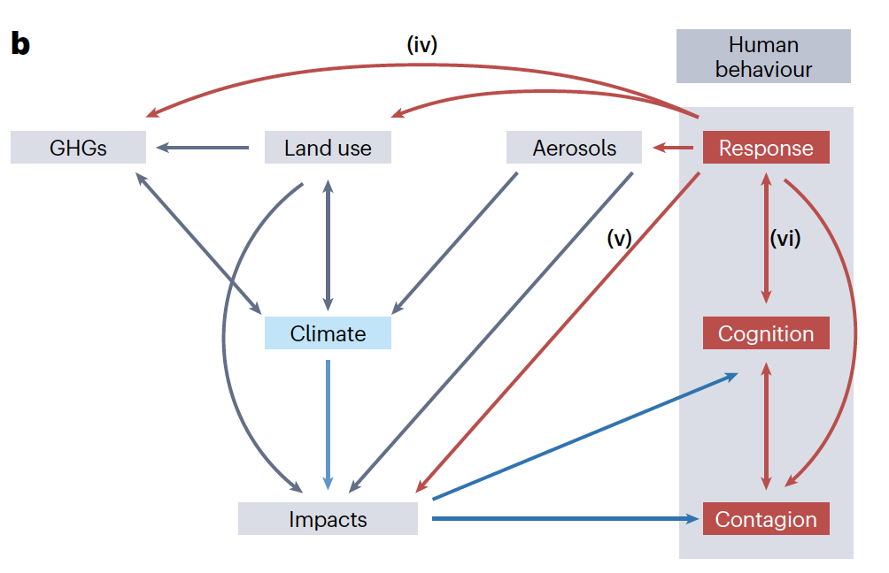
Katherine Lacasse
Rhode Island College
Brian Beckage
University of Vermont
Fran Moore
U Calif - Davis

Slide 29
Theory of Planned Behavior
In psychology, this theory links one's beliefs and behavior.
Ajzen, I. (1991). The theory of planned behavior. Organizational behavior and human decision processes, 50(2), 179-211.
Considers how attitudes, perceived social norm (PSN), and perceived behavioral control (PBC) interact to influence behaviors
Attitudes are people’s positive or negative evaluation of behaviors and policies related to climate change mitigation, comprised of both
(1) risk perception of the adverse effects of climate change and
(2) perceived efficacy, defined by the extent to which people believe a behavior will influence GHG emissions.

Slide 30
Theory of Planned Behavior
Considers how attitudes, perceived social norm (PSN), and perceived behavioral control (PBC) interact to influence behaviors
Perceived social norm (PSN) is the perception of how much a behavior is performed or approved of by other people, and influences the likelihood that people will undertake or support particular behaviors.
Perceived behavioral control (PBC) refers to people’s perception of how much control they have over whether or not they perform a behavior, both in terms of a perceived ability to perform a specific mitigation behavior or to influence policy makers

Slide 31
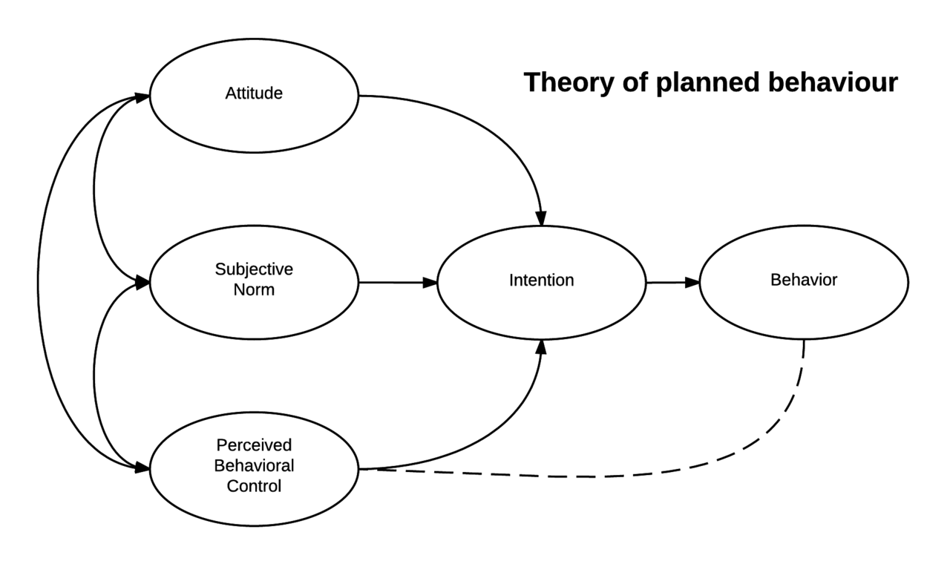
Theory of Planned Behavior
https://commons.wikimedia.org/wiki/File:Theory_of_planned_behavior.png

Slide 32
CSM (Climate Social Model)
Beckage, B., L. J. Gross, K. Lacasse, E. Carr, S. S. Metcalf, J. M. Winter, P. D. Howe, N. Fefferman, T. Franck, A. Zia, A. Kinzig and F. M. Hoffman. 2018. Linking models of human behavior and climate alters projected climate change. Nature Climate Change 8, 79–85

Slide 33
CSM (Climate Social Model)

Slide 34
CSM (Climate Social Model)

Slide 35
Key CSM Assumptions
human behaviors feedback to climate through a modification (increase or decrease) in C emissions;
human behavioral responses arise from perceptions of risk established through experiencing and then remembering the progression of extreme events;
the annual number of extreme events are characterized from temperature conditions, with the number of extreme events occurring per time step being stochastic, but increasing with mean temperature;
modification of emissions due to behavior feedbacks are maintained in a pool representing cumulative changes which reflect cumulative infrastructural change that continue to impact future emissions even without additional behavioral responses;
there is a minimum level of C emissions that no behavioral changes can modify and a maximum change per time step in emissions that can arise from behaviors.

Slide 36
Model dynamics of change in global temperature from preindustrial under different model assumptions

Slide 37
Regression tree partitioning of variation in mean global temperature in 2100 across 766,000 model simulations varying functional form and parametersfor mitigation mode

Slide 38
Conclusions from the CSM integration
1. Integrated human behavioral and climate model resulted in a global temperature change ranging from 3.4–6.2 ºC by 2100 compared with 4.9 ºC for the C-ROADS model alone.
2. Cumulative, infrastructural change significantly reduced future climate change. Non-cumulative, short-term behaviors (adjusting thermostats, limiting mileage driven) had much smaller impacts on the future temperature trajectory.

Slide 39
Conclusions from the CSM Integration
3. Magnitude of behavioral uncertainty in mean global temperature in 2100 (2.8 ºC) was similar to physical uncertainty (climate sensitivity) (3.5 ºC).
4. Social components with largest influence: Functional form of response to extreme events and interaction of perceived behavioral control with perceived social norm.
5. Attribution of extreme events to climate change and infrastructural mitigation may most reduce climate change.

Slide 40
Alternative model that includes economic and policy feedbacks
Models formation of climate policy as the outcome of more fundamental social, political, and technical processes
Systematically explore the space of model dynamics to identify tipping point processes, thresholds, and interactions
Constrain model parameters and run model forward to generate storylines of emissions futures arising endogenously from the model
This uses a System Dynamics Modeling framework (a system of ordinary differential equations)

Slide 41
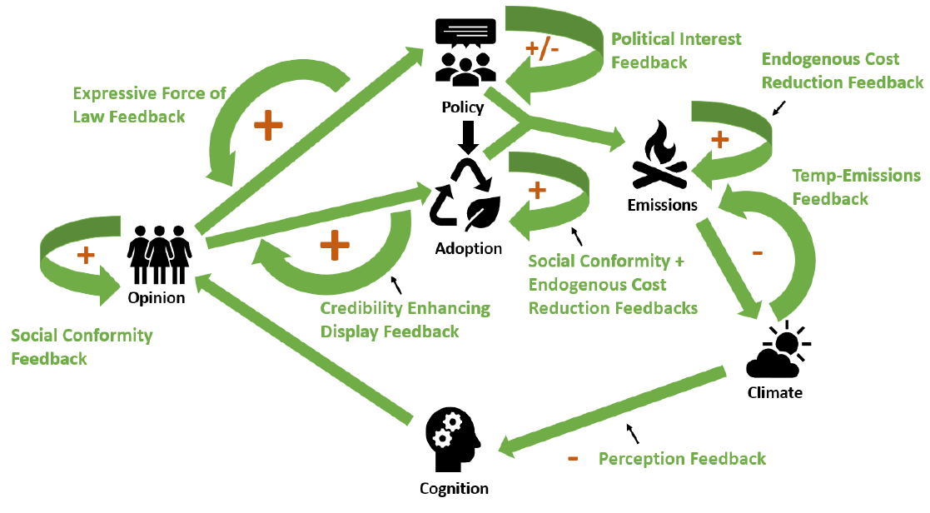
Components and feedbacks in the coupled climate-social system

Slide 42
Opinion Component
Key Features:
Three groups of opinions about climate change policy (Support, Neutral, Oppose)
Size of opinion groups evolve based on interactions with others in social network
Social network may be different from population depending on network homophily parameter (tendency to preferentially associate with similar individuals)
Possible Component Feedbacks:
Social conformity feedback
Expressive force of law feedback (from Policy component)
Credibility-enhancing display feedback (from Adoption component)
Cognition feedback (from Cognition component)

Slide 43
Adoption Component
Key Features:
Individual decision to adopt a single representative pro-climate behavior
Logistic uptake curve
Can be affected by opinion on climate policy so different for different opinion groups
Social norm effect depends on social network, not population uptake
Possible Component Feedbacks:
Social conformity feedback
Endogenous technical change (learning-by-doing) feedback

Slide 44
Policy Component
Key Features:
Ambition of collective climate policy summarized by single stock variable representing a carbon price (or subsidy)
Change in the carbon price each period depends on the ratio of opposers to supporters in the population and characteristics of the political system
Status-quo bias parameter requires larger majorities in favor of certain policies before change occurs
Larger neutral population results in slower policy change
Possible Component Feedbacks:
Political Interest Feedback (positive or negative)

Slide 45
Emissions
Climate
Global
National
Policy
Behavior
Change
Public
Opinion
Social
Individual
Cognition

Slide 46
Projecting Climate Futures
Run model initializing opinion, carbon prices and climate state in 2020 and running until 2100
Perform 100,000 Monte Carlo samples over 23 uncertain parameters
Perform k-means clustering on policy and emissions trajectories to identify clusters of similar trajectories (5 clusters)
Examine average parameter values across different clusters to uncover states of the world that give rise to particular trajectories

Slide 47
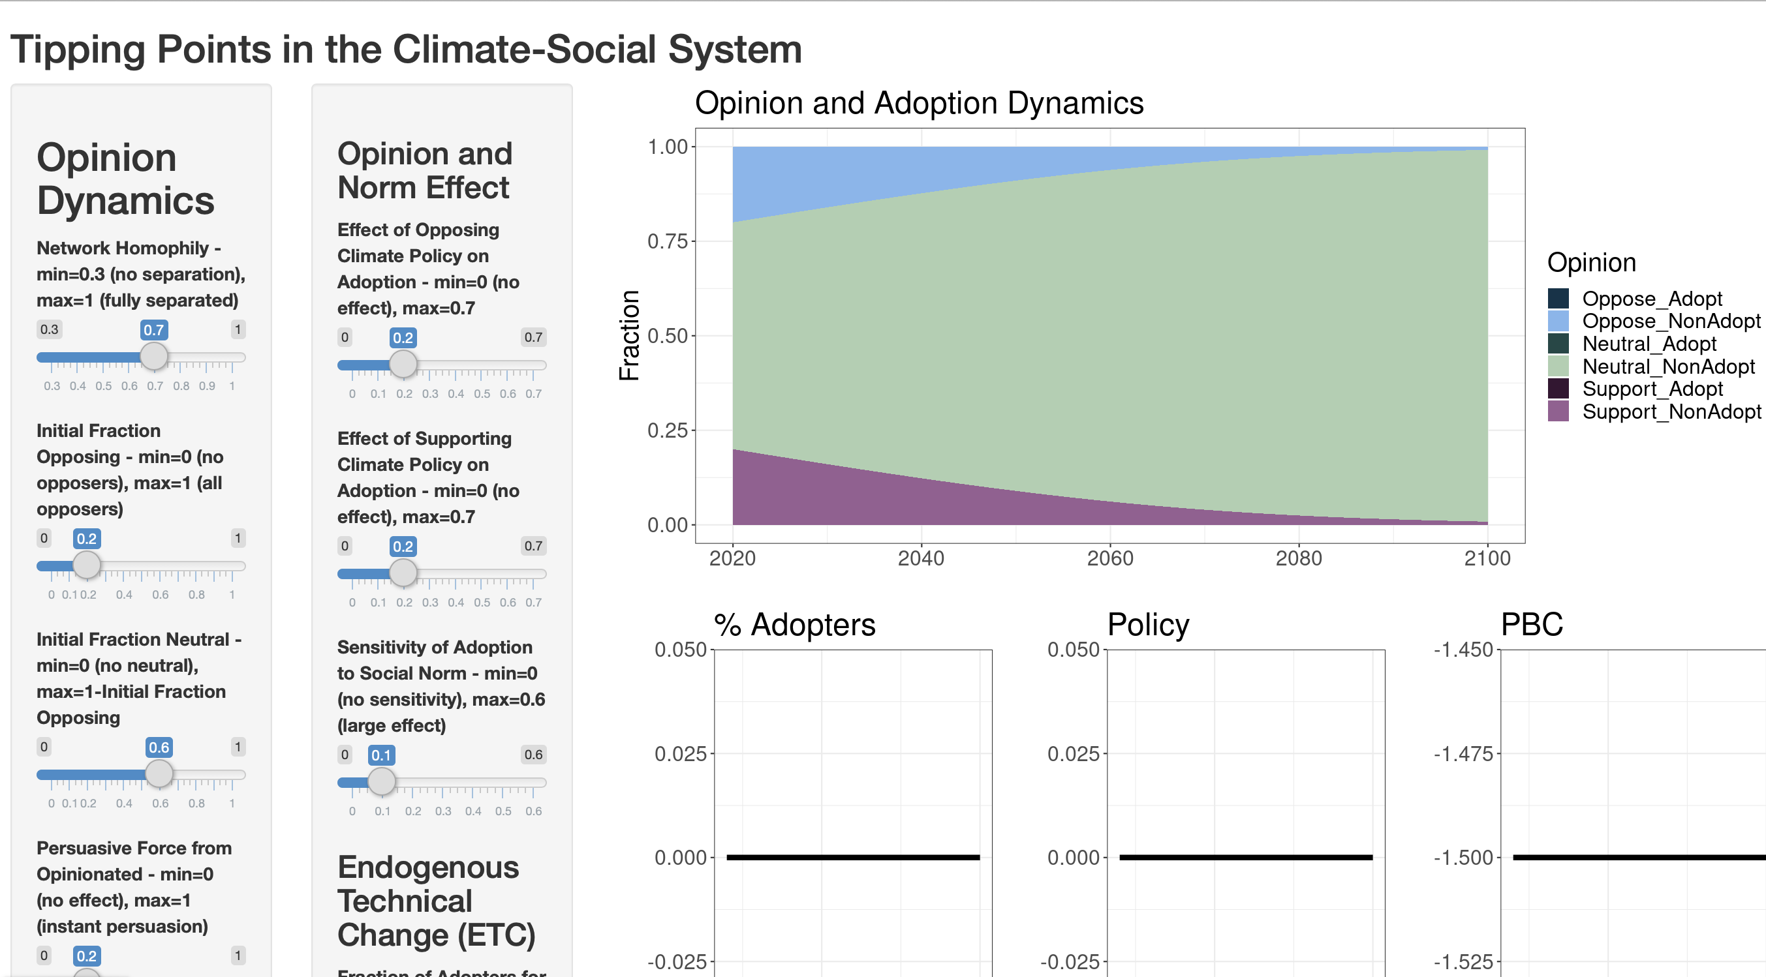
https://fmoore125.shinyapps.io/climate-social-model

Slide 48
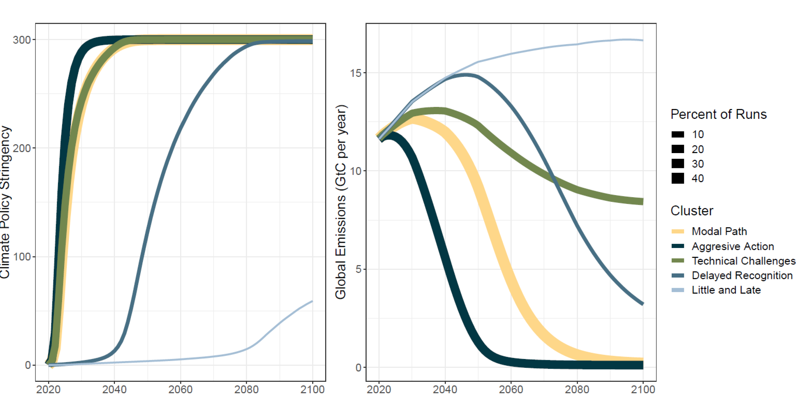
Policy (left) and global CO2 emissions (right) trajectories from 100,000 Monte Carlo runs of the model, clustered into 5 clusters using k-means clustering. The line thickness corresponds to the size of the cluster.

Slide 49
Results
Climate policy and emissions can be analyzed as arising from interactions of more fundamental social, political, technical processes with strong evidence that there are distinct clusters of the associated interactions with different emissions pathways and associated global temperature projections
Feedbacks between multiple scales require representation of individual, social, national and global processes and the feedbacks between the processes at these different scales can lead to significant changes in projected temperature trajectories and there is evidence of tipping points.
“Storylines” of climate futures that we observe as clusters of model responses can be developed endogenously, not as they are typically handled in climate projections as exogenous from “representative emissions pathways”

Slide 50
Global temperature conclusions
Despite parameter uncertainties, none of the policy–emissions clusters identified represent a pure business-as-usual world without climate policy. Even the highest-emission cluster produces warming in 2100 that is lower than the RCP7 business-as-usual baseline of 3.9 °C. The vast majority of runs (98%) produce warming of more than half a degree lower
Identified emissions trajectories, even the aggressive action scenario, fail to meet the more ambitious Paris Agreement target of limiting warming to 1.5 °C above pre-industrial levels.
We estimate a substantial probability of meeting the 2 °C Paris Agreement target—28% of our Monte Carlo runs result in 2091–2100 warming below 2 °C above 1880–1910 levels.

Slide 51
Next Steps
Multi-Model set of CSMs that link alternative behavior models with climate models (SoCM) to assess uncertainty - a Social-sciences Model Inter-comparison Project (SMIP)
The Earth has humans, so why don't our climate models? Beckage et al. 2020. Climatic Change 163: 181–188.

Slide 52
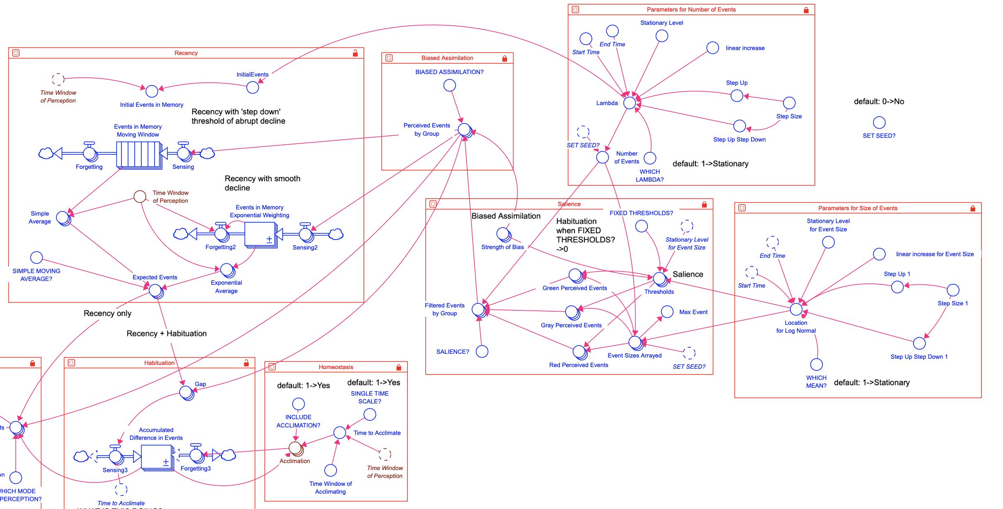
Next Steps
As one component of this, we have been developing a model for individual risk perception that has more explicit connection to cognitive science (e.g. recency and habituation in memory processing of climate events), saliency that accounts for the magnitude as well as number of climate extreme events on risk perception, and incorporates biased assimilation by including population heterogeneity.

Slide 53
In Sum There is some rational basis for hope
This hope is based upon results from multiple models
Climate models have had a huge impact on the ability to project global trajectories, and assess the potential impacts of policies.
Next steps will require us to not fear the linkage to social dynamics and work to overcome the barriers to incorporating human behavior into climate models.

