Slide 1
An Overview of Human Behavior Modeling
Louis J. Gross*
National Institute for Mathematical and Biological Synthesis
Departments of Ecology and Evolutionary Biology and Mathematics
University of Tennessee, Knoxville
*Emeritus
NIMBioS.org

Slide 2
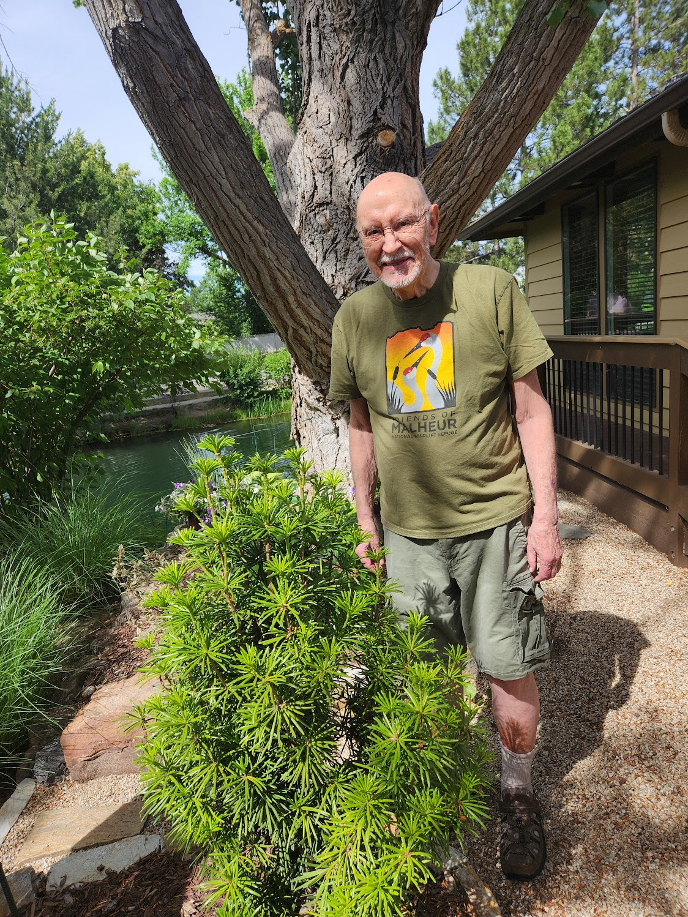
Tom Hallam in Boise, Idaho 2024– founder of the Mathematical Biology program at UTK – Emeritus Professor of Mathematics and Ecology and Evolutionary Biology – former Head of EEB

Slide 3
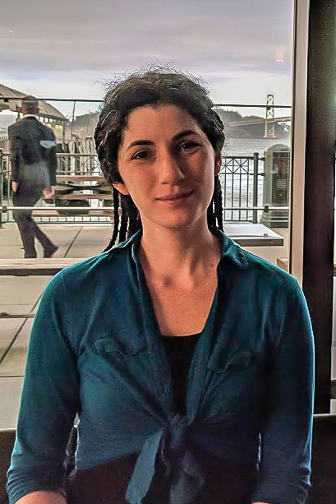
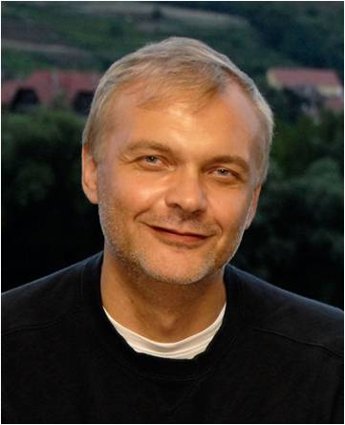
It is presumptuous of me to talk on this topic given the expertise in EEB and other units
Economics Management

Slide 4
Overview
Background on modeling
Possible objectives for models of human behavior
Describing human behavior models
Model evaluation
Efforts to summarize and categorize theories of human behavior
Example approaches used to model behavior
Efforts to categorize behavior models
Take homes

Slide 5
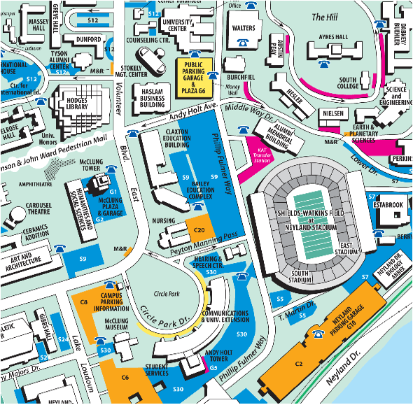
The “stories” in science are models
A model is a simplification of reality. Think of it as a map - it includes some features that represent what we observe but not others. Modeling is the process of selective ignorance - we select what to include and what to ignore.

Slide 6
Considerations in building models
Objectives - Why are you building a model?
What questions are you addressing?
What do you hope to learn from the model?
Scale – What time, spatial and organizational scales are
important for the questions being addressed?
Inputs – What theories, previous models and data are
available and matter for the questions being addressed?
Outputs – What variables are internal to the model? What will be
used to analyze and make inferences about model results?
Evaluation – What criteria will be used to assess whether the
model is useful for the objectives for which it is constructed?

Slide 7
Criteria I use in Reviewing Modeling Papers
1. Are the models appropriate to the scientific questions being addressed?
2. Are the underlying scientific questions of potential
interest to a significant fraction of the journal’s audience?
3. Does the mathematics/model teach us anything new that is scientifically significant?
4. Are the mathematics/modeling/coding correct?
5. If the paper is strictly theoretical, does it point out
broadly useful new insights?
6. Are the model parameters and variables estimable
from observations?
7. Is there some effort devoted to model evaluation?

Slide 8
Taxonomy of Models
This could be based on the model objectives, on the general approaches used, or on the methodology. One possibility is:
conceptual
verbal
quantitative (including math, network, simulation)
physical (e.g. real, such as a physical model for an animal to evaluate heat-loading)
biological (including animal models used for experiments, cell lines, and tissue cultures)
Note that modeling texts typically classify models based on mathematical approach – static, dynamic, spatial, stochastic, statistical.

Slide 9
Possible Human Behavior Model Objectives
1. Suggest observations and experiments (ads/marketing to modify purchasing behavior, time on a site/game)
2. Provide a framework to assemble data and observations (behavioral differences impacted by group dynamics)
3. Consider how our world came to be as it is (F. Jacob) (comparative biology and evolution of behavior/culture)
4. Clarifies hypotheses and chains of argument (relative importance of social factors and personal experience)
5. Identifies key components in systems (what factors affect learning and memory)
6. Allow investigation while accounting for societal or ethical constraints (evaluate impacts of alternative policies)
Notes:
Marketing folks try new schemes to modify purchasing behavior – the whole idea of advertising is to modify behavior
Statistical models do this but other models types can bring together different assumptions

Slide 10
Possible Human Behavior Model Objectives
7. Allows simultaneous consideration of spatial and temporal change (migration and impacts on culture)
8. Extrapolate to broad spatial or long temporal scales for which data cannot easily be obtained (group/nation formation)
9. Prompts tentative and testable hypotheses (impacts of including/excluding components of cognition)
10. Serves as a guide to decision making in circumstances where action cannot wait for detailed studies (vaccine hesitation)
11. Provides an antidote to the helpless feeling that the world is too complex to understand in any generality - a means to get at general patterns and trends (behavioral economics)
12. To predict how a system will behave under different management, and control the system to meet some objective (responses to regulation on resource use, will a marriage last)

Slide 11
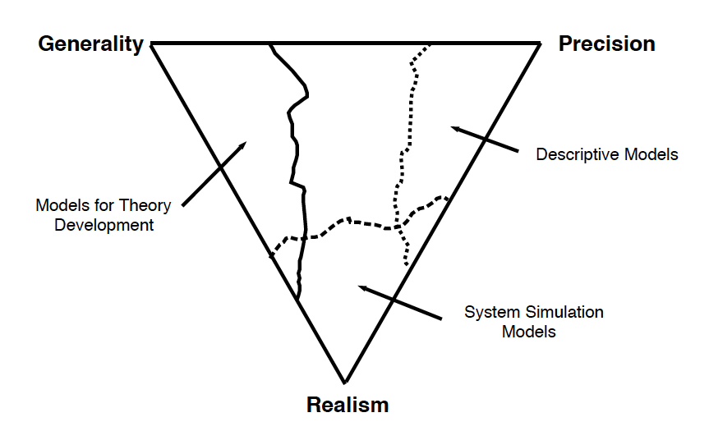
Models and tradeoffs
No one model can do everything

Slide 12
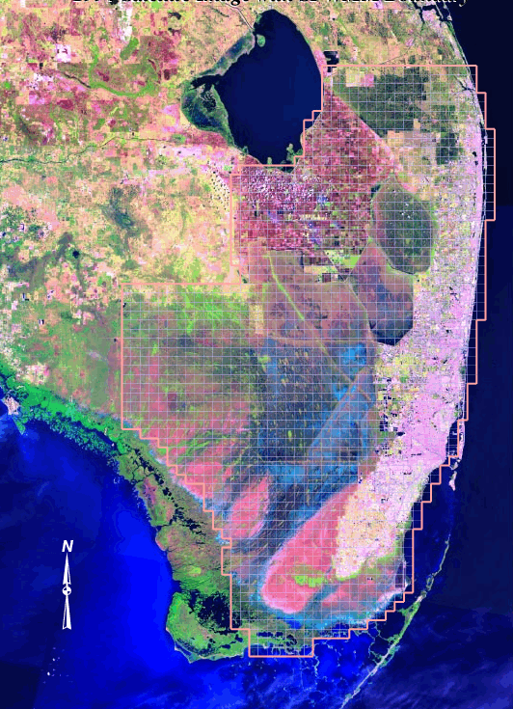
Environmental Modeling
Species densities
Animal telemetry
Physical conditions
Data sources
GIS map layers (Vegetation, hydrology, elevation),Weather, Roads, Species densities
Monitoring
Models
Statistical
Differential equations
Matrix
Agent-based
Management input
Harvest regulation
Water control
Reserve design
Evaluation/Analysis
Simulation
Visualization, corroboration, sensitivity, uncertainty
Matlab, C++, Distributed, Parallel

Slide 13
Describing Models
There is no single protocol to describe models. Some are described graphically
Here the graph is a conceptual model for human behavior for a theory of planned behavior for risk perception and emissions behavior linked to a climate model and the graphical function indicates the impact of extreme events on perceived risk.
Beckage, B., L. J. Gross, K. Lacasse, E. Carr, S. S. Metcalf, J. M. Winter, P. D. Howe, N. Fefferman, T. Franck, A. Zia, A. Kinzig and F. M. Hoffman. 2018. Linking models of human behavior and climate alters projected climate change. Nature Climate Change 8, 79–85

Slide 14
Describing Models
Some are described mathematically with definition of the variables and parameters
Here the N_{i} give the number of aggregated agents of different types in a spatial agent- based model
Federico, P., L. J. Gross, S. Lenhart, and D. Ryan. 2013. Optimal control in individual-based models: implications from aggregated methods. American Naturalist 181: 64-77

Slide 15
Describing Models
Described through the code that simulates the system and associated documentation and metadata
Federico, P., L. J. Gross, S. Lenhart, and D. Ryan. 2013. Optimal control in individual-based models: implications from aggregated methods. American Naturalist 181: 64-77
F Bodine, E., S. Lenhart and L. J. Gross. Mathematics for the Life Sciences. Princeton University Press (2014).

Slide 16
Describing Models
Some are described by the statistical methodology used, data and metadata
Hamelin, F. M., L. J.S. Allen, V. A. Bokil, L. J. Gross, F. M. Hilker, M. J. Jeger, C. A. Manore, A. G. Power, M. A. Rúa, N. J. Cunniffe. 2019. Co-infections by non-interacting pathogens are not independent and require new tests of interaction. https://doi.org/10.1371/journal.pbio.3000551

Slide 17
An example of a general protocol developed specifically for agent-based models but useful across other model types is the ODD Protocol. This is an update of a protocol first published in 2006 for “Overview, Design Concepts and Details”

Slide 18
Grimm et al. (2010) Ecological Modelling 221: 2760-2768

Slide 19
Constraints on models
Data constraints: Available data may not be sufficient to specify appropriate functional forms, interrelationships, or parameters. May force aggregation of components. May not be sufficient to elaborate criteria for evaluation of model performance.
Effort constraints: Resource constraints may limit the amount of detail it is feasible to include. Limits on time modelers and collaborators may invest as well as pressure to produce results.
Computational constraints: Despite great enhancements in computational resources, there are many problems still not feasible to carry out computationally.
Other constraints: ethical, political or other societal considerations (e.g. much data about firearms in the US)

Slide 20
Model evaluation – some terminology
Verification - model behaves as intended, i.e. equations correctly represent assumptions; equations are self-consistent and dimensionally correct. Analysis is correct. Coding is correct - there are no bugs.
Calibration - use of data to determine parameters so the model "agrees" with data. This is specific to a given criteria for accuracy. Some call this Tuning or Curve-fitting.
Corroboration - model is in agreement with a set of data independent from that used to construct and calibrate it.
Validation - model is in agreement with real system it represents with respect to the specific purposes for which it was constructed. Thus there is an implied notion of accuracy and domain of applicability.
Evaluation (testing) - appropriateness to objectives; utility; plausibility; elegance; simplicity; flexibility.

Slide 21
Evaluating different types of models
Models for theory development –
General, some realism, little precision.
Make qualitative comparisons to patterns, not quantitative ones, over some parameter space. No calibration or corroboration performed, except theoretical corroboration (meaning that model agrees with the general body of theory in the field).

Slide 22
Evaluating different types of models
Descriptive models-
Precise, little realism, not general
Statistical hypothesis testing; time series analysis methods applied.
Models for specific systems -
Realism, some precision, not general
Quantitative comparisons, constrained by available
data. Compare component-by-component if data are
available.

Slide 23
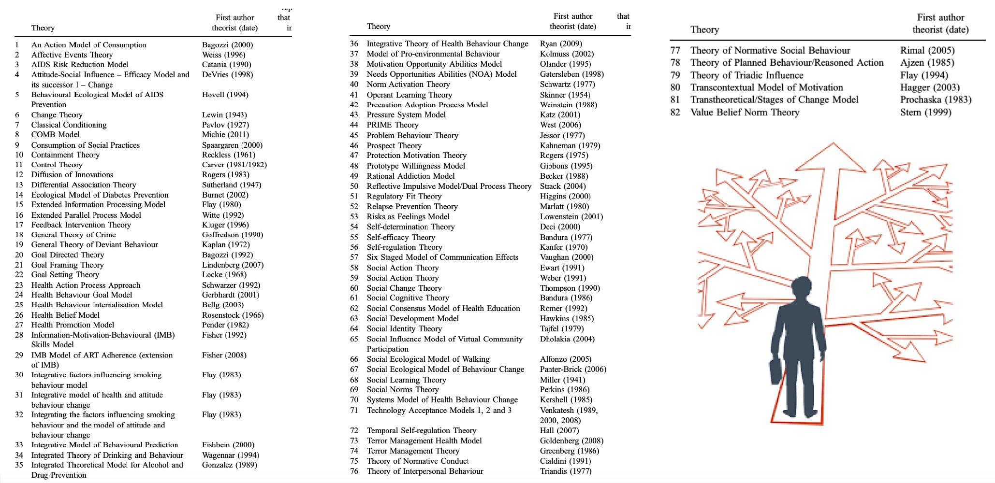
There are a very large collection of theories for individual behavior with many overlapping concepts
Thanks to Sergey Gavrilets for this figure
Davis, R., R. Campbell, Z. Hildon, L. Hobbs & S. Michie (2014): Theories of behaviour and behaviour change across the social and behavioural sciences: a scoping review, Health Psychology Review, DOI: 10.1080/17437199.2014.941722

Slide 24
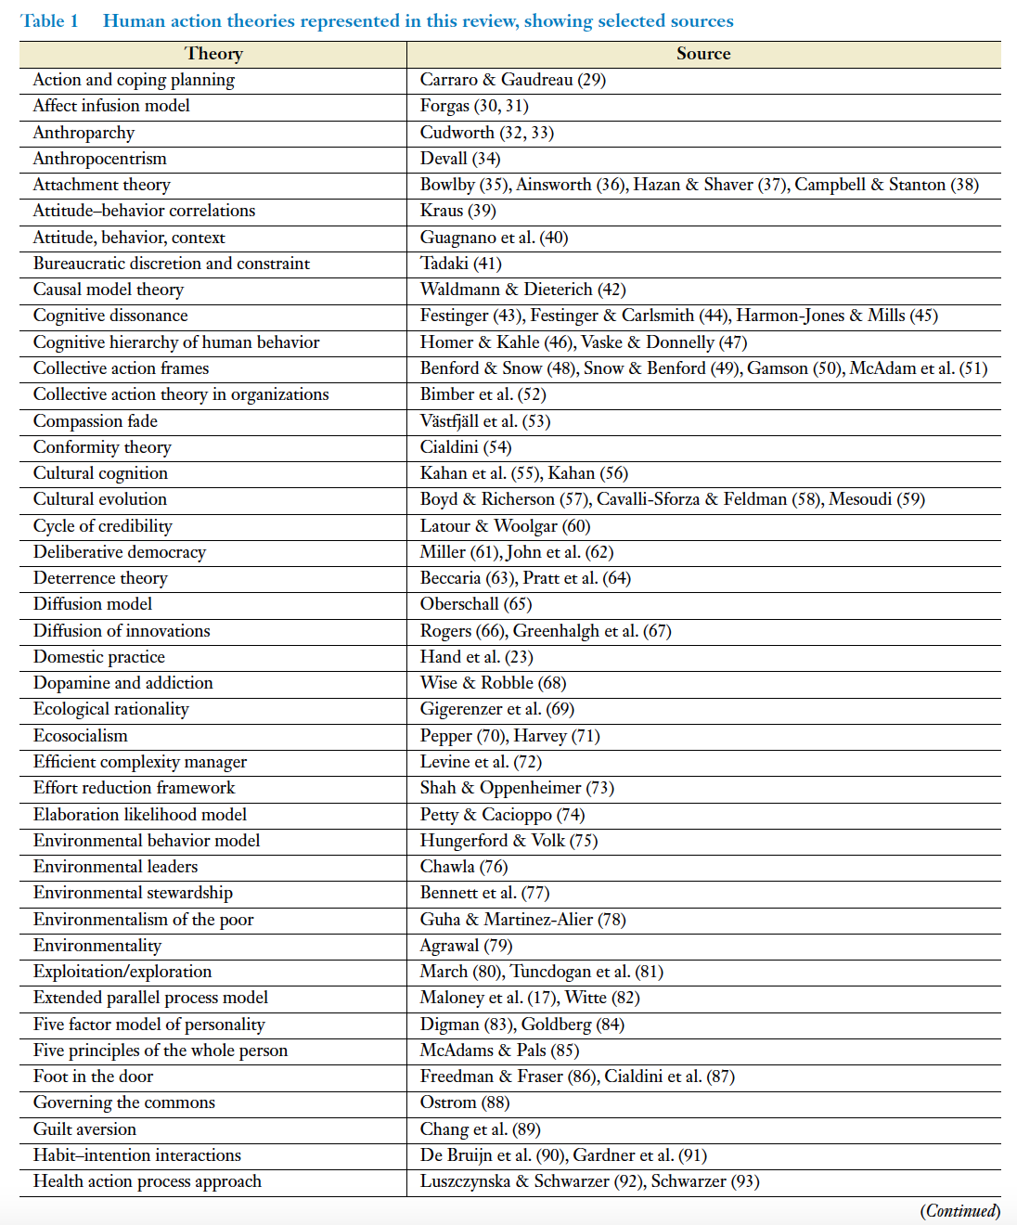
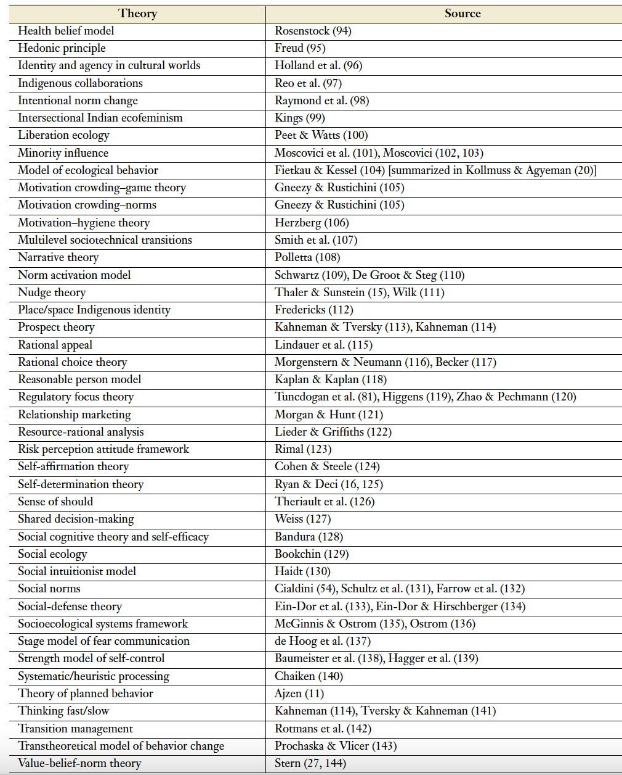
Review of theories to explain human action, free from constraints related to discipline and including collective action
Eyster, H. N., T. Satterfield & K. M.A. Chan (2022) Why People Do What They Do: An Interdisciplinary Synthesis of Human Action Theories. Annu. Rev. Environ. Resour 47:725–51 doi.org/10.1146/annurev-environ-020422-125351

Slide 25
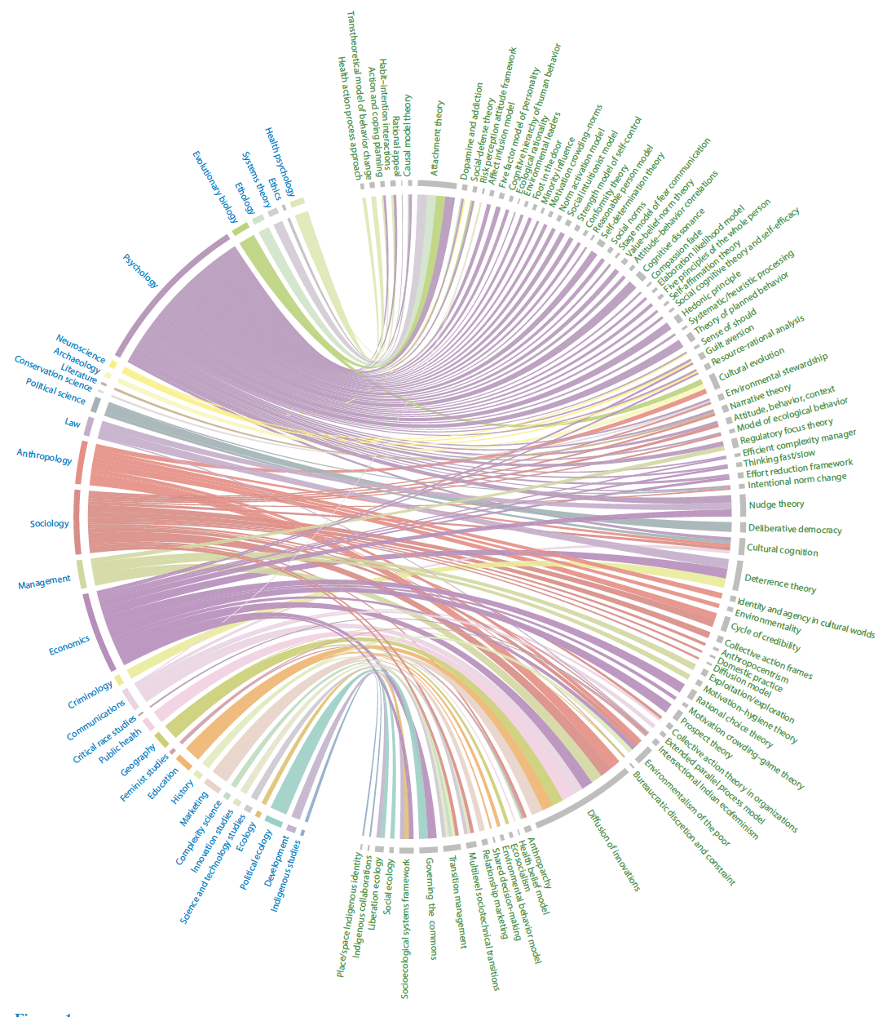
Eyster, H. N., T. Satterfield & K. M.A. Chan (2022) Why People Do What They Do: An Interdisciplinary Synthesis of Human Action Theories. Annu. Rev. Environ. Resour 47:725–51 doi.org/10.1146/annurev-environ-020422-125351
Theories
Disciplines

Slide 26
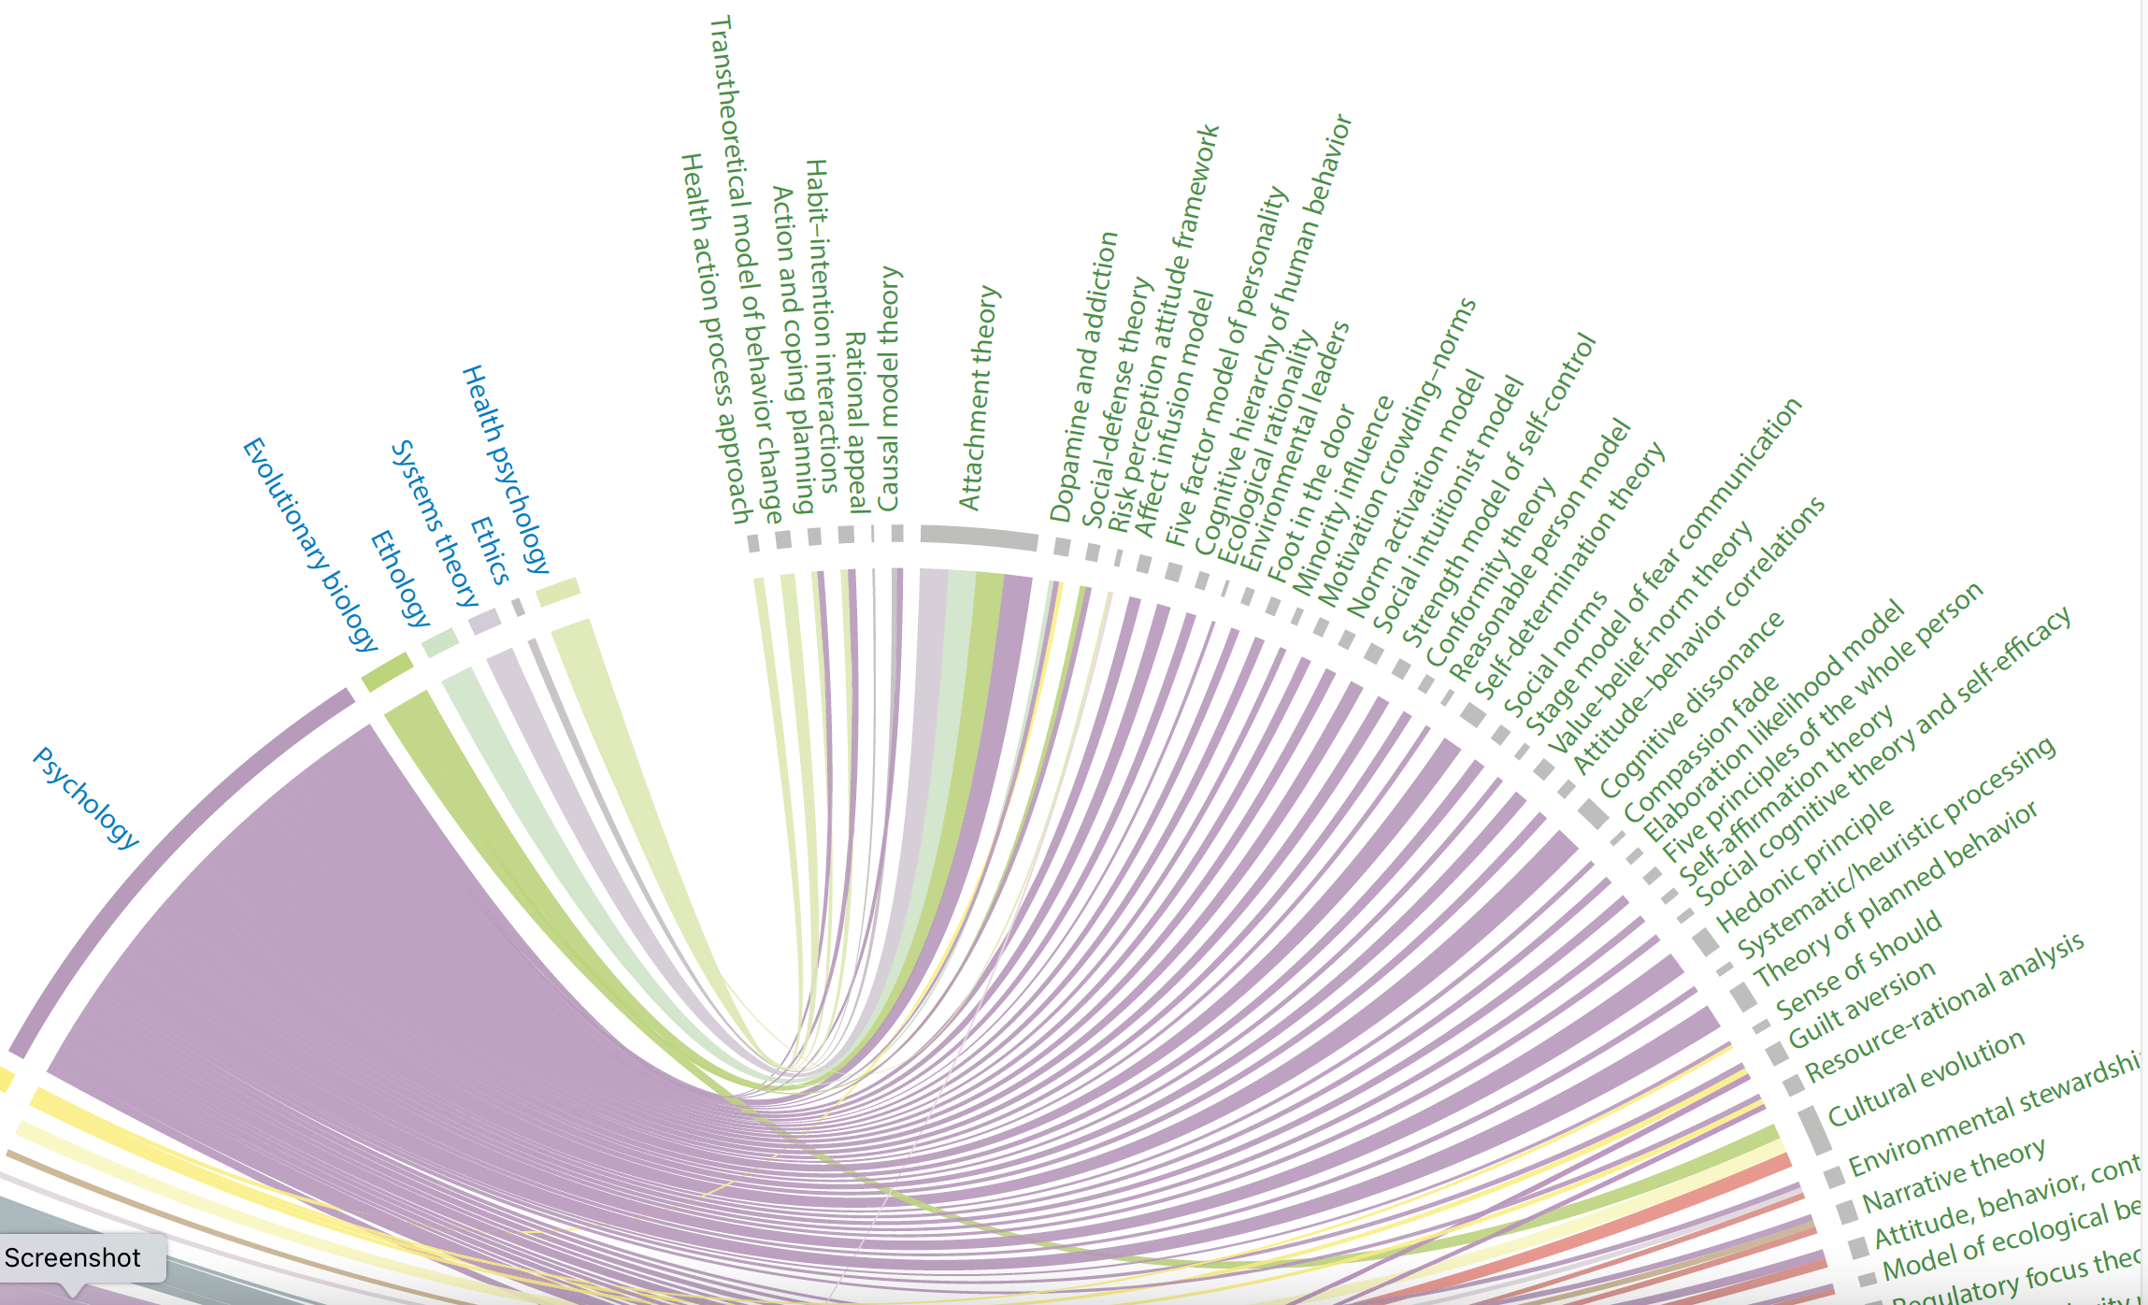
Findings show uneven cross-fertilization between disciplines theorizing about human action. Psychology, neuroscience and economics showed substantial overlap, while psychology and anthropology showed little. Psychological theories were less interdisciplinary than those in most other disciplines.
Eyster, H. N., T. Satterfield & K. M.A. Chan (2022) Why People Do What They Do: An Interdisciplinary Synthesis of Human Action Theories. Annu. Rev. Environ. Resour 47:725–51 doi.org/10.1146/annurev-environ-020422-125351

Slide 27
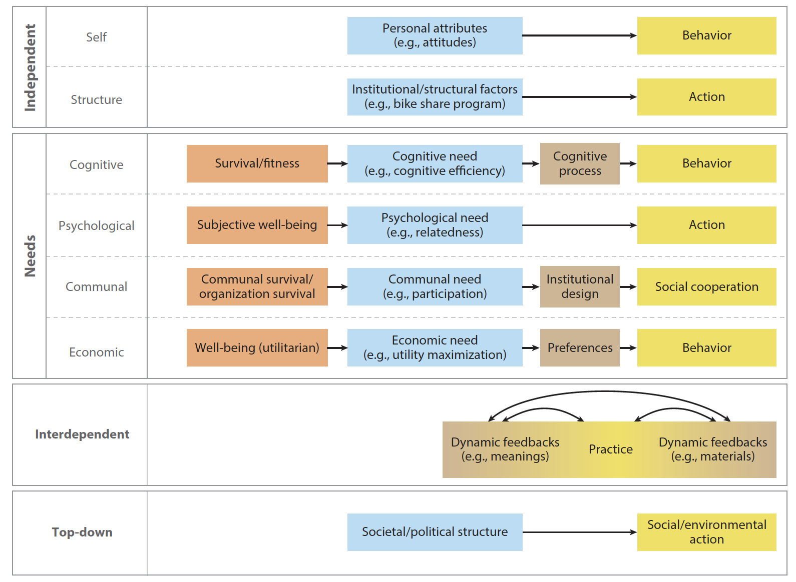
Metatheories for what drives human action: Particular components (blue, tan) are theorized to determine some conception of human action (yellow), which may satisfy particular purposes (orange). Eyster et al. 2022

Slide 28
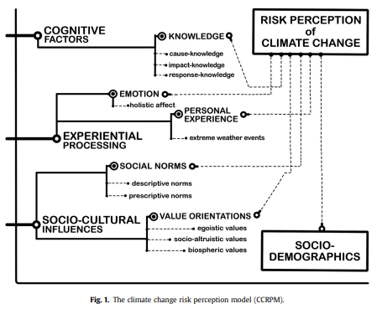
Van der Linden, S. (2015). The social-psychological determinants of climate change risk perceptions: Towards a comprehensive model. Journal of Environmental Psychology, 41, 112-124

Slide 29
Van der Linden, S. (2015). The social-psychological determinants of climate change risk perceptions: Towards a comprehensive model. Journal of Environmental Psychology, 41, 112-124

Slide 30
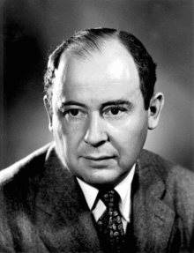
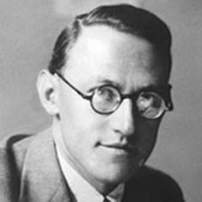
Modeling Human Behavior
There are many approaches that could be taken – I make no attempt to summarize all of these.
https://en.wikipedia.org/wiki/John_von_Neumann
https://oskar-morgenstern-medaille.univie.ac.at/en/oskar-morgenstern/

Slide 31
Many projects with a focus on network science methods
https://humannaturelab.net

Slide 32
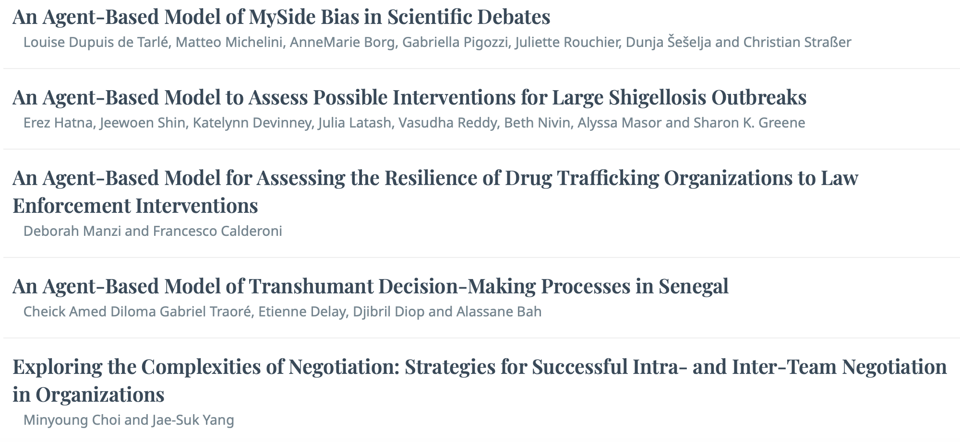
Agent-Based Models and Human Behavior

Slide 33
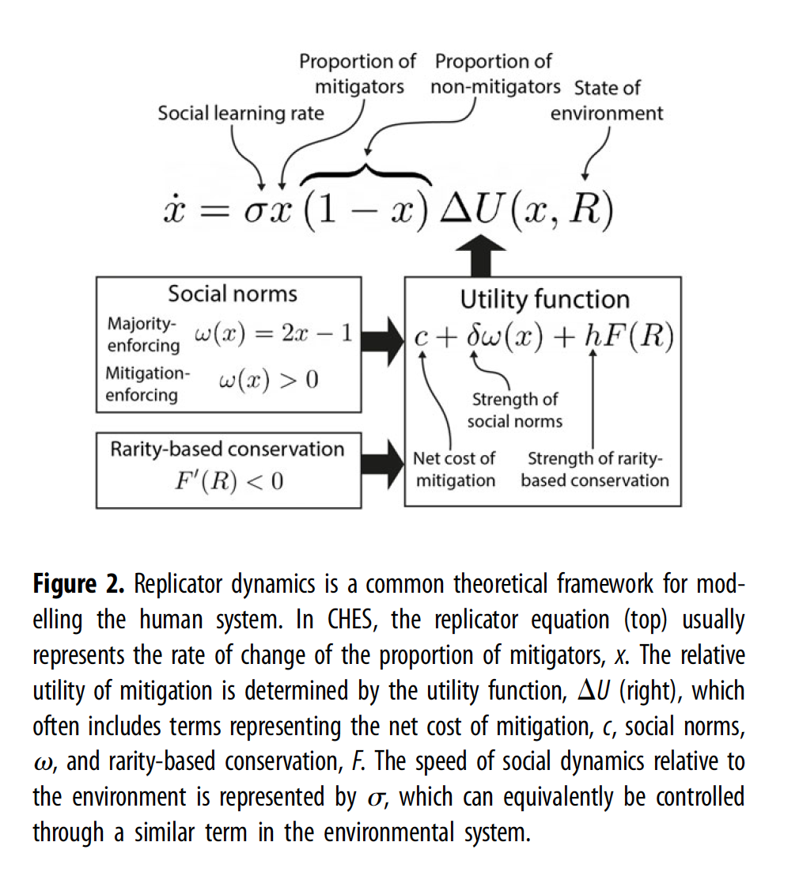
Madhur Anand and Chris Bauch have applied this simplified representation of behavior to many problems of coupled human-environment systems
Farahbakhsh, I., Bauch, C. T. & Anand, M. Modelling coupled human–environment complexity for the future of the biosphere: strengths, gaps and promising directions. Phil. Trans. R. Soc. B 377, 20210382 (2022)

Slide 34
System dynamics approach for cognition models
Beckage et al., A computational model for the perception of risk from climate change (in prep)

Slide 35
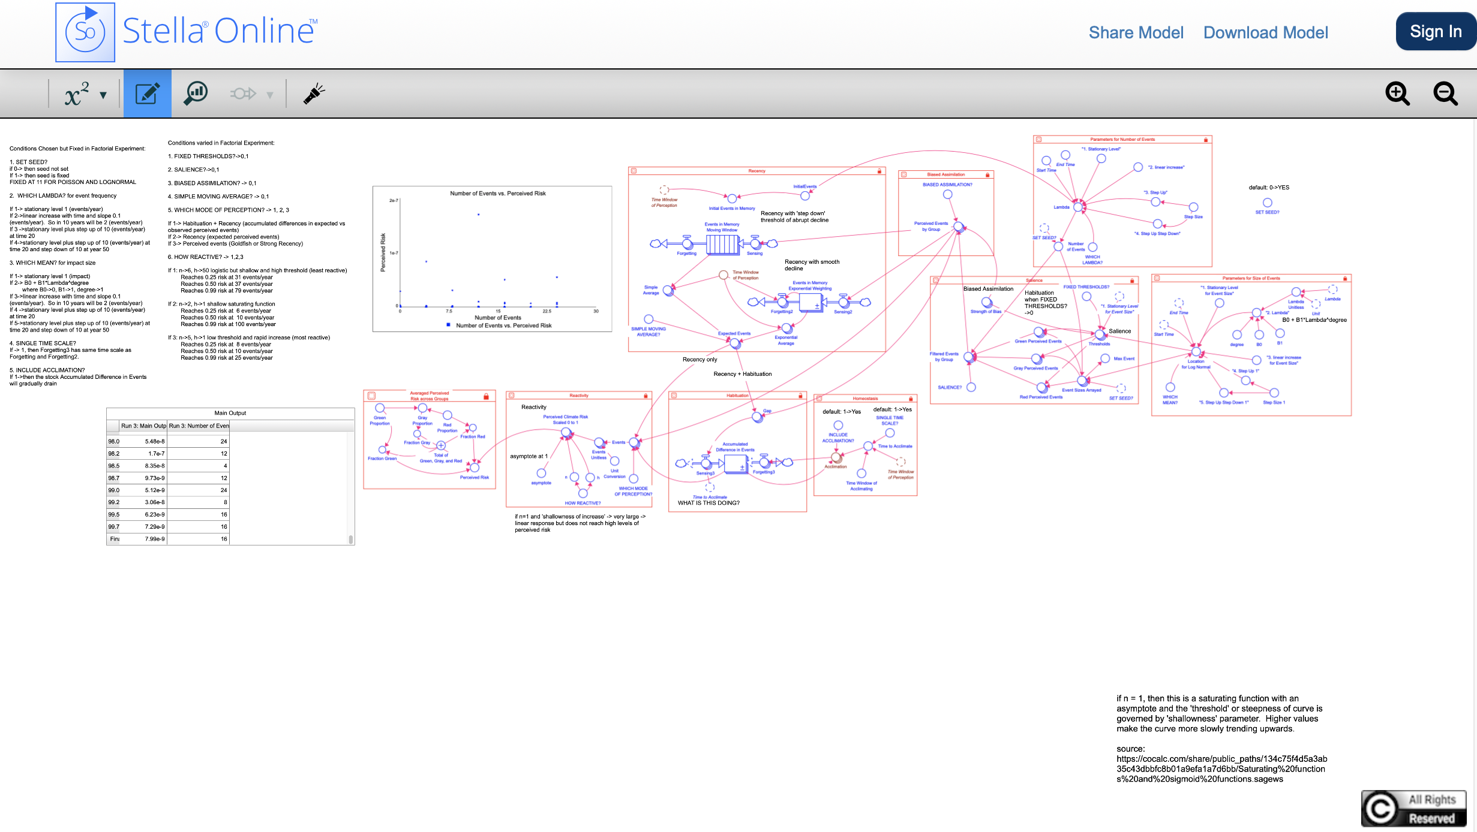
Model is implemented in Stella, has 11 “switches” for alternative model formulations/assumptions, about 30 parameters associated with these switches, and is designed to run factorial experiments.
Beckage et al., A computational model for the perception of risk from climate change (in prep)

Slide 36
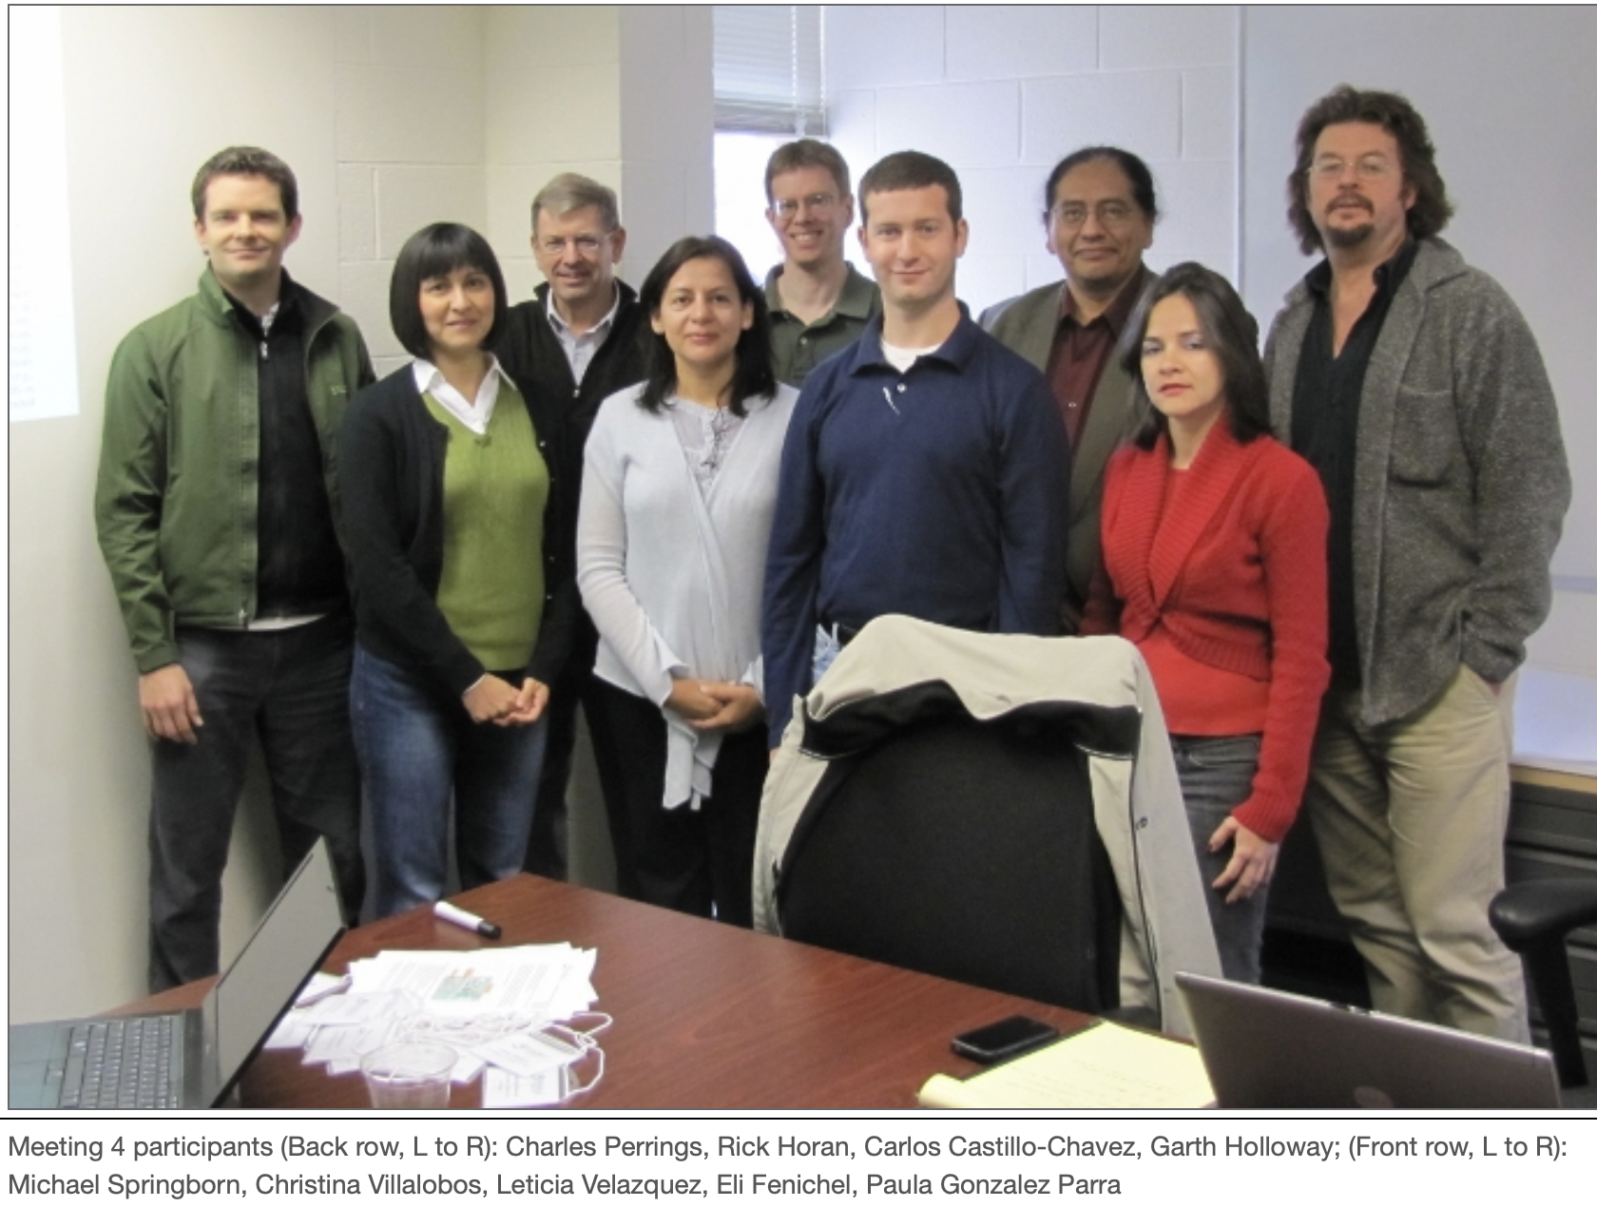
to successfully manage, predict, and develop surveillance strategies for new emerging diseases, it is imperative that the human decision making processes that influence disease risks are formally included in the decision process.

Slide 37
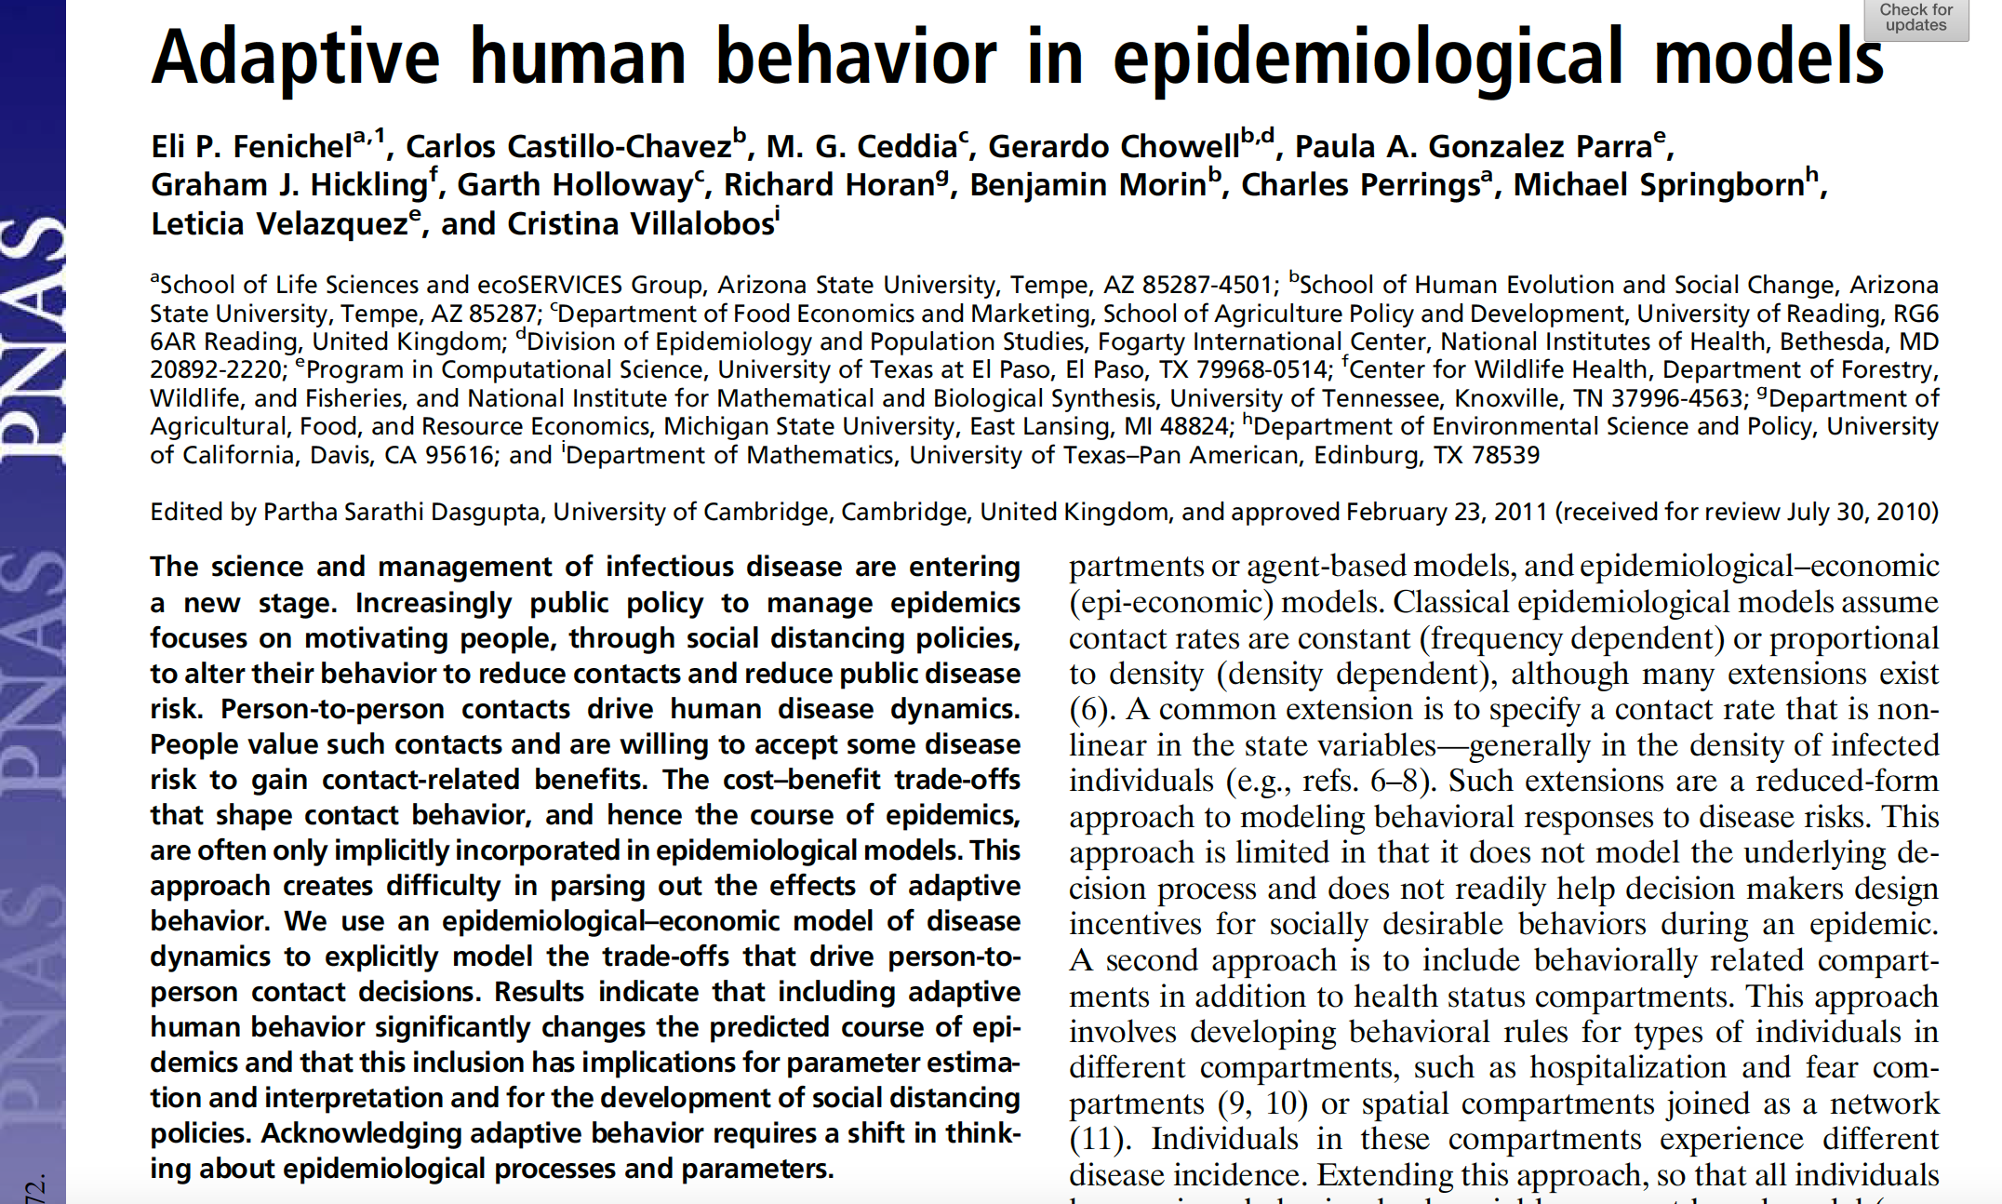

Slide 38
Slide from Baltazar Espinoza (University of Virginia)

Slide 39
Slide from Madhav Marathe (University of Virginia)

Slide 40
Slide from Madhav Marathe (University of Virginia)

Slide 41
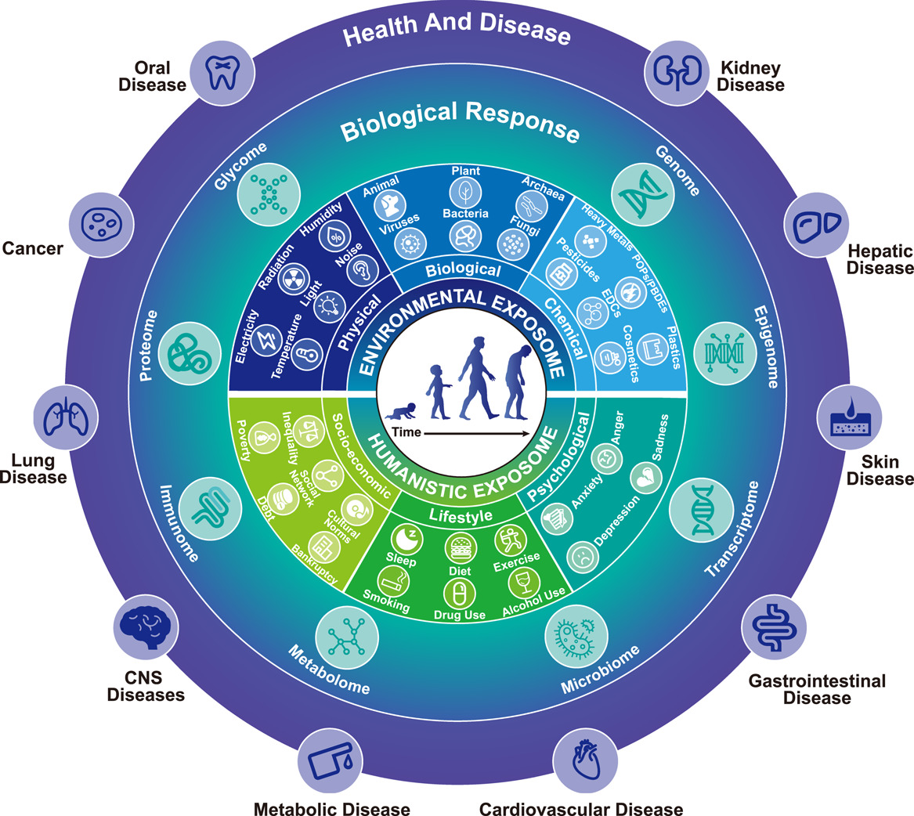
Wei, X. Et al. 2022. Charting the landscape of the environmental exposome. iMeta 1(4) https://doi.org/10.1002/imt2.50

Slide 42
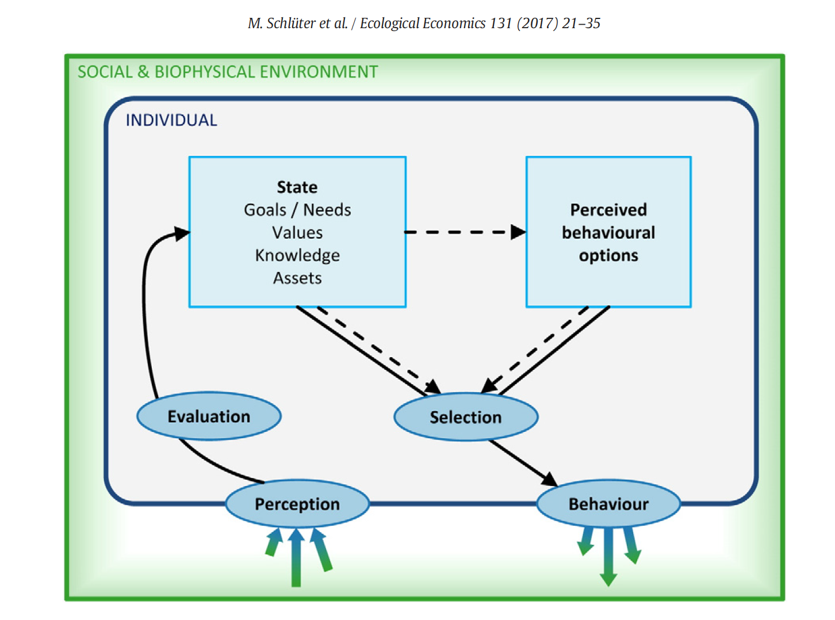
Schlüter, M. et al. 2017. A framework for mapping and comparing behavioural theories in models of social-ecological systems. Ecological Economics 131:21-35. MoHuB

Slide 43
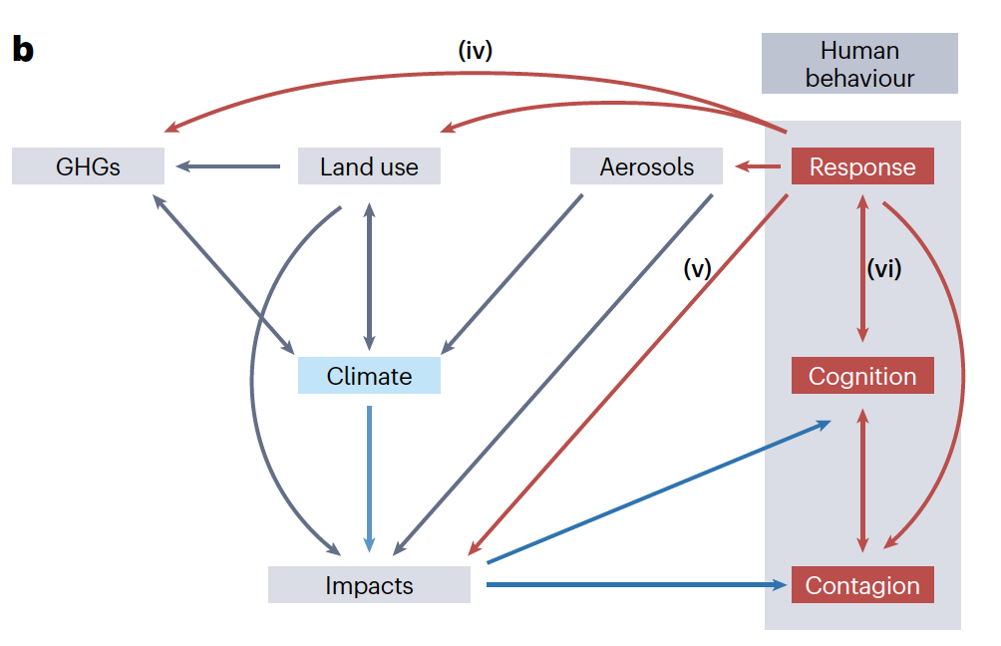
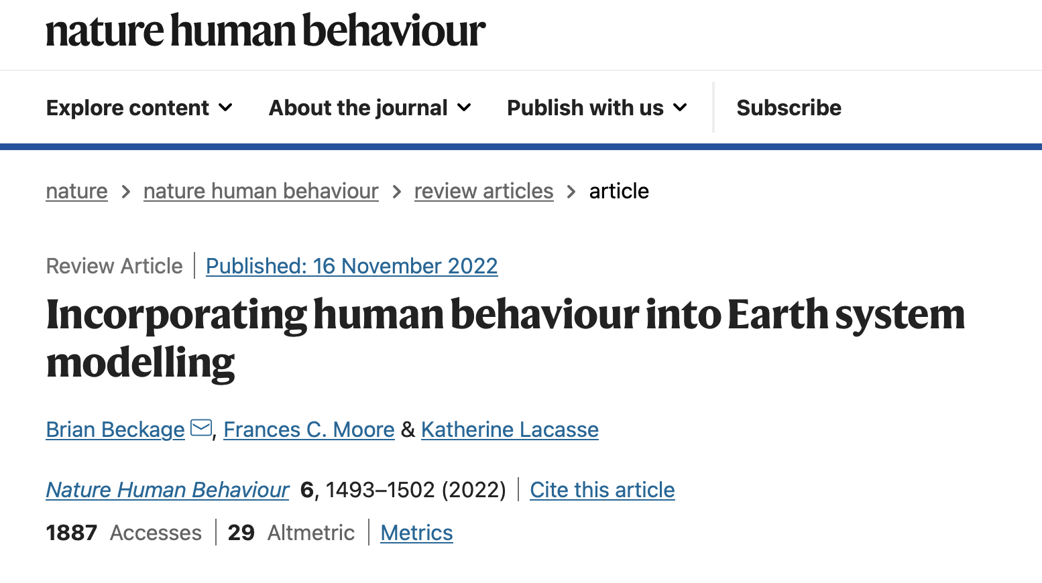
Katherine Lacasse
Rhode Island College
Brian Beckage
University of Vermont
Fran Moore
U Calif - Davis

Slide 44
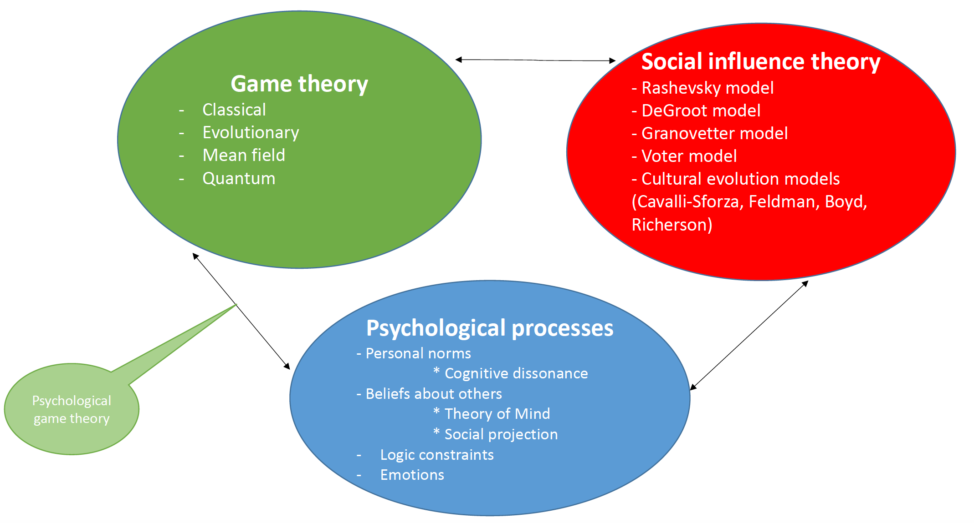
From Sergey Gavrilets

Slide 45
Themes
Many open research questions in linking human behavior to all types of environmental models still remain despite much initial work (particularly on economics)
There is much to be gained from the recent expansion of human behavior linked to infectious disease but challenges remaining include accounting for spatial disaggregation of behaviors based on local/regional social and cultural processes
Linkages to economic and policy models are still somewhat limited and political systems have not been accounted for much at all in coupled models
Comparisons between alternative modeling methodologies are limited
There is continuing benefit to collaboration with psychologists and cognitive scientists to incorporate alternative theories for human behavior

Slide 46
Take home lessons
Model evaluation for all types of behavioral models is relatively rare.
Set criteria for model evaluation prior to expending a lot of effort on a model.
Tie evaluation criteria to model objectives.
Multiple models are good – encourage this.
Consider whether an evaluation has been done or discussed whenever you review a modeling paper.

