Slide 1



Behavior Models for Climate Change and Disease Dynamics
Louis J. Gross
Chancellor’s Professor Emeritus
Departments of Ecology and Evolutionary Biology and Mathematics
University of Tennessee, Knoxville
Supported by NSF Awards DBI-1300426 to NIMBioS, DBI-1052875 to SESYNC and DMS-2436120 to Univ of Vermont
Legacy.NIMBioS.org
SESYNC.org

Slide 2
Overview
Objectives in linking human behavior to climate models
Some alternative climate models with human behavior
Cognitive processes and risk perception
Opinion dynamics models incorporating risk perception, group polarization and climate policy accounting for cultural differences
Results on how culture influences the potential for a shift in majority opinion on climate mitigation policy
Applying risk perception and impacts of behavior on infectious disease dynamics
Initial results on an SEIR model with explicit dynamics of risk perception driving NPI use

Slide 3
Broad Objective of Multiple Connected Projects
Human activities are interconnected with earth systems and associated projections for future climate. Our objective is to consider how human risk perception and behaviors arising from this might impact and interact with climate change, potentially modifying projections and analysis of the impacts of greenhouse gas mitigation efforts.
We then use our methods to expand the theory of infectious diseases to account for human behavior and cognition.

Slide 4
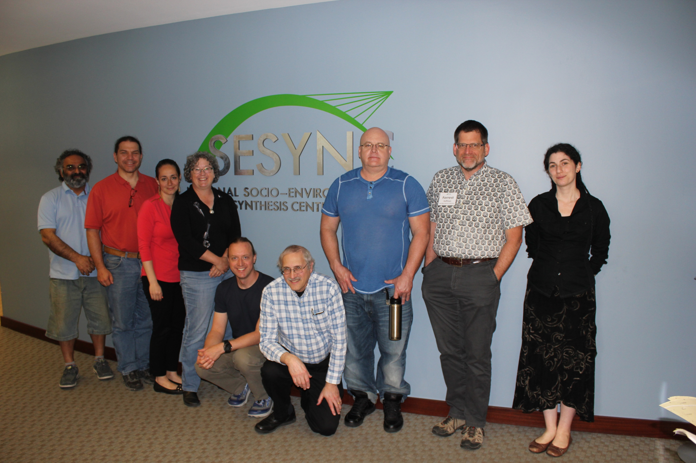
NIMBioS/SESYNC Working Group on Integrating Human Risk Perception of Global Climate Change into Dynamic Earth System Models
Brian Beckage, University of Vermont
Louis Gross, University of Tennessee
Katherine Lacasse, Rhode Island College
Eric Carr, University of Tennessee
Sara Metcalf, State University of New York
Jonathan Winter, Dartmouth College
Peter Howe, Utah State University
Nina Fefferman, University of Tennessee
Travis Franck, Climate Interactive
Asim Zia, University of Vermont
Ann Kinzig, Arizona State University
Forrest Hoffman, Oak Ridge National Lab
0:00-:30
Supported by NSF Awards EF-0832858, DBI-1300426 to NIMBioS, DBI-1052875 to SESYNC
Notes:
W

Slide 5
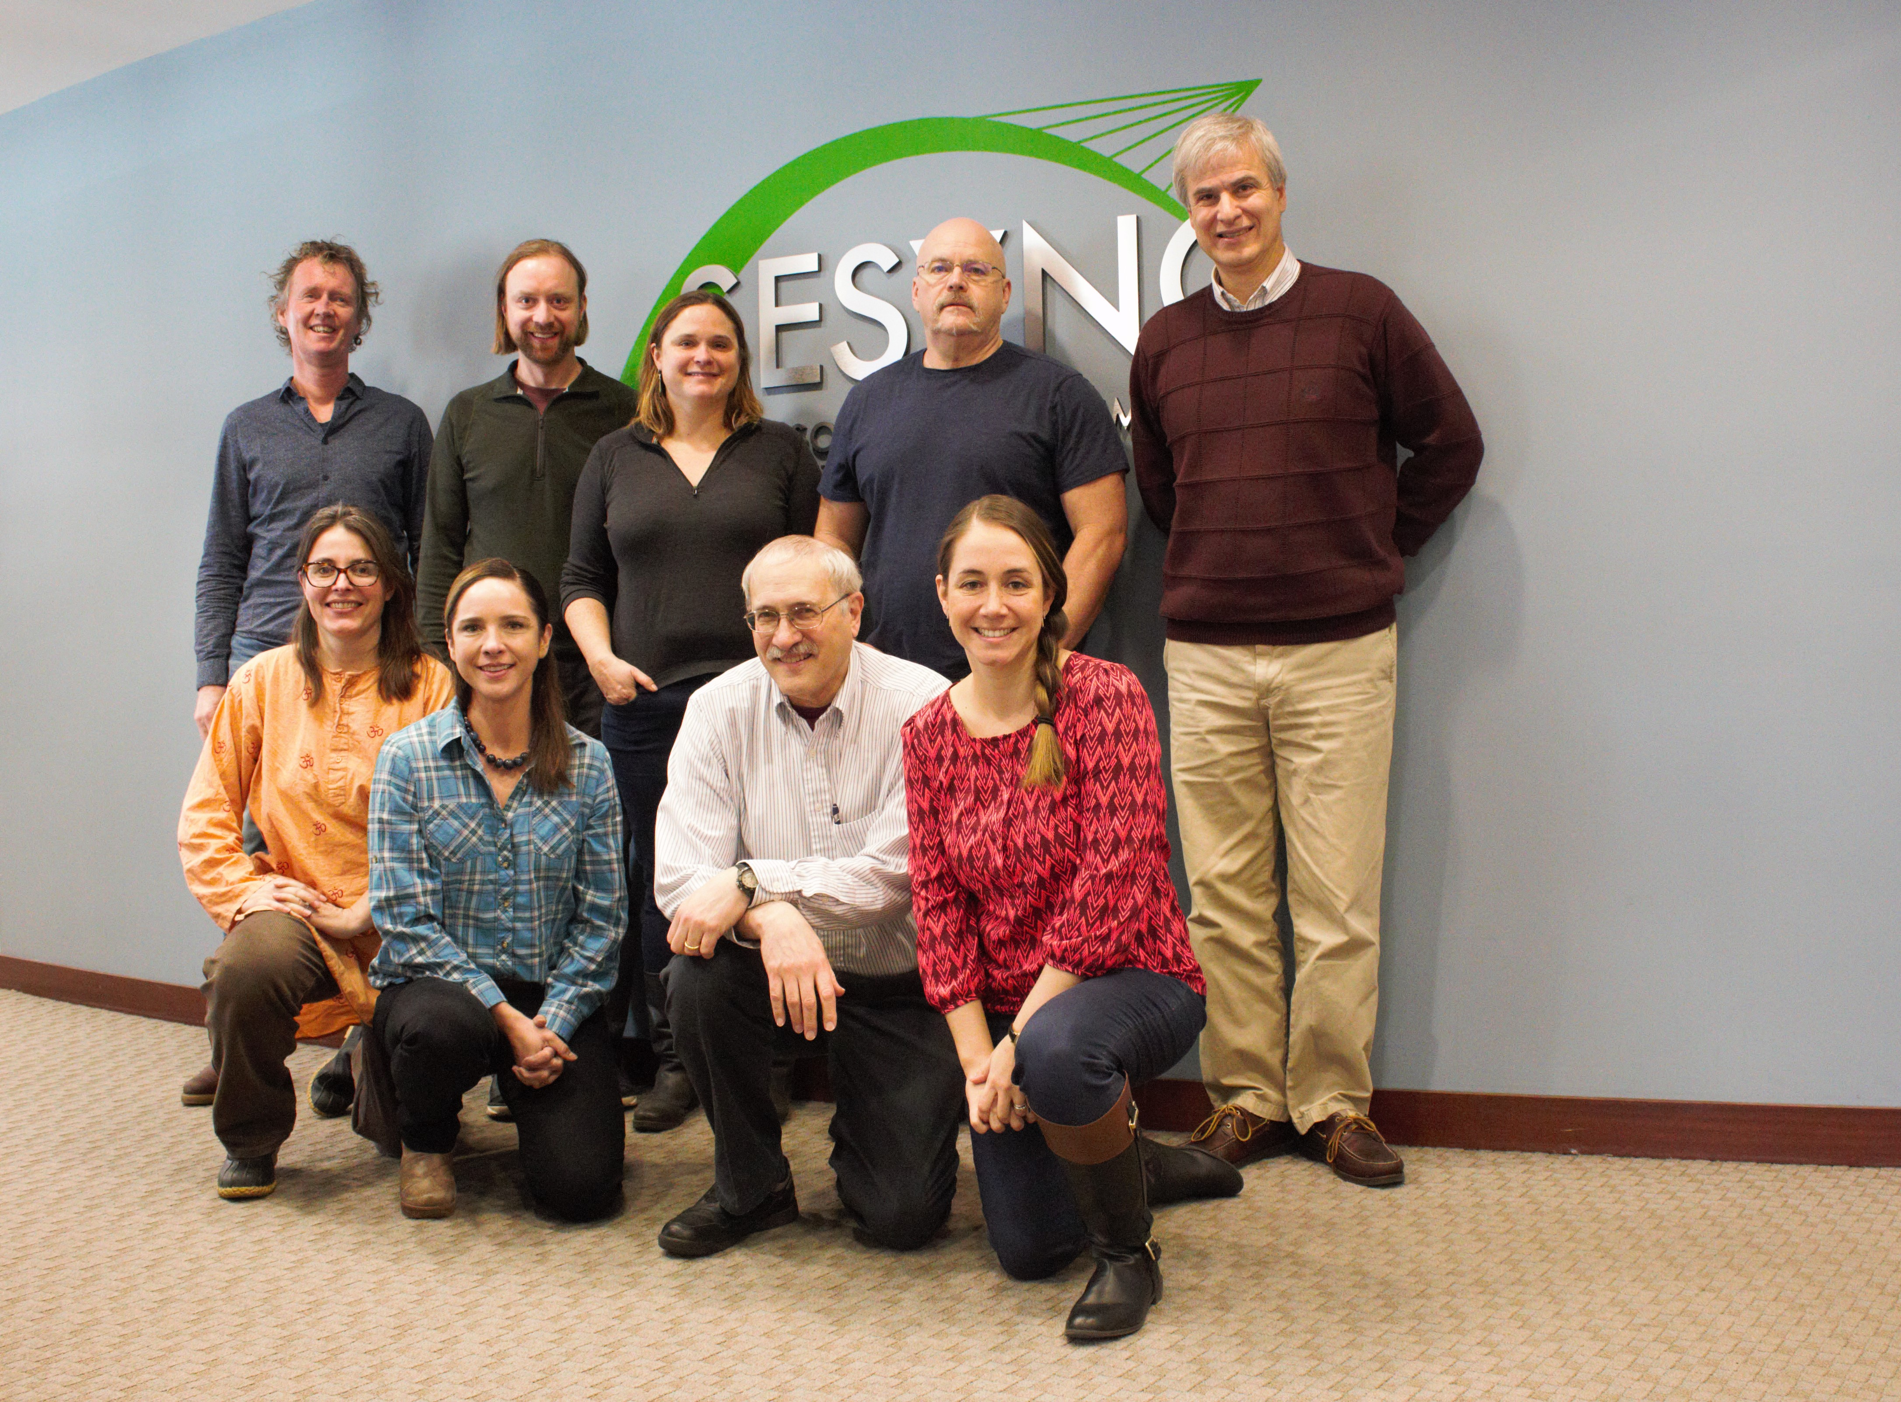


SESYNC Theme: Putting People into Climate Models
Sara Constantino - Stanford
Sara Metcalf, University at Buffalo
Louis Gross, University of Tennessee
Wander Jager, University of Groningen
Katharine Mach, University of Miami
Fran Moore, University of California, Davis
Travis Franck, Climate Interactive
Karim Chichakly, isee systems
Dale Rothman, George Mason University
Ann Kinzig, Arizona State University
Dale Rothman – George Mason
Supported by NSF Award DBI-1052875 to SESYNC

Slide 6
Background on Climate Social Systems Models
Models of climate change have largely focused on physical processes
Social components have generally been external - scenarios that drive the biophysical models. This limits the ability to observe dynamic interactions between humans and the climate system.
Standard economic growth model (DICE) uses an intertemporal optimization assuming perfect information about future climate change and economic impacts to estimate risk and make decisions.
Impacts of climate change are likely to alter human perceptions of climate change risks and associated greenhouse gas (GHG) emission behaviors that feedback to influence climate change
Key driver of interactions between human and climate systems are risk perceptions emerging from experiencing changes to weather patterns, extreme events, and changes that lead to economic damage, mortality and migration.

Slide 7
Major Questions We Address
What models might be used to analyze how human risk perception impacts climate projections?
How might we analyze feedbacks between the dynamics of human response and climate dynamics?
Are there major impacts on climate projections when human behavior feedbacks are included?
How might the various psychological and social theories of human behavior be modeled to link to climate?
How consistent are the resulting impacts of incorporating human behavior across different psycho-social models?

Slide 8
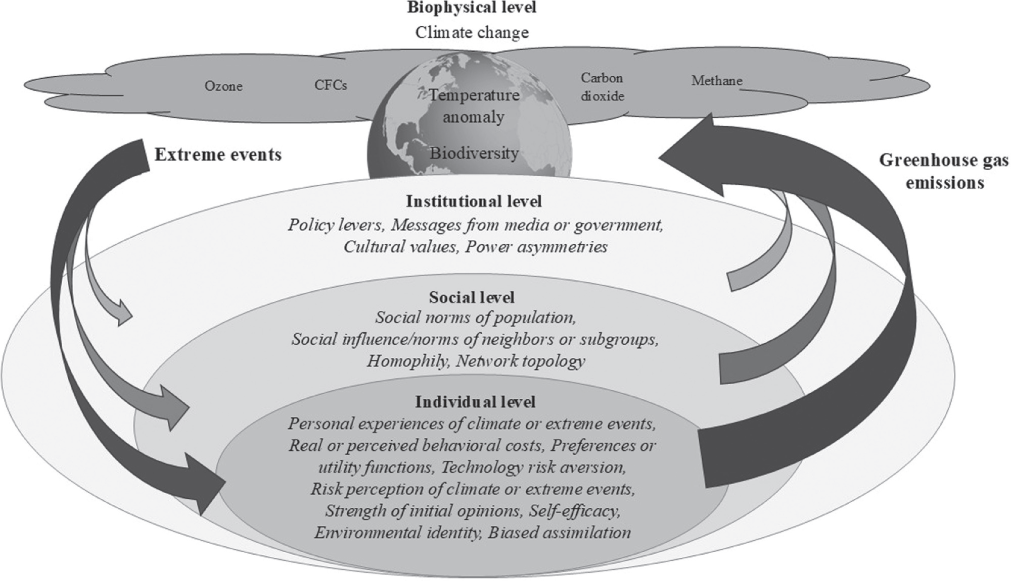
Climate change and opinion dynamics models: Linking individual, social, and institutional level changes. 2025. Yoon Ah Shin, Sara M. Constantino, Brian Beckage and Katherine Lacasse
Current Opinion in Behavioral Sciences 2025, 64:101528
https://doi.org/10.1016/j.cobeha.2025.101528

Slide 9
Beckage et al. 2018. Linking models of human behavior and climate alters projected climate change. Nature Climate Change 8: 79–84.
Climate change and opinion dynamics models: Linking individual, social, and institutional level changes. 2025. Yoon Ah Shin, Sara M. Constantino, Brian Beckage and Katherine Lacasse
Current Opinion in Behavioral Sciences 2025, 64:101528
https://doi.org/10.1016/j.cobeha.2025.101528

Slide 10
Beckage et al. 2020. The Earth has humans, so why don’t our climate models? Climatic Change https://doi.org/10.1007/s10584-020-02897-x
Climate change and opinion dynamics models: Linking individual, social, and institutional level changes. 2025. Yoon Ah Shin, Sara M. Constantino, Brian Beckage and Katherine Lacasse
Current Opinion in Behavioral Sciences 2025, 64:101528
https://doi.org/10.1016/j.cobeha.2025.101528

Slide 11
Moore at al. 2022. Determinants of emissions pathways in the coupled climate–social system. Nature 603: 103–111.
Climate change and opinion dynamics models: Linking individual, social, and institutional level changes. 2025. Yoon Ah Shin, Sara M. Constantino, Brian Beckage and Katherine Lacasse
Current Opinion in Behavioral Sciences 2025, 64:101528
https://doi.org/10.1016/j.cobeha.2025.101528

Slide 12
Shin et al. 2022. How coupled is coupled human-natural systems research? Ecology and Society 27 (3):4.
Climate change and opinion dynamics models: Linking individual, social, and institutional level changes. 2025. Yoon Ah Shin, Sara M. Constantino, Brian Beckage and Katherine Lacasse
Current Opinion in Behavioral Sciences 2025, 64:101528
https://doi.org/10.1016/j.cobeha.2025.101528

Slide 13
Zia et al. 2024. Machine Learning a Probabilistic Structural Equation Model to Explain the Impact of Climate Risk Perceptions on Policy Support. Sustainability 16, 10292.
Climate change and opinion dynamics models: Linking individual, social, and institutional level changes. 2025. Yoon Ah Shin, Sara M. Constantino, Brian Beckage and Katherine Lacasse
Current Opinion in Behavioral Sciences 2025, 64:101528
https://doi.org/10.1016/j.cobeha.2025.101528

Slide 14
Shin et al. 2025. Climate change and opinion dynamics models: Linking individual, social, and institutional level changes. Current Opinion in Behavioral Sciences 2025, 64:101528
Climate change and opinion dynamics models: Linking individual, social, and institutional level changes. 2025. Yoon Ah Shin, Sara M. Constantino, Brian Beckage and Katherine Lacasse
Current Opinion in Behavioral Sciences 2025, 64:101528
https://doi.org/10.1016/j.cobeha.2025.101528

Slide 15
Shin et al. 2025. Culture Mediates Climate Opinion Change: A System Dynamics Model of Risk Perception, Polarization, and Policy Effectiveness. Climate 13(9):194.
Climate change and opinion dynamics models: Linking individual, social, and institutional level changes. 2025. Yoon Ah Shin, Sara M. Constantino, Brian Beckage and Katherine Lacasse
Current Opinion in Behavioral Sciences 2025, 64:101528
https://doi.org/10.1016/j.cobeha.2025.101528

Slide 16
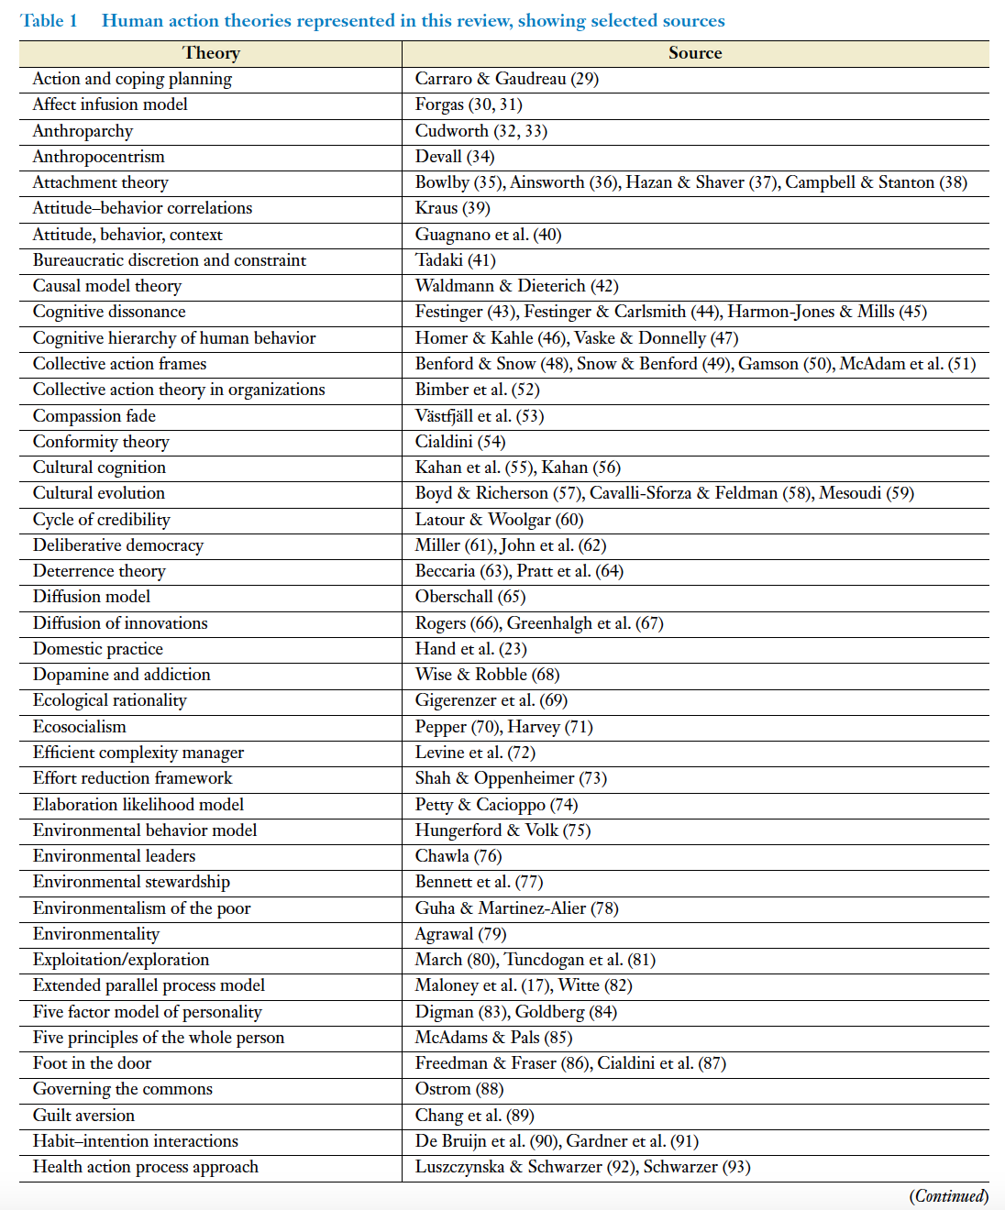
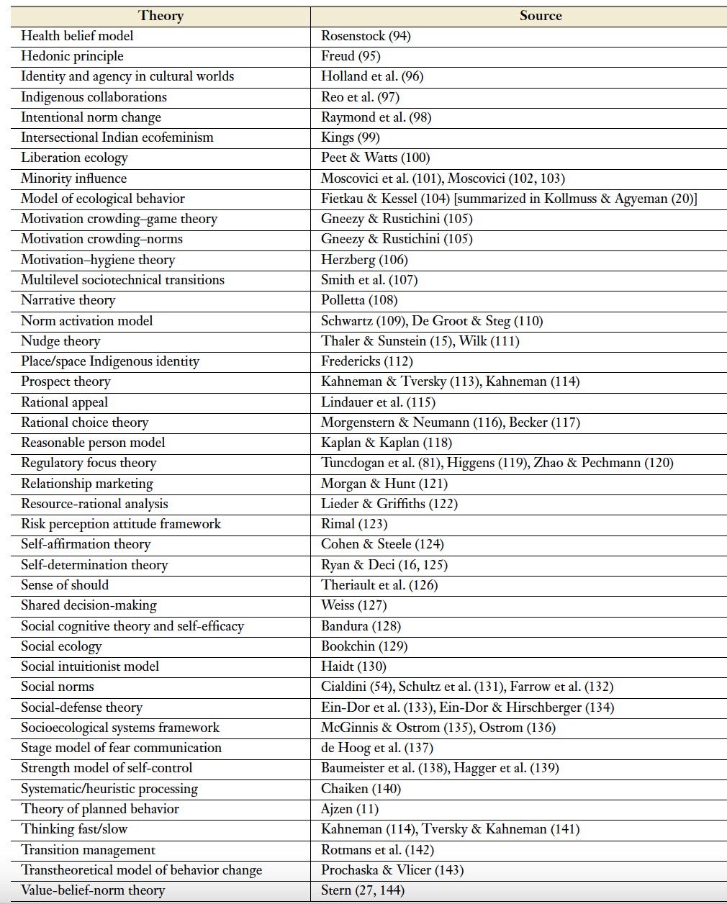
Review of theories to explain human action, free from constraints related to discipline and including collective action
Eyster, H. N., T. Satterfield & K. M.A. Chan (2022) Why People Do What They Do: An Interdisciplinary Synthesis of Human Action Theories. Annu. Rev. Environ. Resour 47:725–51 doi.org/10.1146/annurev-environ-020422-125351

Slide 17
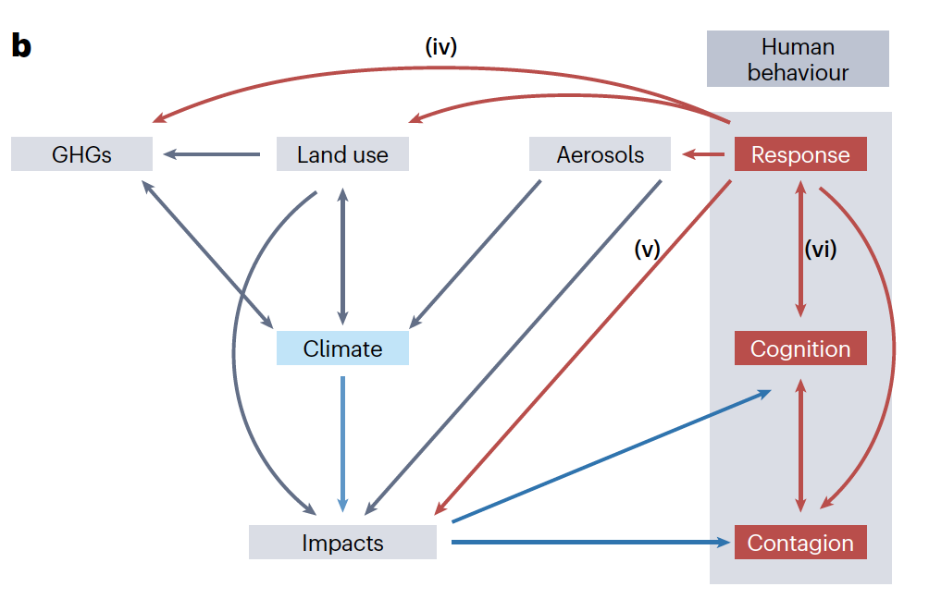



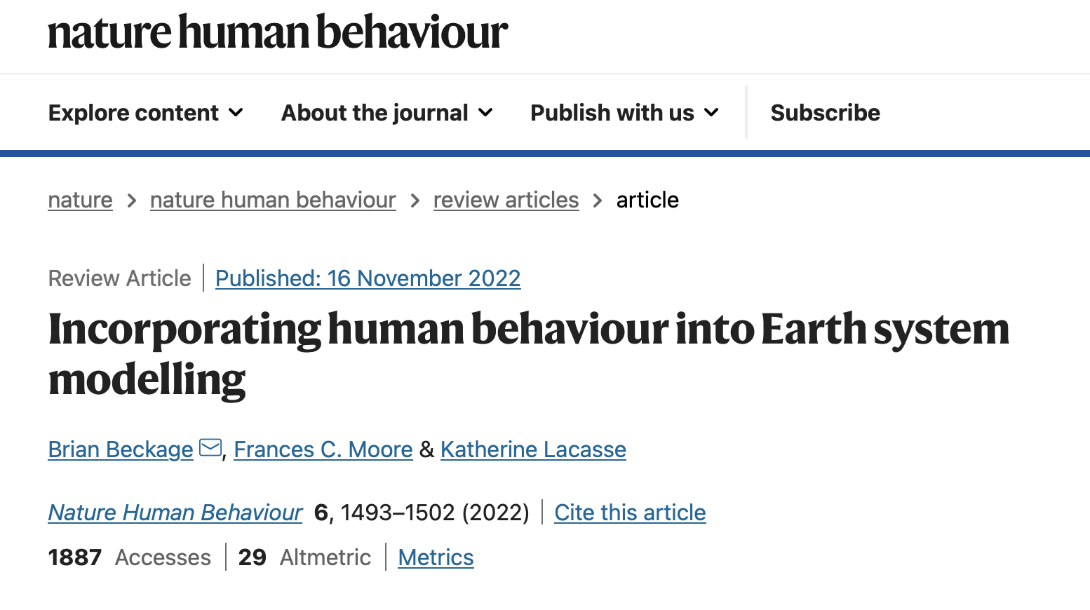
Katherine Lacasse
Rhode Island College
Brian Beckage
University of Vermont
Fran Moore
U Calif - Davis

Slide 18
Climate Social Model
Nature Climate Change 2018 8, 79–85

Slide 19
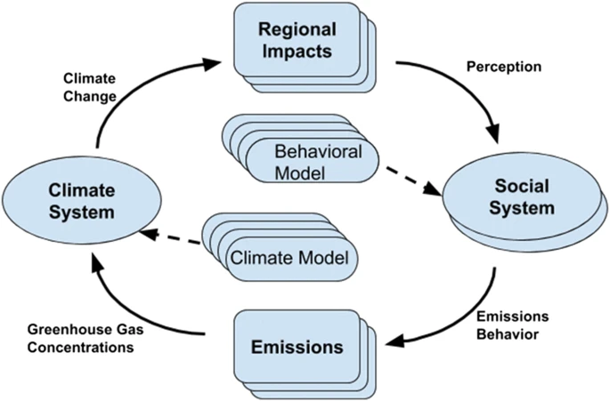
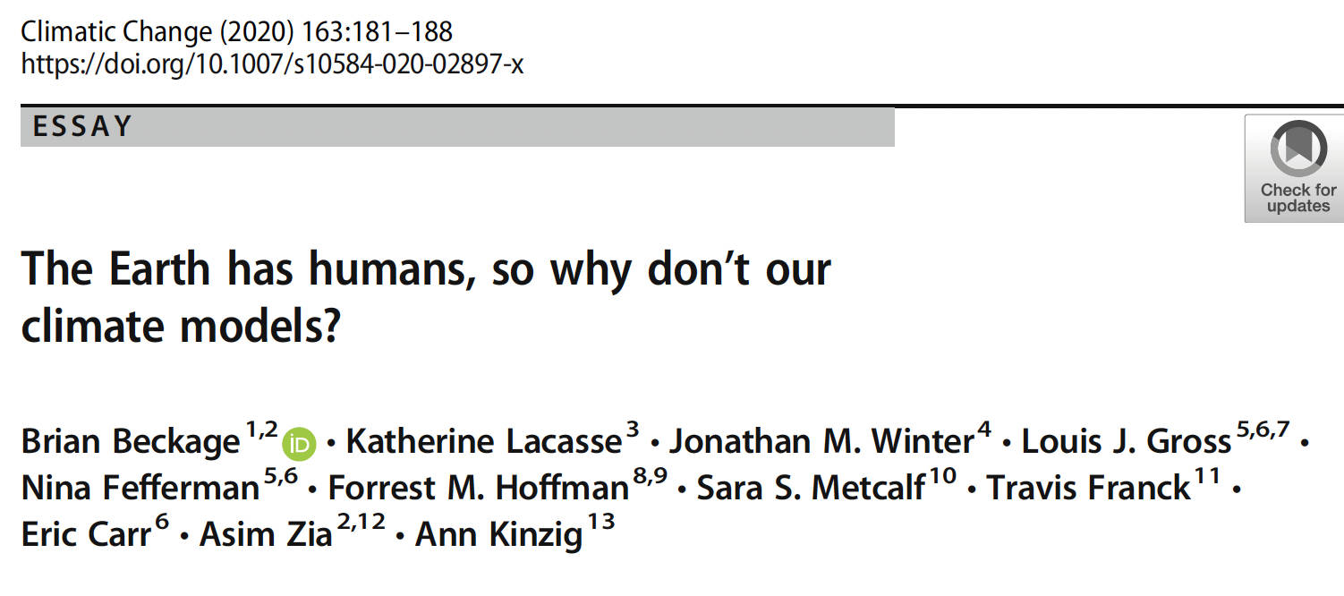

Slide 20
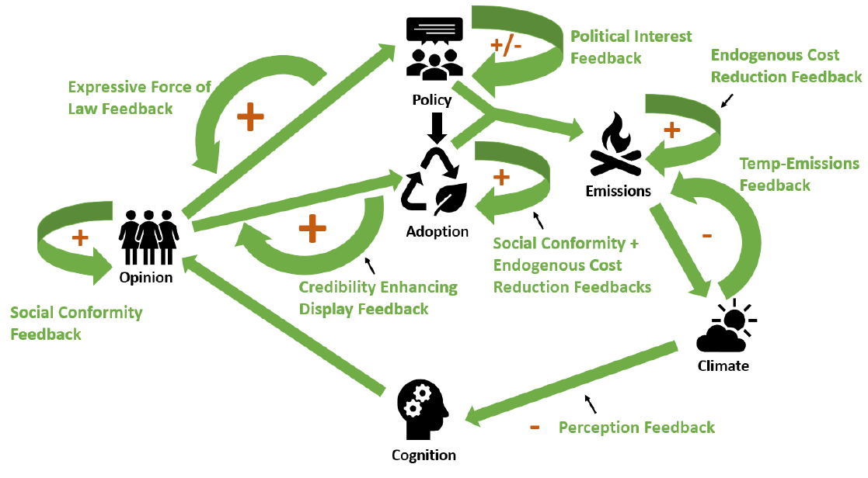
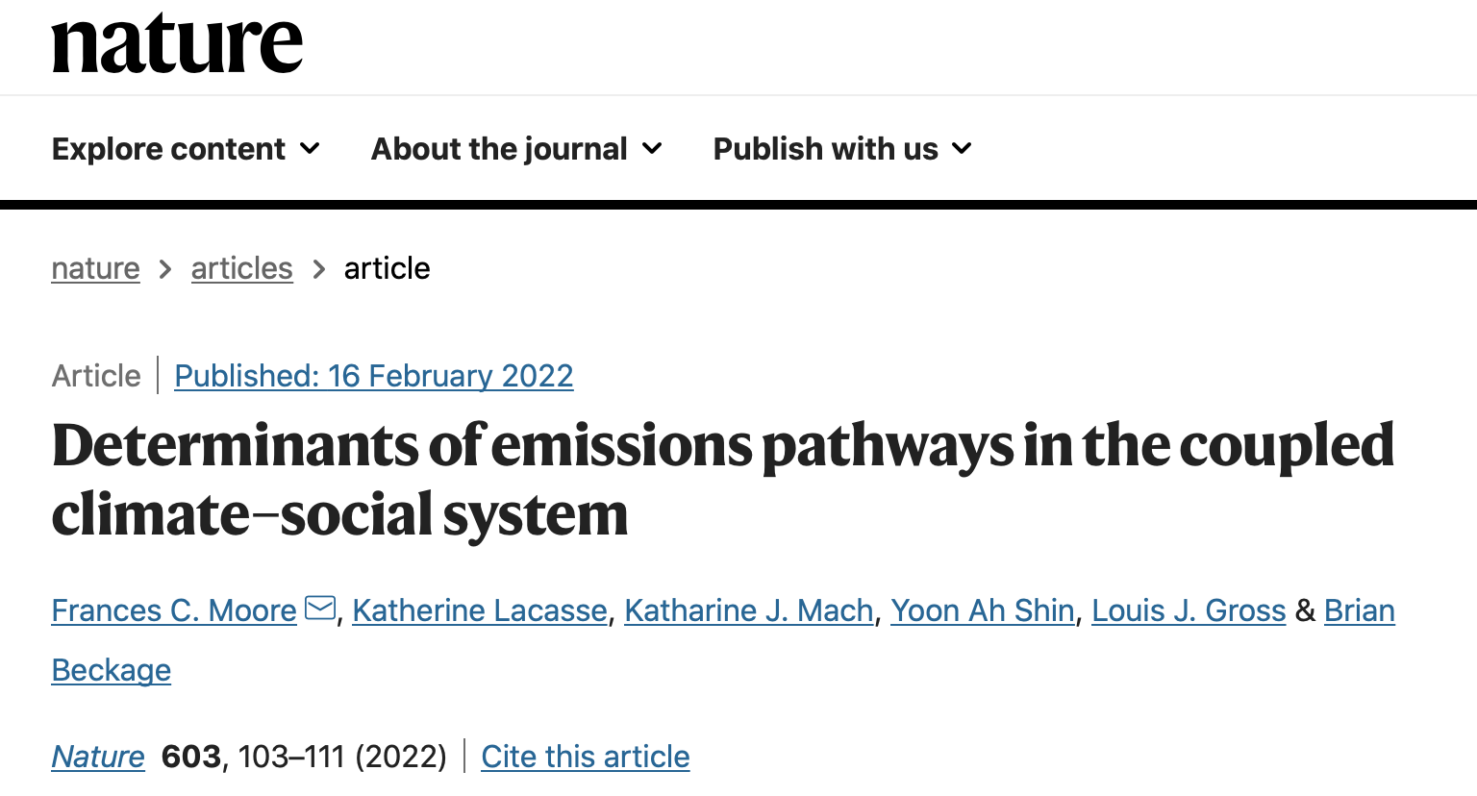
Components and feedbacks in the coupled climate-social system

Slide 21
Cognitive Processes
Social science identifies a range of processes to explain how people react to new experiential information - some information is weighed more or less and associated to stronger or weaker climate risk perception.
Initial theory of risk perception assumed people were making “rational choices”, weighing the probability of available information about negative and positive outcomes and using these to come to conclusions. It is now clear that humans instead make decisions about risk in a boundedly rational way, utilizing emotional feelings, heuristics, social information along with knowledge, with experiential processes of particular importance.
People’s experiences with changing climate can strengthen perceived climate risk, mediated by how humans perceive and process information about the environment. This information processing is cognition - describing how humans sense, forget, and process signals from the environment, translating these signals into responses.

Slide 22
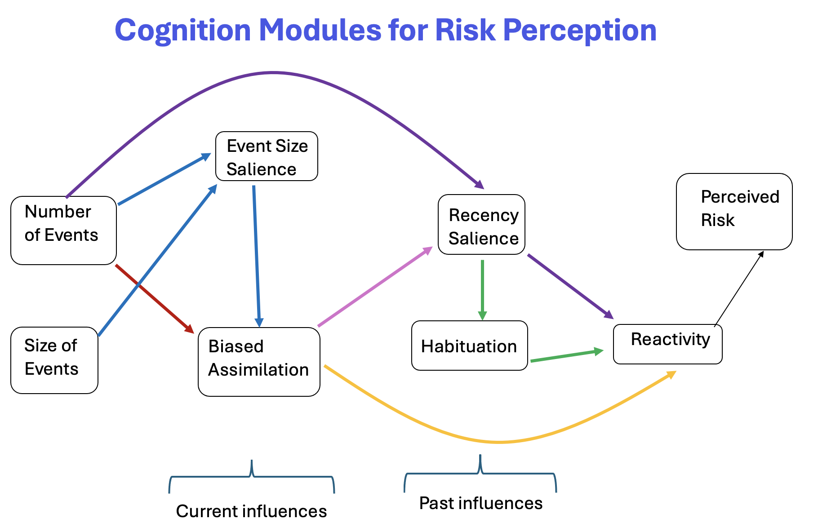

Slide 23
How do we evaluate such models?
First, we ensure the coded model is behaving as designed for the key drivers – e.g. the code is correctly representing the desired model – by checking each component output.
Second, we establish general qualitative expectations – e.g. risk perception should increase as mean number of events increases and as mean size of events increases.
Third, we choose subsets of switched cases for which we have general guidance from our psychology collaborators and data from various publications as to how risk perception will respond.
Fourth, we carry out an uncertainty analysis for key parameters and model components to determine whether model output response is highly sensitive to certain model components.

Slide 24
Take home lessons on cognitive and risk modeling
Linkages to economic and policy models are still somewhat limited and political systems have not been accounted for much at all in coupled models
Comparisons of alternative modeling methods are limited – multiple models are good
Given the host of different behavior theories, compare behavior processes to identify those with most impact
Model evaluation for all types of behavioral models is relatively rare -tie evaluation criteria to model objectives.
There is benefit from collaboration with psychologists and cognitive scientists to incorporate alternative theories for human behavior

Slide 25
Opinion Dynamics Modeling Approaches
Many approaches have been used including data-driven statistical models, dynamical systems for changes in sizes of categorical opinion “groups”, agent-based methods for either discrete or continuous opinion states, network models such as the ”voter” model similar to that used for interacting particles (Ising model), graph theory models, and hybrid methods that combine some of these. For reviews see:
A. Sîrbu, V. Loreto, V. D. Servedio, and F. Tria. Opinion dynamics: models, extensions
and external effects. In Participatory sensing, opinions and collective awareness,
pages 363–401. Springer, 2017
Daniel Simonson. 2022. Mathematical Theory of Opinion Dynamics with Applications. UC-Irvine Dissertation. https://escholarship.org/uc/item/8xn4r7xc

Slide 26
Climate change and opinion dynamics models: Linking individual, social, and institutional level changes. 2025. Yoon Ah Shin, Sara M. Constantino, Brian Beckage and Katherine Lacasse
Current Opinion in Behavioral Sciences 2025, 64:101528
https://doi.org/10.1016/j.cobeha.2025.101528

Slide 27
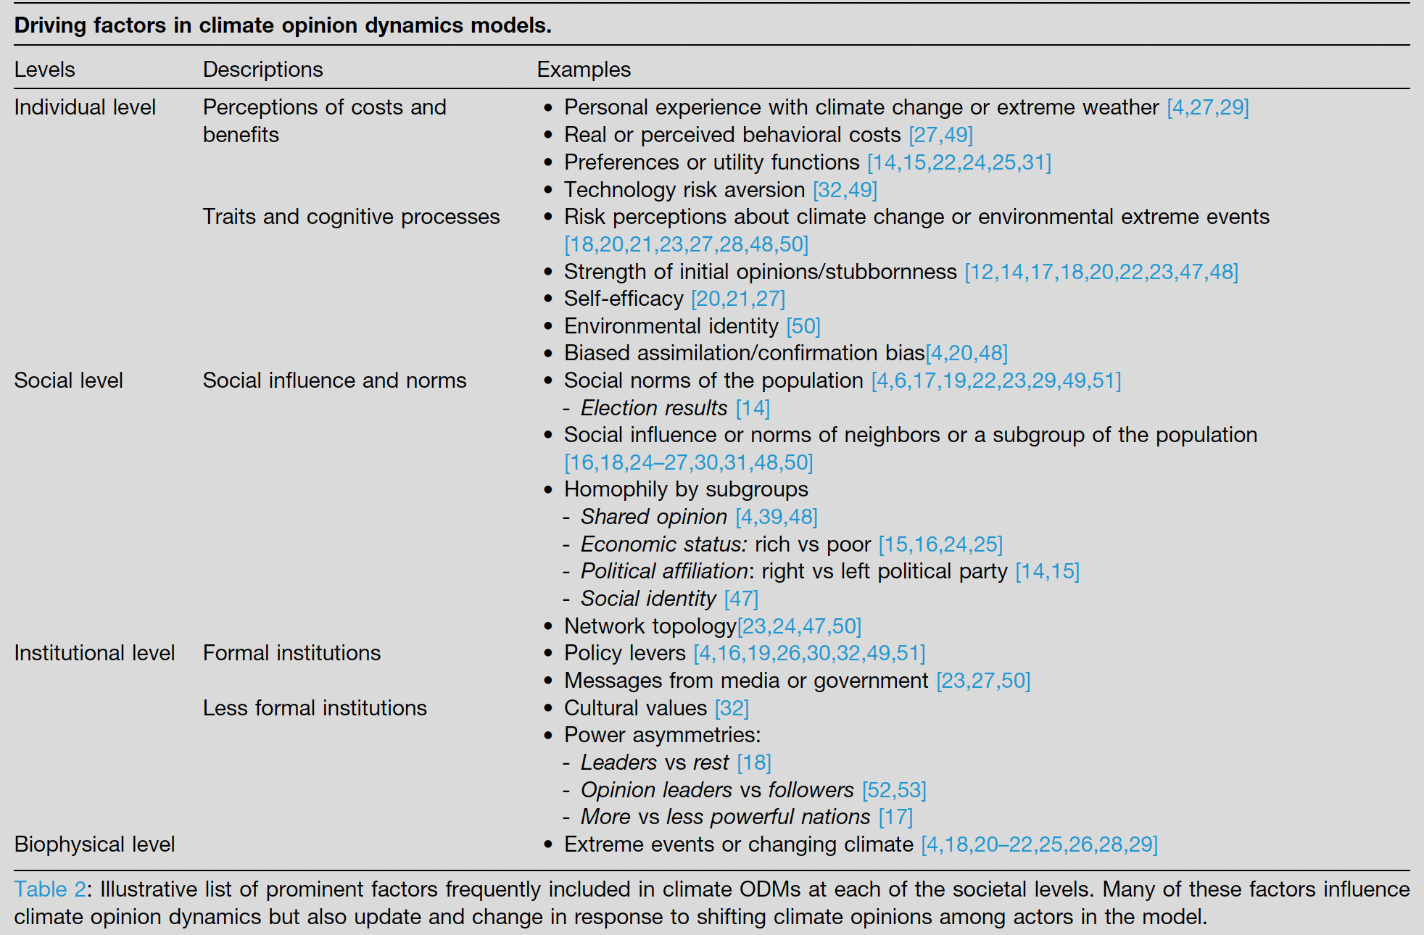
Climate change and opinion dynamics models: Linking individual, social, and institutional level changes. 2025. Yoon Ah Shin, Sara M. Constantino, Brian Beckage and Katherine Lacasse
Current Opinion in Behavioral Sciences 2025, 64:101528
https://doi.org/10.1016/j.cobeha.2025.101528

Slide 28
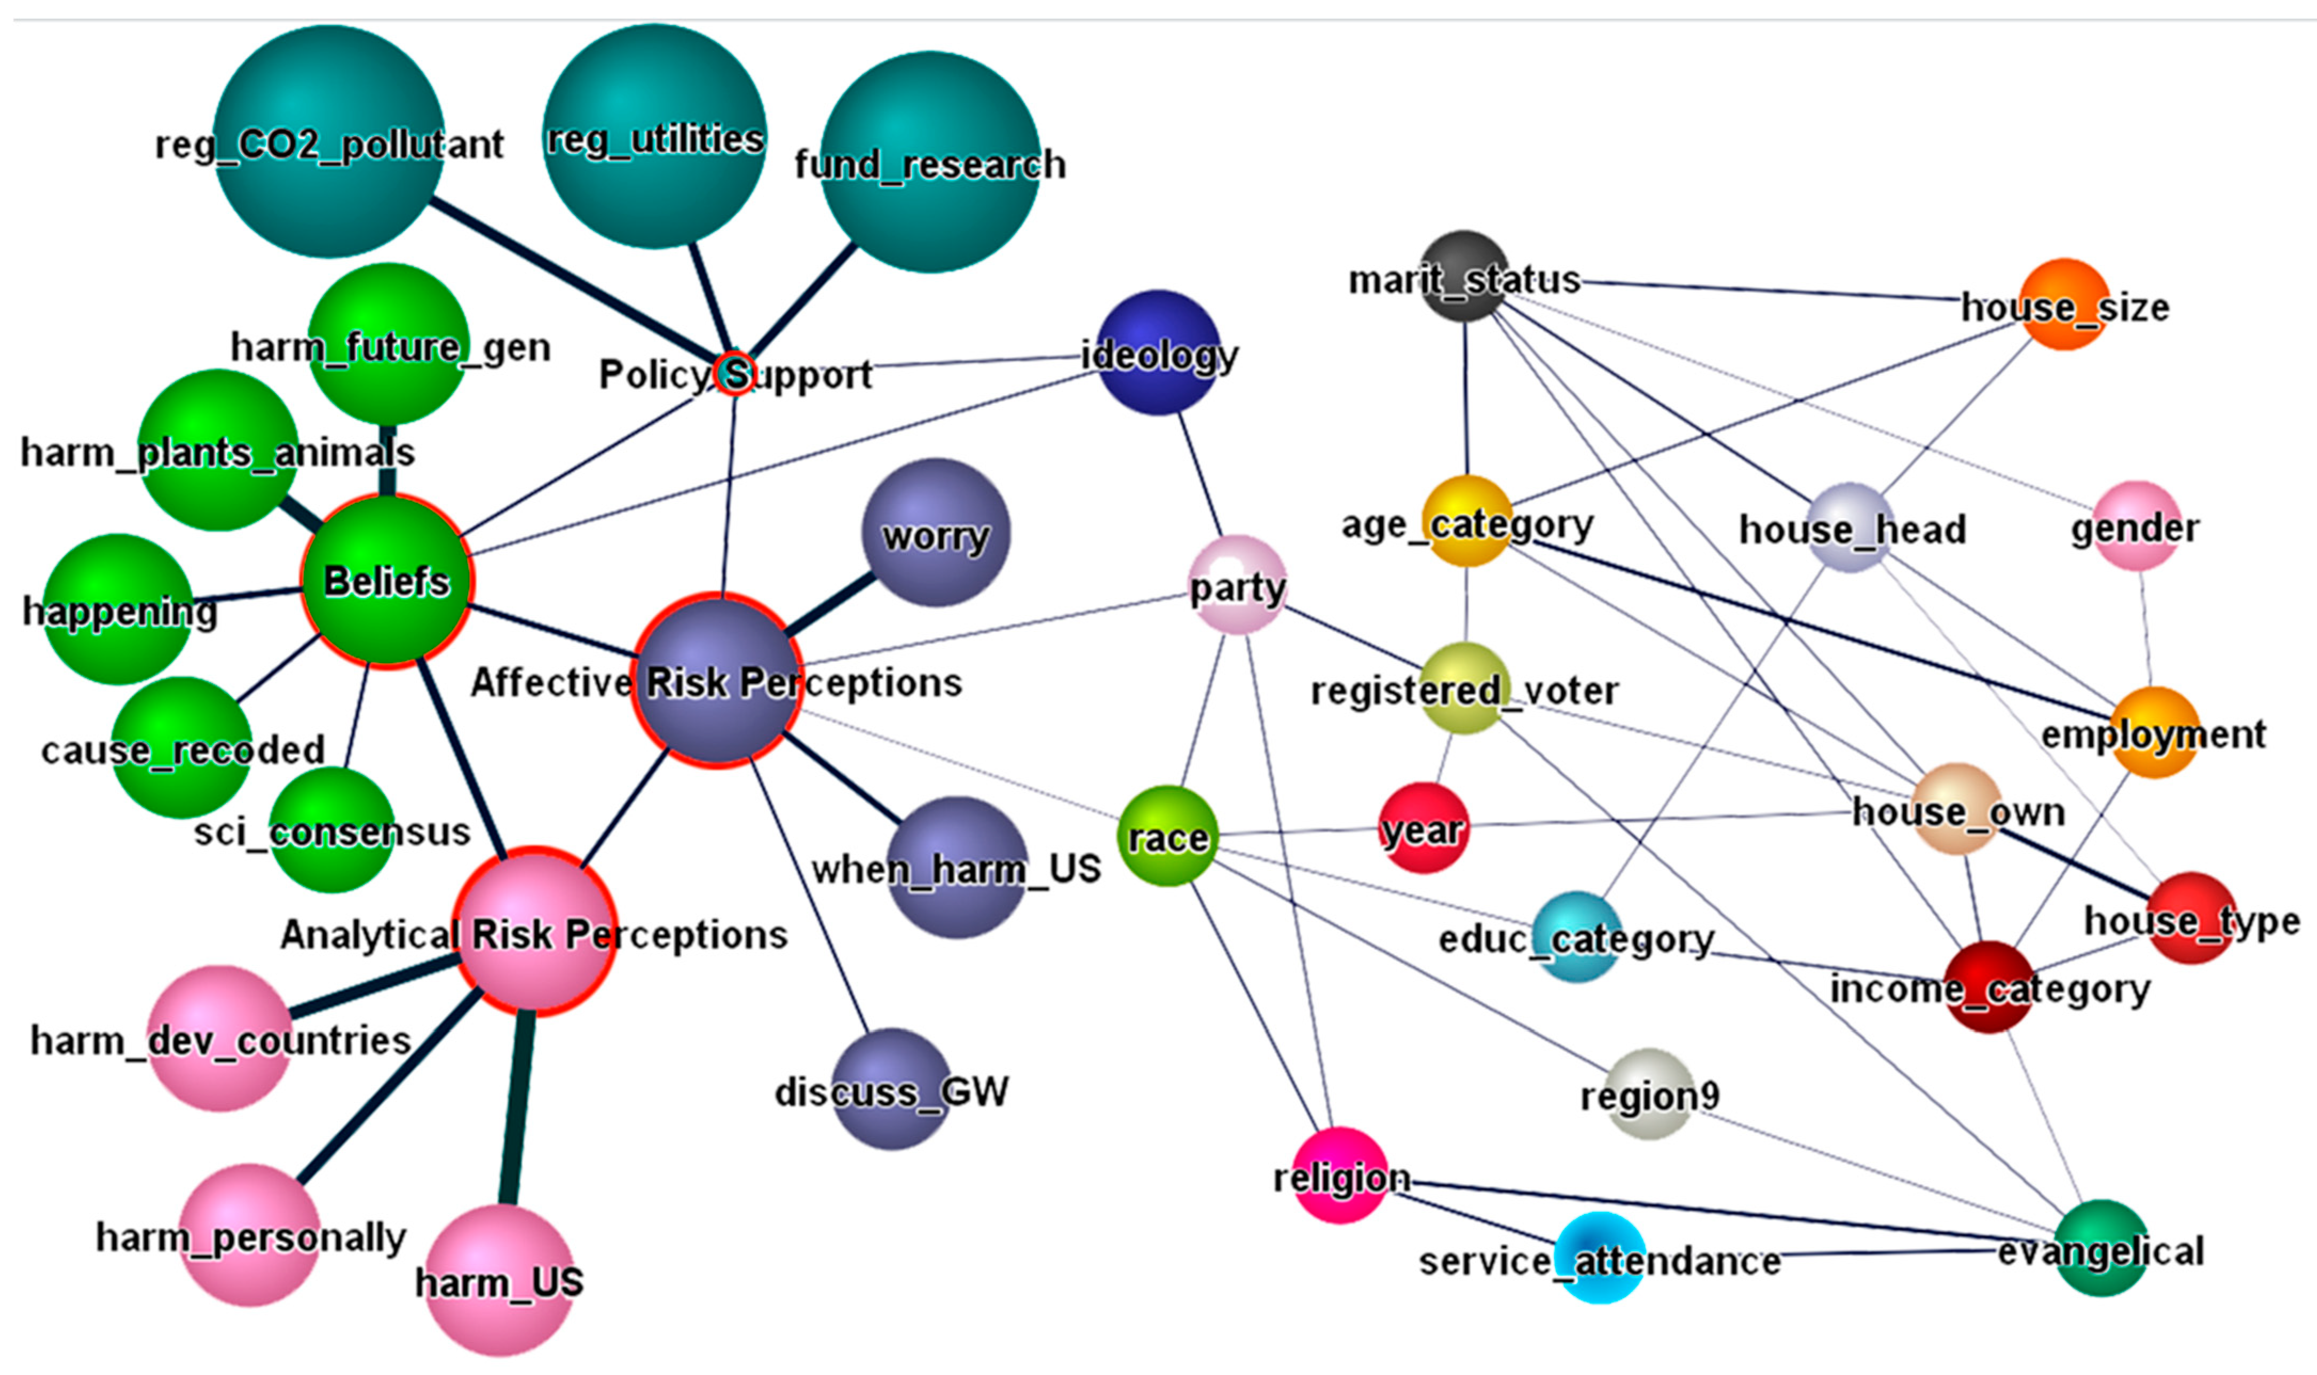
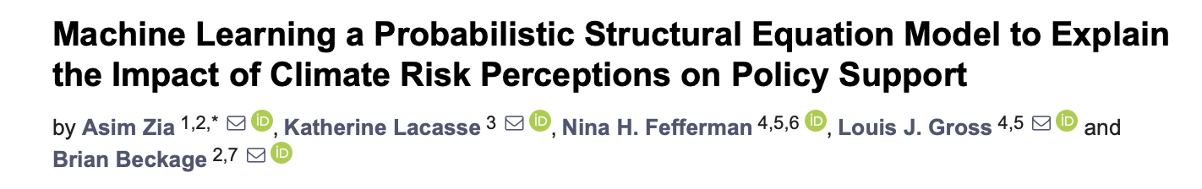
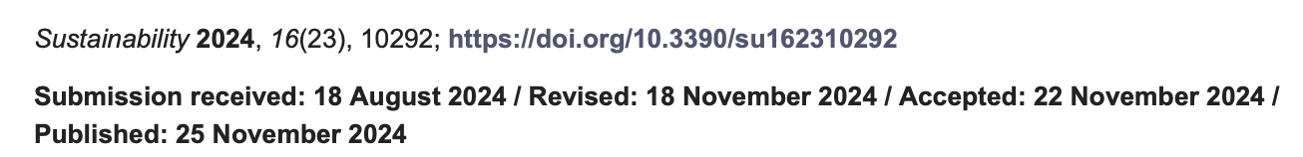

Slide 29
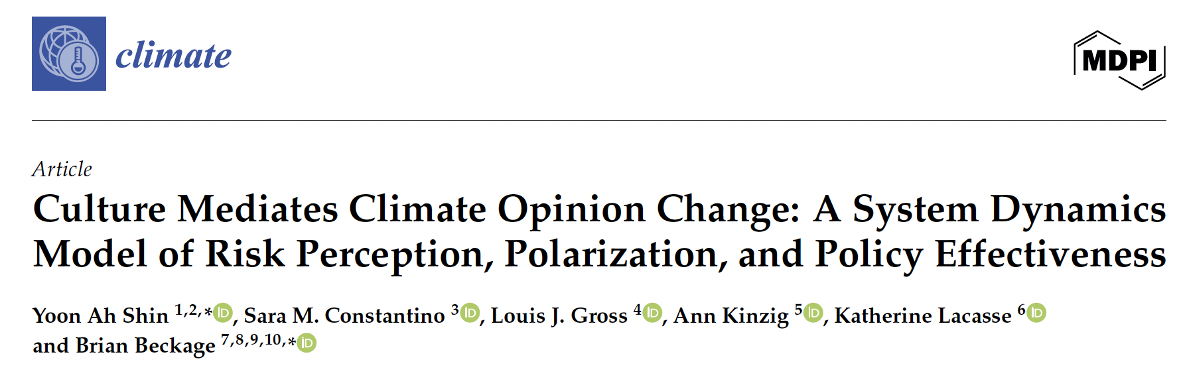



Yoon Ah Shin – Cal St U - Fullerton.
PhD Public Administration
Katherine Lacasse
Rhode Island College
PhD Psychology
Sara Constantino – Stanford
PhD Cognitive Science
Ann Kinzig – Ariz St U.
PhD Energy Resources
Brian Beckage
U. of Vermont
PhD Botany

Slide 30
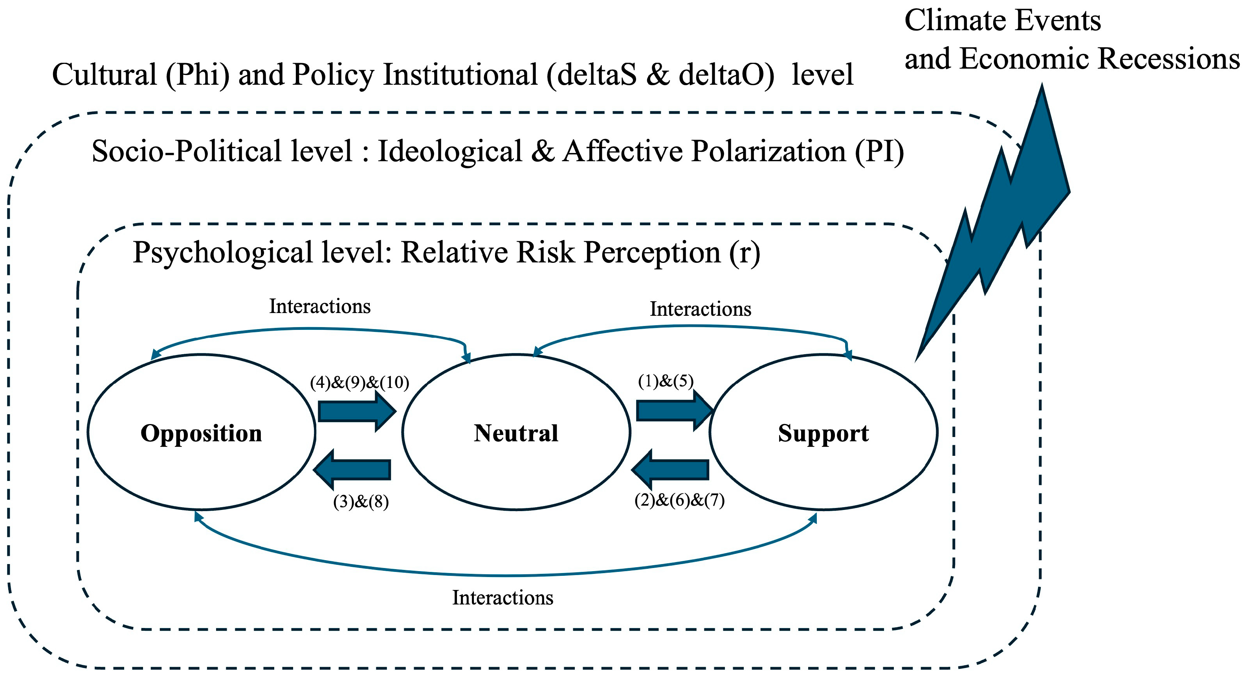
Shin YA, Constantino SM, Gross LJ, Kinzig A, Lacasse K, Beckage B. Culture Mediates Climate Opinion Change: A System Dynamics Model of Risk Perception, Polarization, and Policy Effectiveness. Climate. 2025; 13(9):194. https://doi.org/10.3390/cli13090194

Slide 31
Model parameters
Ideological polarization - the strengthening of opinions so as to be resistant to change. It shapes how personal experiences impact one’s opinions
Parameters are PI_{io} and PI_{is} for opposition and support groups
Affective polarization - emotional warmth towards those with shared opinions and coldness towards those with differing opinions. It alters one’s patterns of social interaction.
Parameters are PI_{ao} and PI_{as} for opposition and support groups
High PI_{ao} and PI_{as} results in homophily, reducing the number of people with differing opinions that one encounters.
Relative risk parameter r - the ratio of perceived severity of climate impacts to perceived economic costs of mitigation from the neutral group’s perspective. So r > 1 means perceived climate risk is greater than the perceived economic risk of mitigation costs.
r affects the rates at which individuals change opinion groups but PI_{io} and PI_{is} bias the perceived climate risks by altering the support and opposition groups perception of climate impacts and mitigation costs.

Slide 32
Model parameters
𝞺 - fraction of the population amenable to opinion change per unit time, given perceived experience of extreme climate events and mitigation costs.
𝞫- fraction of interactions in a well-mixed society without polarization that would lead someone to change their current opinion based on social interactions.
𝝳_{s} and 𝝳_{o} - the effectiveness of current policies in maintaining opinion group membership. 𝝳_{s} reflects benefits from climate policies which encourage supporters to maintain their position. 𝝳_{o} reflects benefits from fossil fuel policies which encourage opponents to maintain their position. These set the time frame in which individuals leave their opinion group, independent of other factors in the model. Larger values lead to less movement between groups.
𝞅 - cultural influences. Determines the relative weight given to relative risk perception versus social interactions that affects movement into and out of each opinion group. 𝞅 close to 1 indicates that the decision is mostly based on experience-based relative risk perception e.g. a highly individualistic culture. 𝞅 close to 0 indicates that the decision is mostly based on social interactions e.g. a collective culture.

Slide 33
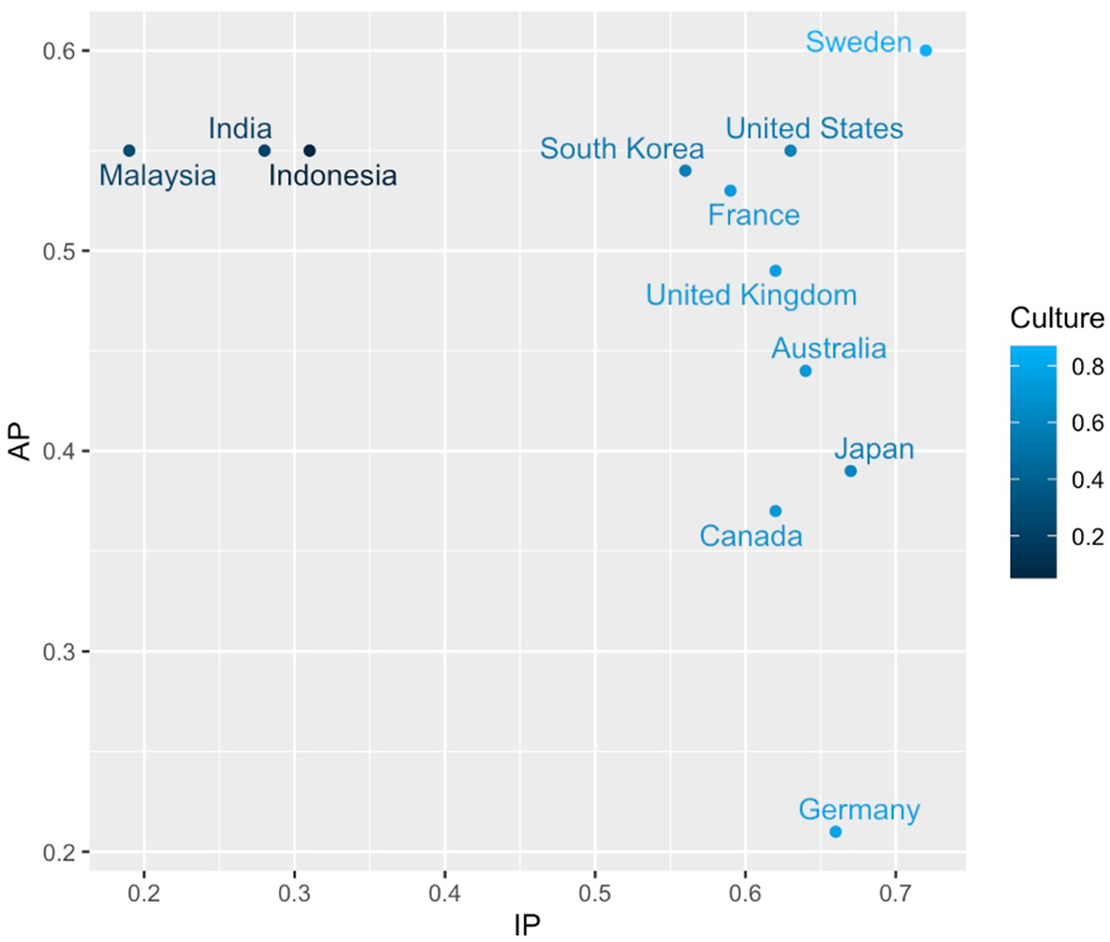
Affective Polarization
Ideological Polarization
Shin YA, Constantino SM, Gross LJ, Kinzig A, Lacasse K, Beckage B. Culture Mediates Climate Opinion Change: A System Dynamics Model of Risk Perception, Polarization, and Policy Effectiveness. Climate. 2025; 13(9):194. https://doi.org/10.3390/cli13090194

Slide 34
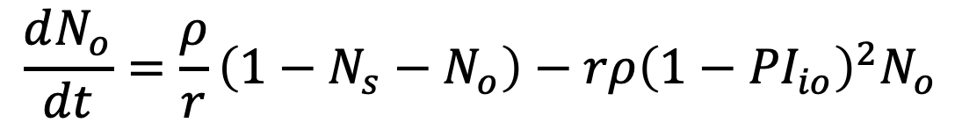
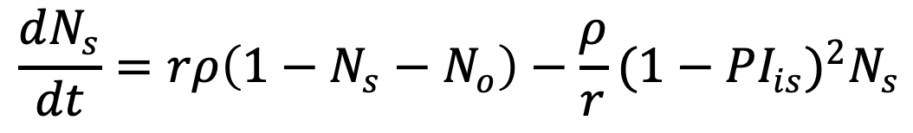
Model equations for perceived experience of extreme climate events and mitigation costs
$$\frac{dN_{s}}{dt}=rρ\left(1−N_{s}−N_{o}\right)−\frac{ρ}{r}{(1−{PI}_{is})}^{2}N_{s}$$
Flow into Support from Neutral due to greater concern about the impact of climate-related extreme events compared to mitigation cost − Flow out from Support to Neutral due to greater concern about mitigation cost compared to climate-related extreme events
$$\frac{dN_{o}}{dt}=\frac{ρ}{r}\left(1−N_{s}−N_{o}\right)−rρ{\left(1−{PI}_{io}\right)}^{2}N_{o}$$
Flow into Opposition from Neutral due to greater concern about mitigation cost compared to extreme events − Flow out from Opposition to Neutral due to greater concern about extreme events compared to mitigation cost
Shin YA, Constantino SM, Gross LJ, Kinzig A, Lacasse K, Beckage B. Culture Mediates Climate Opinion Change: A System Dynamics Model of Risk Perception, Polarization, and Policy Effectiveness. Climate. 2025; 13(9):194. https://doi.org/10.3390/cli13090194

Slide 35
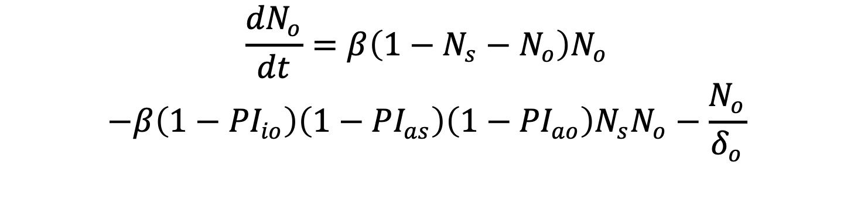

Model equations for social interactions
$$\frac{{dN}_{s}}{dt}=β\left(1−N_{s}−N_{o}\right)N_{s}−$$
$$β\left(1−{PI}_{is}\right)\left(1−{PI}_{as}\right)\left(1−{PI}_{ao}\right)N_{s}N_{o}−\frac{N_{s}}{δ_{s}}$$
Flow into Support from Neutral due to the interactions with the Support group − Flow out from
Support to Neutral due to social interactions with the Opposition group − Flow from Support to
Neutral based on the effectiveness of climate policy
$$\frac{{dN}_{o}}{dt}=β\left(1−N_{s}−N_{o}\right)N_{o}$$
$$−β\left(1−{PI}_{io}\right)\left(1−{PI}_{as}\right)\left(1−{PI}_{ao}\right)N_{s}N_{o}−\frac{N_{o}}{δ_{o}}$$
Flow into Opposition from Neutral due to the interactions with the Opposition group − Flow out from Opposition to Neutral due to the interactions with the Support group – Flow from Opposition to Neutral based on the effectiveness of fossil fuel policy
Shin YA, Constantino SM, Gross LJ, Kinzig A, Lacasse K, Beckage B. Culture Mediates Climate Opinion Change: A System Dynamics Model of Risk Perception, Polarization, and Policy Effectiveness. Climate. 2025; 13(9):194. https://doi.org/10.3390/cli13090194

Slide 36
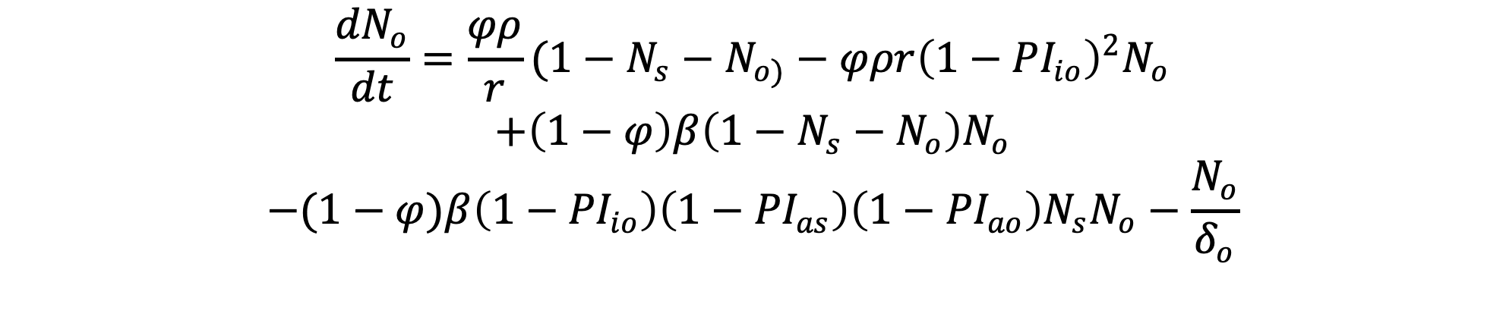
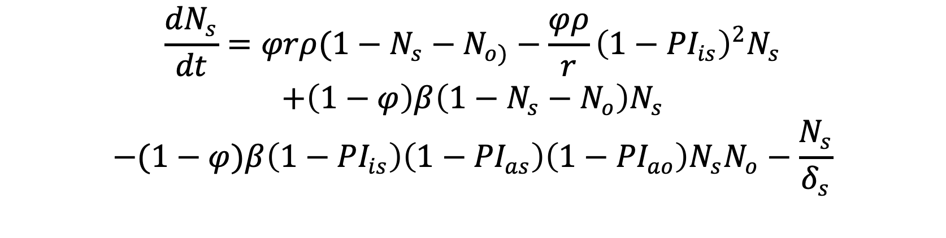
Combined model equations
$$\frac{{dN}_{s}}{dt}=φrρ(1−N_{s}−N_{o)}−\frac{φρ}{r}{\left(1−{PI}_{is}\right)}^{2}N_{s}$$
$$+\left(1−φ\right)β\left(1−N_{s}−N_{o}\right)N_{s}$$
$$−(1−φ)β\left(1−{PI}_{is}\right)\left(1−{PI}_{as}\right)\left(1−{PI}_{ao}\right)N_{s}N_{o}−\frac{N_{s}}{δ_{s}}$$
$$\frac{{dN}_{o}}{dt}=\frac{φρ}{r}(1−N_{s}−N_{o)}−φρr{\left(1−{PI}_{io}\right)}^{2}N_{o}$$
$$+\left(1−φ\right)β\left(1−N_{s}−N_{o}\right)N_{o}$$
$$−(1−φ)β\left(1−{PI}_{io}\right)\left(1−{PI}_{as}\right)\left(1−{PI}_{ao}\right)N_{s}N_{o}−\frac{N_{o}}{δ_{o}}$$
Shin YA, Constantino SM, Gross LJ, Kinzig A, Lacasse K, Beckage B. Culture Mediates Climate Opinion Change: A System Dynamics Model of Risk Perception, Polarization, and Policy Effectiveness. Climate. 2025; 13(9):194. https://doi.org/10.3390/cli13090194

Slide 37
Model Behavior
The model for just the risk perception components is linear with a globally stable equilibrium, while the model for just the social interactions and policy effectiveness is non-linear with several locally-stable equilibria none of which have all 3 opinion groups present. The combined model allows more diverse equilibria for which all 3 opinion groups can be present.
However our focus is not on long-term behavior. Rather we investigate whether there are situations in which an initial larger fraction of either support or opposition to climate mitigation can switch over relatively short time periods (20 years) and how this is affected by culture as measured by parameters for social polarization and collectivist vs. individualistic.

Slide 38
Model Analysis
We consider initial conditions in which the support or opposed group has highest population fraction and carry out a sensitivity and decision tree analysis across parameter space to determine conditions leading to an opinion shift.
Starting with an initial distribution of 35% Support, 40% Opposition, and 25% Neutral, if the Support group’s population exceeds both the Opposition and Neutral groups after 20 years, we call this a shift to Support, using a decision variable coded as ‘Ns.’ If either the Neutral or Opposition group’s population exceeds both the Support and the other group, it is coded as ‘Nn or No’. Likewise, if the initial condition is 40% Support, 35% Opposition, and 25% Neutral, and the opposition group exceeds both the Support and Neutral groups after 20 years, the outcome is coded as ‘No’. Otherwise, the outcome is coded as ‘Nn or Ns’.

Slide 39
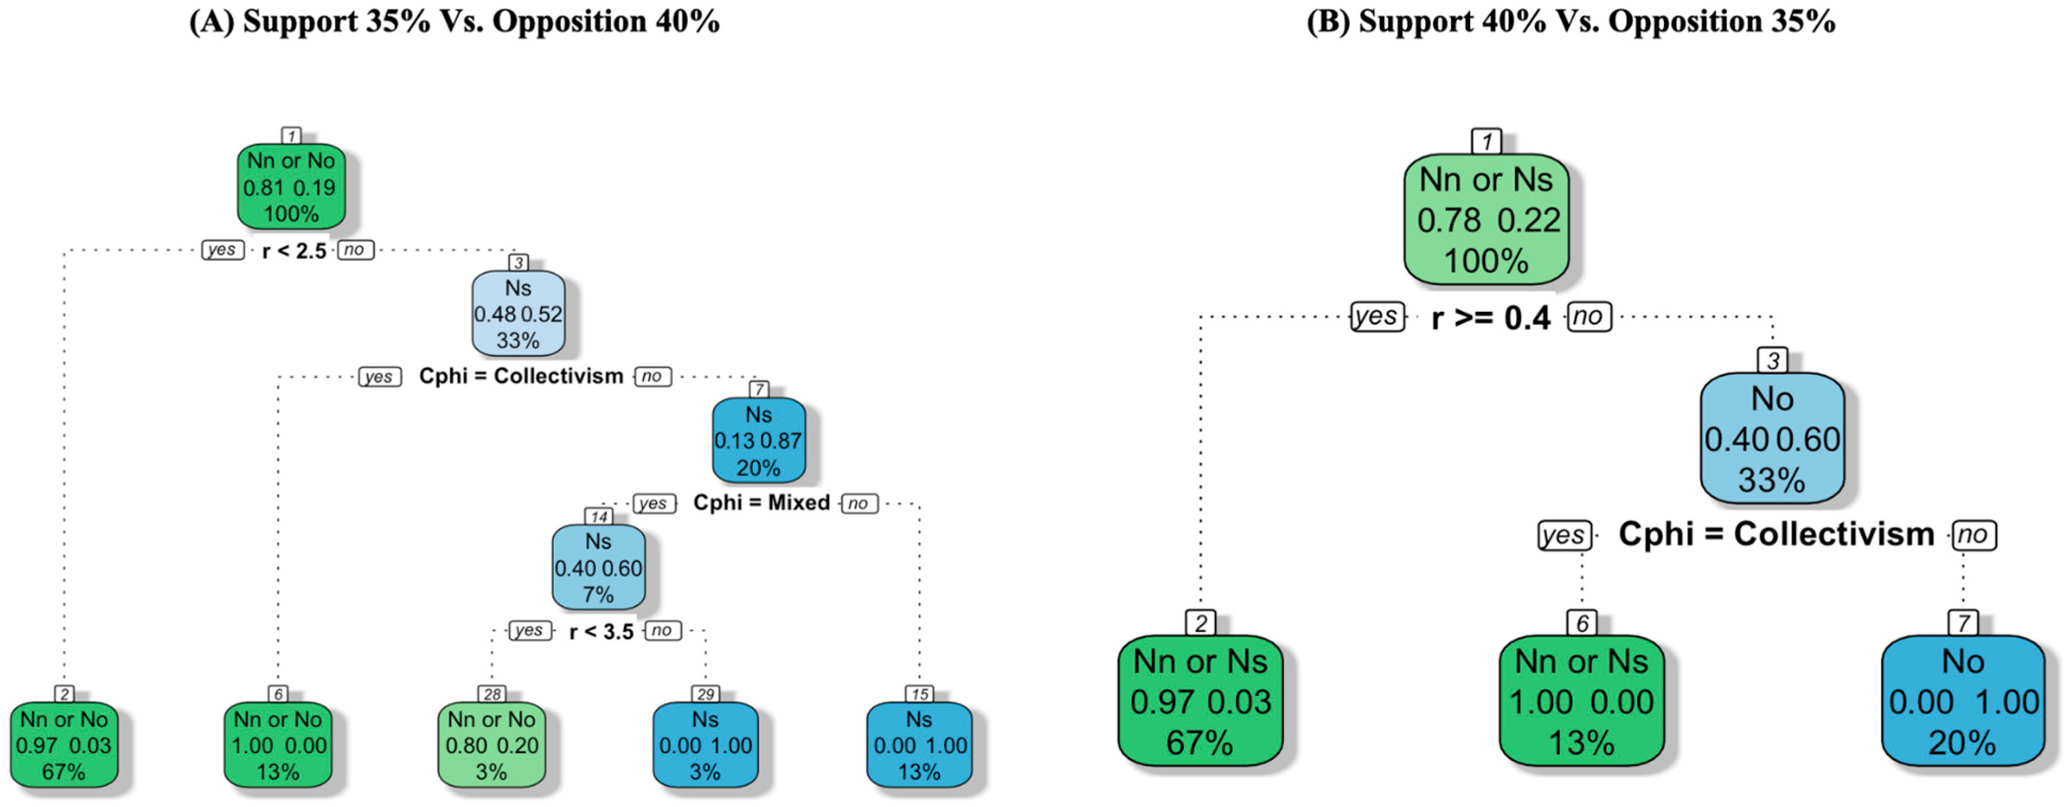
19% of simulations lead to a switch to support becoming dominant in 20 years
22% of simulations lead to a switch to opposition becoming dominant in 20 years
In both cases the relative risk perception (r) of perceived climate risk versus perceived economic costs of mitigation and the culture (collectivist vs. individualist) are the most important factors in determining the dominant opinion group after 20 years.

Slide 40
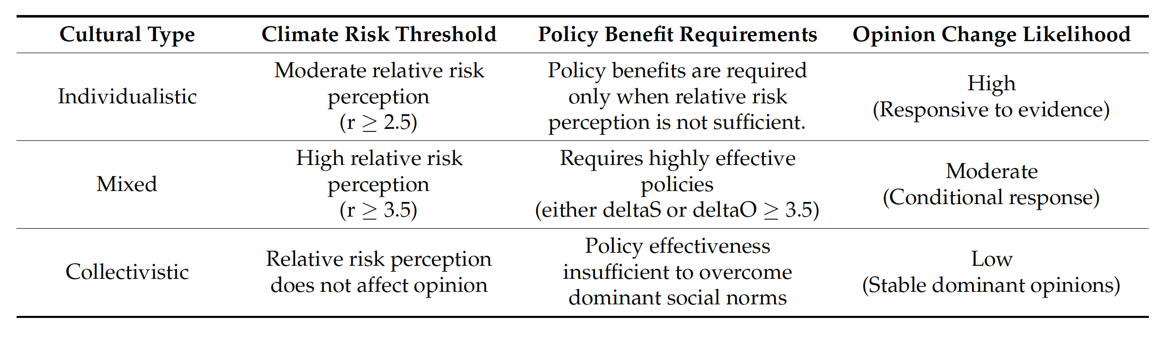
Results Summary
We find that shifts in dominant opinion are relatively rare, especially without
high levels of perceived climate risk (relative to economic risk) or effective policies. Even when perceived climate risks outweigh perceived economic risk and policies are effective (for the initially subdominant group), only 20% of model runs result in changes in opinion dominance. This aligns with previous social science observations that public opinion remains stable over time without strong external drivers. We also find that psychological factors and policy can influence opinion dynamics differently across cultural contexts. The Table provides a summary of the likelihood of changes in opinion dominance based on many simulations with different initial conditions.

Slide 41
Next Steps
Our model is limited in that it did not incorporate media
influences and misinformation. We also treat perceived climate risk and perceived economic risk as static throughout the 20 years of the model and did not allow for feedback between the dominant opinion group and policy effectiveness. Model qualitative evaluation would require longitudinal surveys to achieve a more comprehensive understanding of the social system
and its opinion dynamics.
A goal is to add a similar model for opinion dynamics to ongoing efforts on human behavior and infectious disease dynamics that accounts for cognition and risk perception.

Slide 42


Applying Risk and Behavior Concepts to Infectious Disease Modeling
Brian Beckage, Ari Freedman, Greta Savitsky, Laurent Hebert-Dufresne U of Vermont
Lou Gross, Suzanne Lenhart, Charles Sims, UTK
Katie Lacasse, Rhode Island College
Chadi Saad-Roy, U of British Columbia
Mathematical Modeling of Policy Options for Evolving Public Health Challenges NSF DMS-2436120

Slide 43
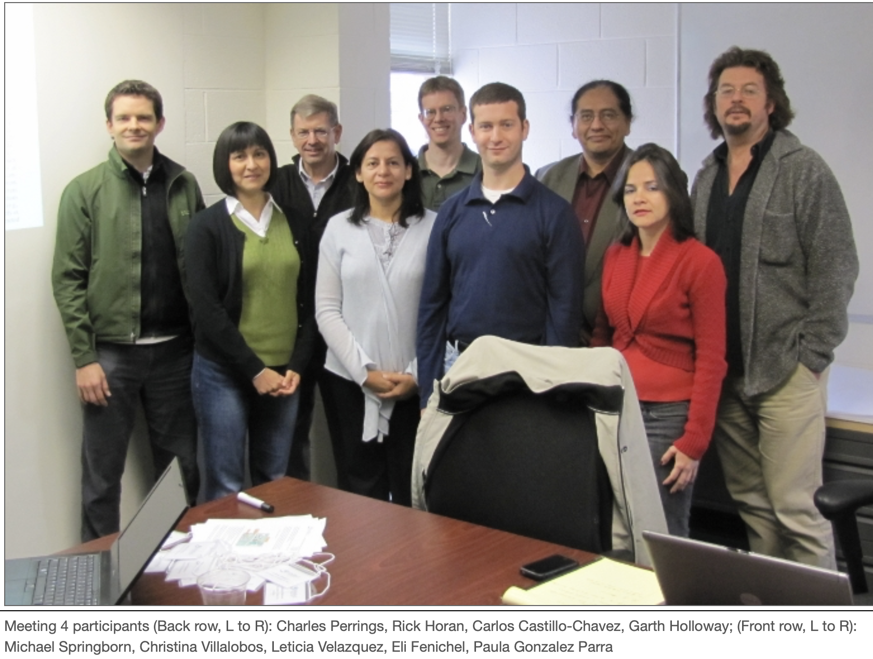
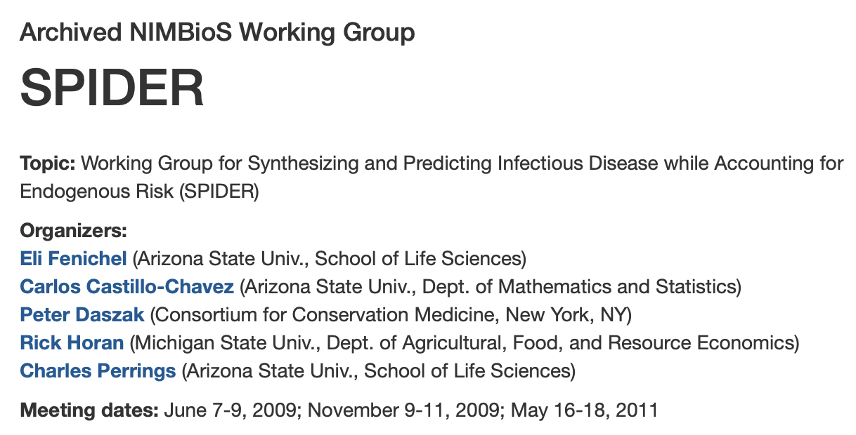
to successfully manage, predict, and develop surveillance strategies for new emerging diseases, it is imperative that the human decision making processes that influence disease risks are formally included in the decision process.

Slide 44
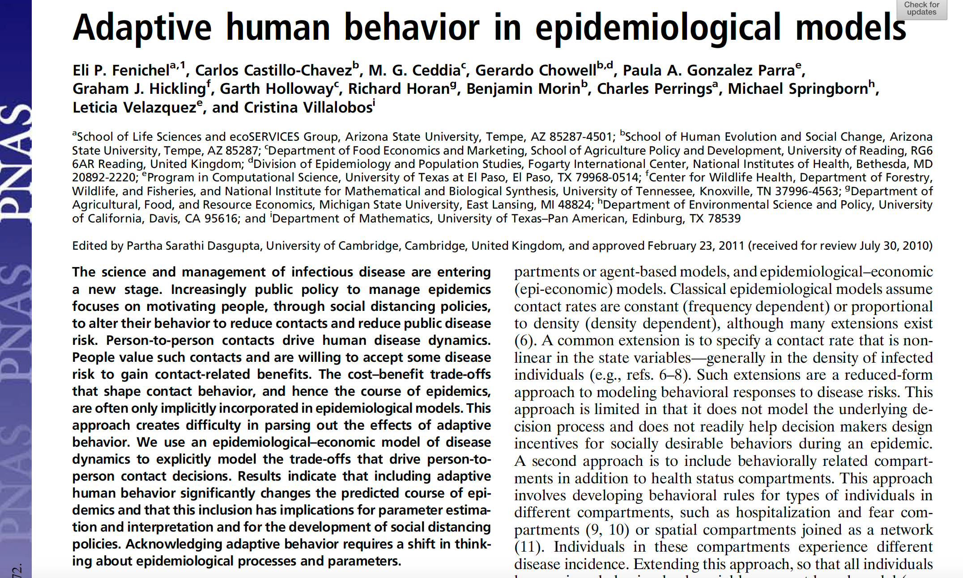

Slide 45
Overall Objective
We consider spread of a disease in which biological, human behavior and social factors impact the development and magnitude of an epidemic. Relatively few mathematical models for epidemics include linkages to human behavior and risk perception and the potential impacts of different regulatory/social policies. Our focus initially is on a single disease outbreak. We use SEIR extended to include dynamic variables for human risk perception and human behavior, and their feedbacks to disease components. The behavioral aspects represent the level of Non-Pharmaceutical Interventions being utilized in the human population. The risk perception impacts the behavior, and both affect the rate of testing.

Slide 46
SEIR Model with Quarantine (Isolated)

Slide 47
Model with Links to Risk Perception ( C) and Behavior (B)

Slide 48
Key Model Assumptions
Behavior affects disease transmission from I to S
Risk perception affects behavior (NPI use).
Infected individuals can be asymptomatic.
Individuals in the Quarantine class have been tested and are isolated - they are no longer able to spread the infection.
The rate of testing, and subsequently movement to Quarantine, depends upon the level of risk perception and NPI use.
Public policies affect different aspects of the disease, including
(i) policies can directly reduce transmission (school closings, implementation of HEPA filters) p₁
(ii) policies can impact testing rate (testing mandates) p₂
(iii) policies can impact risk perception (media and information programs) p₃
(iv) policies can impact NPI use (mask mandates) p₄

Slide 49
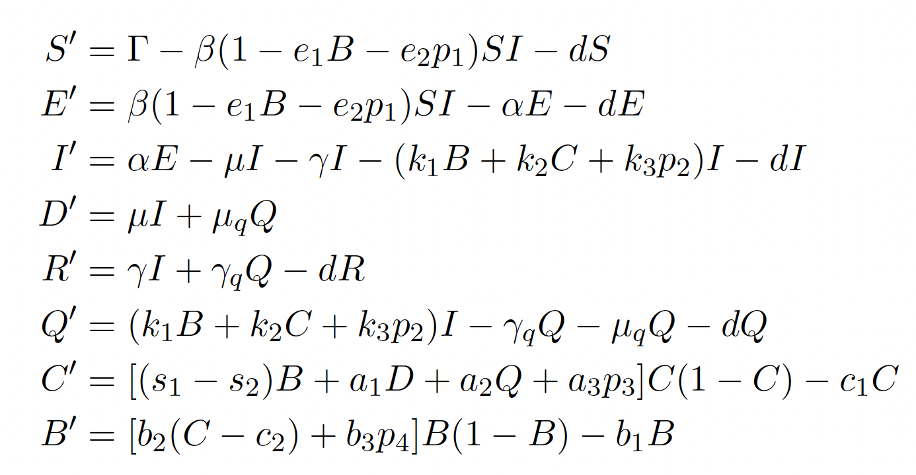
Model Equations
S = susceptibles, E = exposed (infected but not able to transmit), I = infected (able to transmit), D = cumulative number of deaths at time t, R = recovered (immune), Q = quarantine (confirmed cases from testing and isolated), C = cognition (risk perception),
B = behavior (NPI use).

Slide 50
Risk Perception and Behavior
Cognitive aspects of the model focus on Disease Risk Perception (C), representing how concerned or worried people are about the disease on a scale from 0-1.
Higher risk perception (C) implies it is more likely to carry out Behavior (B) that reduces disease transmission.
Behavior (B) is defined as the level of use of non-pharmaceutical interventions (NPIs) that reduce disease transmission, including actions such as mask-wearing, social distancing, or hand washing.
Behavior does not represent medical actions (vaccine uptake before infection, taking medicine if infected).
B and C affect the rate of testing and movement to quarantine.

Slide 51
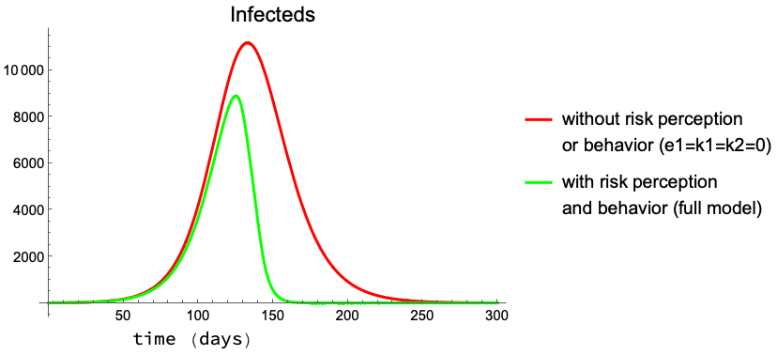
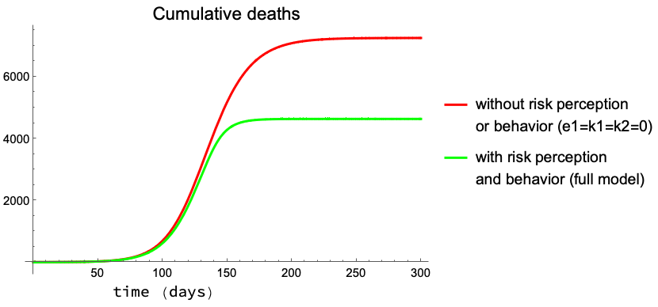
Risk Perception and Behavior Impact

Slide 52
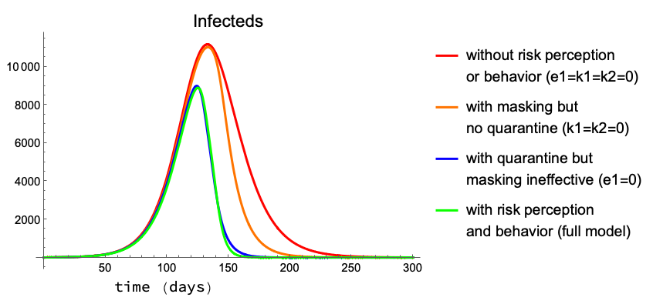
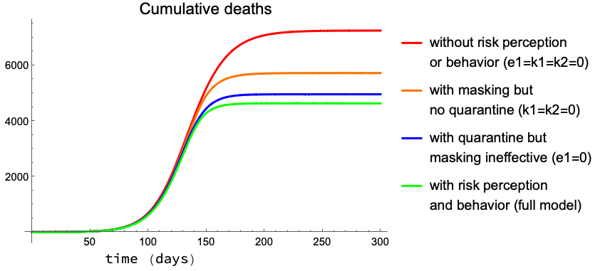
Impact of factors on infected and deaths

Slide 53
Summary of Initial Results
1. Establishing a general framework for considering interactions between policy, risk perception, behavior, and disease dynamics requires multiple assumptions about the feedbacks between social and cognitive processes, for which there are not extensive data or agreement among social scientists.
2. The initial model assumes behaviors (e.g. NPI use) are driven by risk perception, thus delaying the impacts of behavior on disease progression.
3. There is a hierarchy of parameters which affect disease size, e.g. the parameter for the impact of quarantines on risk perception has less effect than the parameter for the impact of total deaths on risk perception.

Slide 54
Ongoing Extensions
1. Incorporating memory effects on risk perception, with the rate of change of risk perception depending only on recent deaths and recent levels of quarantine.
2. Considering impacts on disease dynamics of alternative timing of policies acting at different levels of the social/behavioral processes.
3. Considering longer-term impacts of risk perception and behavior for diseases with multiple outbreaks.

