Slide 1
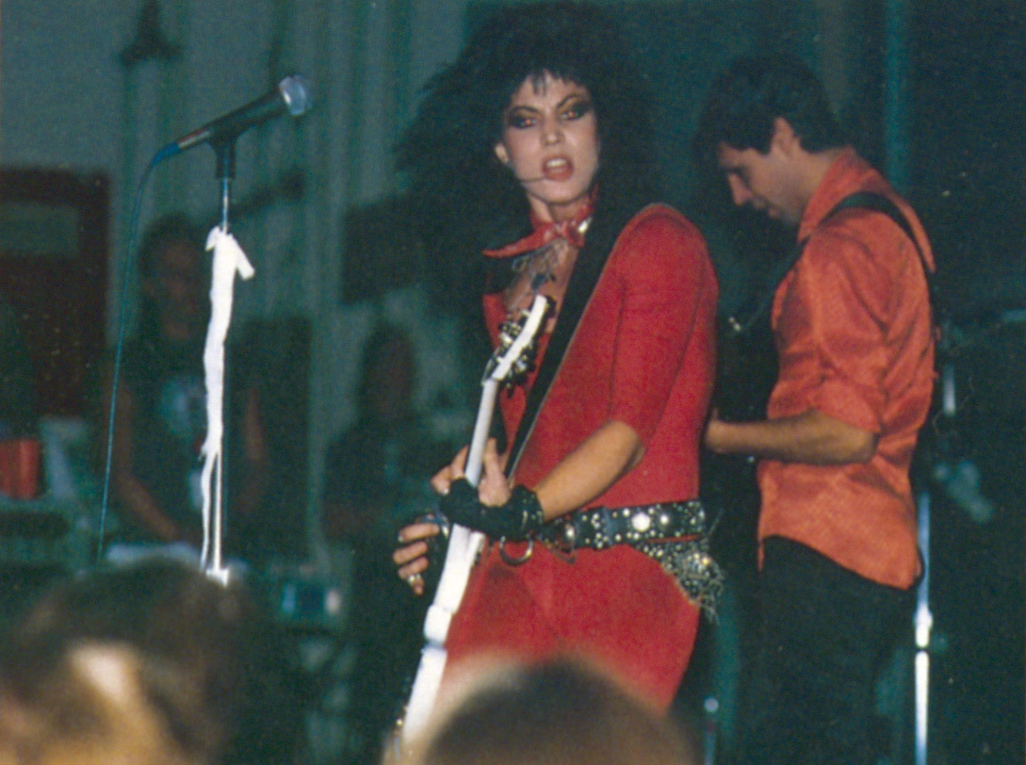

Joan Jett and the Blackhearts performed in UTK Alumni Gym for Homecoming 1981
Bad Reputation is a documentary film about Joan Jett (released 2018). Joan and the Blackhearts were inducted into the Rock and Roll Hall of Fame in 2015 and you can find more about her at joanjett.com

Slide 2




Drugs, Sex, Rock n’ Roll and a Rational Basis for Hope: What’s Math got to do with it?
Louis J. Gross
National Institute for Mathematical and Biological Synthesis
Departments of Ecology and Evolutionary Biology and Mathematics
University of Tennessee, Knoxville

Slide 3
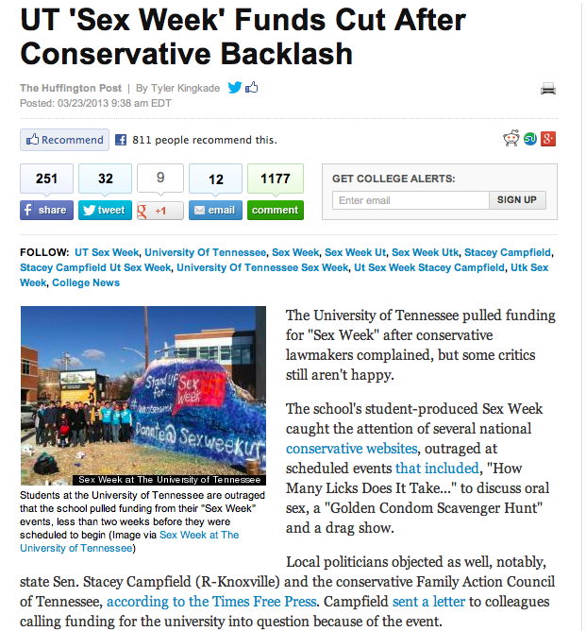

Slide 4

269 page report from Comptroller in 2018 for TN Legislature

Slide 5
What were the implications of “Sex Week” and responses to it for students?
Students pay a program fee every term (the Student Program and Services fee - $418 per semester), but due to the response of UT to legislature complaints about Sex Week, students no longer have authority to choose and manage programs supported by their own fees. Unlike students at every other SEC school, UTK students do not determine how their fees are expended on programs, nor to learn from practice about managing such programs.

Slide 6
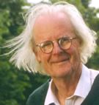
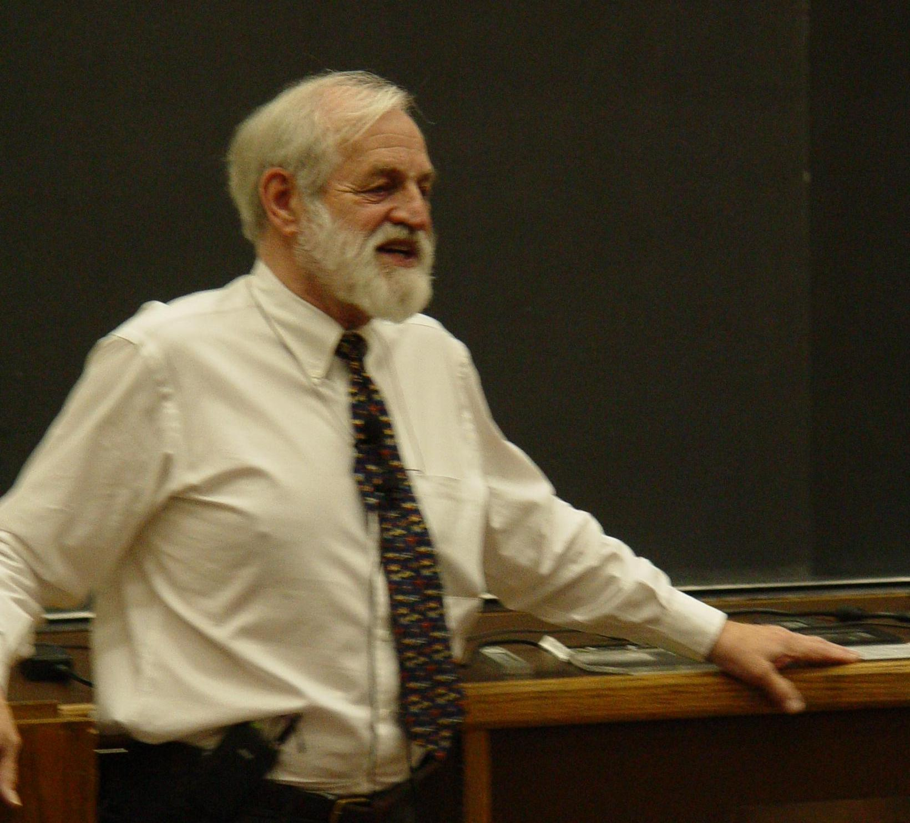


Math and Sex
A long-standing question in evolutionary biology is “why is sexual reproduction so prevalent?”
The Mathematics of Marriage - can we
predict whether a marriage will last?
As one component of the “nature/nuture” controversy, is there evidence that the dearth of women in math-intensive fields in the US arises due to differences in innate ability?
John Maynard Smith
James Murray
Kristin Swanson

Slide 7
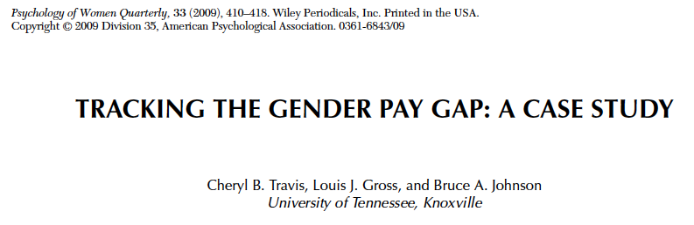
Math and Sex
Gender inequity in salary – resampling statistics and a virtual university with gender equity
For the latest reports see the UTK Faculty Senate Budget and Planning Committee Website

Slide 8

Math and Sex
Gender bias in rating professors
benschmidt.org/profGender

Slide 9
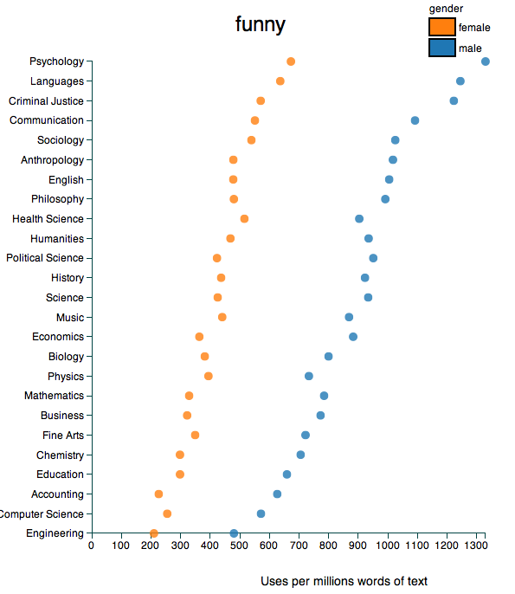
Math and Sex
Gender bias in rating professors
benschmidt.org/profGender

Slide 10
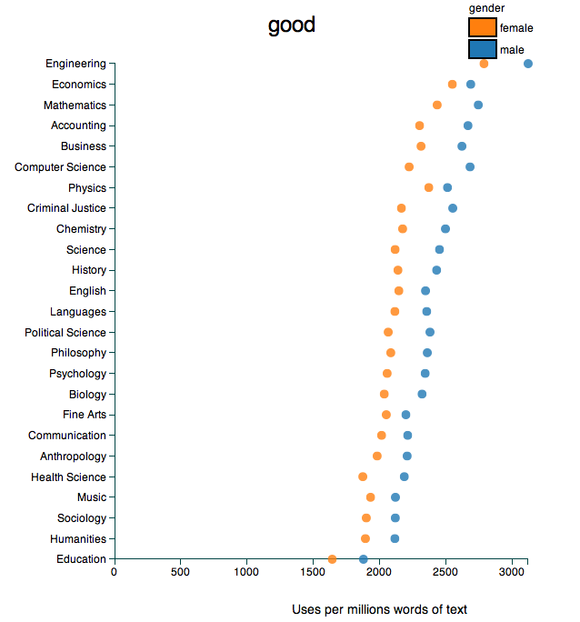
Math and Sex
Gender bias in rating professors
benschmidt.org/profGender

Slide 11
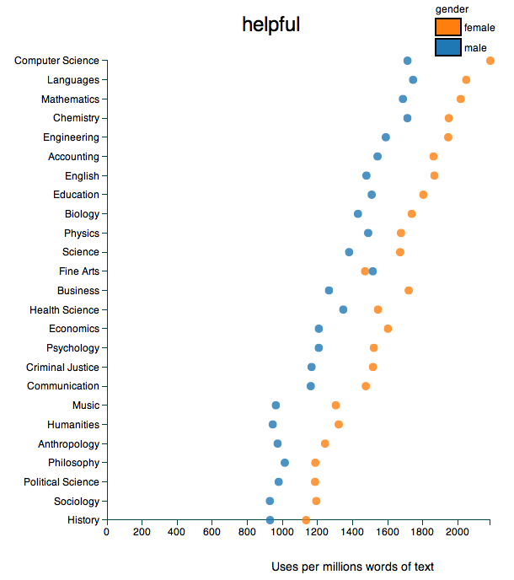
Math and Sex
Gender bias in rating professors
benschmidt.org/profGender

Slide 12
Overview
Science, Models and Complexity
Drugs and math
It’s all Rock-and-Roll to me
Climate change and a rational basis for hope

Slide 13
What is science?
Science is thought to be a process of pure reductionism, taking the meaning out of mystery, explaining everything away, concentrating all our attention on measuring things and counting them up. It is not like this at all. The scientific method is guesswork, the making up of stories. The difference between this and other imaginative works of the human mind is that science is then obliged to find out whether the guesses are correct, the stories true. Curiosity drives the enterprise, and the open acknowledgement of ignorance.
Lewis Thomas - Sierra Club Bulletin, March/April 1982, P. 52
Models
Data

Slide 14
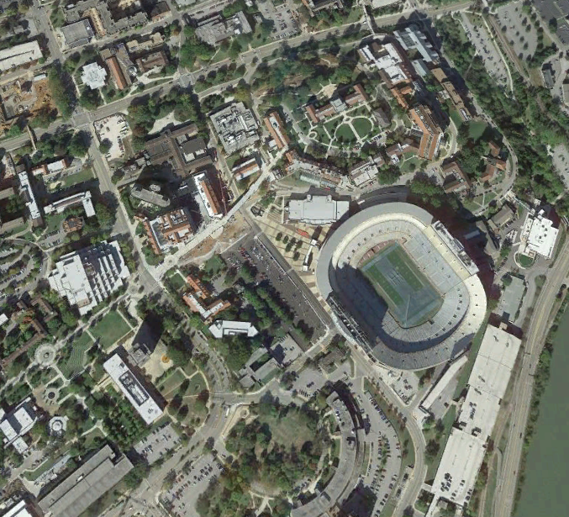
The “stories” in science are models
A model is a simplification of reality. Think of it as a map - it includes some features that represent what we observe but not others. Modeling is the process of selective ignorance - we select what to include and what to ignore.

Slide 15

You make models all the time:
What decision do you make when faced with::

Slide 16
An example from your experience
What factors should be considered in determining a “best” drug to treat a particular ailment?
Given that you have information on the basic factors affecting drug treatment options, what criteria do you use to decide the “best” treatment option?
Once you have chosen a criteria for what is “best” how do you determine the best treatment schedule?

Slide 17
Drug Dosage Scheduling
Pharmacokinetics - study of uptake, metabolism and loss of drugs in an organism
The math starts from simple exponential decay models, expands to hybrid models for decay and discrete doses, then moves to coupled ODEs for movement of drug between tissue compartments, and control techniques to determine optimal dosing methods.
Pharmacogenomics - study of how genetics of an individual affects pharmacokinetics
An active area of current research, involving models for genetic regulation of biochemical and physiological responses to single and multiple drugs. How do an individual’s genetics and physiological state impact the pharmacokinetics of single and multiple drugs?

Slide 18
Basic Pharmacokinetics Model
If an initial amount of drug, b mg, is introduced into the body, the amount of drug in the body diminishes exponentially so after t hours the amount of drug is
If an additional dose of b mg is given every τ hours and x_{n} is the amount of drug in the body just after n^{th} dose is given, then if
solving this gives

Slide 19
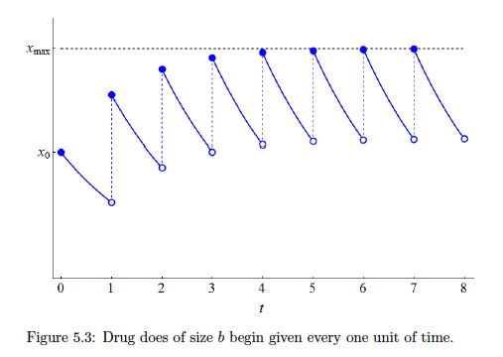
Dynamics of Drug in Body for a Dose Taken Periodically

Slide 20
Basic Pharmacokinetics Model
After a long time we find
If there is a harmful level of the drug, we can choose either the dose level b or the time between doses τ so that this harmful level is never reached
So there is no single “best” treatment schedule if the objective is just to stay below harmful level

Slide 21
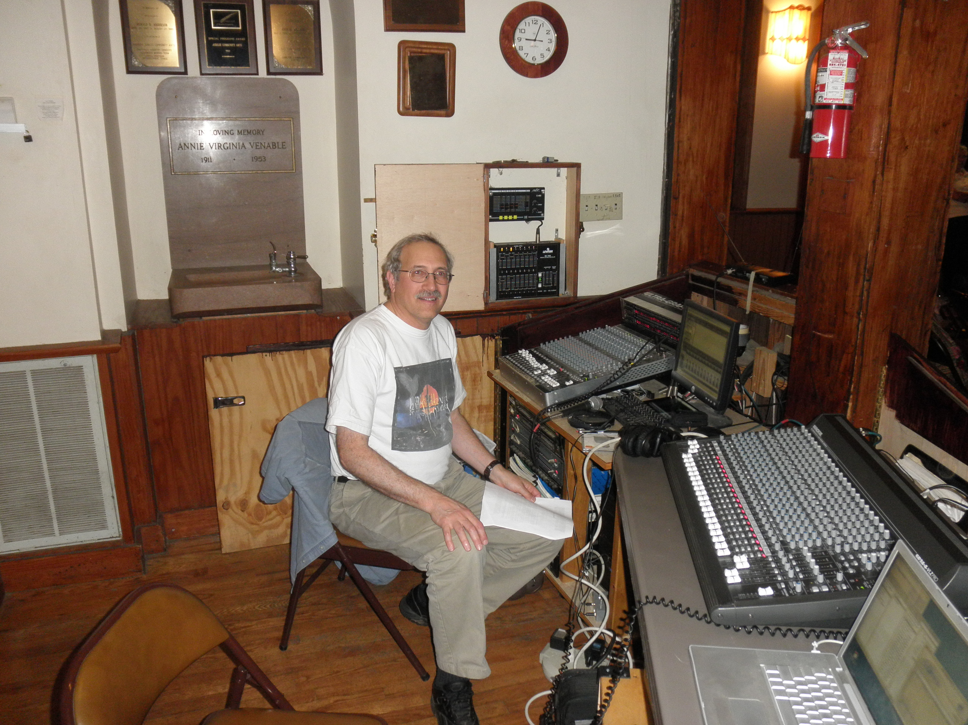
As Sound Engineer at the Laurel Theater

Slide 22
Math Biology and Rock n’ Roll
Music is ubiquitous and part of everyday experience for folks of all ages. How can we use this experience and interest to illustrate some basic (and advanced) mathematics?
Sound: What is it? How do we perceive it? What are its characteristics? How do we measure it? How does a concert arise from its component instruments? What can go wrong?

Slide 23
Math Biology and Rock n’ Roll
At any rock concert, there is a transformation of electrical signals from the pick-ups and mics through mixing devices and filters to the amplifiers and speakers. How does this work and what makes a good concert?
Sound is all about Fourier analysis in which trig functions are transformed, summed and filtered - doing this effectively is a multiple criteria optimization problem with many, many degrees of freedom and differing opinions as to what is “best”.

Slide 24
Sound – Measuring it
Sound arises due to changes in air pressure perceived by our ear – it is changes that we perceive, not absolute values, so we need a relative metric – use log scaling compared to a reference (lowest perceivable sound pressure)
The measure in deciBels (dB) of A to a reference level R is
So a doubling of a signal corresponds to an increase in this metric of 3dB since log(2) =3 approximately and a 10-fold signal increase corresponds to a 10 dB change

Slide 25
Sound – Measuring it
The level of sound - PL or pressure level is in Pascals, but we typically use SPL as a relative measure of intensity compared to lowest audible sound and since this depends upon the square of the pressure the dB is measured as
Here the p’s are pressures and the L is measuring the relative changes in sound intensity which is a power measure (Watts per m²)

Slide 26
Sound – Measuring it
In addition to the level of sound though, sound is made up of components at different frequencies and complex sounds are linear combinations of these oscillations – that is complex sounds are made up of sums of trig functions – a Fourier series. We measure the components by considering the fraction of the total power in the sound at different frequencies – the power spectrum – a Fourier transform (using FFT) of the pressure.

Slide 27
OSHA Regulations (Standards - 29 CFR)
Occupational noise exposure. - 1910.95
http://www.osha-slc.gov/OshStd_data/1910_0095.html
If the variations in noise level involve maxima at intervals of 1 second or
less, it is to be considered continuous.
TABLE G-16 - PERMISSIBLE NOISE EXPOSURES (1)
______________________________________________________________
|
Duration per day, hours | Sound level dBA slow response
____________________________|_________________________________
|
8...........................| 90
6...........................| 92
4...........................| 95
3...........................| 97
2...........................| 100
1 1/2 ......................| 102
1...........................| 105
1/2 ........................| 110
1/4 or less................| 115
____________________________|________________________________
Footnote(1) When the daily noise exposure is composed of two or
more periods of noise exposure of different levels, their combined
effect should be considered, rather than the individual effect of
each. If the sum of the following fractions: C(1)/T(1) + C(2)/T(2)+…+
C(n)/T(n) exceeds unity, then, the mixed exposure should be
considered to exceed the limit value. Cn indicates the total time of
exposure at a specified noise level, and Tn indicates the total time
of exposure permitted at that level. Exposure to impulsive or impact
noise should not exceed 140 dB peak sound pressure level.

Slide 28
Sound – Measuring it
There are a few standard forms of the power spectrum. An octave corresponds to a doubling (or halving) of a frequency and Pink noise corresponds to equal power in each octave, White noise to equal power at all frequencies.
So a = 0 is white noise, a = 1 is pink noise, a = 2 is Brownian noise. Pink noise occurs in many contexts, not just sound.

Slide 29


Slide 30
Sound – problems
You have all been in situations with what is colloqually called “feedback”. This is an example in everyday experience of positive feedback
x
y
The solutions to this linear system can readily be calculated based upon the eigenvalues of the RHS matrix when written in vector form.

Slide 31
Positive Feedback in Biology
Onset of contractions in childbirth (Ferguson reflex – oxytocin stimulates further contractions)
Process of blood clotting (platelets activate more platelets)
Lactation (the more the baby suckles, the more milk is produced, via a surge in prolactin)
Nerve action potential - slight leakage of sodium ions through sodium channels, resulting in a change in the membrane potential, which in turn causes more opening of channels, and a rapid increase in sodium leakage.
Evolutionary arms races (red queen hypothesis)

Slide 32
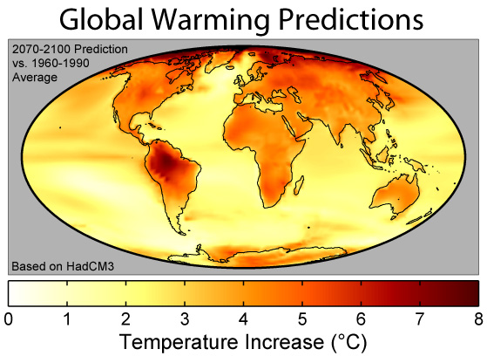
Is there a Rational Basis for Hope regarding Climate Change?
https://commons.wikimedia.org/wiki/File:Global_Warming_Predictions_Map.jpg

Slide 33
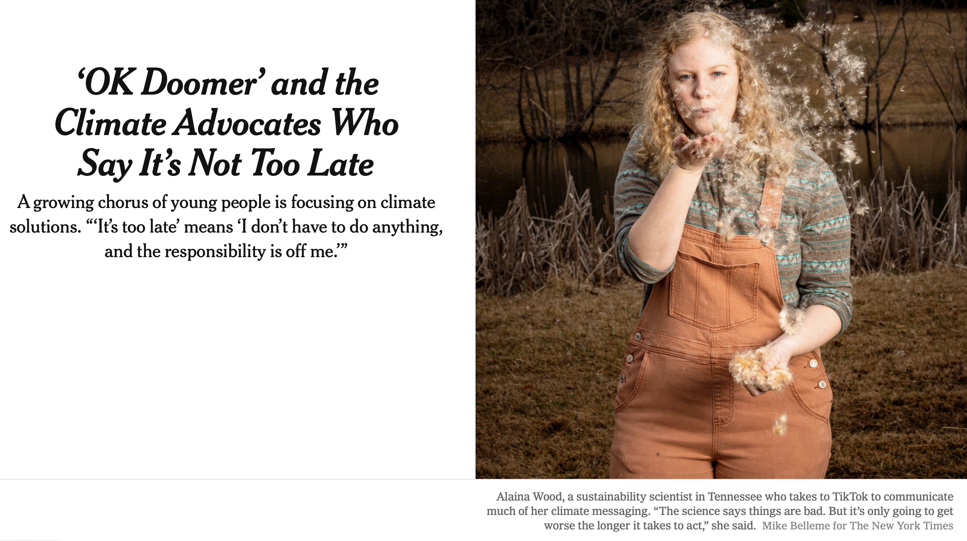
New York Times March 22, 2022

Slide 34
Human activities are interconnected with earth systems and associated projections for future climate. Our objective is to consider how human risk perception and behaviors arising from this might impact and interact with climate change.
Of particular interest is whether the potential feedbacks from human systems are sufficient to significantly, in some appropriate metric, push earth system response to a different state. That is, are there circumstances in which risk perception, perhaps arising from major events, shifts in a manner that causes behavioral changes and policy responses that could measurably impact future climate?

Slide 35
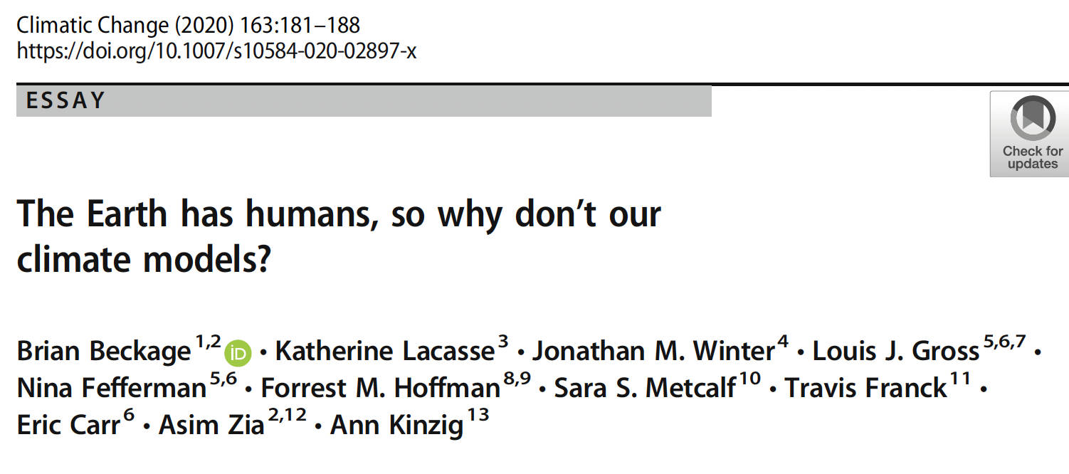
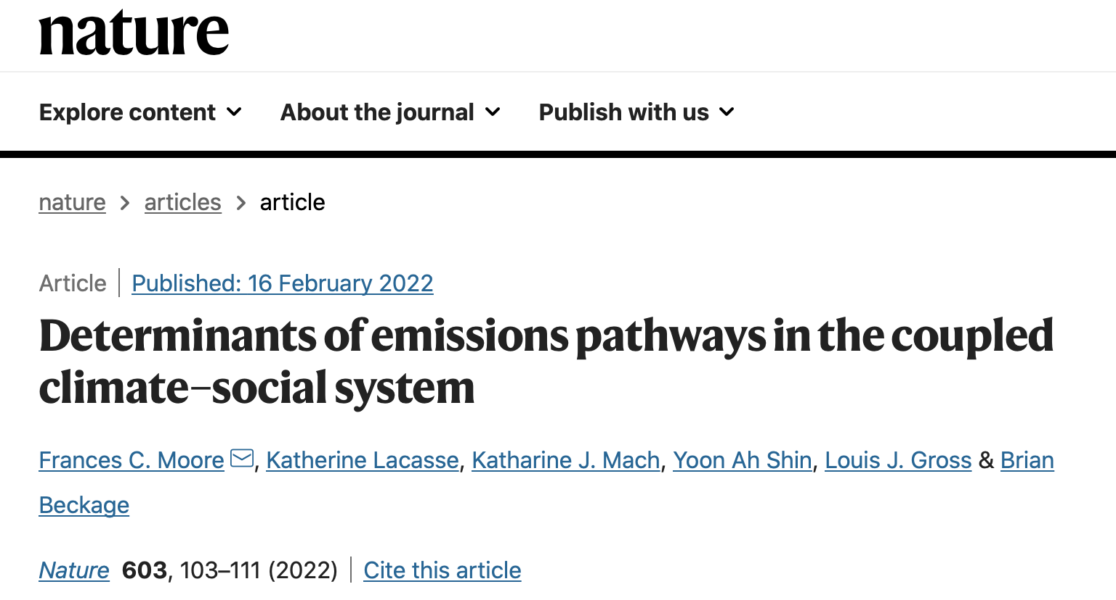

Slide 36
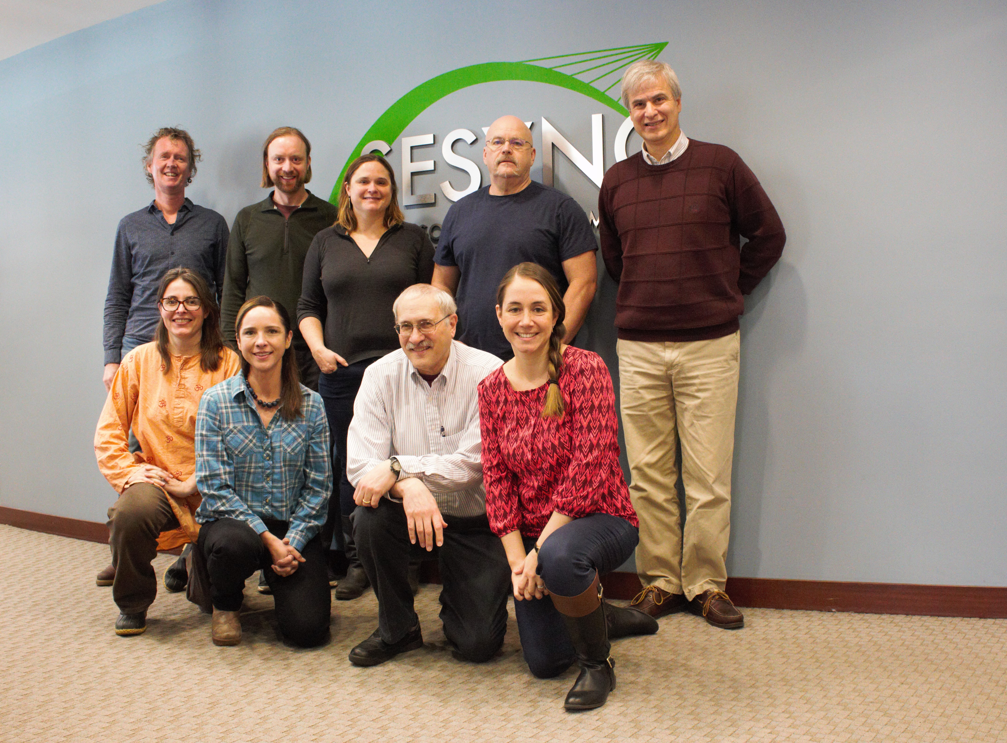
SESYNC Theme: Putting People into Climate Models
Sara Metcalf, University at Buffalo
Louis Gross, University of Tennessee
Wander Jager, University of Groningen
Katharine Mach, University of Miami
Fran Moore, University of California, Davis
Travis Franck, Climate Interactive
Karim Chichakly, Worcester Polytechnic Institute
Dale Rothman, George Mason University
Ann Kinzig, Arizona State University
Supported by NSF Award DBI-1052875 to SESYNC

Slide 37
CSM (Climate Social Model)
Beckage, B., L. J. Gross, K. Lacasse, E. Carr, S. S. Metcalf, J. M. Winter, P. D. Howe, N. Fefferman, T. Franck, A. Zia, A. Kinzig and F. M. Hoffman. 2018. Linking models of human behavior and climate alters projected climate change. Nature Climate Change 8, 79–85

Slide 38
Model dynamics of change in global temperature from preindustrial under different model assumptions

Slide 39
Conclusions from the CSM integration
1. Integrated human behavioral and climate model resulted in a global temperature change ranging from 3.4–6.2 ºC by 2100 compared with 4.9 ºC for the C-ROADS model alone.
2. Cumulative, infrastructural change significantly reduced future climate change. Non-cumulative, short-term behaviors (adjusting thermostats, limiting mileage driven) had much smaller impacts on the future temperature trajectory.

Slide 40
Conclusions from the CSM Integration
3. Magnitude of behavioral uncertainty in mean global temperature in 2100 (2.8 ºC) was similar to physical uncertainty (climate sensitivity) (3.5 ºC).
4. Social components with largest influence: Functional form of response to extreme events and interaction of perceived behavioral control with perceived social norm.
5. Attribution of extreme events to climate change and infrastructural mitigation may most reduce climate change.

Slide 41
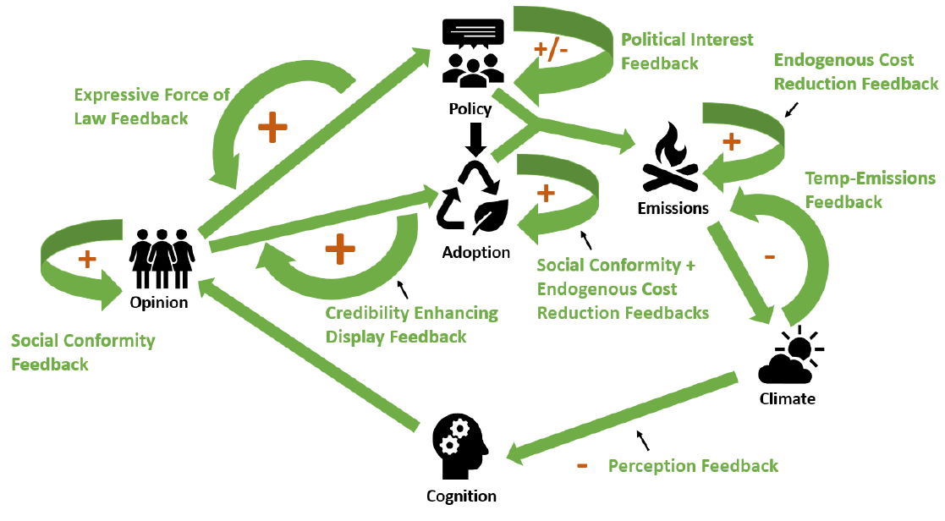
Components and feedbacks in the coupled climate-social system

Slide 42
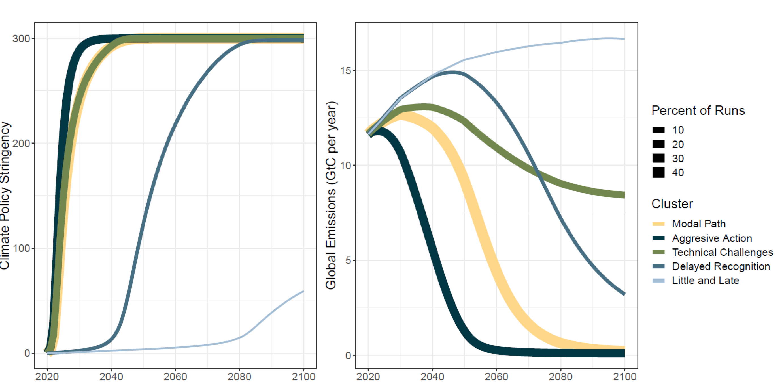
Policy (left) and global CO2 emissions (right) trajectories from 100,000 Monte Carlo runs of the model, clustered into 5 clusters using k-means clustering. The line thickness corresponds to the size of the cluster.

Slide 43
Global temperature conclusions
Despite parameter uncertainties, none of the policy–emissions clusters identified represent a pure business-as-usual world without climate policy. Even the highest-emission cluster produces warming in 2100 that is lower than the RCP7 business-as-usual baseline of 3.9 °C. The vast majority of runs (98%) produce warming of more than half a degree lower
Identified emissions trajectories, even the aggressive action scenario, fail to meet the more ambitious Paris Agreement target of limiting warming to 1.5 °C above pre-industrial levels.
We estimate a substantial probability of meeting the 2 °C Paris Agreement target—28% of our Monte Carlo runs result in 2091–2100 warming below 2 °C above 1880–1910 levels.

Slide 44
In Sum
There is some rational basis for hope
This hope is based upon results from multiple models
Climate models have had a huge impact on the ability to project global trajectories, and assess the potential impacts of policies.
Next steps will require us to not fear the linkage to social dynamics and work to overcome the barriers to incorporating human behavior into climate models.

Slide 45
Lessons from Math Biology
Math serves to integrate science
As more and more reductionist-based data become available, the relative importance of mathematical methods to succinctly summarize large numbers of studies will increase. Math provides the framework to link together the variety of disciplines involved in any major scientific research project, allowing for not just a more common language, but a means to effectively collaborate and link the theoretical underpinnings of diverse fields together.

Slide 46
Math bio is a very viable career option for a diverse array of quantitatively strong researchers, as well as providing a means for those formally educated in mathematics to apply their expertise to advance interdisciplinary science
There are multiple routes to success and lots of examples of individuals who have explored some of these routes, but many routes yet remain to be discovered.

Slide 47

Be fierce about interdisciplinary research and educational goals, and keep on track

