Slide 1
NIMBioS: A Nurturing Environment for
Interdisciplinary Science
Overview of an NSF Synthesis Center
2008-2021
Louis J. Gross
Chancellor’s Professor Emeritus of Ecology and Evolutionary Biology and Mathematics
University of Tennessee - Knoxville
NIMBioS Director 2008-2015, 2017-2021
NSF Awards DBI-1300426, EF-0832858 legacy.nimbios.org

Slide 2
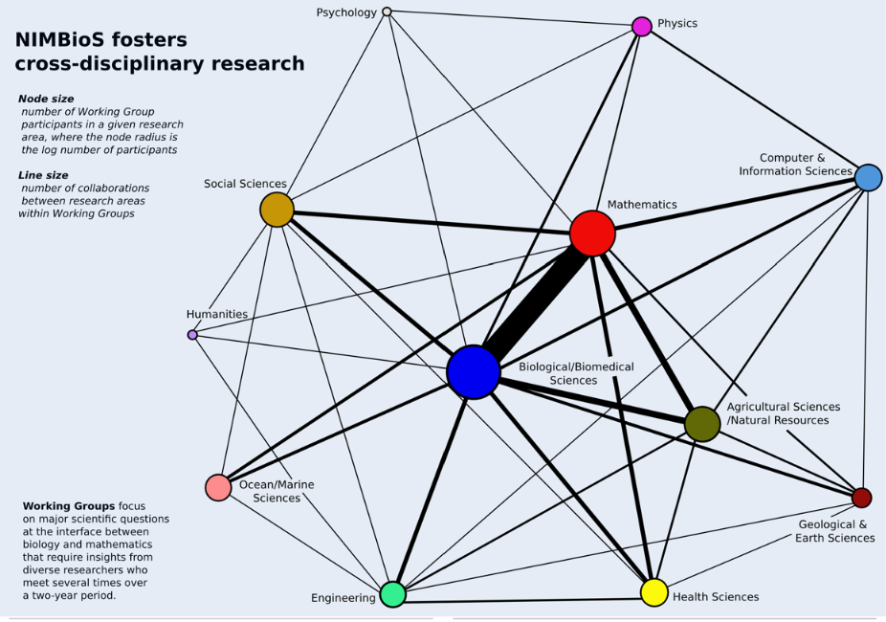
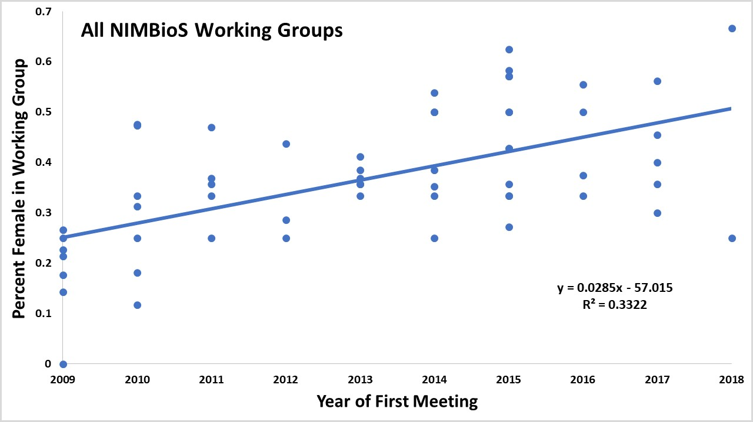
NIMBioS: A Nurturing Environment for
Interdisciplinary Science
NIMBioS supported:
58 Working Groups (184 meetings)
53 Investigative Workshops
52 Postdoctoral Fellows
439 Short-term Visitors
17 Sabbatical Fellows
250+ Educational Activities
9900+ Participants from 56 countries
400+ Videos
Activities led to 1000+ peer-reviewed journal articles, many in high-impact journals, arising from the networks of connections fostered
Evaluation emphasized throughout all aspects

Slide 3
NIMBioS: What we are most proud of:
Innovative, productive interdisciplinary research

Slide 4
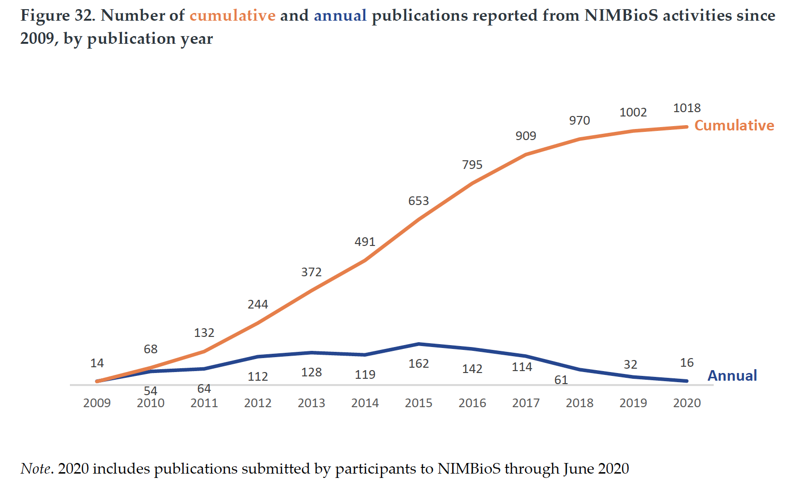

Slide 5
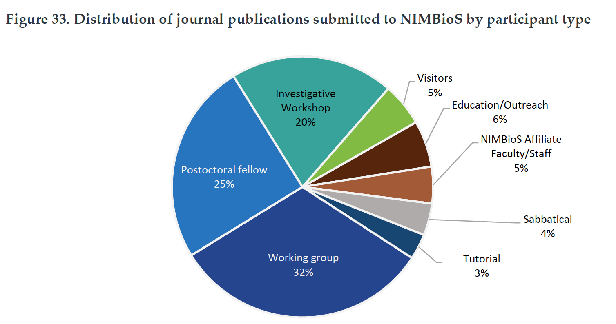
Each of our main sets of activities contributed significantly to new research and scholarly activity

Slide 6
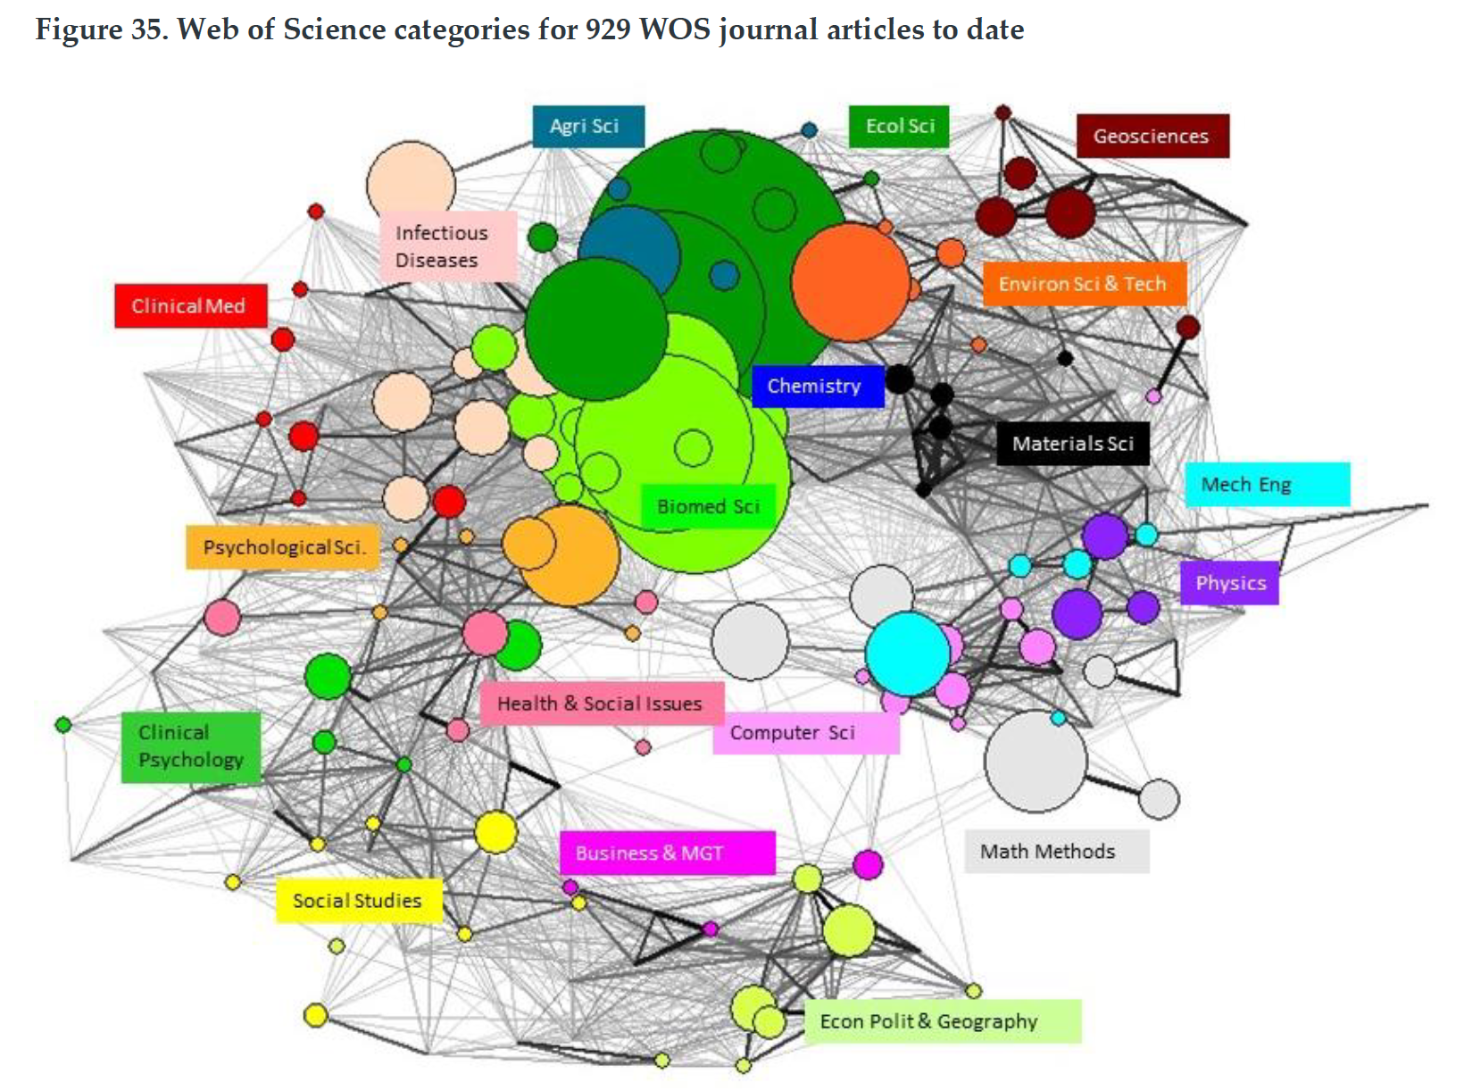
Publications spanned hosts of disciplines

Slide 7
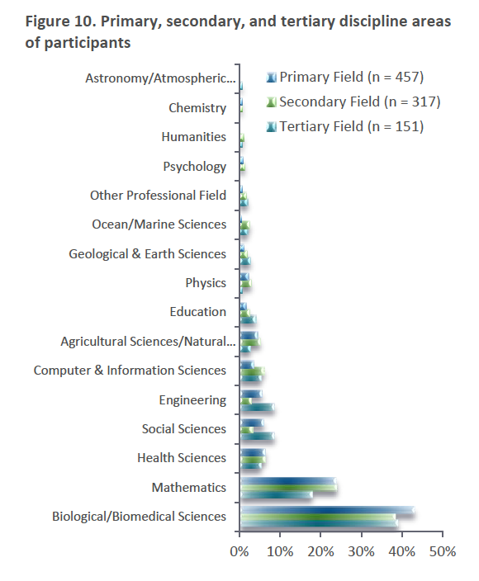
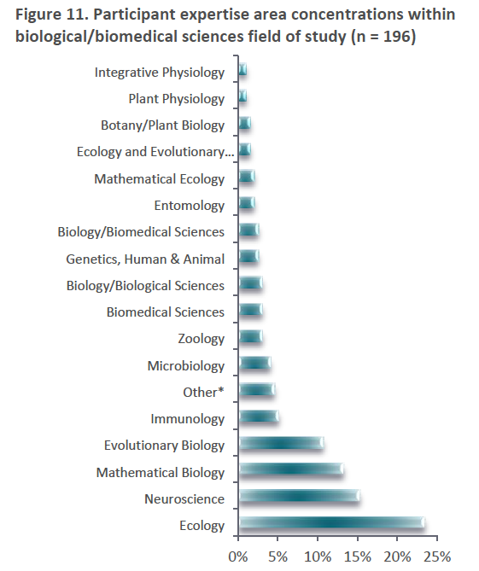
NIMBioS as a Nurturing Environment for Interdisciplinary Science

Slide 8
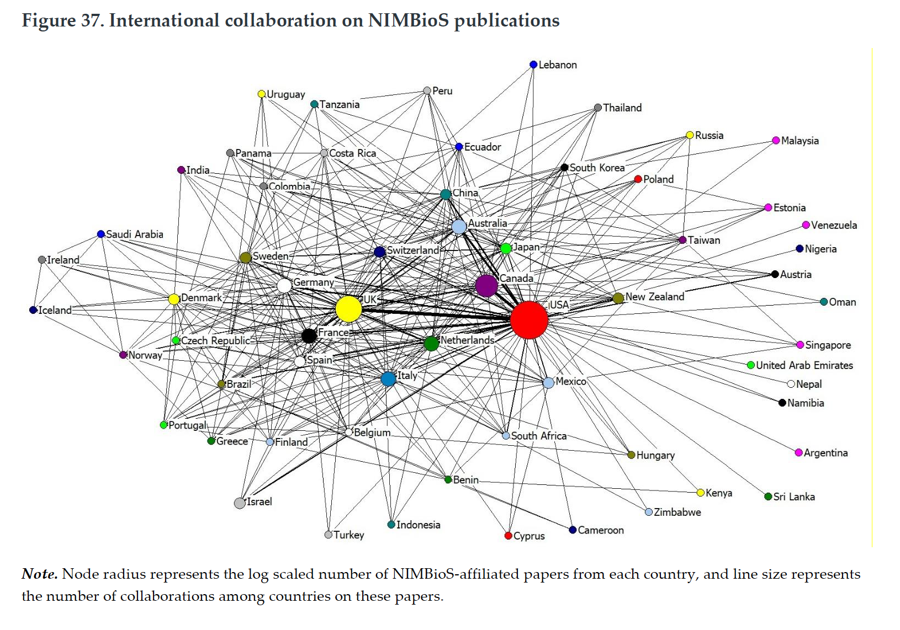

Slide 9
NIMBioS: What we are most proud of:
Innovative, productive interdisciplinary research
Transparency and evaluation emphasized throughout all activities

Slide 10
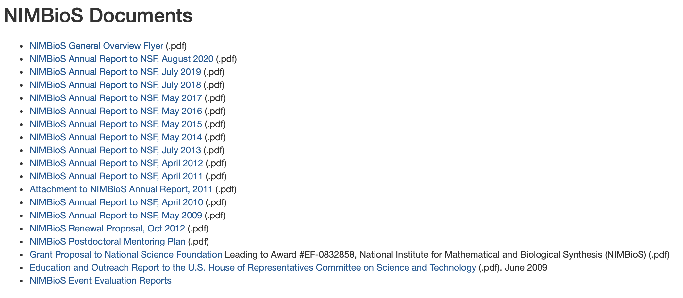
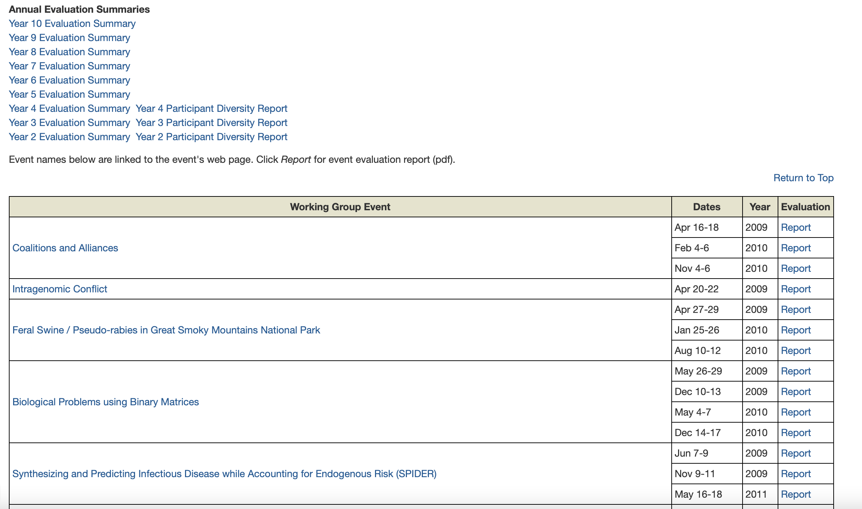
We openly published all full annual reports as well as our NSF proposals
We openly published evaluation reports on all activities - over 120 reports

Slide 11
We fostered the development of an entire center devoted to evaluation and research. The NISER team provided quality research and evaluation services tailored to support evidence-based decision-making of the value, utility, and impacts of STEM-related initiatives in research and education.
PLANNING AND DEVELOPMENT
US Department of Agriculture
DATA COLLECTION
National Science Foundation
ANALYSES
Howard Hughes Medical Institute
Burroughs-Wellcome Fund
REPORTING
National Institutes of Health
Sloan Foundation
Pyramid Peak Foundation`

Slide 12
NIMBioS: What we are most proud of:
Innovative, productive interdisciplinary research
Transparency and evaluation emphasized throughout all activities
Over 250 Education and Outreach activities crossed many levels – K-12 through postdoc

Slide 14
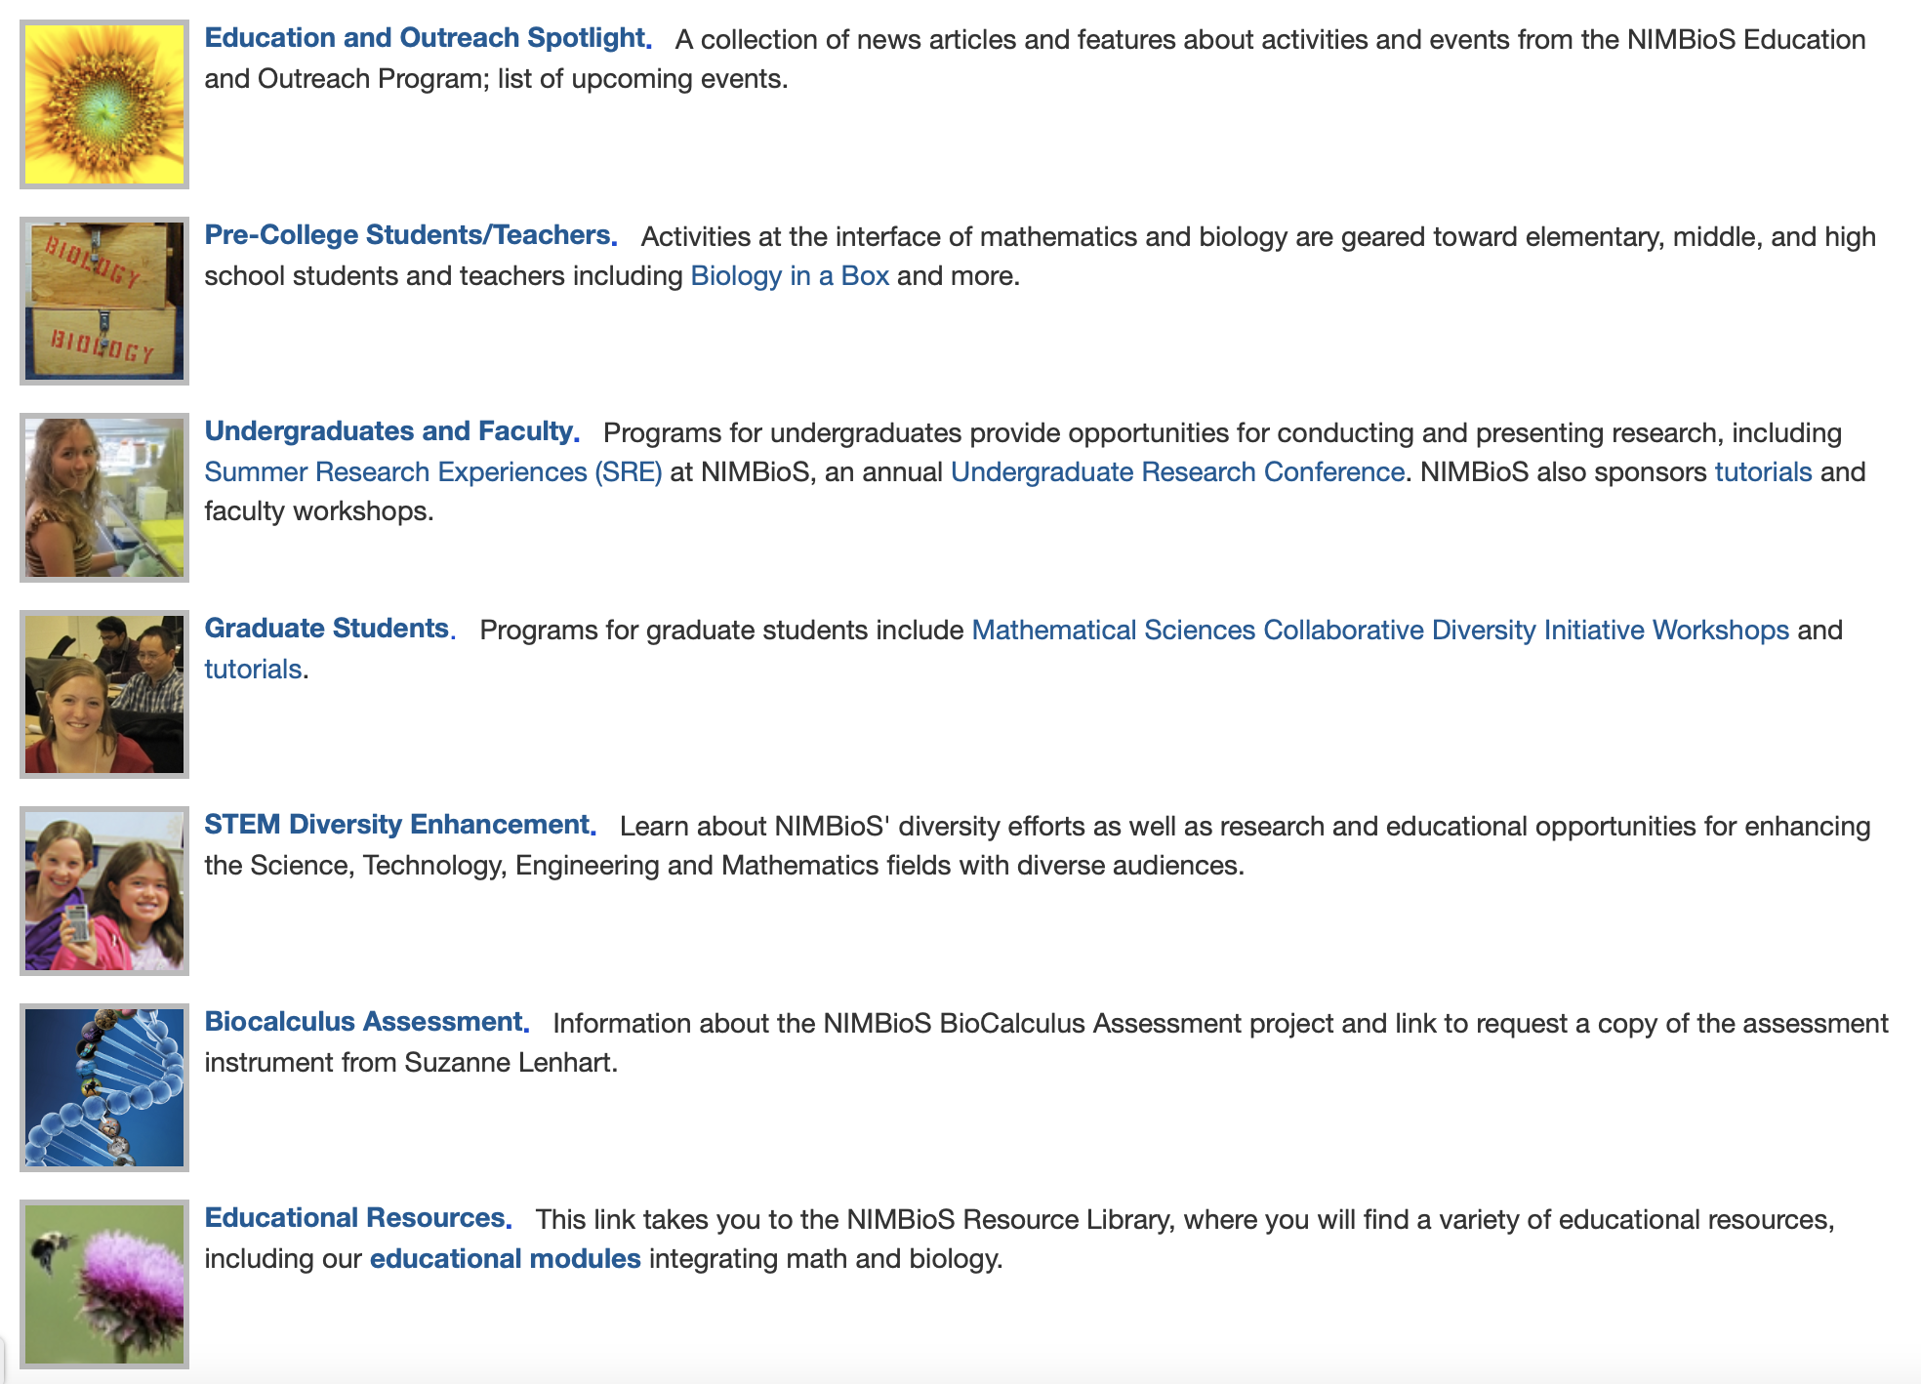

Slide 15
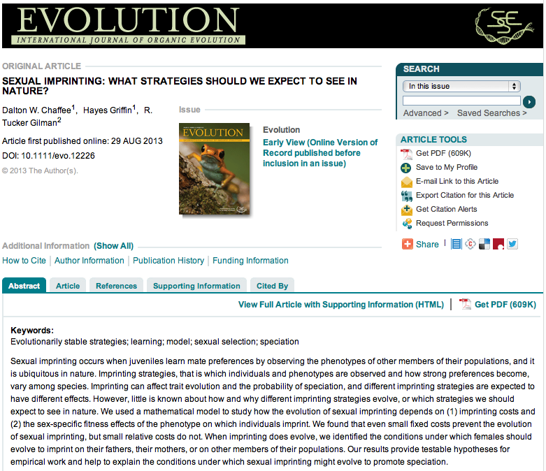
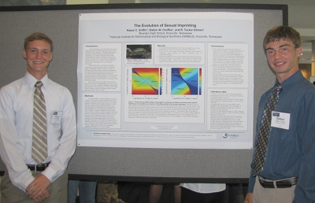
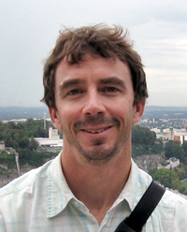
Two high school students collaborate with a NIMBioS postdoc on mathematical models addressing controls on imprinting and publish in a top scientific journal

Slide 16
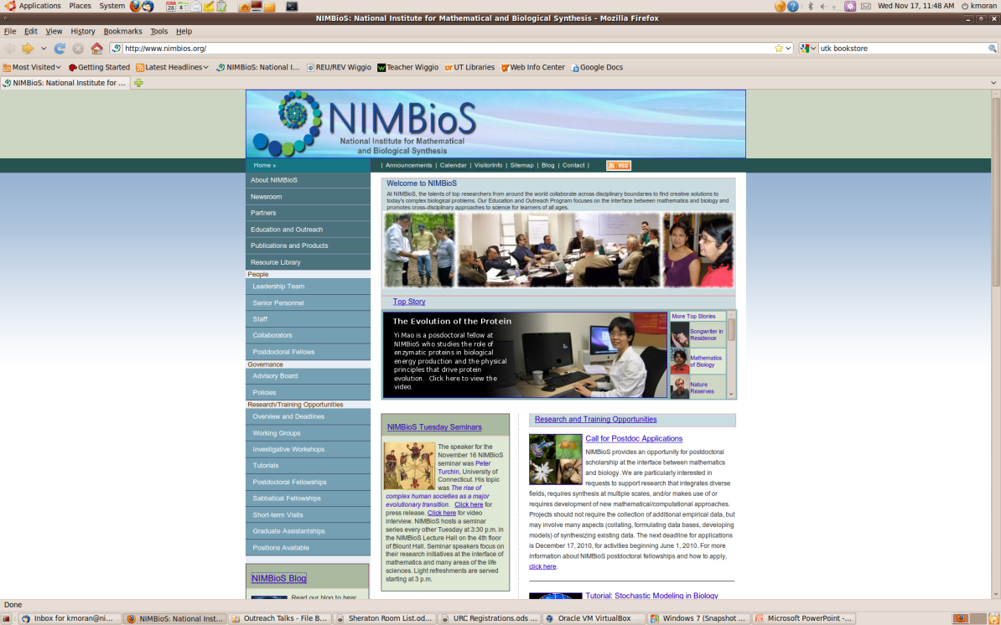
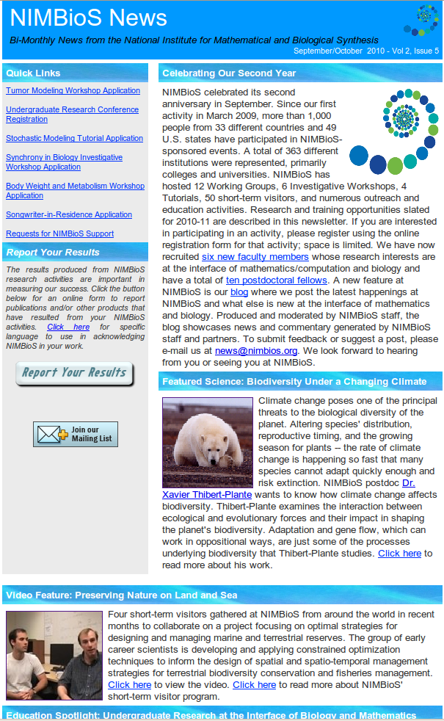
NIMBioS as a Nurturing Environment for Interdisciplinary Science – Broader public
Website: legacy.nimbios.org
with more than 400 videos along with songs from our Songwriters-in-Residence
@NIMBioS
Subscribe to our Bi-monthly
Newsletter
Notes:
For these opportunities and more – connect with us!
Lots of ways to keep in touch – you can choose!
Our website is www.nimbios.org
Most people prefer to sign up for our bimonthly email newsletter
Check out our blog
Find us on Facebook
Follow us on twitter

Slide 17
NIMBioS: What we are most proud of:
Innovative, productive interdisciplinary research
Transparency and evaluation emphasized throughout all activities
Over 250 Education and Outreach activities crossed many levels – K-12 through postdoc
A vision and explicit benchmarks for diversity

Slide 18
NIMBioS Vision for Diversity
Intentionality –this is part of every activity we sponsor
Defining – our diversity statement emphasizes that we include every aspect of diversity - social and scientific, including gender, ethnicity, scientific field, career stage, geography and type of home institution.
Metrics for success – developed in conjunction with Advisory Board to stretch us but be feasible
Ensuring success – incorporating multiple routes
Evaluation – built into all our activities from the start

Slide 19
Benchmarks Established with Board for Participants
Gender: across all Working Groups and Investigative Workshops, the proportion of female participants will be at least 30%.
Geographic - international participation: across all Working Groups and Investigative Workshops, at least 10% of participants will be from outside the USA.
Under-represented groups: across all NIMBioS activities, increase the percent of participants from under-represented groups by approximately 10% per year.
Underrepresented groups: increase the proportion of participants from under-represented groups in Working Groups and Investigative Workshops by 10% per year.
Local participants: limit participation by UT/ORNL faculty/staff to approximately 15% of the total participants in Working Groups and Investigative Workshops.

Slide 20
Benchmarks Established with Board for Organizers
Gender: across all Working Groups and Investigative Workshops, approximately 30% of the organizers will be female.
Local: no more than 25% of Working Group/Investigative Workshop organizers will be UT faculty/staff.
Underrepresented groups: encourage researchers from underrepresented groups to be organizers/co-organizers of requests for support, but no specific goal is set because of the small number of organizers.

Slide 21
Routes to Ensure Success
Associate Director for Diversity Enhancement provides guidance on diversity issues and facilitates MSI connections
All requests for support required to include information on all aspects of participant/organizer diversity
Analysis of requests for support - feedback from Board to suggest additional participants to enhance diversity
Iterative participant selection process between NIMBioS and potential event organizers about increasing diversity both before evaluation by Board and after
Partnerships with MSIs to enhance opportunities for students and faculty from MSIs to participate in all activities
Systematic evaluation of all aspects of diversity using benchmark metrics

Slide 22
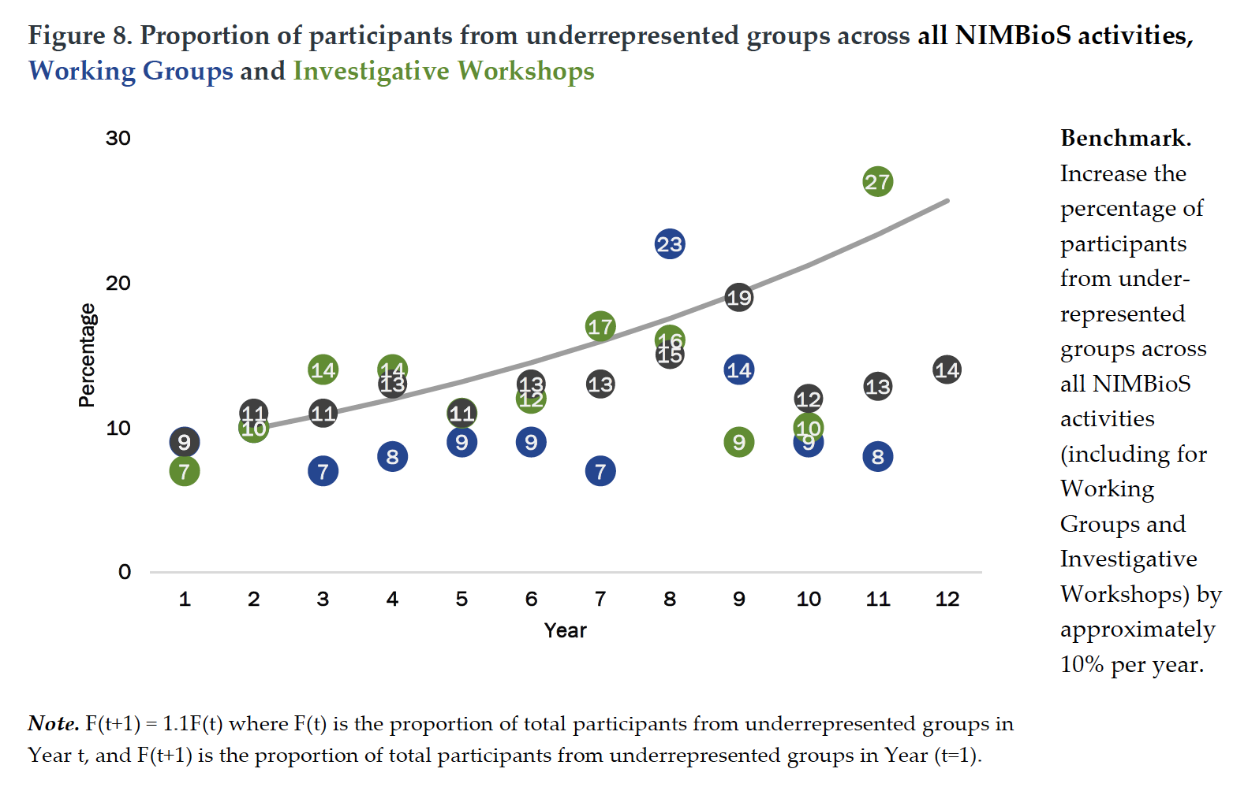

Slide 23
NIMBioS: What we are most proud of:
Innovative, productive interdisciplinary research
Transparency and evaluation emphasized throughout all activities
Over 250 Education and Outreach activities crossed many levels – K-12 through postdoc
A vision and explicit benchmarks for diversity
Consistency of leadership and staff

Slide 24
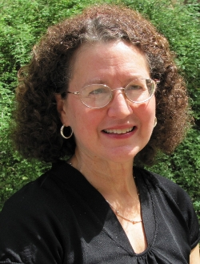
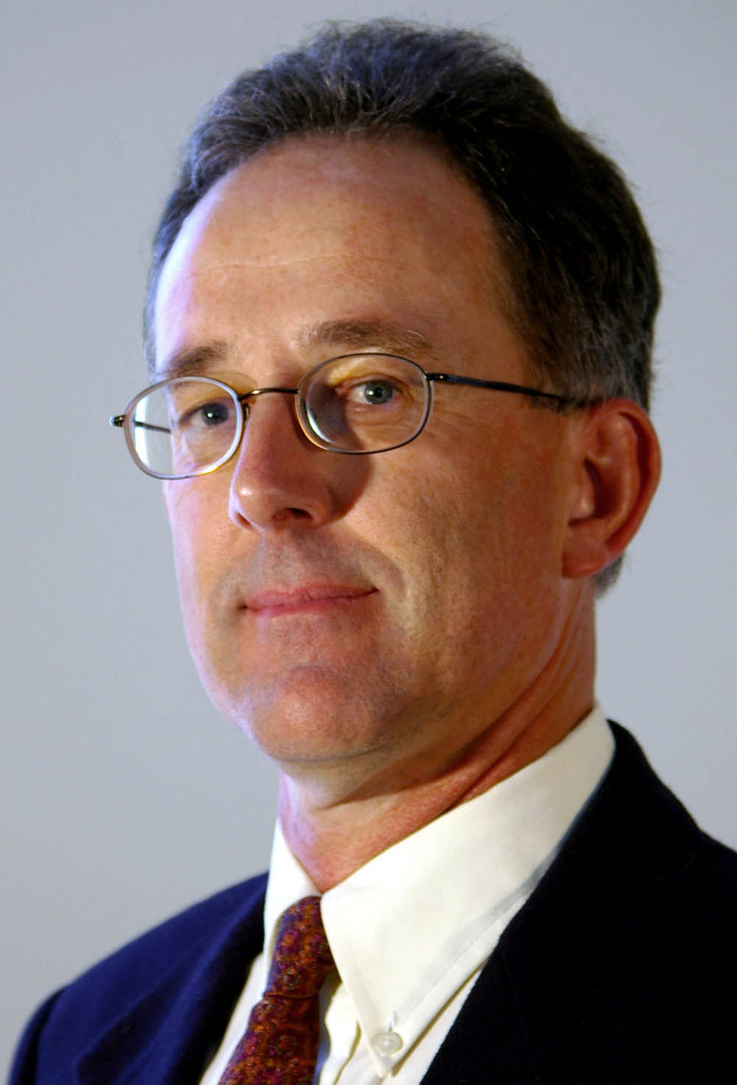
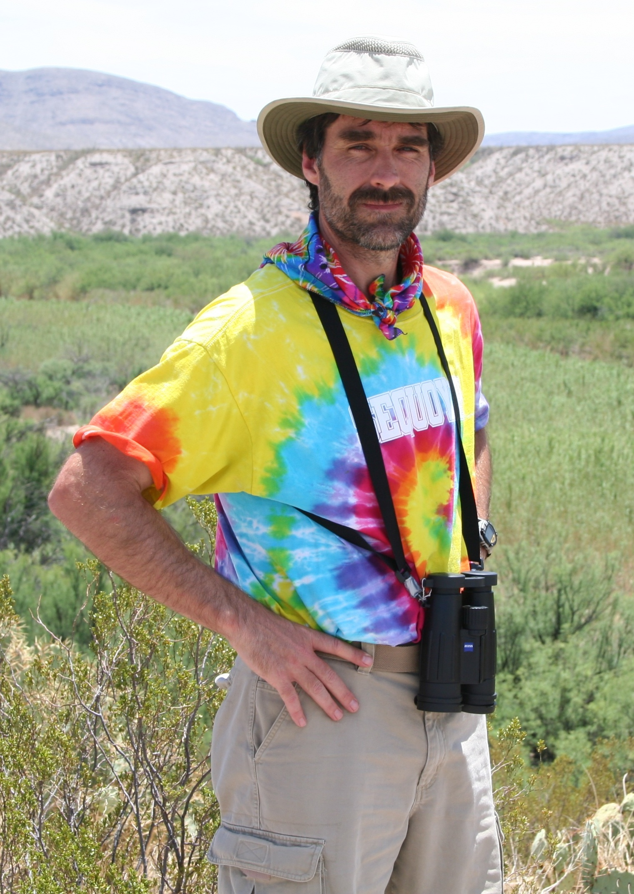
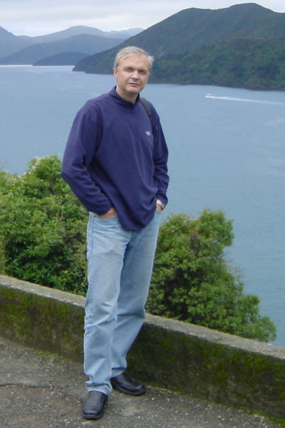
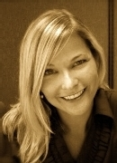
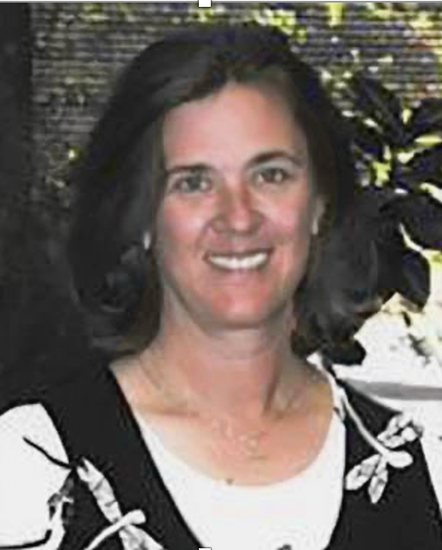
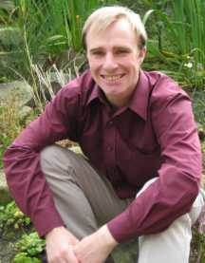
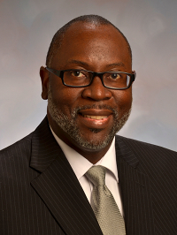
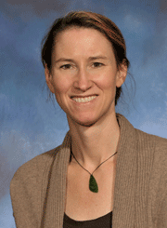
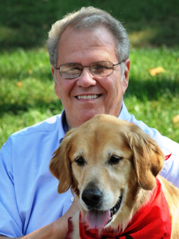
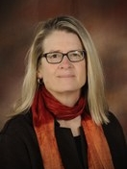
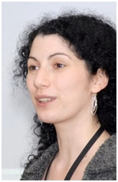
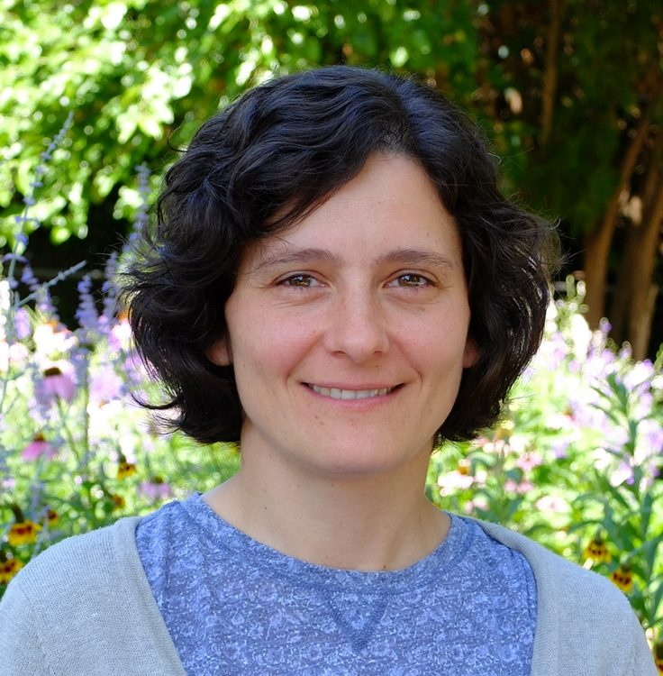
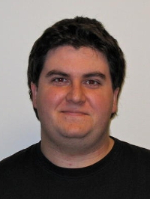
NIMBioS Leadership Team
Suzanne Lenhart
Graham Hickling
Chris Welsh
Sergey Gavrilets
Pam Bishop
Cynthia Peterson
Paul Armsworth
Ernest Brothers
Alison Buchan
John New
Colleen Jonsson
Mona Papes
Brian O’Meara
Nina Fefferman

Slide 25
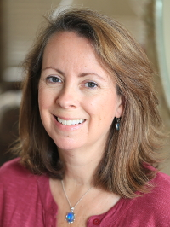
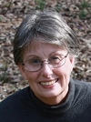
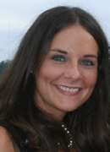
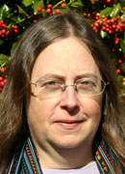
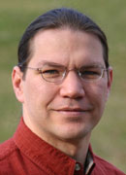
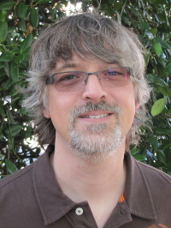
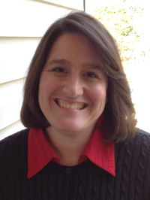
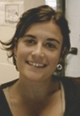
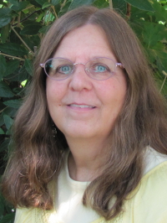
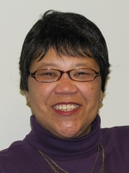
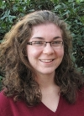
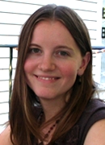
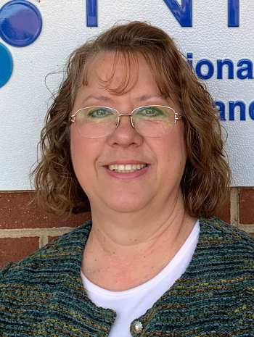
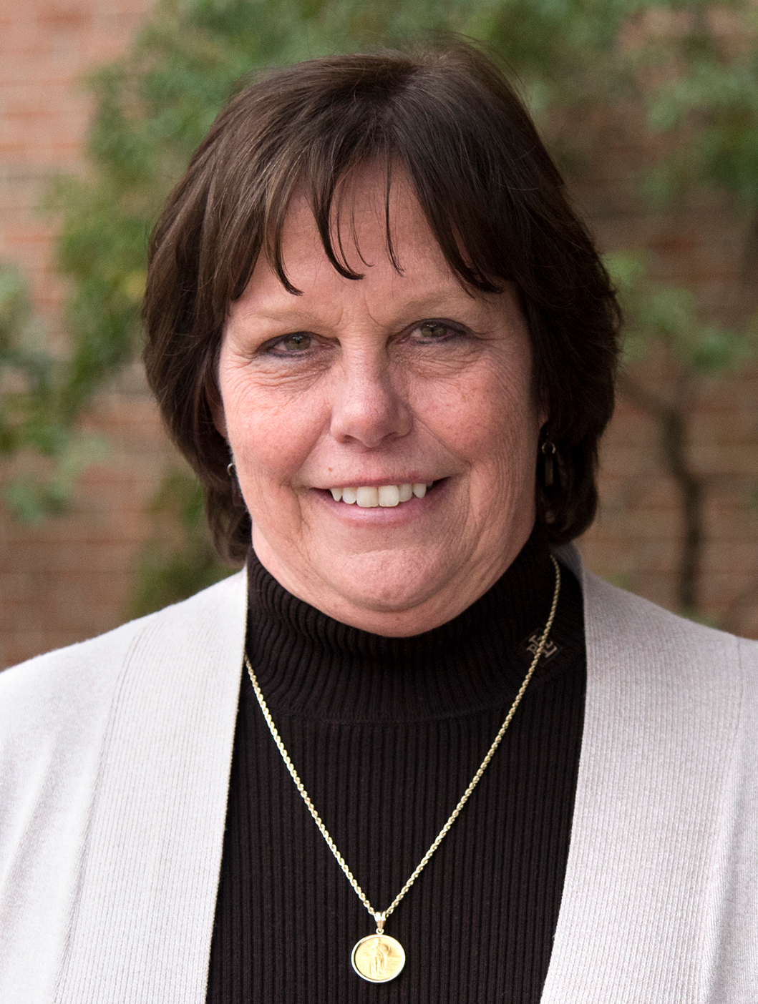
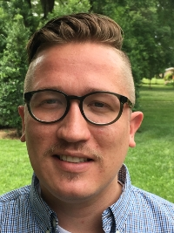
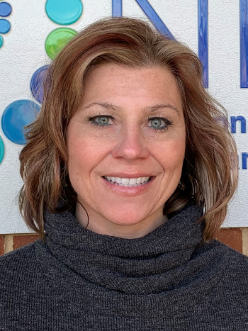
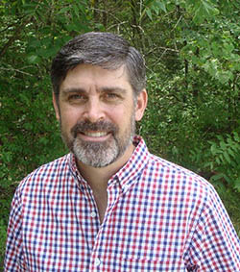
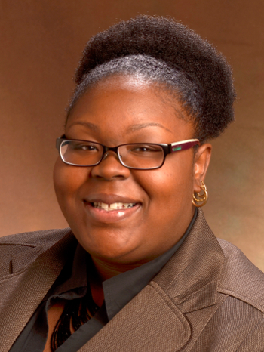
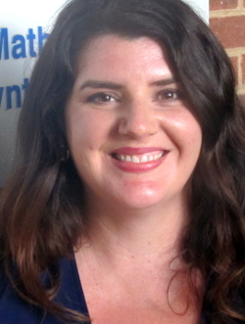
NIMBioS Staff
Catherine Crawley
Jane Comiskey
Toby Koosman
Jennifer Spar
Eric Carr
Michael Peek
Sondra LoRe
Mary Bartolini
Sarah Duncan
Chandra Eskridge
Ana Richters
Kelly Sturner
Louise Murr
Sherri Dugger
Kevin Kidder
Nichole Minshall
Meredith York
Greg Wiggins
Erica Echols
Notes:
25

Slide 26
NIMBioS: What we are most proud of:
Innovative, productive interdisciplinary research
Transparency and evaluation emphasized throughout all activities
Over 250 Education and Outreach activities crossed many levels – K-12 through postdoc
A vision and explicit benchmarks for Diversity
Consistency of leadership and staff
A sustainability plan based upon building new major centers

Slide 27
at NIMBioS
NIMBioS.org
NIMBioS.org/SAL
S A L
The SPATIAL ANALYSIS LAB
NISER.utk.edu
DySoC
DySoC.org
Center for the Dynamics of Social Complexity
MMCC
The Mathematical Modeling Consulting Center

Slide 28
NIMBioS: What we are most proud of:
Innovative, productive interdisciplinary research
Transparency and evaluation emphasized throughout all activities
Over 250 Education and Outreach activities crossed many levels – K-12 through postdoc
A vision and explicit benchmarks for Diversity
Consistency of leadership and staff
A sustainability plan based upon building new major centers
The Unexpected

Slide 29
Legacy.nimbios.org/songwriter

Slide 30
EventRap.com

