Slide 1



Careers in Academia: How to Enhance your Chances for Success
Louis J. Gross
Chancellor’s Professor Emeritus
Departments of Ecology and Evolutionary Biology and Mathematics
University of Tennessee, Knoxville
With thanks to many, many students and colleagues over the past 50 years and to many NSF and other agency funded projects that provided funding support for many staff and students
Legacy.NIMBioS.org

Slide 2
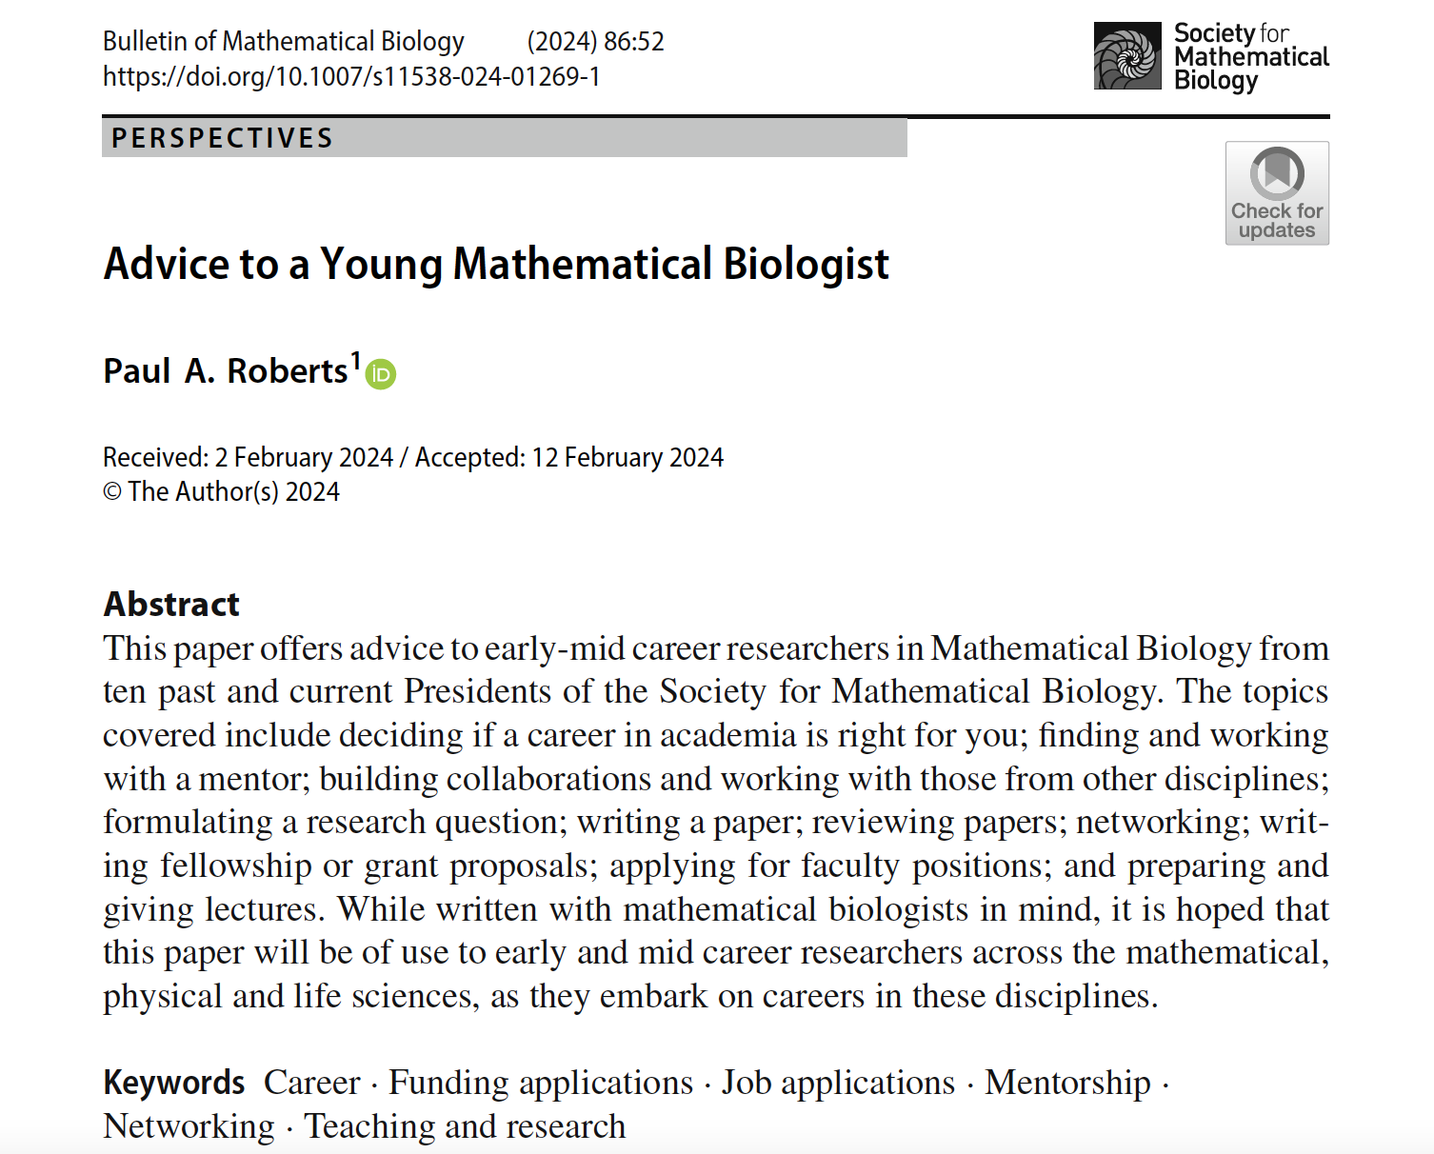
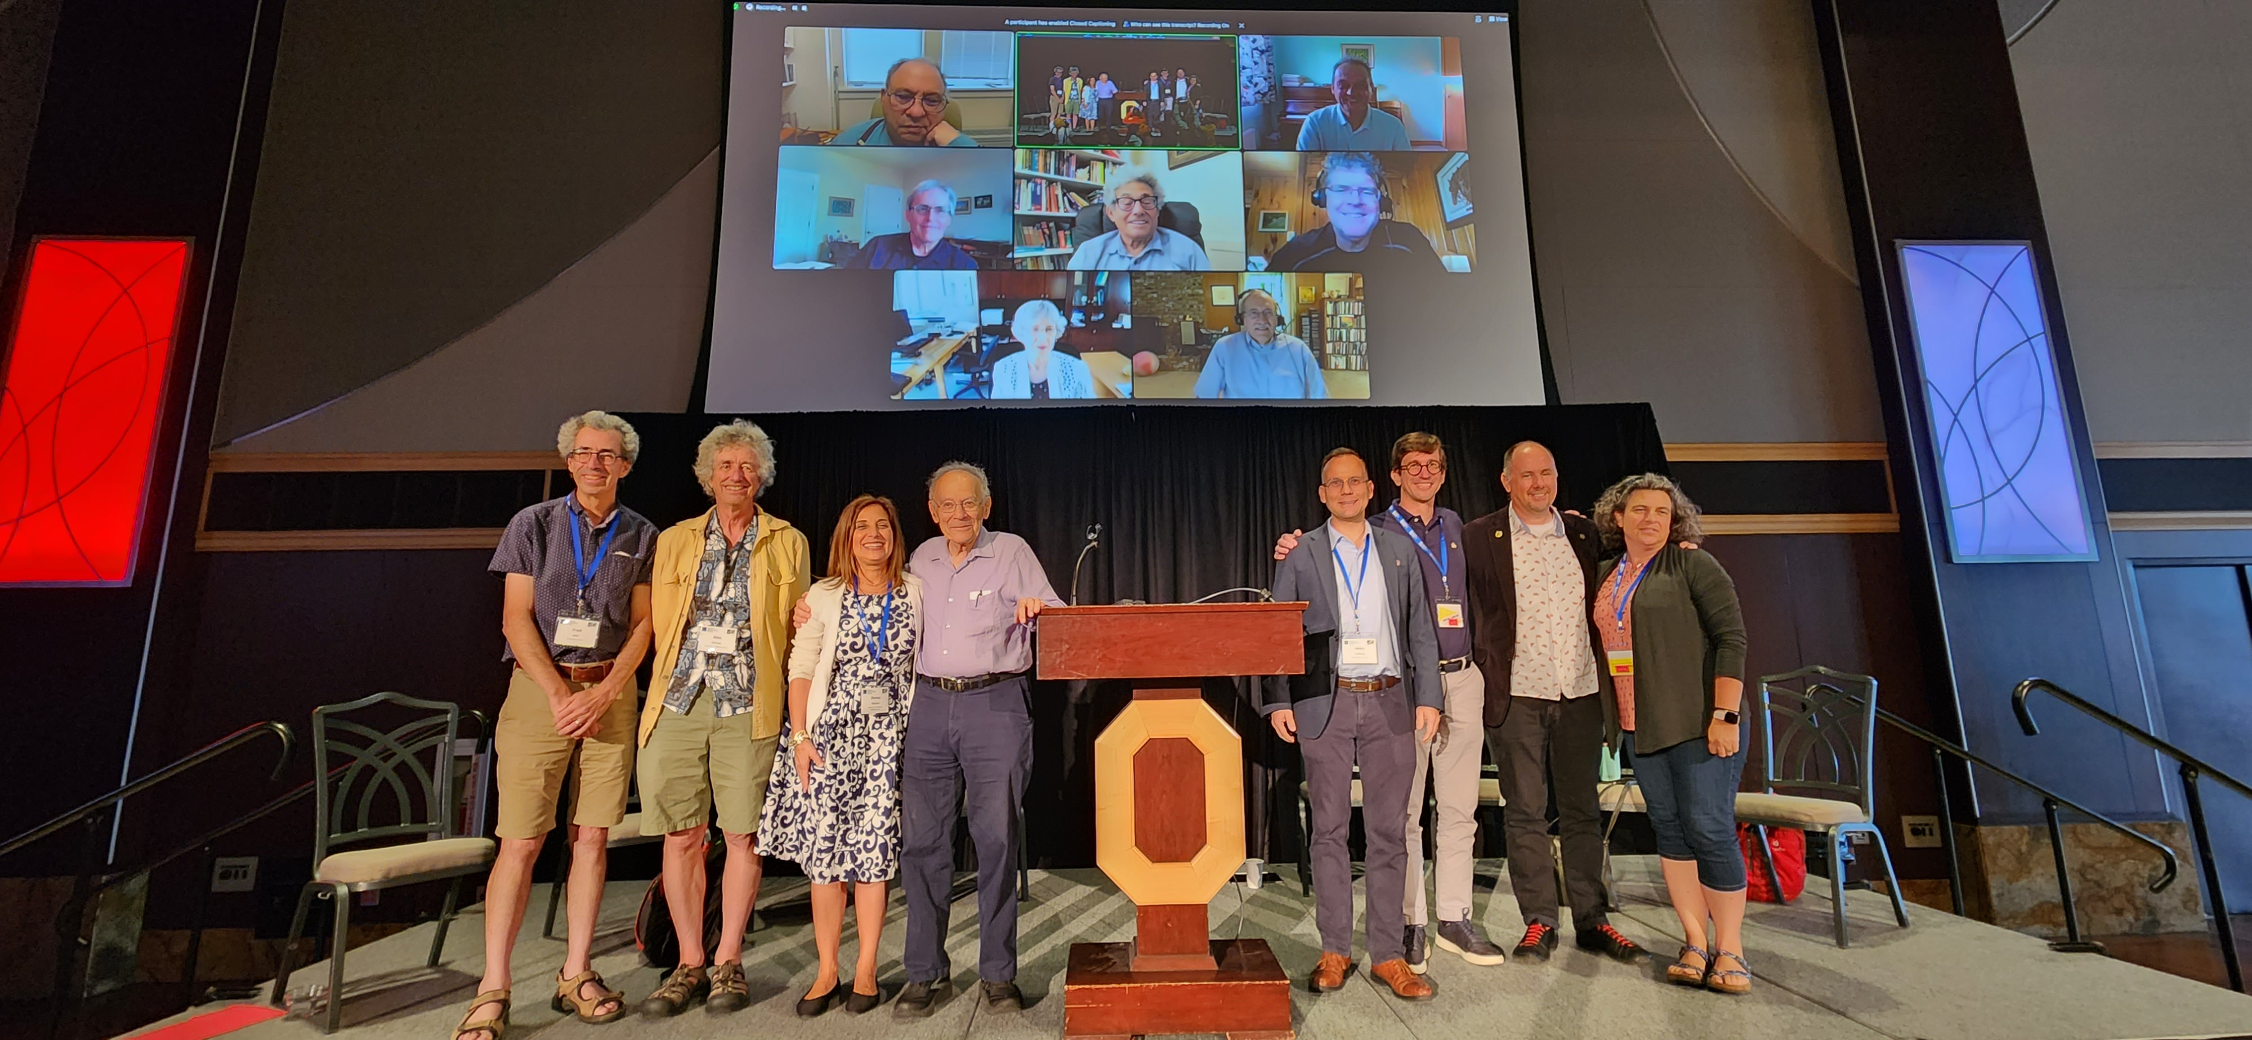

Slide 3
This is a summary of a seminar with all material available at https://lgross.utk.edu/eeb504Spring2021.html
In addition to all course notes, this has references on positions, getting funding, Individual Development Plans (IDP), mentoring, and team science.

Slide 4
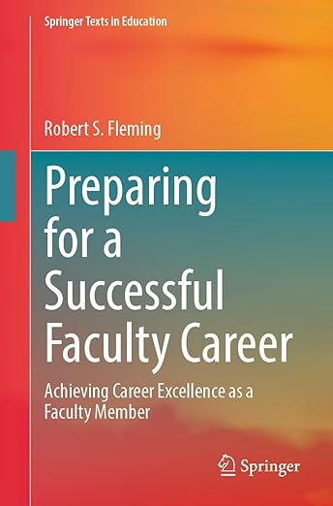
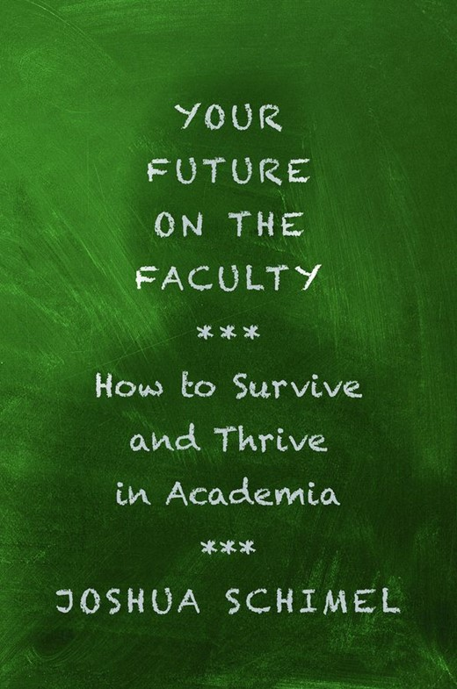


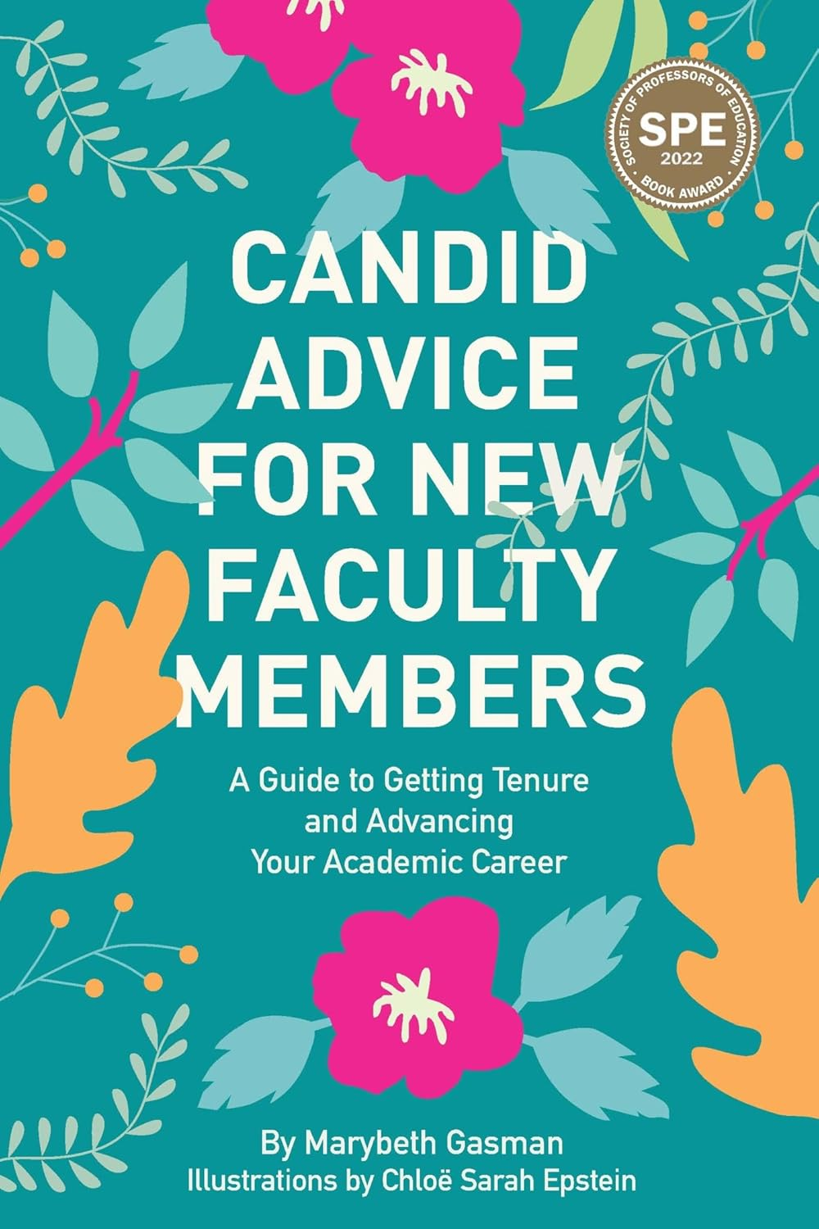
There are several books with advice on getting tenure

Slide 5
These are books about higher education administration, some of which may be helpful to look at.

Slide 6
A couple key tenets:
There are those in positions in academia that essentially ignore most all of the topics listed, do not care to be knowledgeable about the organizational structure of their institution, and just wish to do their work. They can certainly be successful while ignoring most everything included in our discussion.
Knowledge is power, you can more readily prepare yourself for success in an academic position if you are knowledgeable, and there are internal “political” issues at every higher education institution that you might best be served by being prepared to deal with.
Example: NIMBioS

Slide 7
Individual Development Plan:
The concept here is that it will assist you in your consideration of your career by being proactive about what your objectives are, what your strengths and values are, and what processes you might follow to help you get where you want to be. A typical interview question is “where do you want to be in 5 years” and an IDP is one method to help you address this in a somewhat formalized manner. There are a variety of tools available to assist (not to mention “life coaches” and your various mentors serve in that role to some extent), but I suggest starting with the tools available through AAAS Science Careers.

Slide 8
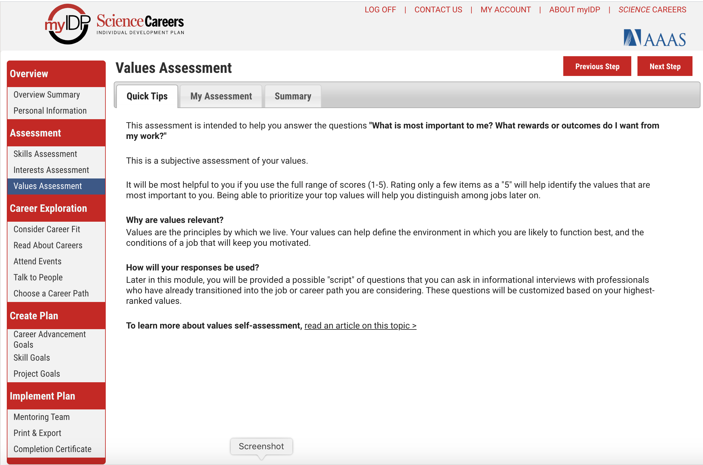

Slide 9
Outline of possible topics:
Types of higher education institutions;
Higher education and the public;
How colleges and universities work; Organization and structures;
Where the money comes from and where it goes;
Various roles of a faculty member and prioritizing among them;
Other academic positions;
Stages of a career and planning for transitions;
Position searches; First faculty position and moving on;
Mentoring - getting it and giving it;
Enhancing your teaching;
Dealing with difficult people;
Funding your scholarship;
Administrators and how they impact your career;
Preparing for evaluations;
Participating in the broader academic community in your field;
Building effective collaborations;
Building balance in your life;
Time management.

Slide 10
Types of Institutions:
Private/Public
Systems
Non-profit/For profit
R1, 2, 3 Carnegie
Comprehensive
Land-grant
4 year (PUI) – Primarily Undergraduate
2 year (Community College)
MSI – Minority-serving, HBCU, Tribal
College (specialty, Arts, Graduate, Medical)
Liberal Arts
Alternative

Slide 11

Higher education and the public
There are regular articles, editorials, and books about the structure and costs of higher education:
The review of this book by Lieber in the NYT notes that:
There is great inequity in what people pay for college
There is inequity in the impact of what college you went to and your career options
There is inequity in public support for the costs of college
Bottom line is that if you choose an academic career you should be aware of the very strong public attitudes regarding the benefits and costs of a college education

Slide 12
Higher education and the public
The book review notes that subsidies for various institutions varies tremendously. Some higher education institutions, such as mine, get as much as 35% of their funding from State sources, while in California about 90% of community college funding comes from State funds while the State supplies about 30% of the UC budget. In some States the cost of undergraduate attendance is highly subsidized, separate from federal funding for Pell and other grants, while in others the higher ed institution is very heavily dependent on tuition and endowment revenue. There are explicit subsidies for higher education from taxes at State, Federal and Local levels and there are implicit subsidies from allowing charitable contributions and endowment income to not be taxed.

Slide 13
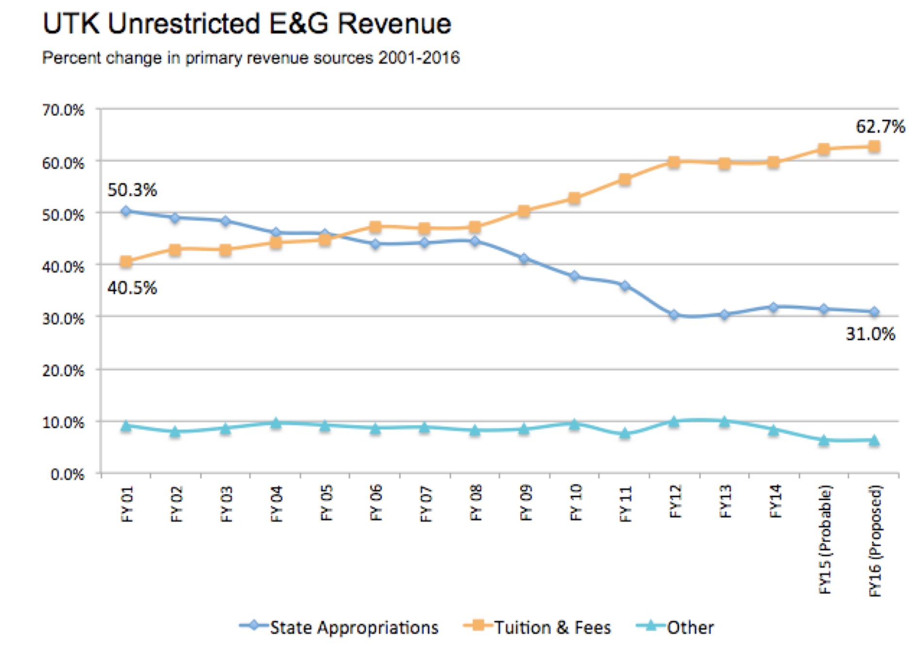
Higher education and the public
http://www.nimbios.org/~gross/Senate/UTKTuitionandExpendituresReportFinal.pdf

Slide 14
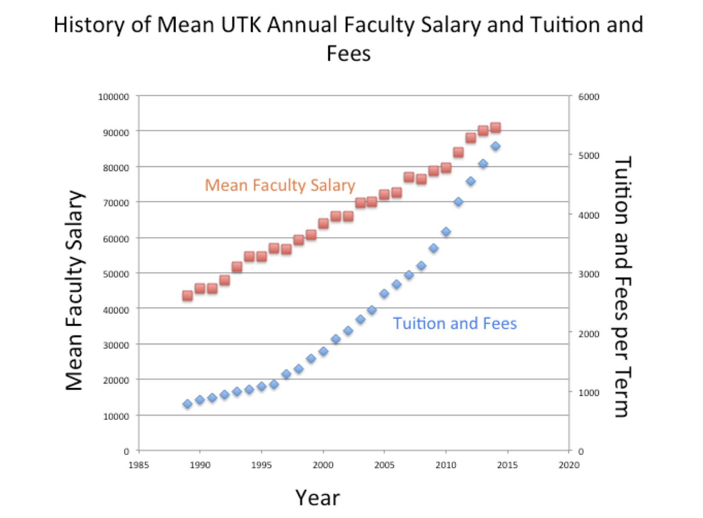
Higher education and the public
http://www.nimbios.org/~gross/Senate/UTKTuitionandExpendituresReportFinal.pdf

Slide 15
Higher education and the public
How much is a college degree worth? A search on this topic shows that average lifetime earnings for a Bachelors degree is about 75% higher than for a high school degree, 100% higher with a Masters degree, 200% higher with a PhD and 360% higher with a professional (nursing, law, medicine MBA, etc.). There are many arguments about these figures though as they depend on the field of the degree, there are many discussions about debt taken on and about the opportunity lost by staying in school longer with low earnings.

Slide 16
Stakeholders in Higher Education Institutions:
General public (State taxpayers, local citizens)
Local Community (government, business)
National agencies (government, accrediting, non-profits)
Governing board
Employees
Administrators
Students
Alumni
Particular constituencies (sports fans, facility users, identity groups)
Note: there are potential conflicts between the perceptions and goals of the stakeholders regarding the role and objectives of the institution

Slide 17
Missions and Objectives:
Every higher institution has some type of mission statement, likely a visions statement, and a strategic plan. These typically have very similar statements of objectives – scholarship and research, education, service to the local and national community, enhancing diverse opportunities for all, and inclusive excellence. Certainly, there are differences connected to the role of the institution, but these statements generally do not include any details of the processes to be used to meet the objectives. Even the strategic plans are typically quite vague. They also are not necessarily binding.

Slide 18
Example Mission Statements
Stanford University's mission centers on creating and sharing knowledge, educating future leaders, and contributing to society through research and teaching, fostering critical thinking, innovation, and preparing students for success and engaged citizenship, all while upholding principles of academic freedom, diversity, and service. Key goals include promoting learning, advancing research, developing leaders, and serving the broader community.
UTK: The primary mission of the University of Tennessee is to move forward the frontiers of human knowledge and enrich and elevate the citizens of the state of Tennessee, the nation, and the world. As the preeminent research-based land-grant university in the state, UT embodies the spirit of excellence in teaching, research, scholarship, creative activity, outreach, and engagement attained by the nation’s finest public research institutions.

Slide 19
Who works at these:
Faculty -Tenured, Tenure-track, Contingent, Part-time
Ranks: Full Professor, Associate Professor,
Assistant Professor
Research Professors at these ranks (Soft money), Professors of Practice (teaching-focused), Clinical Professors (Nursing, Psychology), Instructors/Lecturers
Staff (Hard money, soft money)
Administrators (some have Faculty positions)
Students (Teaching/Research Assistants, hourly, soft and hard money)
Note: some of the above are contract employees, some not.

Slide 20
The hierarchy of positions:
There are several ways to consider this:
Compensation – order is roughly: coaches, administrators, faculty, staff, students
Longevity – order is roughly: staff, faculty, administrators, students
Power (e.g. funding decision authority): administrators, faculty, staff, students
Academic matters: faculty, administrators, staff, students
Student life: students, administrators, staff, faculty
Note: overall authority for all of this rests with an oversight Board (Trustees)

Slide 21
Basic Structure of a University System
Board of Trustees
President/Chancellor
Vice Presidents
Campus Chancellors
Offices for Research, Academics, Development, Treasurer, Government Relations
Campus Administration

Slide 22
Basic Structure of a Campus
Chancellor
Provost
Vice Chancellors for Student Affairs, Development, Communications, Finance, Research, Diversity
Athletics
Deans
Department Heads
Associate Deans
Faculty

Slide 23
From Stanford President Website

Slide 24
From Stanford Provost
Website

Slide 25
UTK Organization chart

Slide 26
Departmental Structures:
Except for those reporting to some type of center or interdisciplinary units, faculty generally report to a Department.
There are two general ways Departments are led:
Department Head – appointed by a Dean, serves at the pleasure of the Dean for 3-5 years and often longer, has authority over issues such as recommending raises for faculty, and decisions on hiring by making recommendations to Dean – may be external hire
Department Chair – elected by the faculty though appointed formally by Dean, serves at the pleasure of the faculty, expected to rotate among senior faculty who take their turn serving typically a 3-year term, may not have authority over faculty salary, hiring decisions typically made by faculty and then recommended by Chair to Dean – usually internal appointment

Slide 27
Departmental Structures:
Governance documents –
Bylaws of the Department typically provide guidance on hiring practices; expectations for retention, promotion and tenure that are specific to the department to expand on those provided in a Faculty Handbook; committees such as graduate affairs and undergraduate affairs; appointment, responsibilities and evaluation of Head/Chair; expectations regarding mentoring of undergraduate and graduate students.
Curricular plans – as approved by the faculty for all degrees and aligned with College/University requirements
Student handbooks – typically only for Graduate students with undergrads referred to curricular materials

Slide 28
College Structures:
Colleges have their own structures that rely on participation from faculty in the departments that are part of the College.
Governance documents –
Bylaws of the College specify roles of Deans, their appointment process and evaluation; structure such as roles of Associate Deans (typically for faculty affairs, student affairs and research); any structure that groups departments into Divisions; committees such as curriculum, promotion and tenure (which looks at these for all departments in the College), and advisory; College-level guidelines for retention, promotion and tenure; selection of representatives to University Committees (e.g. Faculty Senate, Research Council, Teaching Council, University promotion and tenure Committee)

Slide 29
Budgets:
There are two basic budget models for universities which have implications for units at all levels:
Historical budget or incremental funding model – units receive an annual allocation of funds based on historical needs, mainly salary expenses for faculty and staff, and ask for new funds for special needs
Responsibility-based budget model – units receive annual funding based on student credit hours generated, majors graduated, external research funding received
In the first of these, Colleges and Departments focus on requests for new resources each year (e.g. new faculty/staff positions). In the second of these, Colleges and Departments focus on gaining student credit hours, attracting students for degrees, allocating budgets to meet current needs and planning for new initiatives

Slide 30
Departmental Budgets:
Expenditures: In either budget model, most funding goes to salaries. New faculty/staff positions typically arise only from faculty who leave, unless the institution has a major initiative. GTA lines may be determined by the department based on teaching needs, or may be historical. Grad tuition waivers may be available centrally or may be charged to the unit. GRAs arise typically only from external grant support.
Revenues: Major portion is for teaching needs and arises either historically, or based on a formula for credits taught in the past from tuition and State support. Summer teaching may generate revenue depending upon university. External funding supports research faculty, postdocs, GRAs. Indirect cost returns (F&A – Facilities and Administrative) from grant expenditures the previous year may be available. Endowment funding may be available but typically supports students.

Slide 31
Indirect Costs or F&A:
Indirect costs (F&A – Facilities and Administrative) are the costs charged to external funding for infrastructure such as phones, network, payroll systems, library, buildings, utilities, etc. The rate is typically 50% (full-F&A) for research and lower for teaching awards. The rate is negotiated every few years by the university with one federal agency which sets the rate for all agencies. Some government agencies (e.g. Dept of Interior, State agencies) will not pay the full rate, and most private foundations will not pay any F&A.
Indirect cost returns are funds from the F&A that the institution charges that are “returned” to the unit (College, Department, faculty member who is the PI – principal investigator). This is typically some fraction of the total F&A the institution receives and used to cover basic department costs and can be used by a faculty member for research, travel, students, lab expenses, etc.

Slide 32
Indirect Cost Returns to Faculty:
Can you negotiate indirect cost returns? This is dependent upon the institution, College culture, and Departmental leadership. How F&A flows and the amounts distributed vary a lot between and within institutions. Sometimes the constraints on Heads limits their ability to return some funds to individual faculty who are PIs. In other cases, particularly at time of hiring or when you are negotiating if you have an offer elsewhere, you can request that some fraction of F&A you generate be returned to you. At initial hire, if you are given a start-up package you should try to negotiate the potential extension of the time period of the start-up if you get external funding that covers some of what start-up would have covered. You can ask for resources from departmental F&A even if you don’t generate it.
Bottom line – ask or else you won’t receive.

Slide 33
Faculty Compensation:
How are you paid? There are two types of general faculty positions – 9-month and 12-month. The vast majority of faculty are 9-month employees meaning that you are not paid by the institution for the 3 months of summer. Most faculty in Agriculture units are 12-month employees, and research faculty supported on external funding are typically 12-month as well.
There are two main systems to set faculty salaries: (i) step-system set up by the State or institution with formal pay-grades and times of changes in these grades, upon promotion, regular evaluation, etc. (ii) free-for-all in which it is whatever you can negotiate with a Head and argue for regularly, even if there are institutional constraints set by some annual raise pool. Significant raises beyond typical annual ones require a major event (e.g. an offer from somewhere else, a major new grant/award, salary compression due to new faculty hired making a lot more than you).

Slide 34
Faculty Compensation:
Higher education institutions are NOT meritocracies!
You are not compensated based mostly on merit in terms of your contributions to the institution.
Evidence of this is clear by considering the outrageous salaries of Athletics staff and the tremendous increases in salary given to administrators.
Compensation within an institution is mostly driven by market forces – beginning faculty in some areas receive higher salaries than distinguished faculty with decades of experience in other areas (e.g. engineering, science and business salaries are uniformly higher than humanities, arts and social science faculty at the same rank and experience). There are inherent gender aspects to the associated salary differences plus the fact that there are gender differences between faculty who are tenure-track compared to those who are contingent.

Slide 35
Faculty Compensation:
How can you make more money?
Go somewhere else – you often get a significant raise
Get a grant – you can pay yourself summer salary but only at the rate set by your base salary. Typical federal agencies limit this to 2 months summer pay.
Get a promotion in rank – there is a typical raise for this
Teach in the summer – rate will generally be lower than your normal salary for a course.
Consult – this should be in your professional areas, in which case you can typically spend 1 day a week and set your own rates. Money does not flow through the university.
Get an endowed chair – this is typically a supplement to your salary and to enhance the chances you might cultivate a donor to an endowment.
Make an argument - based on equity/compression.

Slide 36
Faculty Roles:
Faculty have diverse responsibilities, but these are generally split into: Research/Scholarship, Teaching, Service. The allocation of effort to these roles depends upon the institution (e.g. some 4-year institutions may have much heavier teaching expectations and lighter research ones, while others may weight research more heavily) and position (e.g. lecturers may have no research expectations). The expectations for faculty are explained in an appointment letter (which takes the place of a formal contract, unless there is a Union representing faculty), and in University/College and Departmental guidance documents. The expectations in each area are often modified based on rank so that beginning faculty may have lower service expectations in the institution compared to tenured faculty – this may not hold at smaller institutions though.

Slide 37
Faculty Roles:
Research/Scholarship:
Appropriate to the institution, varies with rank, and varies with the expectations of the discipline. In general, this means actively publishing in appropriate journals, making efforts to obtain external funding (in some cases success at this is required for retention/tenure), presentations at professional society gatherings, building a professional reputation. Some units may have explicitly stated expectations (number of papers, citations, number of grants, amount of grants, number of students supported, invited lectures, etc.). The assessment of this is done throughout a career with feedback from Heads and mentors/mentoring committee making suggestions for goals regularly.

Slide 38
Faculty Roles:
Teaching/Mentoring:
Appropriate to the institution, varies with rank, and varies with the expectations of the discipline. In general, this means actively teaching appropriate courses at undergrad (and grad level if the institution has these), developing new courses and/or modifying the pedagogical approach in current courses, potentially publishing articles/modules on your educational initiatives, mentoring students either formally in your lab or informally by serving on student committees and publishing research with mentees. Some units may have explicitly stated expectations (courses taught, number of students mentored, etc.). The assessment of this is done throughout a career through student evaluations, peer reviews by colleagues, with feedback from Heads and mentors/mentoring committee making suggestions for goals regularly.

Slide 39
Faculty Roles:
Service:
Appropriate to the institution, varies with rank, and varies with the expectations of the discipline. In general, this means actively participating in departmental affairs (e.g. serving or leading committees, accepting new students, serving on search committees for new faculty, etc.), serving at College or institution level on committees or faculty senate leadership, professional service (being on agency review panels, serving on editorial boards, peer-reviewing for journals, etc.). Some units may have explicitly stated expectations (journal articles reviewed, committees served on). The assessment of this is done throughout a career through annual evaluations, external letters at retention/promotion reviews with feedback from Heads and mentors/mentoring committee making suggestions for goals regularly.

Slide 40
Faculty Evaluation:
Tenure: see https://www.aaup.org/issues/tenure
A tenured appointment is an indefinite appointment that can be terminated only for cause or under extraordinary circumstances such as financial exigency and program discontinuation.
The principal purpose of tenure is to safeguard academic freedom, which is necessary for all who teach and conduct research in higher education. When faculty members can lose their positions because of their speech, publications, or research findings, they cannot properly fulfill their core responsibilities to advance and transmit knowledge.
Education and research benefit society, but society does not benefit when teachers and researchers are controlled by corporations, religious groups, special interest groups, or the government. Free inquiry, free expression, and open dissent are critical for student learning and the advancement of knowledge. Therefore, it is important to have systems in place to protect academic freedom. Tenure serves that purpose.

Slide 41
Faculty Evaluation:
There are several stages:
Pre-tenure: Generally annual retention reviews by Head and sometimes with input from mentoring committee, with typically votes and discussion by tenured department faculty. Criteria are those in Department Bylaws and any appointment letter. There may be an extended 3-year review with external letters.
Tenure/promotion: Typically promotion to Associate Professor occurs concurrently with tenure decision. A very formal process typically with an extensive dossier provided by the candidate, external letters requested from experts without conflicts of interest with candidate, and teaching evaluation analysis. A presentation of the case is made to Department, College and University with review committees potentially at each stage and final decision by the Provost.

Slide 42
Faculty Evaluation:
Promotion to Full Professor: Generally annual retention reviews by Head and sometimes with input from a mentoring committee. Promotion to Full Professor from Associate is typically held at least 5-6 years after tenure but there can be a lot of variance in this depending upon whether there is a likelihood of recruitment elsewhere. Criteria are those in Department Bylaws. A very formal process typically with an extensive dossier provided by the candidate, external letters requested from experts without conflicts of interest with candidate, and teaching evaluation analysis. A presentation of the case is made to Department, College and University with review committees potentially at each stage and final decision by the Provost.

Slide 43
Faculty Evaluation:
Post-tenure Reviews: Generally annual retention reviews by Head with a formal statement of activities for the past year made by the faculty member (workload statement) that sometimes is just an updated CV with recent activities highlighted.
All institutions have some process to dismiss a faculty member who is no longer meeting expectations, though this is typically a very lengthy process and is described in a faculty handbook. Dismissals for “cause” are separate, involving criminal or unethical behavior. Some institutions have a very formal post-tenure review with oversight by a committee or administrator above department level.
These reviews are also used for faculty consideration for various awards including endowed chairs, service and teaching awards.

Slide 44
Other Academic Positions:
Administrative: Those with advanced degrees can be hired in all kinds of administrative positions, some with faculty appointments (e.g. Dean, Provost, Chancellor) and some not (e.g. Center directors, Student affairs, Health Center director).
Research: These can be either research staff positions (e.g. Research Associate, Research Leader) which are typically funded by grants, or Research Faculty positions which may be externally or internally funded.
Support staff: These are often associated with an IT office, a consulting office (e.g. statistics, computing), or may be based in a unit such as a College or Department (e.g. grant writing, development officer, lab manager). These are typically not on soft funding (e.g. not supported on grants).

Slide 45
Transitions of Career Stages:
Some priorities at different stages:
Note that family and personal commitments occur and potentially change at all stages
Beginning Assistant Professor: Get to know your colleagues, initiate some collaborations at your institution, plan your course teaching for several years to meet tenure goals, get papers from prior work out, build your “lab”, submit external funding proposals
Later-stage Assistant Professor: Check that all the requirements for tenure are being met, get papers out from your time at the institution, pursue diverse external funding, mentor and recruit students, build your teaching portfolio, possibly look at options at other institutions

Slide 46
Transitions of Career Stages:
Beginning Associate Professor: Use this as a time to consider new initiatives, initiate new collaborations as appropriate, actively recruit students for your lab, initiate new teaching methods/courses, become more involved in department/institution service, find ways to carry out more professional service (editorial boards, agency panel reviews)
Later-stage Associate Professor: Check that all the requirements for promotion are being met, build a body of papers so that you are the go-to person in some area, pursue some larger sources of external funding, mentor students at all levels, build your teaching portfolio, become known for some internal and external service role (e.g. chair of a department committee, university committee, chair editorial board), possibly look at options at other institutions

Slide 47
Transitions of Career Stages:
Beginning Full Professor: Use this as a time to consider new major initiatives that will define your career, build a cohesive lab that is supportive, take responsibility for major teaching initiatives, take on a leadership role in department or institution as well as in professional organizations.
Later-stage Full Professor: Continue to build a substantive body of scholarship, lead some initiatives that are either internal or external (e.g. chair of Advisory Boards for programs elsewhere, Faculty Senate leader), build larger collaborations to go after larger external funding, possibly consider administrative leadership roles at your institution or elsewhere.

Slide 48
Faculty Search Processes:
This is somewhat institution-dependent but the basics are:
The overall faculty agree to the position description, though the search is managed by a committee that may include the Head, several faculty, potentially a student and faculty from outside the department.
Sometimes letters of reference are requested for all applicants and sometimes only for higher-listed ones.
Applications are ranked by the search committee, and may (but not always) be open to comments from other faculty. Initial ranking may be in 2-3 groups – highest, maybe, not competitive.
A final list will typically be 3-5 invited for interview and secondary pool of 3-5 if primary pool doesn’t work out
You generally will not know the outcome of the search until it is completed but some institutions do let you know if you are not on the final list.

Slide 49
Faculty Search Processes:
If you are invited to an interview this may be virtual to start, at a professional society meeting, or just a phone call. This will generally be when the pool is still large – it indicates you are in the top group
If you are invited to campus for an interview, you are in the group of 3-5 candidates and you may be able to tell who the others are, but the search committee will not tell you.
The search committee will assign one member to be the primary liaison for each candidate so it doesn’t all fall to the chair to do. They will be your host and arrange meetings with faculty, staff, students and a tour.
There may be several presentations expected of you – research talk, chalk-talk, informal discussion on a topic, formal class teaching
You can ask for feedback if you are not offered the position, but it may not be forthcoming

Slide 50
First Faculty Position Search:
There are many guides available on applying for a job – this is a brief summary of suggestions
Use your network: Use your advisors, committee members, colleagues to suggest positions, comment on your application materials. For positions you have strong interest in and think you are well-qualified for, encourage your mentors to contact faculty at the institution with the opening to look at your application.
Tailor your application to the position: Build a few alternative application packages that are somewhat more specific to the different types of positions you intend to apply to and have these vetted by people who are familiar with that type of position.
Don’t limit your pool too much: Even if you don’t feel you are competitive, apply if you are interested and have the experience to meet the needs of the position.

Slide 51
First Faculty Position Search:
How many positions to apply to? This depends upon where you are in your career. If you are early in a postdoc of several years, be very selective – limit applications to your “ideal” long-term job. Later in a postdoc, apply much more broadly to anything you think you might accept (based on constraints such as location, institution, etc.)
Handling a 2-body problem. There are no completely agreed-upon rules. I suggest never bringing this issue up during any early stage of the search, even if “pushed” by a search committee member (they are not supposed to do this). If you are invited to a campus interview and at the end of the interview you are really interested in the position, informing the Head and passing on a partner cv may be appropriate. This allows them time to try to figure something out, but many view it as a dangerous tactic.

Slide 52
First Faculty Position Search:
What in an offer is negotiable? First rule is, it can’t hurt to ask. Second rule is, it can hurt to “push” once told something is not negotiable. What can be changed depends upon the institution, department and Head. You will typically get an informal offer verbally with a rough outline of compensation, startup and teaching expectations. Sometimes you are given this info during an interview (do not bring it up yourself during interview, though teaching expectations are often discussed). If you want more startup, be prepared to be very explicit about why you need that much - you will always be asked for a detailed plan for start-up expenditures. You can ask about teaching releases, TA support for classes you are scheduled to teach, moving expenses, and whether the startup can have an extension (there is a time limit on spending it) if you get external funding, so you can leverage external support.

Slide 53
First Faculty Position Search:
What is the offer process? After an informal verbal offer, there will be a set of back and forth on details. This is your last opportunity to make sure that the position offer is going to allow you to be successful. Neither party wants to go into a final offer unless each feels that it adequately addresses all concerns and each is happy. It does no one any good to move to a place if there are issues up-front with the offer that are not addressed to the satisfaction of all involved, but remember there are lots of constraints on any Head. A formal appointment letter (typically from the Provost) is only drafted after all negotiations are done – you should get everything tied down before the formal letter is sent to you. Once you sign it, it is considered a contract – backing out is not something you want to do, even if they will not send lawyers after you.

Slide 54
First Faculty Position Search:
What if there are several offers possible? If you are negotiating with several different places, or you are trying to delay getting a final offer from one place in hopes that another place will make an offer, be very careful. Generally, you will be given a deadline to respond (e.g. agree to conditions and say it is acceptable, meaning that you will sign a formal letter when it is completed) and it will be obvious if you are trying to delay this. Hopefully the place will not start negotiations with someone else until you turn them down, but they are under no legal obligation to avoid this until you sign. Delaying tactics can misfire and you have little knowledge about how competitive the others were in the pool, or how eager they are to accept a position that you are unsure about. I encourage you not to quibble over small details, but be aware that if you don’t get what you want up-front, it will be difficult to get it later.

Slide 55
First Faculty Position Search:
How can you tell that the position is right for you? Check the vibe from the department – after the Head starts negotiations with you, if it is a together place the Head will have informed the faculty and at least some of them (in your field) should be getting in touch telling you they’d be happy to talk about the advantages there and encouraging you to accept. Welcome statements should come from many faculty after you accept too. You can check public info on salaries - I would encourage you not to quibble over small amounts, but do look at the history of past raises to compare offers if you have multiple ones. In some places, starting behind in salary makes you behind for years (e.g. fixed % increases), while in others there is more flexibility to avoid issues such as salary compression. Bottom line is, you can never be certain it will be the best fit for you, but remember you can always move (though it is more difficult than a first job, generally)

Slide 56
Moving after the First Position:
There are several reasons why you may consider moving from your first position: Promises made to you were not fulfilled, leadership (of department or institution) has changed and is no longer supportive, colleagues are not supportive, compensation has not lived up to your expectations, your career objectives have changed, new personal/family goals, a new institution offers potential for major career advancement that is not available at our current position.
Reasons not to try to move: Potentially negatively impacts relationships with colleagues, it requires a lot of effort to apply for positions, deciding between options if you are given an offer and your institution counter-offers is stressful, the grass-is-greener syndrome may not lead to a position that is significantly better, trying to move to improve your current salary may backfire and you are told “fine, go ahead and leave”

Slide 57
Moving after the First Position:
What might you be able to get from a new institution: Better compensation, changed responsibilities (e.g. teaching, service loads may change), better lab, early tenure/promotion, sabbatical/leave options, a more prestigious unit that could improve your career options (e.g. access to awards, leadership opportunities), an endowed position with enhanced resources you control, better options for partner/spouse, an institution that better aligns with your values, colleagues who better suit your research objectives.
Assessing the above is not trivial: They will be putting a very positive outlook on what they offer so talk as much as possible with the new colleagues you would mostly likely interact with, have frank discussions with those there who would be potential mentors
Trust your intuition: You can never be certain about a move, but if the “feel” isn’t positive, don’t move

Slide 58
Moving Later in your Career:
Why you might consider this: Ambition – opportunities through a new affiliation could enhance your ability to pursue major funding/awards, higher salary, endowed chair position, desire to move to an administrative position (e.g. Dean), new collaboration opportunities as your research shifts.
How to enhance the potential of being offered such a move: Work your butt off, be very successful in publications and external support, take on national professional leadership roles, take a leave to serve at a funding agency, for administrative positions gain some experience in administration at your institution (e.g. getting a Dean position requires experience as Head or Institute leader in which you managed a staff and faculty), build a set of professional references inside and outside your institution.

Slide 59
Moving Outside Academia:
Why you might consider this: You are tired of the academic rat-race, you want more administrative support (e.g. help with the onslaught of emails and other distractions from your main career objectives), higher salary and benefits, desire to “consult” rather than publish, you desire explicit achievable short-term goals rather than being totally self-motivated, you are no longer motivated by interactions with students
Where you might move and why: Industry – offers higher salaries, project-driven goals, extensive professional support so you don’t have to do it all yourself. Government – offers long-term position stability, potential to impact policy/regulation, publications still valued. NGOs – offer potential to interact directly with diverse stakeholders including volunteers, values may align with yours, potential for direct action

Slide 60

Mentoring: Getting and Giving:
There are a variety of guides – the course website has a brief listing: A recent one focused on institution-level processes is The Science of Effective Mentorship in STEMM: Online Guide https://www.nap.edu/resource/25568/interactive/
The underlying report is
The Science of Effective Mentorship in STEMM
https://www.nap.edu/catalog/25568/the-science-of-effective-mentorship-in-stemm/

Slide 61
Mentoring: Getting and Giving:
Components of effective mentorship:
Support Functions. Effective mentorship provides psychosocial and career support, as well as networking opportunities tailored to the needs, interests, and priorities of mentees.
Trust. Trust develops when mentors and mentees work together to identify and respond to their mutual goals, needs, and priorities, which can change over time and thus require adjustment.
Self-reflection. Effective mentorship entails critical and honest self-reflection at multiple stages of the mentorship process.
Expectations. Effective mentorship involves mentors stating expectations explicitly and the creation of a safe space for mentees to make their expectations explicit.
Education. Mentorship is a learned skill, and mentorship education influences mentor and mentee attitudes, self-efficacy, and behaviors.

Slide 62
Mentoring: Getting it:
Having effective mentoring in your career: One of the NAP report recommendations is: “Institutional leadership should support policies, procedures, and other infrastructure that allow mentees to engage in mentoring relationships with multiple individuals within and outside of their home department, program, or institution, such as professional societies, external conferences, learning communities, and online networks, with the ultimate goal of providing more comprehensive mentorship support.”
So you should expect an institution to help you by having a mentor or mentoring committee from your Department/College, have cross-institution mechanisms to share concerns with peers and with those with differing experiences, and support time to participate in formal and informal professional society mentoring activities (e.g. Project NeXT, SMB Mentoring, ESA mentoring chains).
Project NExT – MAA https://www.maa.org/programs-and-communities/professional-development/project-next
SMB - https://www.smb.org/mentorship-program/
ESA - https://www.esa.org/earlycareer/resources-2/early-career-mentoring-program/

Slide 63
Mentoring: Getting it:
Having effective mentoring in your career: A mentor from your department is one way to help with challenges of a first position. What you should expect from this is regular feedback on grant proposals, teaching plans, dealing with others in the unit, prioritizing your effort. It may be appropriate to ask for comments on articles you plan to submit, depending upon the mentor’s expertise.
Being careful with your mentors: They are in a potentially uncomfortable situation in both providing guidance and at the same time being required to be honest with colleagues. So do not place them in situations that might cause them concern (e.g. regularly bitching about problems they have no capacity to address, such as personal interactions with others in the unit). You need to keep them as your advocate.

Slide 64
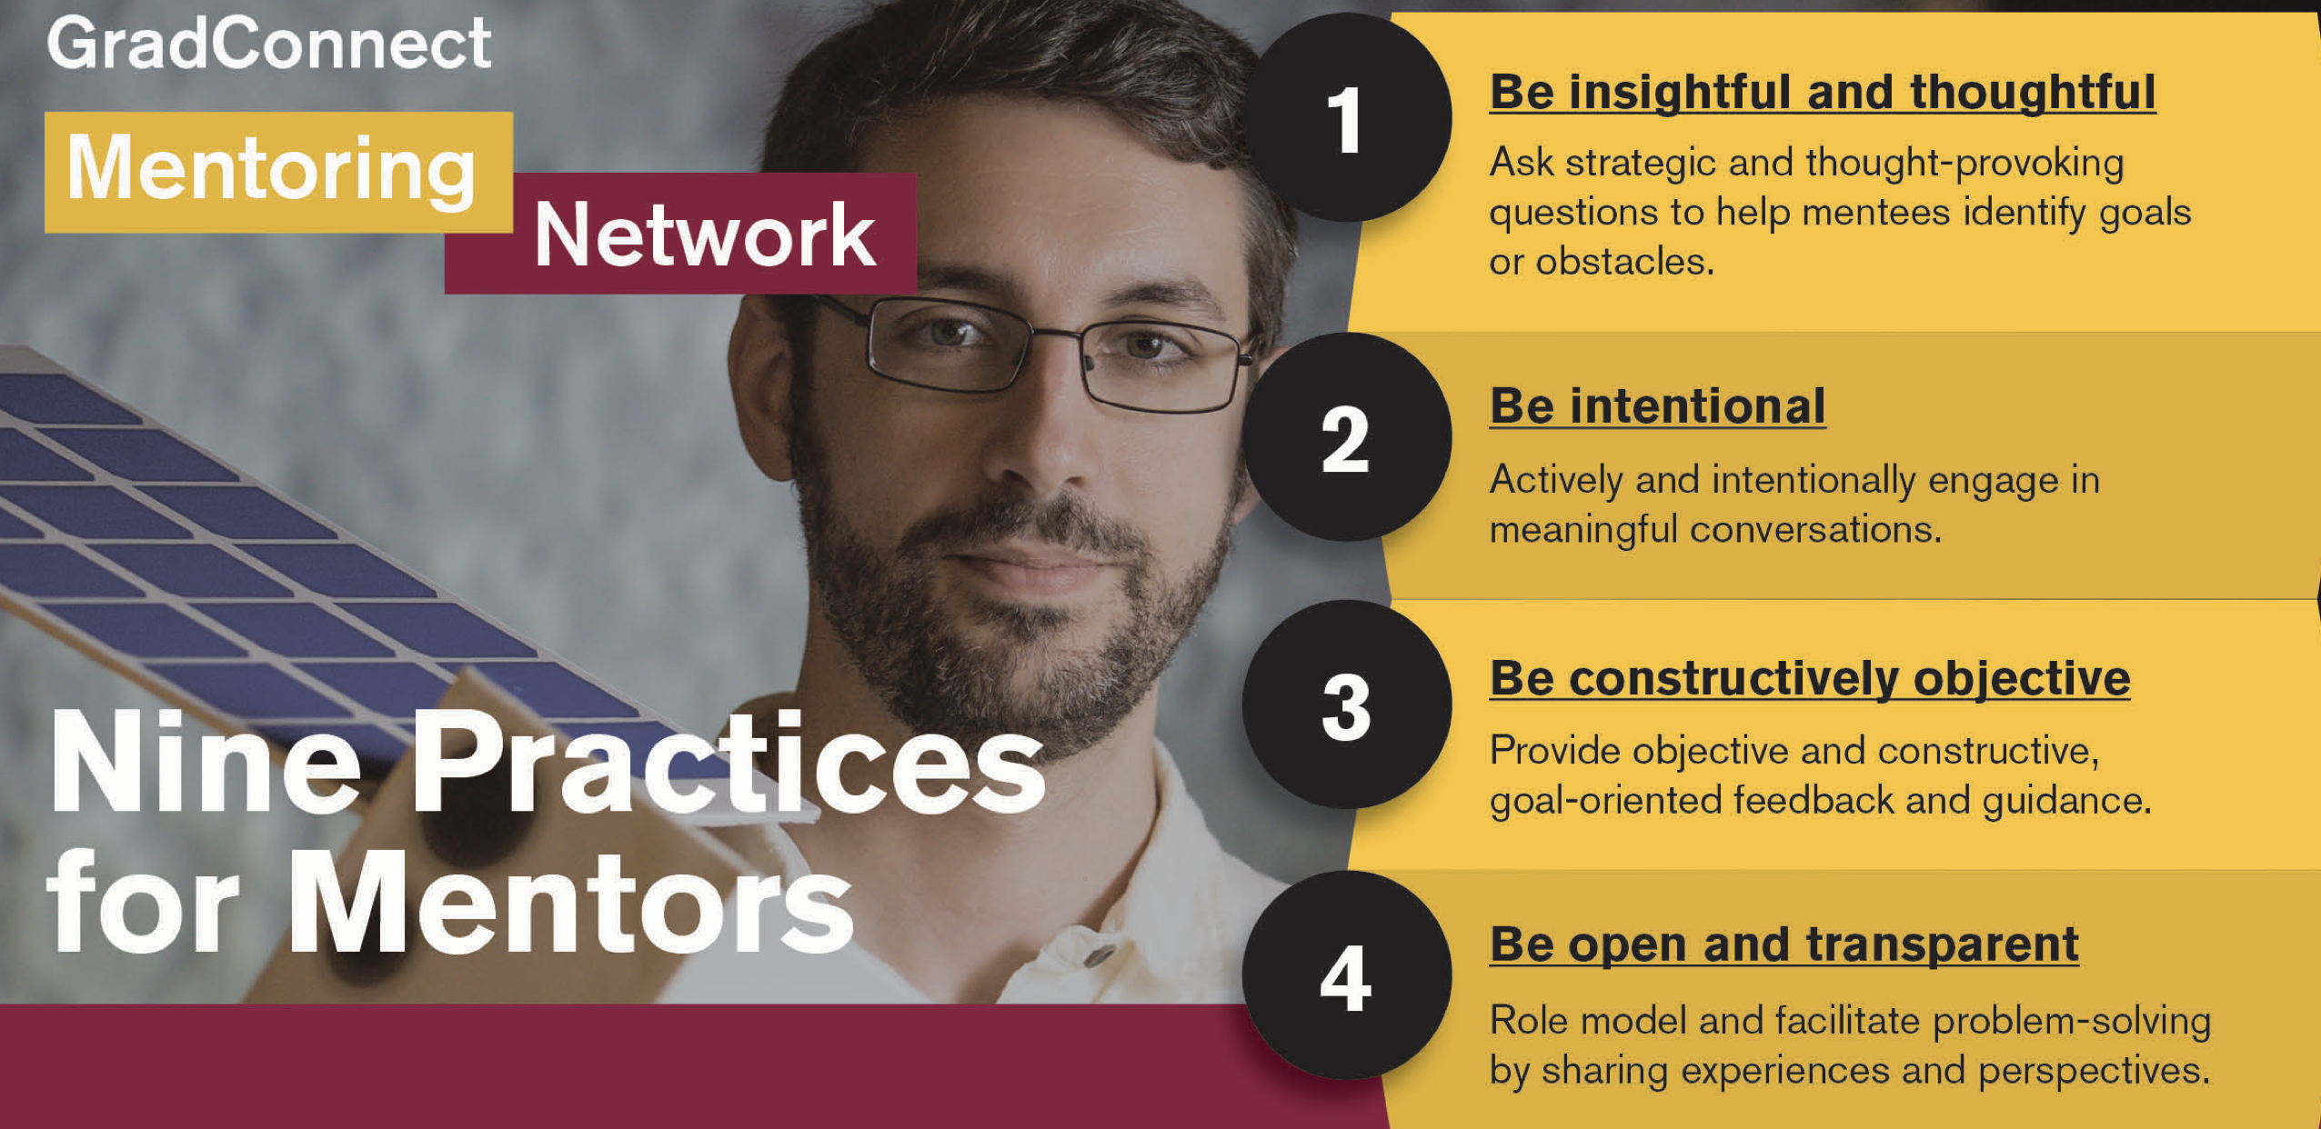
Mentoring: Giving it:
One of the criteria you will be evaluated upon as a faculty member is how effectively you mentor students (and colleagues). Much of the guidance on this applies outside academia too.
Graduate.asu.edu/mentoring

Slide 65
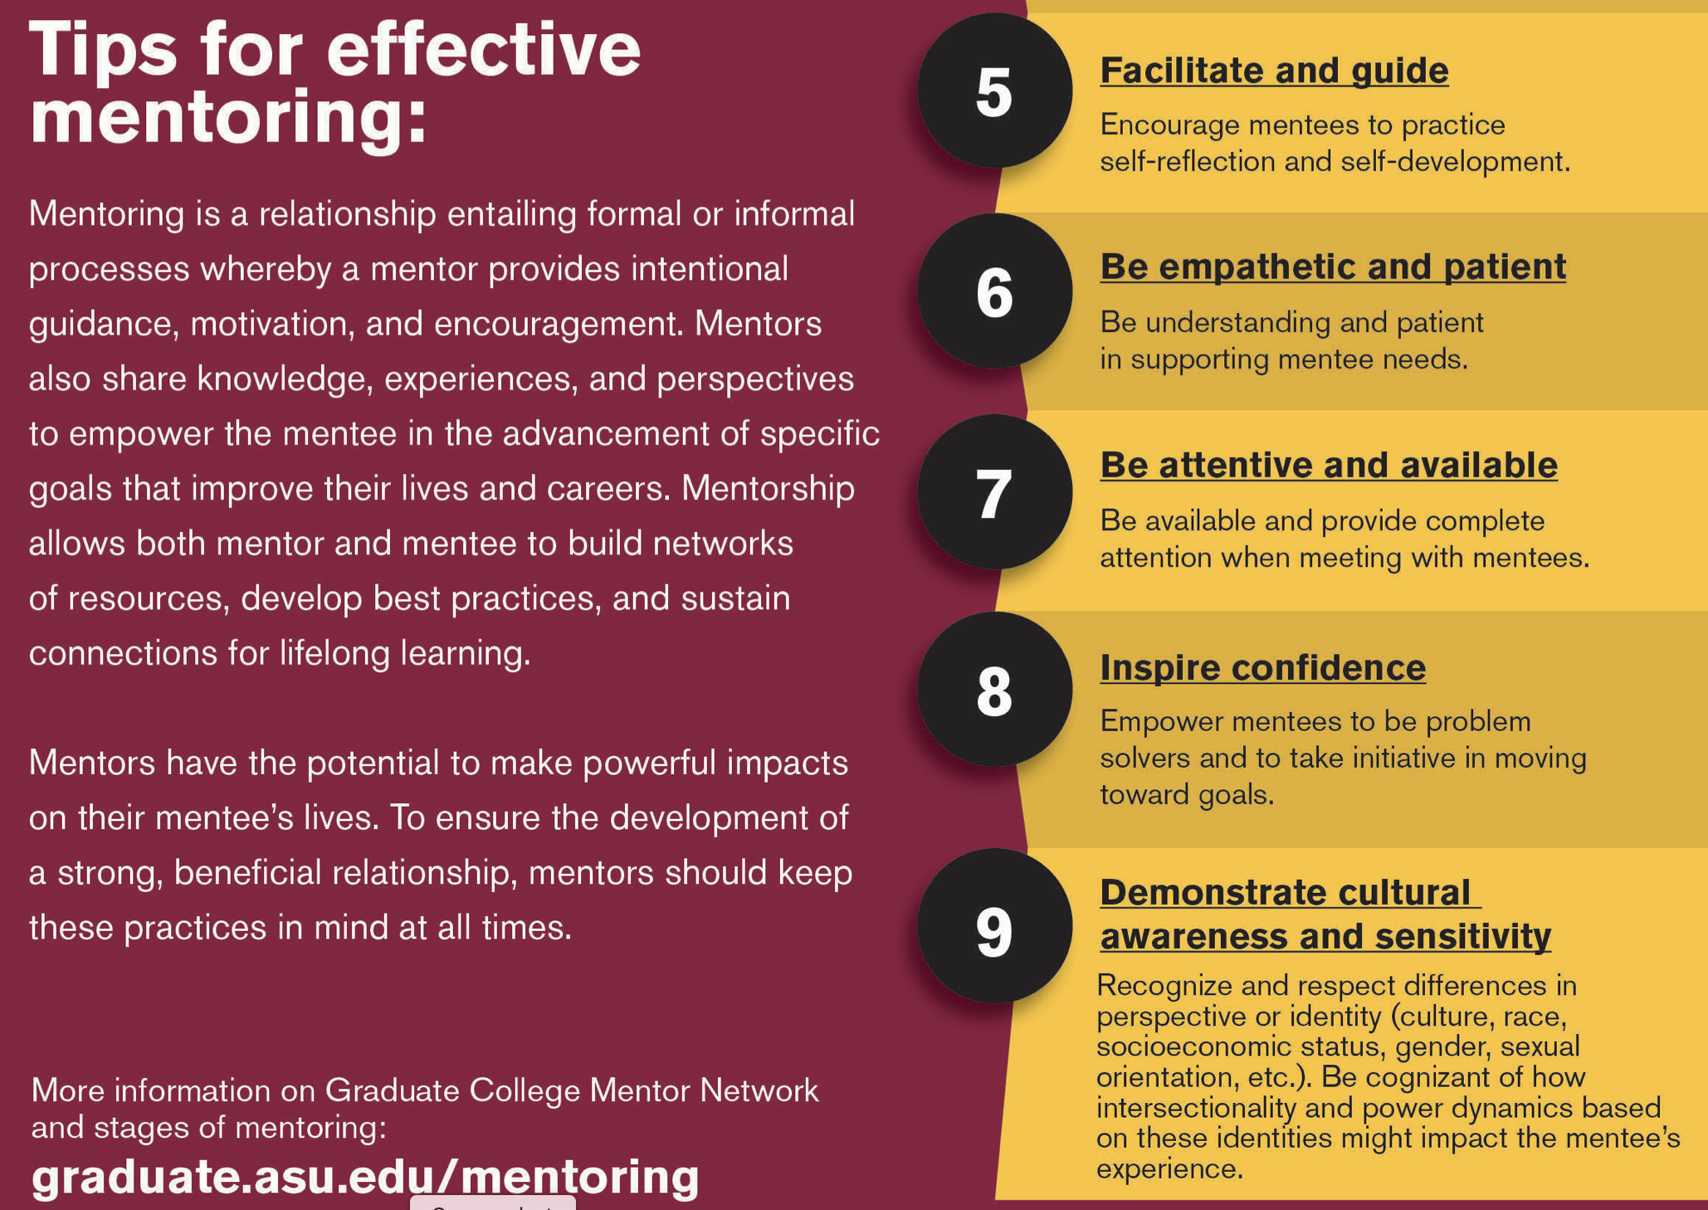
Mentoring: Giving it:

Slide 66
Mentoring: Giving it:
Mentoring undergrads has three main routes (aside from formal classroom instruction, in which you may have a mentoring role with some small number of students in a class):
As an academic advisor – you are generally expected to provide overall guidance on curricular requirements, provide career options, and be their advocate in disputes with others at the institution. Doing this effectively means investing time in understanding the curriculum, the processes for analyzing the student’s progress, and coordination with any other advisors (such as professional ones at the College).
As an instructor in a course-based undergraduate research experience (CURE) – for this you are often providing some oversight of group or individual projects that connect to the course content. As one of the main routes to research experiences for undergraduates (others are REU summer programs and in a faculty member’s lab), a CURE may be the only research a student experiences.
In a faculty member’s lab – this may be funded research, work-study supported by the institution, or an un-paid internship. Combining the skills and experiences of undergraduates, graduate students and postdocs in an effective lab is challenging due to the different individual objectives and levels of maturity involved, the differing levels of individual investment, and the differences in compensation. A key to success is developing a lab ethos in which all involved have “ownership” of the ongoing projects by ensuring all are aware of the overall goals, how they contribute, the expectations for each individual and sharing successes

Slide 67
Mentoring: Giving it:
Undergraduate students differ from graduate students and postdocs:
Often new to science, undergraduates likely have limited experience working within the scientific process and may be wholly unfamiliar with academic research and culture.
Undergrads may be juggling many outside demands on their time including classes, work, extracurricular activities, and/or family obligations that prevent them from dedicating significant time to research.
While graduate students have committed themselves full‐time to scientific research, undergraduates are likely still figuring out what career they want to pursue. Thus, they may justifiably question whether research will help them in their long‐term goals.
These unique characteristics of undergraduate researchers reinforce the importance of being flexible, patient and cognizant of students’ individual needs when developing one's mentoring approach.
Emery, N. et al. 2019. Students as ecologists: Strategies for successful mentorship of undergraduate researchers.
Ecology and Evolution, Volume: 9, Issue: 8, Pages: 4316-4326. DOI: (10.1002/ece3.5090)

Slide 68
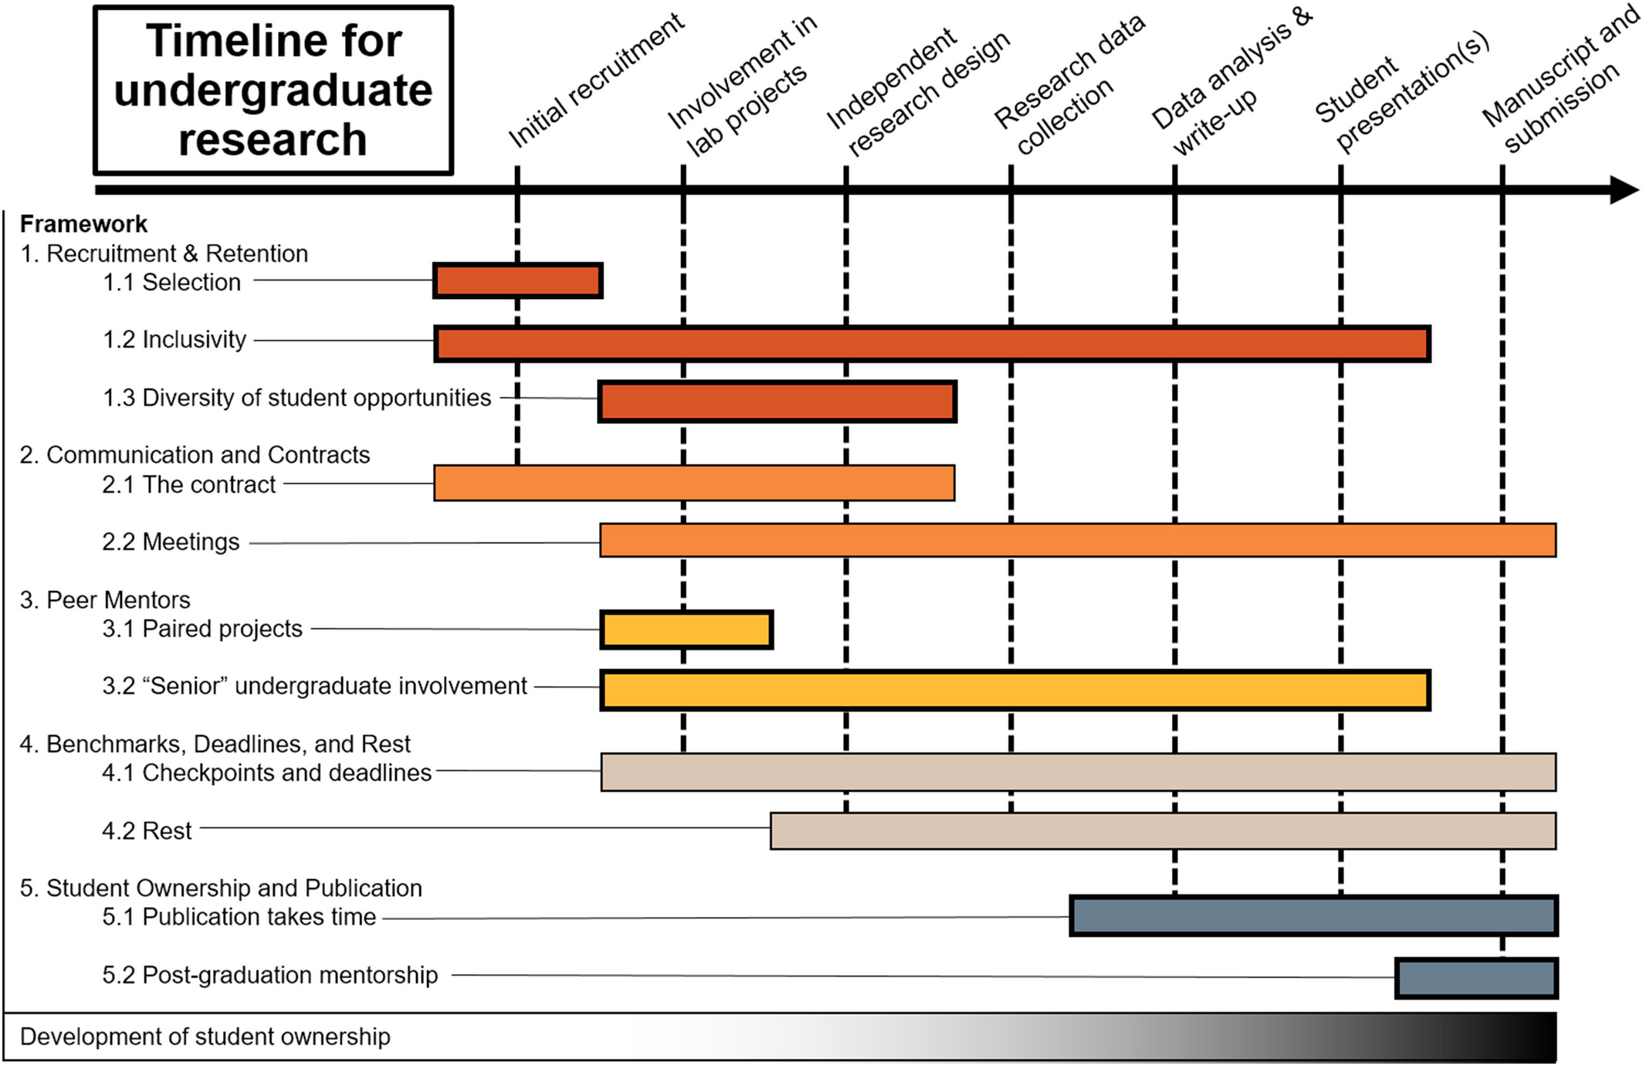
Mentoring: Giving it:
Mentoring students effectively in your lab is critical to both their career success and the success of your research program
Students as ecologists: Strategies for successful mentorship of undergraduate researchers
Emery, N. et al. 2019. Students as ecologists: Strategies for successful mentorship of undergraduate researchers.
Ecology and Evolution, Volume: 9, Issue: 8, Pages: 4316-4326. DOI: (10.1002/ece3.5090)
Notes:
How mentors are involved in the undergraduate research experience over time. Each color represents a different topic described in the text, and the bars indicate when a given mentoring effort generally overlaps with the undergraduate research timeline. The gradient at the bottom represents the development of student ownership over time
IF THIS IMAGE HAS BEEN PROVIDED BY OR IS OWNED BY A THIRD PARTY, AS INDICATED IN THE CAPTION LINE, THEN FURTHER PERMISSION MAY BE NEEDED BEFORE ANY FURTHER USE. PLEASE CONTACT WILEY'S PERMISSIONS DEPARTMENT ON PERMISSIONS@WILEY.COM OR USE THE RIGHTSLINK SERVICE BY CLICKING ON THE 'REQUEST PERMISSIONS' LINK ACCOMPANYING THIS ARTICLE. WILEY OR AUTHOR OWNED IMAGES MAY BE USED FOR NON-COMMERCIAL PURPOSES, SUBJECT TO PROPER CITATION OF THE ARTICLE, AUTHOR, AND PUBLISHER.

Slide 69
Mentoring: Giving it:
Assessment – how good a mentor are you?
Activity/Strategy | Question/Task
Appreciating individual differences | Give an example of an incident that illustrates your acknowledgement of individual difference
Availability | Give an example of the strategy you use to be available to your students/staff
Self-direction | Do you micromanage or promote self-independence
Questioning | Describe how you last used active questioning to lead a mentee towards a solution
Celebration | When did you last celebrate a student/staff member’s achievement? How did you celebrate?
Nature's guide for mentors https://www.nature.com/articles/447791a

Slide 70
Mentoring: Giving it:
Assessment – how good a mentor are you?
Activity/Strategy | Question/Task
Building a scientific community | Describe a deliberate strategy you use to build a scientific community in your group
Building a social community | Describe a deliberate strategy you use to build your group as a social community
Skill development | Describe steps you take to develop the critical, writing and presentation skills of your students/staff
Networking | Describe one example of how you have introduced each of your students/staff into the scientific network of your research area
Mentor for life | How many of your past students/staff are you in contact with?
Nature's guide for mentors https://www.nature.com/articles/447791a

Slide 71
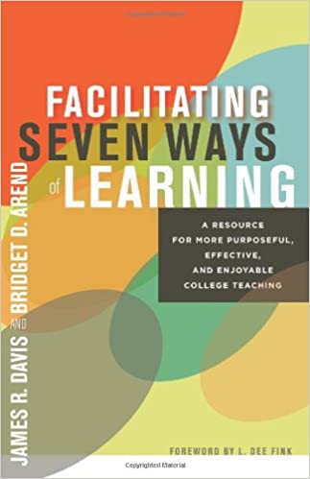

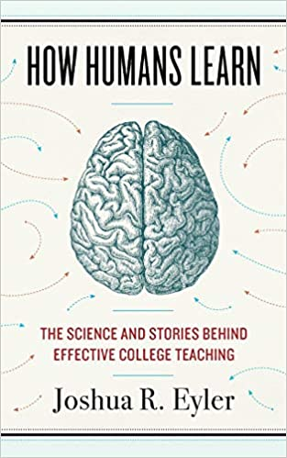
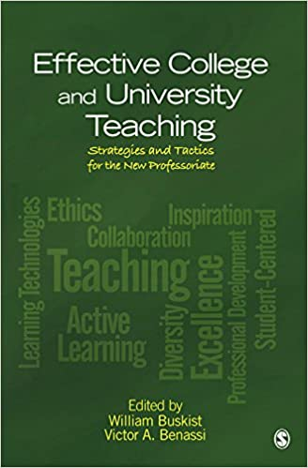


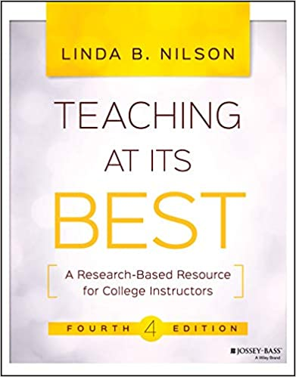
Enhancing Your Teaching:
There is a lot of guidance:

Slide 72
Enhancing Your Teaching:
This is important assuming that you have an academic position that somehow connects to students. Even if your position is mostly research, extension or consulting, if you interact with students, you should consider it part of your responsibility to assist their learning.
Use the resources available to you – every institution has some teaching and learning center, there are regular workshops about various aspects of classroom instruction, professional societies have workshops specific to the discipline, there are education research journals in every discipline, professional journals often have sections on teaching

Slide 73
Enhancing Your Teaching:
Six Things That Make College Teachers Successful:
Study the knowledge base of teaching and learning - there are extensive publications in education research in every STEM discipline
Accept all who enter the classroom door - students enter with different experiences and models for how to learn and behave, so be prepared to assist all
Plan for instructional management - put policies in place, explain them on the syllabus, and help keep students regularly aware of the topics and expectations of them
Mary Clement. Six Things That Make College Teachers Successful. The Teaching Professor, 27.7 (2013): 5

Slide 74
Enhancing Your Teaching:
Six Things That Make College Teachers Successful:
Teach with a variety of strategies - there are multiple routes to a successful classroom and not all students learn similarly - consider alternatives and a mixture - learner-centered teaching, guided inquiry, active learning, lecture, group work, peer evaluation and online discussion.
Use assessment to inform students of their achievement - have clear grading schemes and regularly inform students where they stand - make sure they are aware that assessment helps them to understand their achievement and helps teachers meet their needs
Keep the passion - you became a faculty member in part because you had a passion to assist others learn - remind yourself that you are teaching to shape the future of your disciplines and influence the larger world through your disciplines.
Mary Clement. Six Things That Make College Teachers Successful. The Teaching Professor, 27.7 (2013): 5

Slide 75
Enhancing Your Teaching:
Teaching and Success in Tenure/Promotion:
Do something unique for your department: develop a new course, implement a new set of practices in an existing course, develop new materials to help Teaching Assistants in a standard course, organize a journal club on education research in your discipline, collaborate with an education researcher on papers, help revise the curriculum
Be involved in activities that indicate you value the importance of teaching: attend workshops at your institution, become a “teaching fellow” if these exist, participate in (or even better organize) an education workshop/special session at your professional society, become a leader in the education section of your professional society
Get a grant that involves education - this can be one that focuses on education perhaps in collaboration with an education researcher, it could be taking the lead on the education/broader impacts of an award for which you are not the lead investigator, it could be developing a tutorial or other training as part of a research grant

Slide 76
Enhancing Your Teaching:
Teaching and Success in Tenure/Promotion:
Tenure documents:
In your portfolio you will be asked to provide a teaching section. If you have done any of the above they should be highlighted in this section along with anything you have done on a regular basis to make your classes more effective. In reviewing tenure cases, external reviewers are mostly not specifically tasked with saying much about teaching, however if you have done any of the above it makes it easier for a reviewer (as well as the local Tenure Committee) to state something positive about your teaching.
About student evaluations of teaching: these are held essentially everywhere but there are major problems with them (e.g. various biases). Take them seriously but consider supplementing them with questions you ask the students in classes (anonymously) to help you improve as the course goes along (e.g. don’t wait til the end of the term) and keep these to potentially add to your department file. Ask a colleague to sit in on your classes occasionally to provide feedback either informally, or formally as part of the peer review process.

Slide 77








Dealing with Difficult People:
Be prepared for this – it will happen: There are many books on this - it may be helpful to read about this in advance.

Slide 78
Dealing with Difficult People:
Some basic tips:
Be calm.
Understand the person's intentions.
Get some perspective from others.
Let the person know where you are coming from.
Build a rapport.
Treat the person with respect.
Focus on what can be actioned upon.
Ignore.
https://www.businessinsider.com/9-useful-strategies-to-dealing-with-difficult-people-at-work-2011-6

Slide 79
Dealing with Difficult People:
Be prepared for this – it will happen: Academia offers somewhat different challenges though:
It could involve a colleague you have no authority over and who you have to interact with long-term
It could involve an administrator who can make decisions that impact your success
It could involve students/staff who report to you
It could involve a student in your class
It could involve someone you are expected to mentor.
In 3-5, you are in a position of authority for the person involved – so be very careful to follow all of the rules in the Faculty Handbook or HR manuals . If you are not certain what the rules are, be sure to ask HR or someone who knows.

Slide 80
Dealing with Difficult People:
Some tips:
Treat everyone with respect, even those not deserving (e.g. take the high road).
Place yourself as much as possible in a position of unassailable integrity – because you have been very successful, have great knowledge of the institution, have been above reproach.
Use the processes at the institution if appropriate (e.g. for harassment, inequity) but sparingly.
Know the appeals routes (every institution has these for all kinds of issues possibly in the Faculty Handbook or in the Human Resources manuals) if the actions of the person involved directly impacts your career.

Slide 81
Dealing with Difficult People:
Some additional tips:
(v) Cultivate someone in authority (e.g. a mentor, Head, Dean, etc.) who can stand up for you if necessary.
(vi) If the difficult person has authority over you (e.g. your Head), be very careful about going to someone above them without being sure you have tried all you can to resolve the situation
Note: in every situation (not just dealing with difficult people) be sure to copy everyone in the line of authority if you contact a higher-up about any issue.
(vii) Most institutions have an ombudsperson who is charged with helping resolve differences and fix problems - they may have some capability to assist though most really are there to guide you to other resources and to play the role of mediator.

Slide 82
Getting Funding for your Scholarship:
Initial Overall Comments:
You will be frustrated (everyone is) – so be prepared for rejection and expect it
Don’t expect that you will be highly successful – very few faculty ever attract substantial external funding. If you are regularly bringing in some external funding, then you are more successful than most of your colleagues.
All money is not the same – some requires huge effort for very little funding, some has no allowable indirect costs.
Not every institution has the capacity to support success in obtaining external funding, and there are tremendous differences between institutions in their capacity to assist in obtaining funding from different sources. Any lack of success may be because your institution is not set up to assist adequately.

Slide 83
Getting Funding for your Scholarship:
How hard is it? Background data on NSF awards (2017):
Of research proposals submitted (82% of all proposals to NSF), only 21% were funded. There is variation between programs though.
Early career PI funding rate was 18%, vs. 22% to other PIs
The 3-year funding rate was 39%, meaning that of all PIs who submitted a proposal over 3 years, 39% received at least one award.
Average number of proposals submitted to obtain an award was 2.4 – so for those who did get an award during those 3 years, on average they submitted 2.4 proposals
Average annual award amount was $169K and average duration of award was 2.9 years. Median award size was about $130K. These values vary tremendously across programs.
https://www.nsf.gov/nsb/publications/2018/nsb201915.pdf

Slide 84
Getting Funding for your Scholarship:
Types of external funding mechanisms:
Grants – these are the most common from NSF, NIH, DOE, private Foundations, etc. They support specific research/education projects using a formal proposal process. There are no specific “deliverables” but you are expected to carry out the man objectives in the proposal. So, if you included a workshop, tutorial, etc. in the proposal you must carry out those activities. However, there is considerable flexibility to modify the specific research efforts you proposed to do. Training grants are somewhat less flexible – you are expected to carry out whatever educational program you proposed (e.g. undergrad research, graduate training, etc.). Virtually all grants are awarded to the institution, not to the faculty member.
fellowships, coop agreements, contracts.

Slide 85
Getting Funding for your Scholarship:
Types of external funding mechanisms:
Contracts – these are the most common from industry and from various government agencies in which there are specific tasks to carry out – you are providing “technical assistance” to the client. Many State-level awards to higher education institutions are contracts. These have “deliverables” meaning specific activities, reports, experiments, data collection, etc. that you are expected to carry out. Contracts are in general much less flexible than grants. Contracts are awarded to the institution and may well arise from a non-competitive process (e.g. you were specifically asked to carry out the work without there being a formal open proposal process), but often there is at least some form of “bid process”.

Slide 86
Getting Funding for your Scholarship:
Types of external funding mechanisms:
Cooperative agreements – these are most common from various government agencies in which there is a collaboration expected between the agency staff and your institution. These may be research or education focused and how much collaboration there is with the agency is highly variable. Many Department of Interior units use these to foster collaborative efforts between their staff and college researchers (and there are formal “coop-units” from these agencies at colleges).
Fellowships – these can be awarded to the institution or to an individual faculty member. They may be for general support (e.g. a stipend for a leave), or may be targeted to a specific topic, area or individual.

Slide 87
Getting Funding for your Scholarship:
Types of external funding mechanisms:
Sub-awards – these typically arise because a grant is awarded to a particular university and there is a partnership with faculty at other universities so some of the funding is sent from the main institution receiving the award to other institutions. NSF awards may be handled in this way to foster partnerships between institutions, or they may be structured as “Collaborative proposals” in which each institution receives its own separate NSF award.
Sub-contracts – similar to sub-awards for grants but in this case one entity receives a contract (or a grant) and wishes another entity to carry out specific tasks. For example, many grants that require evaluation have sub-contracts to evaluation experts at other institutions to carry out the evaluations required.

Slide 88
Getting Funding for your Scholarship:
Types of external funding mechanisms: A special tip for NSF awards
DCL – Dear Colleague Letter– these are used by NSF to make announcements of new initiatives that are not handled through the typical proposal grant and review process. They are now one of the easiest ways to obtain NSF support, typically for smaller pilot projects, conferences, etc. A DCL will announce a new initiative, inform you about the funding mechanisms, and often note that you should contact particular program officers with your idea prior to submitting a full proposal. There may be back-and-forth with a program officers prior to them asking you to submit

Slide 89
Getting Funding for your Scholarship:
Changes to awards:
Supplements – these are additions to awards to allow you to carry out some new work that is aligned with the effort on the original award. Typical supplements at NSF are for an REU student to work on the project, a workshop/tutorial to promulgate the research being done.
Modifications – these are changes to a contract to provide additional funding, modify the tasks/deliverables, change the time period for the award.
No Additional Cost Extension – this extends the end date of a project, typically because you have funds remaining and the funding agency is OK with you continuing to work on the project
Rebudget – this allows you to change the amount being spent among the project components, your institution can approve sometimes, or agency may have to approve

Slide 90
Getting Funding for your Scholarship:
The process for getting an award:
(i) Have an idea that is supportable
(ii) Find an appropriate agency and read the rfp (Request For Proposals)
(iii) Write the proposal and submit it
(iv) Wait (anywhere from 2 months to 2 years or longer)
(v) If accepted, typically a revised budget and revised scope of work is needed (e.g. they cut the budget) - send this in and wait another couple of months
(vi) If denied, read the reviews, decide if resubmission might be successful and if so, revise based upon the reviewers comments and resubmit. Otherwise submit to a different agency, or choose a different idea to submit, and go back to (iii)
The above can take 6 months to 2 years for first proposal - NSF typically takes 6 to 9 months after submission to decide on a proposal

Slide 91
Getting Funding for your Scholarship:
Deciding where to submit:
Where to submit depends on the idea, what the agency is currently funding, and how much funding you need.
Be sure you are on the lists to get emails from the agencies of possible interest about their requests (every division at NSF sends out emails regarding new opportunities –
nsf-update@govdelivery.nsf.gov).
Most higher ed institutions have a contract with a firm that searches for awards of possible interest to you and send you a weekly listing from many agencies/foundations. At UTK this is called Pivot. Be sure to update your profiles on whatever product is used to ensure the listings you get are appropriate. Many professional societies send out similar emails or notes to lists about new programs that are of interest

Slide 92
Getting Funding for your Scholarship:
Deciding where to submit:
Aside from NSF, NIH and some competitive grants programs in other agencies, much Federal R&D funding is project driven or task-specific. You have to be doing something directly related to their project, or have an approach that can be made useful for their project, in order to be supported. To be successful here requires building a relationship with a particular program manager at the agency until they eventually ask you to submit a proposal (which may or may not be connected to one of their formal proposal announcements). So networking to cultivate a relationship with a program manager is essential for success from many agencies (DoD is like this) – they are cultivating you and you are cultivating them.
Private Foundations are typically very difficult to obtain funding from without having “connections” to their funding officers. Many Foundations accept applications for funding on from those who are “invited” to apply.

Slide 93
Getting Funding for your Scholarship:
Writing a successful proposal:
READ the Request For Proposals (RFP) and be sure to respond to it
Look at the language in the RFP. It will tell you what some of the keywords in your proposal should be. The proposal must be responsive to the RFP or it will not be funded.
For NSF it is expected that writing will be technical, but understandable to a generally educated scientist who has some training in the general field you are submitting to. Flowery writing styles don't fare too well at NSF. Keep the writing concise, clearly elucidate why the problem you are proposing is important, set out the goals, make it clear that you are familiar with the background materials needed to carry out the work, put the proposed work in a context of previous work by yourself and others, explain why you are the person capable of carrying it out, and explain each budget item carefully in the budget justification section. Having an overall conceptual figure helps.

Slide 94
Getting Funding for your Scholarship:
Writing a successful proposal:
If the proposal is to a Foundation that supports general research (e.g. Ford Foundation, Kellogg Foundation, etc.), it is likely that you will have to write the proposal in a much less technical manner, but this depends upon how specific the RFP is.
A typical funding mechanism for junior researchers are “starter awards” internal to your institution. For these submission, since the reviewers will typically be chosen from a broad spectrum of faculty rather than ones in your particular field, being very clear about why what you propose is important, will allow you to advance in your career (e.g. leverage this to get external funding) and/or enhance your research or education tool set.
It helps to know as much as possible about the evaluation process for whatever you are submitting. So volunteer to serve on review panels, particularly at major funding agencies such as NSF.

Slide 95
Getting Funding for your Scholarship:
Writing a successful proposal:
Do you include data, statistics, tables, mathematical formulas, and such to support your proposal? Include whatever is necessary to make it clear to reviewers that you know the area, have a new idea that is worth pursuing, and have the background to do the work. This means you should include anything directly pertinent to the proposed work, but don't put things in just for filler - whatever figures or data you include should be directly related to the proposed work. Having a few overall conceptual figures is expected so build your capacity to do this, or collaborate with someone who is good, or use the media staff at your institution to help.
Are there certain "key phrases" for which agencies look? Most definitely - look at the language in the RFP. It will tell you what some of the keywords in your proposal should be. The proposal must be responsive to the RFP or it will not be funded.

Slide 96
Getting Funding for your Scholarship:
Writing a successful proposal:
How long does it take to write a proposal – do you go through many rough drafts? This is very individual, as is all writing. Just don't expect to dash off a proposal the night before it is due and have it be successful. Have colleagues, friends, students, etc. look over the proposal before submission to determine places where you thought it was clear, but others were confused. Leave time for this type of feedback.
How much "paper work" is involved? Proposals to Federal agencies (e.g. through research.gov) require lots of forms. Many of these (e.g. drug policy, accounting policy, etc.) are supplied by the administrators at your institution. Your responsibility is to complete all the forms you can, be sure the proposal is correctly assembled, and is submitted by the appropriate date. The more of the work you do, the faster and more efficient will be the submittal process. If you do most of the work yourself, the administrative staff will be much more likely to rush to help you when you really need it, than if you were constantly needing their assistance.

Slide 97
Getting Funding for your Scholarship:
How do agencies review proposals?
There are several different routes:
Review by program officers/agency staff - This is typical of certain agencies in which the program officers have developed relationships with investigators and request proposals. Used in some parts of DoD, DOI, USDA, some private Foundations.
Reviews by ad hoc reviewers – reviews by knowledgeable experts are requested by program officers, and the program officers compile these reviews and make funding decisions
Panel reviews – used by almost all programs at NSF and NIH (they are called NIH Study Sections), and many private Foundations. Requests by program officers are made to experts to serve as a group in reviewing many proposals submitted for a certain RFP, each panel member reviews a group (typically 10-20) proposals, with each proposal reviewed by 3-4 reviewers, the panel meets and provides a ranking to the program officers based on discussions.

Slide 98
Getting Funding for your Scholarship:
Writing a successful proposal:
What criteria are used to evaluate the proposal? This is agency specific and will be stated in the RFP - read it and be sure you are writing the proposal to meet the review criteria.
If the proposal is awarded, what happens next? What's the process for getting the funding? What financial accountability is involved? This depends on the type of award. Some multi-year awards grant your institution the full amount up front - others require a yearly renewal based on your reporting. Some agencies require formal invoices to be sent regularly. Typically, the Principal Investigator (P.I.) doesn't have to deal with any of this. BUT, it is your responsibility to be sure the funds are spent in the manner appropriate to do what the proposal included, that they are not misspent, and that any agency guidelines for budgeting are met. You must be sure that expenditures do not vary greatly from budgeted line items – get explicit permission from the agency if major changes are needed. Of course, you also have to do the work you proposed to carry out!

Slide 99
Getting Funding for your Scholarship:
Writing a successful proposal:
How are all the finances handled for an award? Accounts will be established by your institution with budgets based on those in your proposal. There may be more than one account if part of the award has F&A charges allowed and another part does not (e.g. for tuition of students and participant support). Charges to the accounts will be made in your institution’s financial system and you should receive regular ledgers or sheets with the charges. Institutions typically require your approval as the PI for charges before they are made (e.g. you sign a charge form for paying salaries, hiring students, buying equipment, etc.) and you are asked to approve the charges after they appear on ledgers. Hopefully there will be a department finance person to assist with all this, but the overall responsibility is yours as the PI. Mistakes do happen and you should follow through on your responsibility to check the accounting.

Slide 100
Getting Funding for your Scholarship:
Writing a successful proposal:
If the proposal is rejected, what happens then? Is there an appeals process? Can you resubmit? Most agencies do have an appeal process, but it is very rare for an individual investigator to try to use it. Much more likely is resubmission, unless the reviews were so negative that the whole idea is not really worth pursuing at that agency anymore. There is no rule at most agencies against resubmission of a proposal that hasn't been funded, but usually it is assumed it will be rewritten based upon review comments. Rewriting to meet review comments is still no guarantee of success. The review panel (and perhaps the agency program officers) change regularly so it is highly likely that a second proposal submission will not be read by the same reviewers who read the first one. Some agencies do allow you to note changes you made based upon previous reviews – this may be helpful if allowed.

Slide 101
Getting Funding for your Scholarship:
Overall tips on getting funding:
1. Know your audience - what the agency is requesting, what the review procedures will be, who will be the reviewers - Read the RFP carefully
2. Have an idea that is appropriate, carefully state the goals of the proposed work near the beginning of the proposal and come back to these goals regularly in the proposal
3. Emphasize why you are the appropriate person to do the work
4. If appropriate, discuss the proposal with the agency's program manager before submitting it - be certain what you are proposing fits the guidelines for support. Ask if the proposal may be reviewed by more than one group in different programs (particularly possible for interdisciplinary proposals)
5. Find out as much as you can about the review procedures - volunteer to review for the program if you have not reviewed for the agency to see what the procedures are

Slide 102
Getting Funding for your Scholarship:
Overall tips on getting funding:
6. Feel free in the cover letter or in the appropriate place in the proposal to suggest reviewers with whom you do not have a conflict of interest
7. Be flexible - if one of your ideas is not getting funding support after several attempts, try something else
8. Don't get discouraged - keep trying - try different agencies, different ideas
9. Look at the list of successful previous proposals, read their abstracts, and modify your proposal accordingly to be sure it is in a similar vein
10. Have someone who has been successful getting grants from the agency look over your proposal before sending it in.
11. If you are not familiar with budgeting, have someone who is knowledgeable help you with the budget

Slide 103
Getting Funding for your Scholarship:
Overall tips on getting funding:
12. Don't overcommit yourself. All grants will require some administrative work on your part - be sure the grant includes sufficient support (or you should get agreement that, if funded, your institution will provide the support) to be able to actually do the work you propose
13. Remember, many faculty at research universities never get any appreciable external funding support, but it is expected that most faculty in STEM will obtain some support. If you are having difficulty getting external funding, try collaborating with someone who has been successful and be a co-PI on a proposal with them. This need not be someone at your own institution, but be aware that it is in general much simpler administratively if the support goes to one institution. Being a co-P.I. is fine to start and will give you a chance to learn without all the headaches of being a lead P.I.

Slide 104
Getting Funding for your Scholarship:
Overall tips on getting funding:
14. If you ever get to the stage where you are highly successful, realize that running a research group is similar to running a small (or not so small) business. You will have to deal with personnel issues (hiring, reviewing the personnel who report to you, firing), budgetary issues, and space and supplies. You also will have an obligation to continue to find support for the full-time staff you have and to ensure that funding for a student does not end in the middle of their degree programs. This typically means that you will need to be constantly searching for more funding. Do not take on this level of obligation unless you are really committed to handling all of this, most of which a typical faculty member has no interest or training in dealing with.

Slide 105
Administrators and how they impact your career
The key administrator you will deal with is your Department Head (or possibly Dean in a small institution). A good Head will do everything they can to provide you the resources to do your job, ensure you have effective mentoring, be equitable regarding expectations for your teaching and service, and will get out of your way as much as possible to allow your scholarship to flourish. Heads are typically overwhelmed with administrative tasks, but they are also colleagues and are expected to maintain their own scholarship, bring in funding, etc.
How to help ensure your Head considers you a great faculty member? Become outstanding in your scholarship, treat all your students and colleagues with respect, volunteer at least occasionally to accept service roles even if you have little interest in the ones that need doing, and do not go directly to any administrator higher up in the institutions hierarchy without making sure your Head is in the loop.

Slide 106
Administrators and how they impact your career
Getting your Head on your side: Do keep them apprised of your accomplishments and goals (typically this is in a yearly review but make sure your Head is informed about any major new accomplishments such as a major paper), be careful about contacting them for assistance on routine matters which should be handled by staff in the department or by associate Heads/Deans (e.g. most details of undergraduate and graduate activities are handled by others) and be careful about making regular complaints to them (e.g. don’t be a “whiner”). Personnel issues are a tremendous time-sink for Heads – be careful to document everything if there is an issue you think they need to deal with arising from your interactions with others on campus.
You don’t need to be superb in each of the faculty members responsibilities (research, teaching and service), but you are expected to be competent in all and really strong in at least one (and preferably two) of these.

Slide 107
Administrators and how they impact your career
Dealing with administrators other than your Head: Some administrators are involved in the academic chain of command with your Head (e.g. Head reports to a Dean who reports to a Provost, who reports to a Chancellor/President). Other administrators are not part of this chain of command (e.g. Human Resources, Finance, IT, etc.) and your Head may well have less ability to deal with issues arising from their units. Start with your Head or departmental staff if there is an issue with any of the offices that these administrators are responsible for, but do not expect your Head to resolve issues that other units outside the academic chain of command are responsible for. In general, it is best to deal directly with the lower-level staff in these other units as they are the ones who can actually do something to resolve issues. If it involves the policies in a unit though, lower-level staff will be bound by them and you may have to go to your Faculty Senate or other representative body to foster a policy change, even if to you it appears to be a simple matter.

Slide 108
Administrators and how they impact your career
Dealing with administrators other than your Head: Be careful of hubris. You don’t know as much as you think you do. You may think you understand what is happening and what a certain unit on campus should be doing. However, you are viewing this from your own perspective and there may well be good reasons for a policy that seems unreasonable to you. Universities are complex entities and administrators are dealing with hosts of issues and planning that involves diverse objectives, plus having to manage a staff that often have been around for many years and they have little ability to change. To get a better idea of how the University operates at levels beyond that in your own department, consider volunteering to serve on the Faculty Senate or any of the host of committees that are established at different levels in the University hierarchy.

Slide 109
Preparing for Evaluations
The Review Process: We already discussed the tenure review and promotion process. There are additional annual reviews typically expected to be carried out by Heads for all the faculty. There may be explicit formats for documents you supply for this rather than just turning in a cv. It will help in completing these if you keep careful records of everything you have done, including all your formal courses, any other teaching you have done (e.g. running a tutorial for a professional society, giving guest lectures for classes of other faculty, journal clubs or seminars you have participated in, etc.), your mentoring activities, efforts for any professional societies, talks you have given, external funding proposals submitted, editing/reviewing for journals, reviewing for funding agencies, etc. Make it as easy as possible for your Head to complete a review by including in your annual report a “summary” that they can lift and use to laud you.

Slide 110
Preparing for Evaluations
The Review Process: While your Head is the primary individual involved in your evaluation as a faculty member, the colleagues in your department also have a role for promotions and awards. Typically, the pre-tenure faculty are all reviewed annually by either a subcommittee of the tenured faculty or the complete group of tenured faculty. The tenured faculty may then make a recommendation to the Head (or Dean) on retention of the pre-tenured faculty. For promotion reviews, Associate Professors are reviewed by Full Professors. Departments (and the College, and University) have award committees who take nominations for whatever honors/awards are available, and then review these to make a recommendation to the administrator making the final decision. Sometimes these award committees are made up of recent or current winners of the awards. Professional societies also have awards – be aware of those in your field so if appropriate you can ask a colleague to nominate you. Be pro-active about these – awards are a typical method to assess the success of faculty.

Slide 111
Participating in the broader academic community:
What does this mean? In your academic field it could mean participating in professional societies, editing for journals, attending or organizing workshops/tutorials, reviewing for grant agencies. In a wider sense it refers to participating in the professoriate at your institution (e.g. being a good colleague when someone in another field asks for writing for your input), serving on advisory boards for local, regional or national organizations that may not directly relate to your academic discipline, giving outreach presentations, writing for the public.
Why does this matter? It helps you expand your network. It can provide different perspectives than those available in your home institution. It builds your reputation. It can indicate that you have the “altruism gene” that may eventually lead to being recognized as an officer of your professional society or editor of a main journal. All this reflects positively on you and your institution .

Slide 112
Participating in the broader academic community:
How do you bring this about? Join appropriate professional societies (they often have lower rates for junior researchers), determine whether they have sub-groups that directly align with your interests and join these. The subgroups often are much more readily open to having new researchers take on leadership/volunteer roles than the larger overall society, so start there. If you publish in a particular journal you are already likely already on their potential reviewer list but if you don’t get requests and wish to, look at the editorial board and send a note to one of the board members whose area is most closely aligned with yours and volunteer to review. At your institution there is likely an outreach office which manages requests for faculty speakers – you can get on their list. Look at local organizations that you could feel connected to, attend some activities and volunteer for them if you are drawn to their efforts.

Slide 113
Participating in the broader academic community:
Is this really necessary? No, there are highly successful faculty who don’t invest time and effort in this. They “hunker down” and focus on their own scholarship. Or they limit their connections to those activities that are directly beneficial to their careers. However, among the leading researchers I’ve known, the really top ones (e.g. ones who win the major awards such as Medal of Science, National Academy membership, etc.) typically are known for their efforts outside the strictly research ones. One advantage of participating as described in the academic community is finding these folks and interacting with them. This can be professionally and personally rewarding.

Slide 114
Building Effective Collaboration:
What counts as effective? Each person involved has shared responsibility to carry out the effort, everyone contributes though not necessarily in “equal” ways, there is consensus about who is doing what, there is mutual respect, there are products that all agree upon
Why this matters? Effective collaborations are like “leveraging” in that they allow you to both hone your skills by learning from others with different skill sets, while being more effective yourself in getting scholarship accomplished. Particularly for problems crossing disciplinary boundaries, having a diversity of skills ensures that no single approach limits the methods utilized. In many particular areas there can be disagreement by experts on key approaches, as well as the particular methods to employ. Having diverse collaborators to call upon reduces the likelihood that the research becomes “canalized” along a particular path when other routes may be more productive

Slide 115
Building Effective Collaboration:
How to bring this about? The “Science of Team Science” has provided guidance on effective collaboration, though there is no single route to build these. Some arise from acknowledgement up-front that various skills are needed to analyze a problem, some arise only after a research effort has started and it is determined new perspectives are necessary to really address the main problems. There are organizations (KnowInnovation is one) that agencies such as NSF rely upon to foster collaborations ( e.g. this group coordinates the NSF “IDEAS Labs”) through formal facilitation. The NSF Synthesis Centers were designed to foster team science.
Baron, J. S. et al. 2017. Synthesis Centers as Critical Research Infrastructure, BioScience, Volume 67, Issue 8, August 2017, Pages 750–759, https://doi.org/10.1093/biosci/bix053
Hall, K. E. et al.,. 2018. The Science of Team Science: A Review of the Empirical Evidence and Research Gaps on Collaboration in Science. American Psychologist 2018, Vol. 73, No. 4, 532–548.

Slide 116
Fostering Interdisciplinary Collaboration: My Tips
Hubris is the enemy of collaboration - you don’t know as much as you think you do.
Trust your colleagues - they know more than you do.
Don’t feel obliged to collaborate with assholes, even if they are brilliant.There are great non-assholes out there - find them.
Spice up your life - marry a poet.

Slide 117
Fostering Interdisciplinary Collaboration: My Tips
Don’t judge other disciplines based upon their students.
Find ways to explain your passion for your field to others.
Be patient - don’t expect to learn the language of another field easily.
The status quo arose from disciplinary silos - don’t be afraid to challenge it and modify or throw out the “rules”
Find mechanisms to ensure everyone benefits from a collaboration - individuals, their students, their department - share the wealth in order to generate new resources.

Slide 118
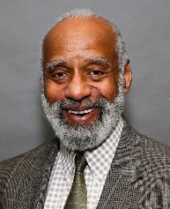
Building Balance in your Life:
Remembering a Conversation:
When visiting Morehouse College several years ago, I had a fascinating conversation with J.K. (as he is known) not about biology though there was that too) but about what drove us. In all my many visits to higher education institutions, J.K. was the only person who asked the deep questions of “What drives you”, “What really matters to you”, “What do you do for yourself”, “How do you contribute to the world”. This led to a discussion of family, art, music and educating students to “build a life they can look back on without regret”.
This seems to relate today to YOLO – You only live once
J.K. Haynes – Professor of Biology and Dean of Science and Math, Morehouse College

Slide 119
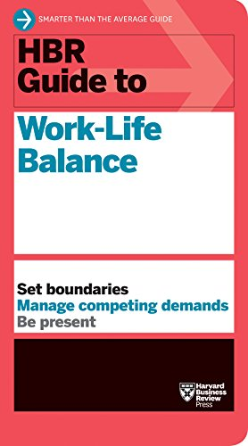


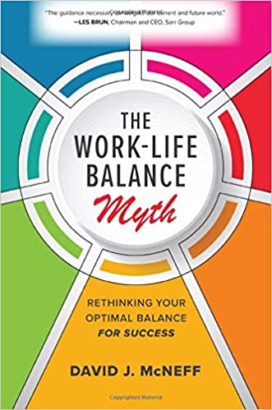

Building Balance in your Life:
There’s hosts of books on work-life balance:

Slide 120
Building Balance in your Life:
The Typical Suggested Steps include:
Prioritize and redo this regularly
Set firm boundaries between work and life
Be consistent about your time for each
Find time everyday to do something other than work
Learn to separate and focus on work there but not at home
Find people who are supportive
The academic life is rather different from other “jobs” though. In academia, rather than having a “boss” who manages you, much of what you do is self-motivated. If you do not heavily prioritize your scholarship, frankly you are simply not going to be successful (brilliance is not sufficient – you have to work very hard to be successful – just the effort to publish a single paper is substantial).

Slide 121
Building Balance in your Life:
So there is the danger:
Creative effort in scholarship may well not be readily separable from the rest of your life. Indeed, that are many stories/books about self-absorbed artists whose life is destructive, and scientific work can be just as self-absorbing as artistic efforts.
Avoiding this:
Look at the values in the IDP you chose – add to these values a set of items that are not on the list that really matter to you now, that you look forward to having time to spend on in the future (e.g. family activities, playing music, running, sports, etc.) and make sure that these make it into your IDP and revise the IDP and career plan accordingly

Slide 122
Building Balance in your Life:
My suggestion:
Have something outside your professional career and responsibilities that you want to be able to say you are really good at, maybe that you are the “best” at among some selected group. Then allocate time and effort to getting to that point. Like playing a musical instrument, it may require years of effort, and there may be plateau’s where you want to evaluate whether you want to try something else to focus on (this is typical of certain physical activities that are more difficult to be as competitive at as you age). So resetting and reevaluating these, particularly as your family responsibilities may change, is needed.
In the end, have something outside academia that allows you to build a different cohort of friends and to be proud of your accomplishments is healthy.

Slide 123

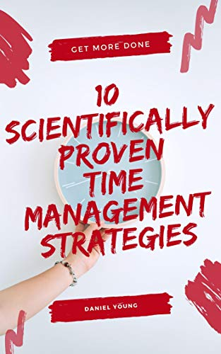
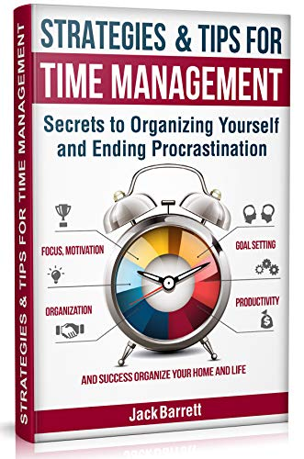
Time Management:
Again there are many books with suggestions:

Slide 124
Time Management:
Example of the tips (from Steven Covey’s book):
Be proactive
Begin with the end in mind
Put first things first
Think win/win
Seek first to be understanding (of others), then to be understood
Synergize (seek creative cooperation)
Sharpen the saw – improve yourself mentally, in value seeking, socially/emotionally, physically
A key in the time management literature is making lists, formalizing these, establishing a schedule and setting rules for yourself to follow the schedule.

Slide 125
Time Management:
Some tips:
Prioritize (how will this help my career goals, how much effort will it take) – view it as a cost/benefit analysis even if you don’t know the exact values
Give higher priority if it is “fun”
Learn to say “No”
Plan and make time for the “big issues” that you hope to look back on and say you chose to work on problems that matter
Use a “time matrix” placing tasks on Urgent/Not urgent and Important/Less important
Set goals on different time scales – short/medium/long that align with phases of your career plan
Learn to “triage” and discard (or don’t agree to) tasks that don’t align with your career plan
Avoid procrastination

