Slide 1
EEB 504 and EEB 607 - Spring 2021 - Careers in Academia: How to Enhance your Chances for Success
Instructor: Louis J. Gross
Chancellor’s Professor, Departments of Ecology and Evolutionary Biology and Mathematics
College Costs, Institutions Types, Missions, Stakeholders, Employees, Structure, Processes, Budgets
Feb 1, 2021

Slide 2
Outline of course topics:
Types of higher education institutions;
How colleges and universities work;
Where the money comes from and where it goes;
Various roles of a faculty member and prioritizing among them;
Stages of a career;
Planning for transitions in career stages;
Position searches and how to apply;
Mentoring - getting it and giving it;
Enhancing your teaching;
Building your communication capabilities;
Administrators and how they impact your career;
Effectively preparing for evaluations at various levels;
Funding your scholarship;
Participating in the broader academic community in your field;
Building effective collaborations;
Combining your personal life and academic expectations;
Time management.

Slide 3
Types of Institutions:
Private/Public
Systems
Non-profit/For profit
R1, 2, 3 Carnegie
Comprehensive
Land-grant
4 year (PUI) – Primarily Undergraduate
2 year (Community College)
MSI – Minority-serving, HBCU, Tribal
College (specialty, Arts, Graduate, Medical)
Liberal Arts
Alternative

Slide 4
Higher education and the public
There are regular articles, editorials, and books about the structure and costs of higher education:
The book review of this published in the NYT this weekend notes that:
There is great inequity in what people pay for college
There is inequity in the impact of what college you went to and your career options
There is inequity in public support for the costs of college
Bottom line is that if you choose an academic career you should be aware of the very strong public attitudes regarding the benefits and costs of a college education

Slide 5
Higher education and the public
The book review notes the subsidies for various institutions. As an example, UTK gets $271M in State funding this year and so this amounts to $11,700 subsidy for each undergrad or $9300 for each student if you count undergrad and grad students. Endowment revenue is about $30M for UTK so this is about $1000 per student compared to the stated amount in the NYT article of $105,000 per student at Princeton.
There are explicit subsidies for higher education from taxes at State, Federal and Local levels and there are implicit subsidies from allowing charitable contributions and endowment income to not be taxed.

Slide 6
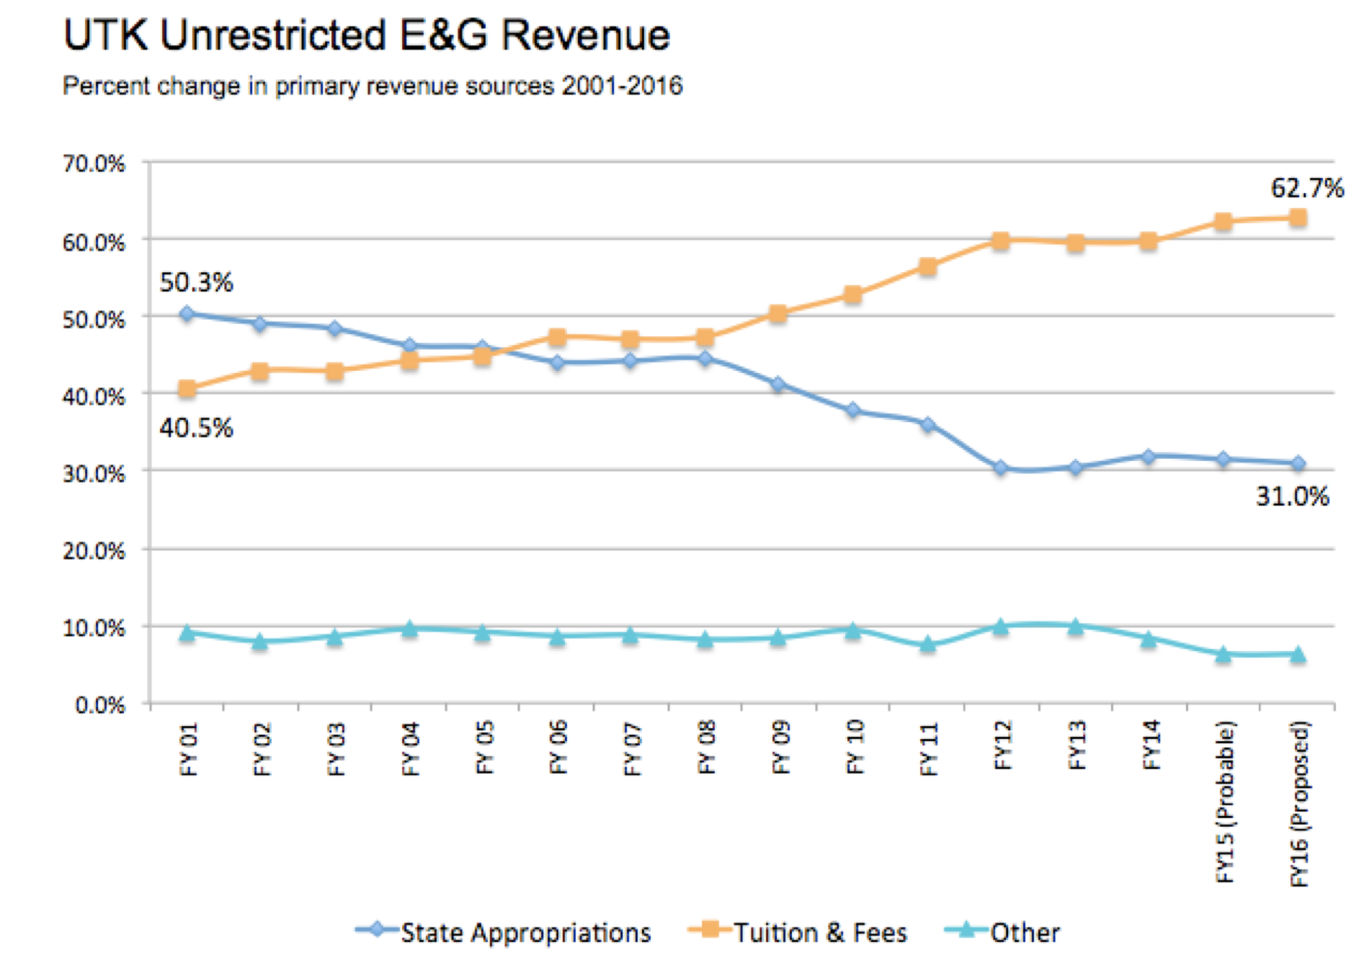
Higher education and the public
http://www.nimbios.org/~gross/Senate/UTKTuitionandExpendituresReportFinal.pdf

Slide 7
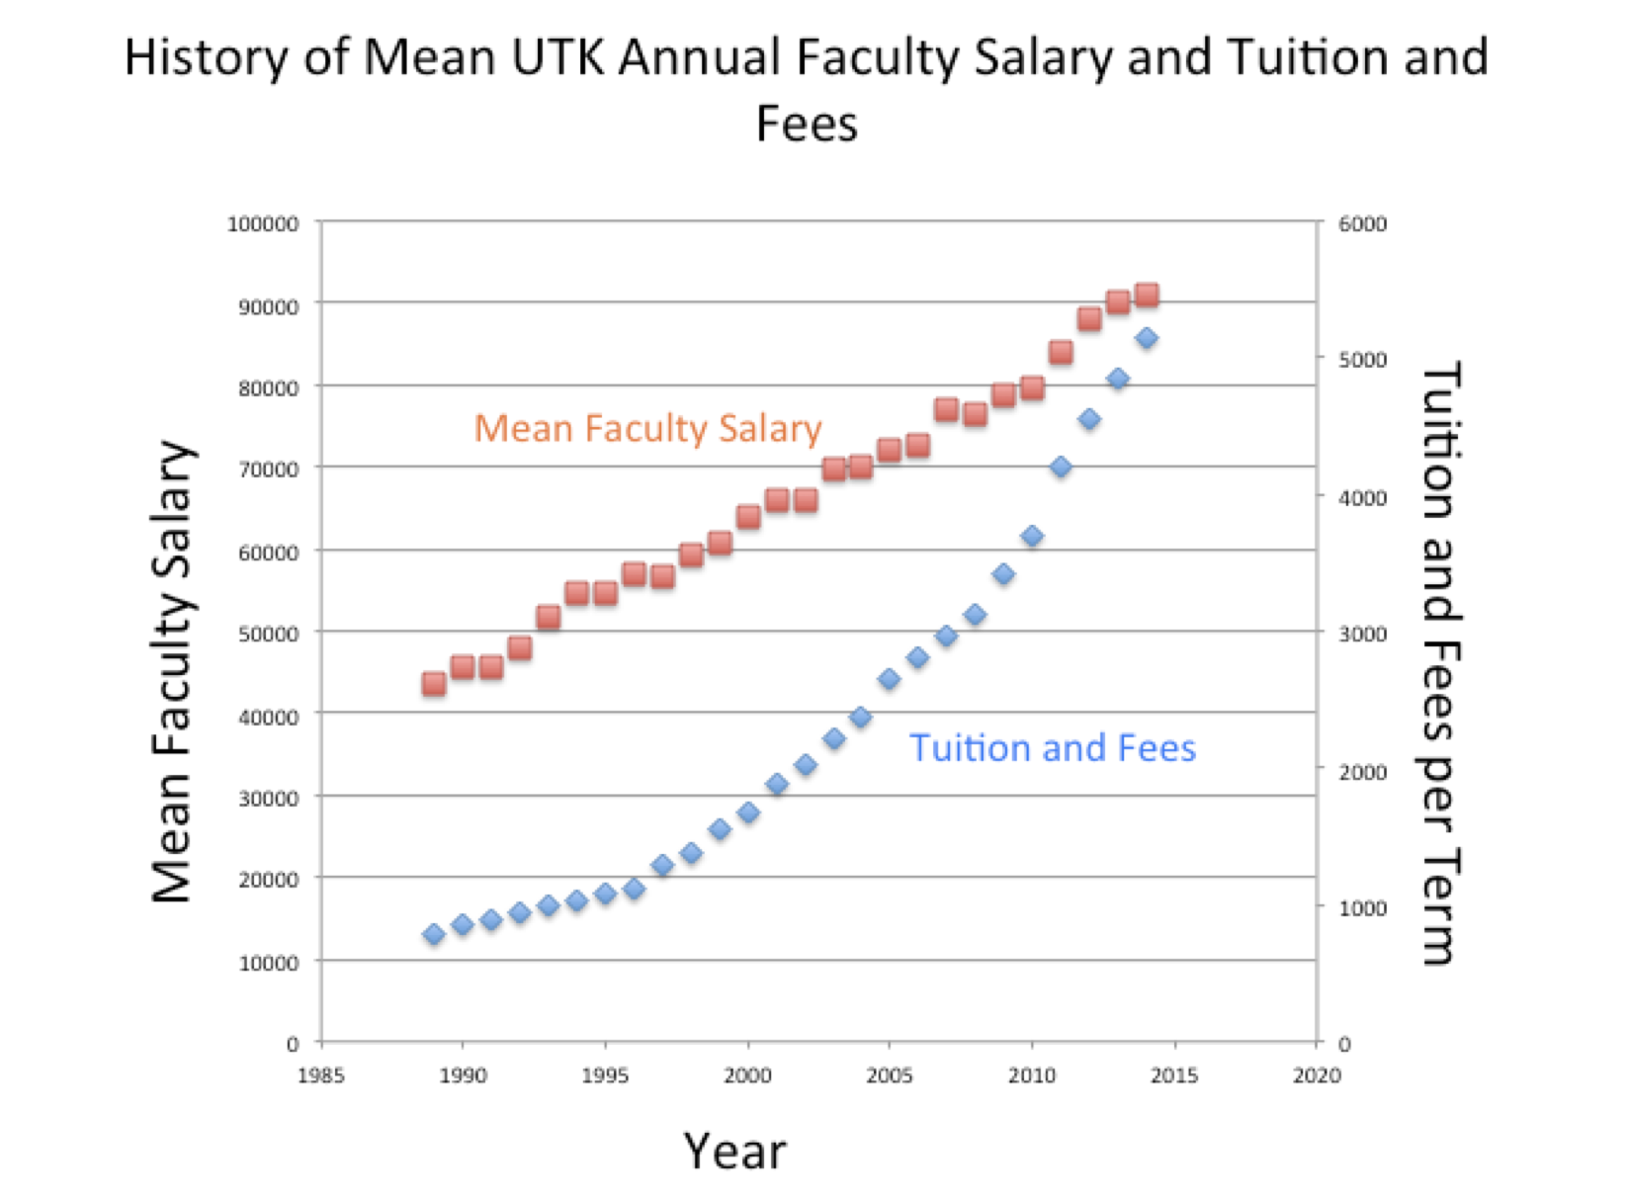
Higher education and the public
http://www.nimbios.org/~gross/Senate/UTKTuitionandExpendituresReportFinal.pdf

Slide 8
Higher education and the public
How much is a college degree worth? A search on this topic shows that average lifetime earnings for a Bachelors degree is about 75% higher than for a high school degree, 100% higher with a Masters degree, 200% higher with a PhD and 360% higher with a professional (nursing, law, medicine MBA, etc.). There are many arguments about these figures though as they depend on the field of the degree, there are many discussions about debt taken on and about the opportunity lost by staying in school longer with low earnings.

Slide 9
Stakeholders in Higher Education Institutions:
General public (State taxpayers, local citizens)
Local Community (government, business)
National agencies (government, accrediting, non-profits
Governing board
Employees
Administrators
Students
Alumni
Particular constituencies (sports fans, facility users, identity groups)
Note: there are potential conflicts between the perceptions and goals of the stakeholders regarding the role and objectives of the institution

Slide 10
Missions and Objectives:
Every higher institution has some type of mission statement, likely a visions statement, and a strategic plan. These typically have very similar statements of objectives – scholarship and research, education, service to the local and national community, enhancing diverse opportunities for all, and inclusive excellence. Certainly, there are differences connected to the role of the institution, but these statements generally do not include any details of the processes to be used to meet the objectives. Even the strategic plans are typically quite vague. They also are not necessarily binding.

Slide 11
Example Mission Statements
UT System: The University of Tennessee System, through its multiple campuses and institutes, serves the people of Tennessee and beyond through the discovery, communication and application of knowledge. The System is committed to providing undergraduate, graduate and professional education programs in a diverse learning environment that prepares students to be leaders in a global society. The UT System’s delivery of education, discovery, outreach and public service contributes to the economic, social and environmental well-being of all Tennesseans.
UTK: The primary mission of the University of Tennessee is to move forward the frontiers of human knowledge and enrich and elevate the citizens of the state of Tennessee, the nation, and the world. As the preeminent research-based land-grant university in the state, UT embodies the spirit of excellence in teaching, research, scholarship, creative activity, outreach, and engagement attained by the nation’s finest public research institutions.

