Slide 1
Mathematical Theories of Everything Overview of Catastrophe Theory from the Perspective of Bifurcation Theory

Slide 2
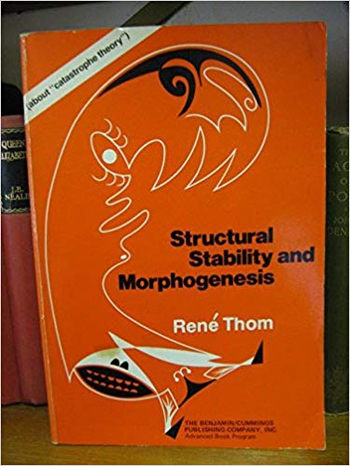
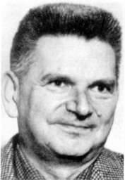
Rene Thom

Slide 3
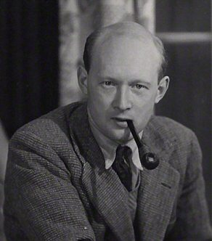
C. H. Waddington
Waddington, C. H. (1939). An Introduction to Modern Genetics. London : George Alien & Unwin.
Waddington, C. H. (1940). Organisers & Genes. Cambridge: Cambridge University Press.
Waddington, C. H. and others (1942). Science and Ethics, George Allen & Unwin.
Waddington, C. H. (1946). How Animals Develop. London : George Allen & Unwin.
Waddington, C. H. (1956). Principles of Embryology. London : George Allen & Unwin.
Waddington, C. H. (1957). The Strategy of the Genes. London : George Allen & Unwin.
Waddington, C. H. (1959). Biological Organisation Cellular and Subcellular : Proceedings of a Symposium. London: Pergamon Press.
Waddington, C. H. (1961). The Nature of Life. London : George, Allen, & Unwin.
Waddington, C. H. (1962). New Patterns in Genetics and Development. New York: Columbia University Press.
Waddington, C. H. (1966). Principles of Development and Differentiation. New York: Macmillan Company.
Waddington, C. H., ed. (1968–72). Towards a Theoretical Biology. 4 vols. Edinburgh: Edinburgh University Press.

Slide 4
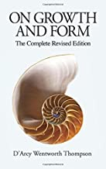
D’Arcy Wentworth Thompson

Slide 5
Some vocabulary that arises:
Potential function
Catastrophe
Homeomorphism
Topological space
Manifold
Singularities
Hysteresis
Robustness
Cusp catastrophe
Fold catastrophe
Butterfly catastrophe
Morphogenesis
Morphogen
Differentiation
Structural stability

Slide 6
Introduction (from 1.1 A of SS and M)
One of the central problems studied by mankind is the succession of form. Whatever is the ultimate nature of reality, it is indisputable that our universe is not chaos. We perceive beings, objects things to which we give names. These beings or things are forms or structures endowed with a degree of stability; they take up some part of space and last for some period of time. … the universe we see is a ceaseless creation, evolution and destruction of forms and that the purpose of science is to foresee this change of form and, if possible, explain it.

Slide 7
Overall idea of catastrophe set
The subtitle of Thom’s book is “An outline of a general theory of models” and this underlies the theory. If M is a topological space, and a point lies in M and outside of a closed set K of “catastrophe points” then the qualitative nature of the state represented by the point doesn’t change with a sufficiently small deformation of the state. The dynamics are specified by a vector field X on M. As a point m moves in M and meets K there is a discontinuity in the nature of the system and a “morphogenesis” occurs. The objective is to classify and predict the singularities generated by the morphogenesis without knowing the underlying dynamic or X. In general the plan is that a macroscopic examination of the morphogenesis and local and global study of its singularities allows one to reconstruct the dynamic that generated it.

Slide 8
Cusp catastrophe example

Slide 9
Spruce budworm example
See
D. Ludwig, D. D. Jones and C. S. Holling. 1978. Qualitative Analysis of Insect Outbreak Systems: The Spruce Budworm and Forest. Journal of Animal Ecology 47: 315-332
R. Robeva and D. Murrugarra. 2016. The spruce budworm and forest:
a qualitative comparison of ODE and Boolean models. Letters in Biomathematics 3:75-92,

Slide 13
CATASTROPHE THEORY IN SOCIAL PSYCHOLOGY : SOME APPLICATIONS TO ATTITUDES AND SOCIAL BEHAVIOR

