Slide 1
Mathematical Theories of Everything Introduction to Complexity Theory

Slide 2
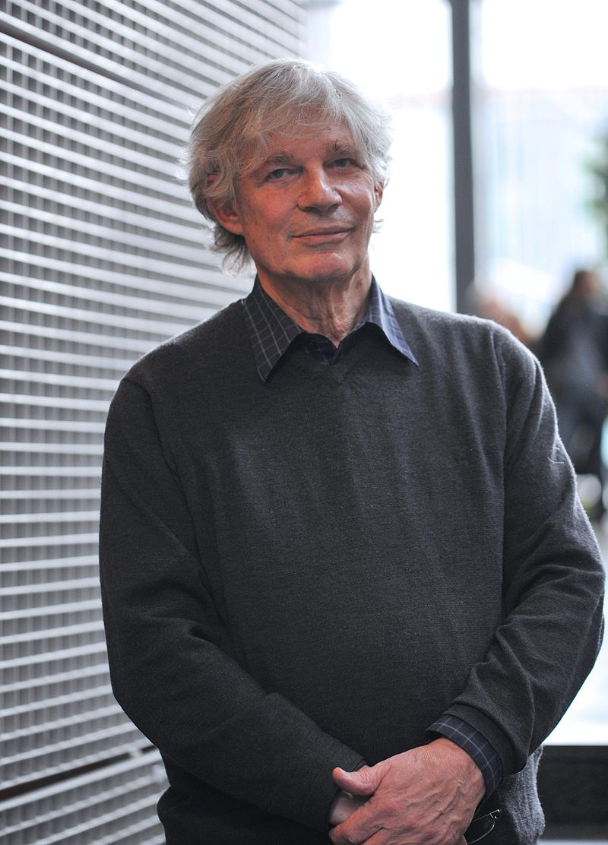
Stuart Kauffman

Slide 3

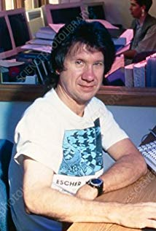
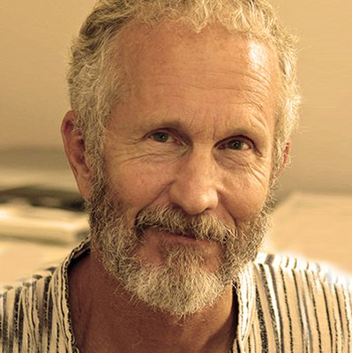

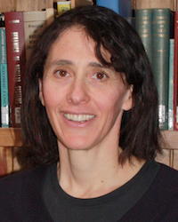
Doyne Farmer
Stephanie Forrest
Chris Langton
John Holland
Melanie Mitchell

Slide 4
Some vocabulary that arises:
Self-organized
Emergent phenomena
Collective behavior
Adaptation
Complex adaptive systems
Power laws
Cooperation
Agents
Agent-based models
Information processing
Co-evolving system
Fitness landscape
Rugged landscape
N-K model
Artificial life
Autocatalytic
Network
Small world network
Scale-free

Slide 5
Properties of Complex Systems (from Melanie Mitchell)
Complex collective behavior – networks of components with relatively simple rules and no central controller
Signaling and information processing – systems produce and use information and signals from internal and external
Adaptation – adapt to modify behavior through learning or evolutionary processes
Notes:
predict

Slide 6
Examples
Trophic networks
Insect colonies
Immune system
Economies
The brain
The internet
Gene regulatory networks

Slide 7
Complex Adaptive Systems
John Holland defined these as “systems that have a large numbers of components, often called agents, that interact and adapt or learn.” What distinguishes a CAS from a multi-agent system (MAS) is the focus on top-level properties like self-similarity, emergence and self-organization. A MAS has multiple interacting agents - in CAS, the agents as well as the system are adaptive and the system is self-similar (e.g. has some form of scale invariance so the system is exactly or approximately similar to parts of the system – like fractal patterns). They are complex in that have dynamic network interactions that are not static entities, i.e., the behavior of the ensemble is not predicted by the behavior of the components

Slide 8
https://www.hsdinstitute.org/resources/complex-adaptive-system.html

Slide 9
http://militaryepistemology.com/designing-complex-adaptive-systems-for-defence/

Slide 10
http://www.calresco.org/lucas/cas.htm

Slide 11
www.necsi.org/projects/mclemens/cs_char.gif.

Slide 13
Characteristics of complex systems (from Paul Cilliers (1998) Complexity and Postmodernism: Understanding Complex Systems
The number of elements is sufficiently large that conventional descriptions (e.g. a system of differential equations) are not only impractical, but cease to assist in understanding the system. Moreover, the elements interact dynamically, and the interactions can be physical or involve the exchange of information
Such interactions are rich, i.e. any element or sub-system in the system is affected by and affects several other elements or sub-systems
The interactions are non-linear: small changes in inputs, physical interactions or stimuli can cause large effects or very significant changes in outputs
Interactions are primarily but not exclusively with immediate neighbours and the nature of the influence is modulated
Any interaction can feed back onto itself directly or after a number of intervening stages. Such feedback can vary in quality. This is known as recurrency
The overall behavior of the system of elements is not predicted by the behavior of the individual elements
Such systems may be open and it may be difficult or impossible to define system boundaries
Complex systems operate under far from equilibrium conditions. There has to be a constant flow of energy to maintain the organization of the system
Complex systems have a history. They evolve and their past is co-responsible for their present behaviour
Elements in the system may be ignorant of the behaviour of the system as a whole, responding only to the information or physical stimuli available to them locally

Slide 14
Principal Concepts in CAS from Robert Axelrod and Michael Cohen (Harnessing Complexity 1999)
Strategy, a conditional action pattern that indicates what to do in which circumstances
Artifact, a material resource that has definite location and can respond to the action of agents
Agent, a collection of properties, strategies & capabilities for interacting with artifacts & other agents
Population, a collection of agents, or, in some situations, collections of strategies
System, a larger collection, including one or more populations of agents and possibly also artifacts
Type, all the agents (or strategies) in a population that have some characteristic in common
Variety, the diversity of types within a population or system
Interaction pattern, the recurring regularities of contact among types within a system
Space (physical), location in geographical space & time of agents and artifacts
Space (conceptual), "location" in a set of categories structured so that "nearby" agents will tend to interact
Selection, processes that lead to an increase or decrease in the frequency of various types of agent or strategies
Success criteria or performance measures, a "score" used by an agent or designer in attributing credit in the selection of relatively successful (or unsuccessful) strategies or agents

Slide 15
Defining and Measuring Complexity (Melanie Mitchell (Chap. 7 of Complexity a Guided Tour)
Seth Lloyd (2001) proposed 3 dimensions to measure the complexity f an object or process: HOW HARD IS IT TO DESCRIBE? HOW HARD IS IT TO CREATE? WHAT IS ITS DEGREE OF ORGANIZATION?
Complexity as size
Complexity as entropy
Complexity as algorithmic information content
Complexity as logical depth
Complexity as thermodynamic depth
Statistical complexity
Complexity as fractal dimension
Complexity as degree of hierarchy

Slide 16
Some centers
http://cscs.umich.edu with undergrad and grad programs
www.necsi.org NECSI researchers study networks, agent-based modeling, multiscale analysis and complexity, chaos and predictability, evolution, ecology, biodiversity, altruism, systems biology, cellular response, health care, systems engineering, negotiation, military conflict, ethnic violence, and international development.
www.santafe.edu

