Slide 1
Mathematical Theories of Everything Quick Summary of Game Theory

Slide 2
Some vocabulary that arises:
Emergent behavior
Complicated vs. complex
Chaotic dynamics
Bifurcations
Edge of chaos
Strange attractors
Cooperation
Artificial life
Boolean networks
Cellular automata
Evolutionary algorithm
Computationally irreducible
The adjacent possible
Neural nets
Predictability
Information processing
Sensitive dependence
Fractal
Nash solution
Turing machine
Self-organized criticality
Complex adaptive systems
Phase locking

Slide 3
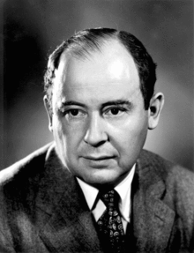
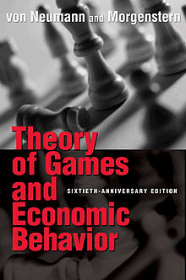
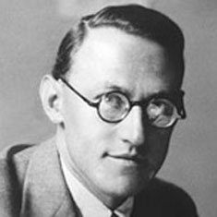
John Von Neumann
Oskar Morganstern

Slide 4
Game Theory:
Game classifications:
Non-Cooperative
Cooperative
2-person game
n-person game
Games against nature
Zero-sum or non-zero sum
Many others – imperfect information, sequential, differential
Game representations:
Extensive form (tree)
Normal form (payoff or utility and strategy set)
Characteristic function (cooperative games)
Solution concepts:
Minimax
Pure vs mixed strategy
Nash equilibrium
Core and Shapley value (cooperative games)
Evolutionary stable strategy

Slide 5
Game Theory: Background
Overall objective is to have a mathematical model for conflict and cooperation between intelligent, rational decision-makers (e.g. 2 or more individuals make decisions that influence each individuals welfare). It is one of the mathematical foundations of social science.
Rational means individuals make decisions consistently in pursuit of their own objectives (for which they must have some utility metric to measure their objectives).
Intelligent means individuals know everything that we know about the game and can make inferences that we can make.
.

Slide 6
Game Theory: decision theory
Game theory is part of decision theory – the process of choosing among a set of alternative options (implying knowledge of the consequences of a choice and of preferences for these consequences). Decision theory historically focused on a single decision maker, game theory on more than one. The background for decision theory is Bayesian in which a utility function provides a quantitative characterization of the decision-makers preferences, a subjective probability distribution characterizes beliefs about what happens that impacts the decision, this distribution is updated by Bayes formula with new information, and under a basic set of axioms, decisions are made to maximize the expected utility. See Marc Mangel and Colin Clark (1989) Dynamic Modeling in Behavioral Ecology.

Slide 7
Game Theory: Types of games
Cooperative means all individuals involved in the game are able to form alliances that are binding (e.g. there are contracts that all must follow). The analysis considers what alliances (coalitions) form, and the payoffs that are given to each coalition.
Non-cooperative means individuals cannot form alliances. The focus is on what strategies individual players use, the payoffs to individuals and whether equilibria arise.
n-person game –means in general more than two players, while much of traditional game theory dealt with 2-person games.
Zero-sum game is one in which the total benefit (payoff) to all players is zero so one player can benefit only at the expense of others.
Non-zero-sum game is one in which a gain by one player doesn’t necessarily mean there is a loss (in payoff) to one of the other players.
Game against nature is one in which one player cannot be regarded as rational or intelligent with preferences. So players cannot count on rational behavior of “nature”.
Simultaneous game means all players make decisions at the same time (or don’t know what others do so it is effectively simultaneous).
Dynamic games (sequential) means players have some knowledge about actions of earlier players.

Slide 8
Game Theory: Representations
Normal form refers to a game described by a list of strategies (moves or actions) that each player can take along with the outcomes (payoffs) to each player when a particular set of strategies are chosen by each player. For 2-person games the normal form is equivalent to a payoff matrix that describes the payoffs to each player
In the payoff matrix, the list of strategies are “pure” meaning that at any given move a player chooses one of these. A mixed strategy refers to the situation in which a player assigns a probability distribution to the pure strategies, which specifies the probability that any pure strategy is played.

Slide 9
Game Theory: Representations
Extensive form refers to a game described by a tree that shows the sequences of possible moves made by each player sequentially. At each level of the tree one of the players options of moves is shown, and the root of the tree shows payoffs (a vector of length n if there are n players)

Slide 10
Game Theory: Characteristic functions
In cooperative game theory, consider all subsets of the players, so if there are n players then there are 2^{n} - 1 possible subsets (or coalitions). A characteristic function is a function on the collection of all such subsets that assigns a number (the worth of the coalition) to each subset, v(S). This represents the amount of transferable utility (this assumes there is a commodity like money – that can readily be transferred among players) that the members of S could earn without any assistance from the players outside of S. A game with this representation is a game in coalition form.

Slide 11
Game Theory: Solution concepts
In a 2-person game with pure strategies, a dominating strategy is one that is at least as good, and possibly better, than any other strategy, regardless of what the other player does. If there is a pair of pure strategies for the two players so this pair gives the best that either player can do independent of what the other player does, then it is a saddle point for the game – a minimax (or maximin) solution. If a game has one or more saddle-points, the best that each player can do is choose the strategy which contains the saddle point. There is no guarantee that such a saddle point solution exists.

Slide 12
Game Theory: Solution concepts
In a 2-person zero-sum game, there can be a number v and a pure strategy (maximin) for player 1 such that it guarantees player 1 obtains at least v, and a pure strategy (minimax) for player 2 which guarantees that player 1 gets no more than v. The pair of pure strategies are an equilibrium and any pair of pure strategies which are an equilibrium have a maximin and minimax strategy for the two players. Note that not all such games necessarily have an equilibrium, such equilibria may not be unique if they exist, if more than one equilibrium exists they all give the same value v. If an equilibrium exists, it maximizes player 1’s security level (e.g. provides the most player 1 can be guaranteed to obtain).

Slide 13
Game Theory: Solution concepts
In a 2-person zero-sum game, though an equilibrium strategy may not exist, there is a natural extension which instead of restricting the players to a finite set of pure strategies, allows players to establish a probability distribution across all their strategies – the distribution specifies a mixed strategy. Then instead of think of a fixed value v, the game outcomes are obtained as a probability distribution of outcomes, and so it is natural to assign a value that is an expected value of the payoffs. So the notion of minimax and maximin are extended to mixed strategies and the payoff obtained when this extended version of an equilibrium is used is the value of the game. If a game has a pure strategy equilibrium, this is the same value as would arise from a mixed strategy perspective.

Slide 14
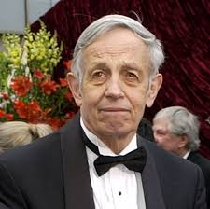
Game Theory: Solution concepts
Minimax theorem: For a 2-person zero-sum game with a finite number of pure strategies for each player, there is a number called the “value” V of the game, such that there is a mixed strategy for player 1 such that player 1’ s average gain is at least V no matter what player 2 does and there is a mixed strategy for player 2 such that player 2’s average loss is no more than V no matter what player 1 does.
If V =0 the game is called “fair”.
Note that Nash proved that such a mixed strategy equilibrium must exist for any 2-person game with finite strategies, not just zero-sum ones. See Sigmund and Hilbe for definition of “best reply”, Nash Equilibrium and connection to replicator equation.
John Nash

Slide 15
Game Theory: Solution concepts
In a 2-person cooperative game, it is assumed that (i) there is communication between the players so that each player tells the other what they are doing exactly, (ii) any agreements between the players are binding contracts and (iii) players utilities of the outcomes of the game are not impacted by the negotiations. Here any randomized strategy is determined by a joint distribution across the strategy sets for the two players. The joint maximal set (Pareto optimal set) is the set of payoffs that are jointly undominated (no other strategies produce higher payoff for either player). Whether these are reachable assumes group rationality. Von Neumann and Morganstern called the negotiation set to be the set of all joint maximal outcomes which yield each player at least as much as the maximin strategy. They considered this the cooperative solution, but it is in general not unique.

Slide 16
Game Theory: Solution concepts
In an n-person cooperative game with utility side-payments allowed and utility acts like money (is transferable and maintains its value when transferred), the characteristic function defines the value of a coalition of players. One solution concept is the Core of strategies for which (i) individual rationality holds, so that each player obtains at least as much payoff as they would obtain if they played as an individual, (ii) group rationality holds, so the sum of all payments to all players is at least as much as the amount available to the characteristic function value of the entire set of players, and (iii) every coalition of players is rational so that the payment to all individuals in a coalition is at least as large as the value of the coalition. Imputations meet (i) and (ii) and are inherent in (iii). Note that the core may be empty.

Slide 17
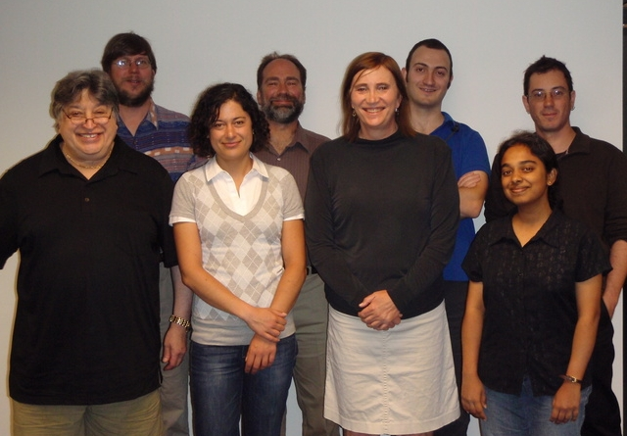
Cooperative Game Theory and Evolution
NIMBioS WG – Function and Evolution

Slide 18
Evolutionary Game Theory
Unlike other games, evolutionary game theory assumes nothing about rationality but rather organisms carry out actions to increase “fitness” . The Evolutionary Stable Strategy (ESS) is a state of in the game dynamics where, in a very large population of competitors, another mutant strategy cannot successfully enter the population. So an ESS must be both effective against competitors when it is rare – to enter the previous competing population, and successful when later in high proportion in the population – to defend itself. An ESS is uninvadeable.
John Maynard Smith

