Slide 1
Intro to Mathematical Theories of Everything
Some Big Ideas of Applied Math over the Past century

Slide 2
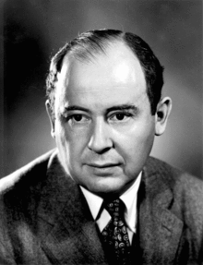
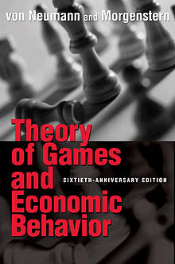
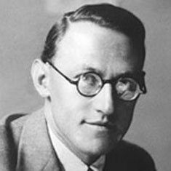
John Von Neumann
Oskar Morganstern

Slide 3
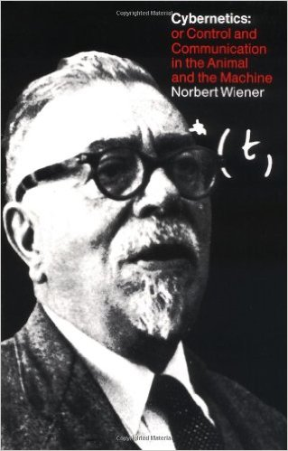
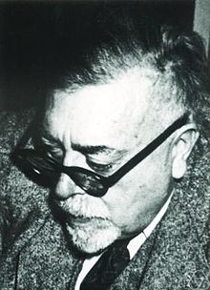
Norbert Weiner

Slide 4
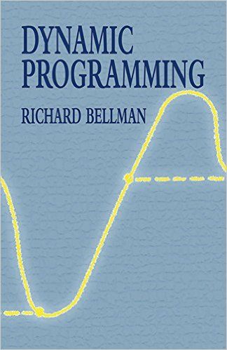
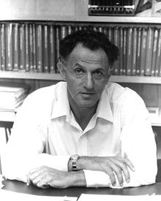
Richard Bellman

Slide 5
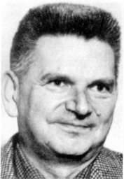
Rene Thom

Slide 6
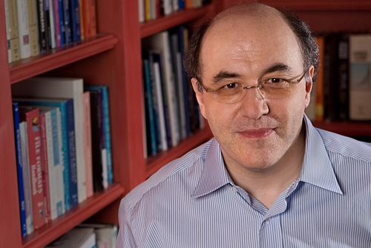
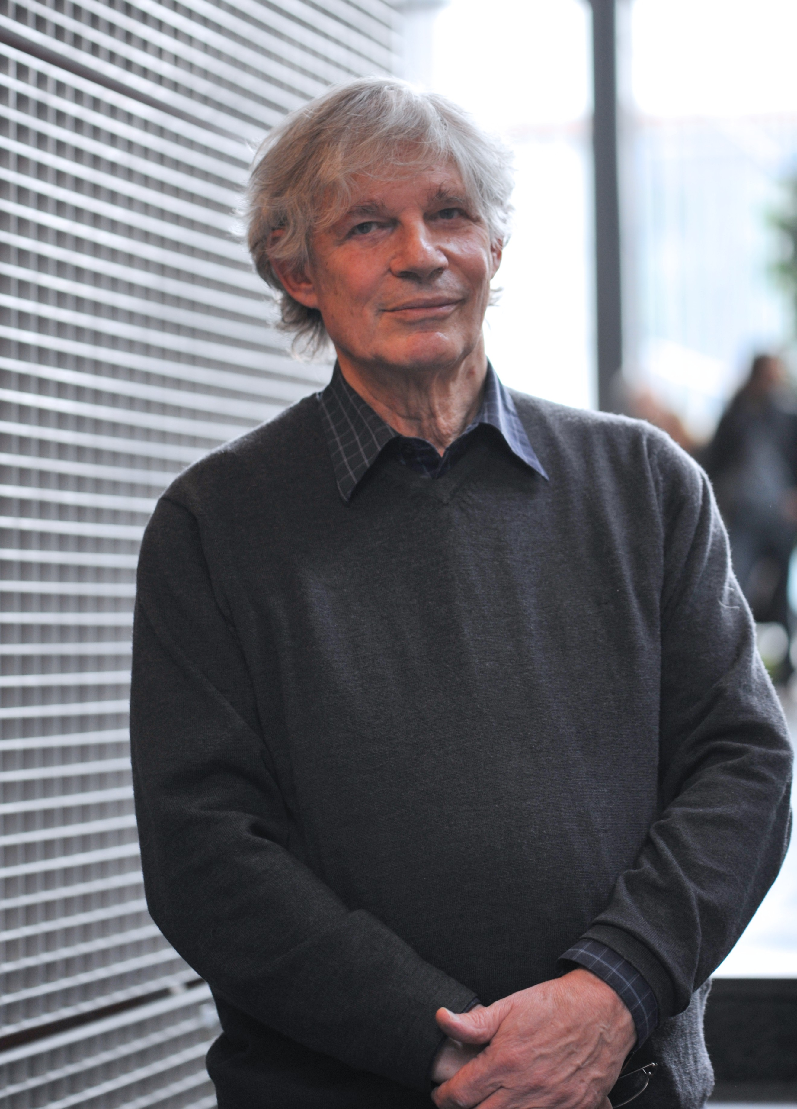
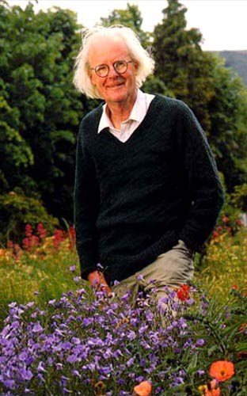
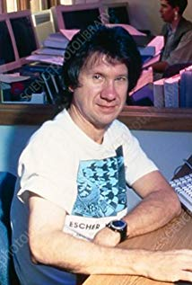
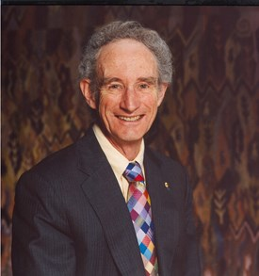
Some people whose work will be making appearances in this seminar
Steve Wolfram
Stu Kauffman
John Maynard Smith
Bob May
Chris Langton

Slide 7
Some vocabulary that arises:
Emergent behavior
Complicated vs. complex
Chaotic dynamics
Bifurcations
Edge of chaos
Strange attractors
Cooperation
Artificial life
Boolean networks
Cellular automata
Evolutionary algorithm
Computationally irreducible
The adjacent possible
Neural nets
Predictability
Information processing
Sensitive dependence
Fractal
Nash solution
Turing machine
Self-organized criticality
Complex adaptive systems
Phase locking

Slide 8
Game Theory:
Game classifications:
Non-Cooperative
Cooperative
2-person game
n-person game
Games against nature
Zero-sum or non-zero sum
Many others – imperfect information, sequential, differential
Game representations:
Extensive form (tree)
Normal form (payoff or utility and strategy set)
Characteristic function (cooperative games)
Solution concepts:
Minimax
Pure vs mixed strategy
Nash equilibrium
Core and Shapley value (cooperative games)
Evolutionary stable strategy

