Slide 1
Mathematical Theories of Everything More about Complexity Theory

Slide 2
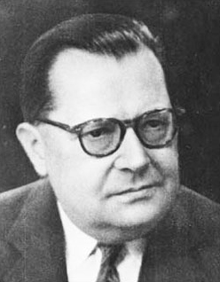
Ludwig von Bertalanffy
General Systems Theory
A system is a cohesive conglomeration of interrelated and interdependent parts - may be naturally occurring or constructed
A system is delineated by its spatial and temporal boundaries, influenced by its environment, described by its structure and purpose or nature and expressed in its functioning.
Systems theory is expressed by transforming inputs into outputs and as a method of identifying inputs, processes, outputs, and feedback components of a system
Von Bertalanffy explicated GST in his book "General System theory: Foundations, Development, Applications" (1968) in which he posited that “there are general aspects, correspondences, and isomorphisms common to ‘systems’”. Key concepts of GST involve definitions of open and closed aspects of a system and reversible (irreversiblility).

Slide 3
Some tools for analyzing system dynamics in line with GST
AnyLogic - Supports system dynamics, agent based and discrete event modeling, allows making hybrid models.
Berkeley Madonna – developed by George Oster - ODEs and difference equations (initial conditions and boundary value
Simulink – connected with Matlab
Stella - System dynamics and discrete event modeling with some agent-based capabilities.
Vensim - Continuous simulation with stocks and flows, some discrete delay and discrete event functionality.

Slide 4
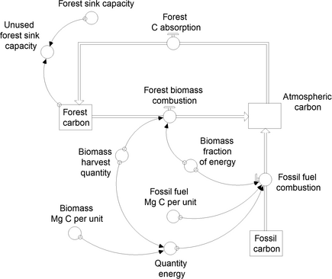
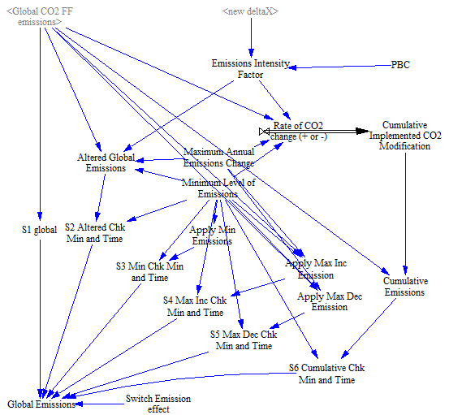
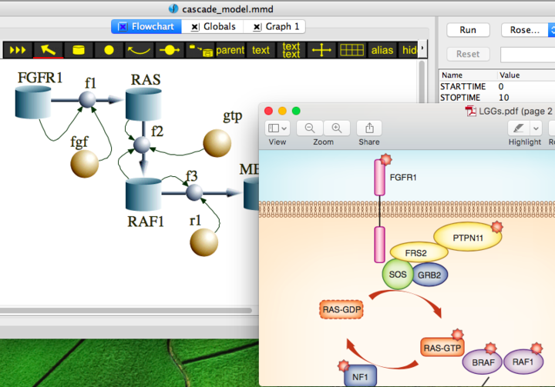
A Stella model
Part of a Vensim model
A Berkeley Madonna model

Slide 7
J. R. Turner and R. M. Baker 2019. Complexity Theory: An Overview with Potential Applications for the Social Sciences Systems 2019, 7(1), 4; https://doi.org/10.3390/systems7010004

Slide 8
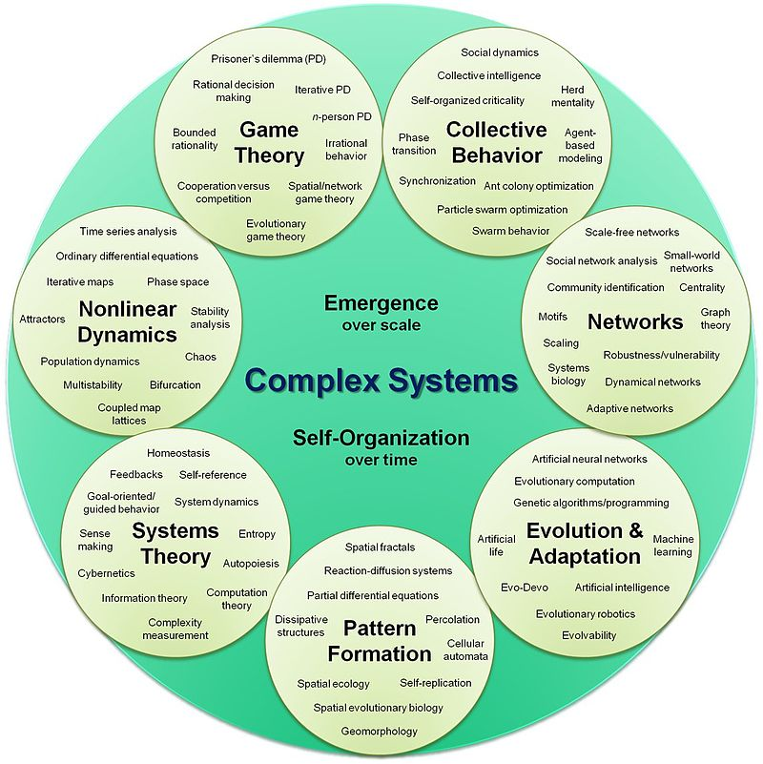
Hiroki Sayama, D.Sc. - Created by Hiroki Sayama, D.Sc., Collective Dynamics of Complex Systems (CoCo) Research Group at Binghamton University, State University of New York

Slide 9
Characteristics of complex systems (from Paul Cilliers (1998) Complexity and Postmodernism: Understanding Complex Systems
The number of elements is sufficiently large that conventional descriptions (e.g. a system of differential equations) are not only impractical, but cease to assist in understanding the system. Moreover, the elements interact dynamically, and the interactions can be physical or involve the exchange of information
Such interactions are rich, i.e. any element or sub-system in the system is affected by and affects several other elements or sub-systems
The interactions are non-linear: small changes in inputs, physical interactions or stimuli can cause large effects or very significant changes in outputs
Interactions are primarily but not exclusively with immediate neighbours and the nature of the influence is modulated
Any interaction can feed back onto itself directly or after a number of intervening stages. Such feedback can vary in quality. This is known as recurrency
The overall behavior of the system of elements is not predicted by the behavior of the individual elements
Such systems may be open and it may be difficult or impossible to define system boundaries
Complex systems operate under far from equilibrium conditions. There has to be a constant flow of energy to maintain the organization of the system
Complex systems have a history. They evolve and their past is co-responsible for their present behaviour
Elements in the system may be ignorant of the behaviour of the system as a whole, responding only to the information or physical stimuli available to them locally

Slide 10
Principal Concepts in CAS from Robert Axelrod and Michael Cohen (Harnessing Complexity 1999)
Strategy, a conditional action pattern that indicates what to do in which circumstances
Artifact, a material resource that has definite location and can respond to the action of agents
Agent, a collection of properties, strategies & capabilities for interacting with artifacts & other agents
Population, a collection of agents, or, in some situations, collections of strategies
System, a larger collection, including one or more populations of agents and possibly also artifacts
Type, all the agents (or strategies) in a population that have some characteristic in common
Variety, the diversity of types within a population or system
Interaction pattern, the recurring regularities of contact among types within a system
Space (physical), location in geographical space & time of agents and artifacts
Space (conceptual), "location" in a set of categories structured so that "nearby" agents will tend to interact
Selection, processes that lead to an increase or decrease in the frequency of various types of agent or strategies
Success criteria or performance measures, a "score" used by an agent or designer in attributing credit in the selection of relatively successful (or unsuccessful) strategies or agents

Slide 11
Defining and Measuring Complexity (Melanie Mitchell (Chap. 7 of Complexity a Guided Tour)
Seth Lloyd (2001) proposed 3 dimensions to measure the complexity f an object or process: HOW HARD IS IT TO DESCRIBE? HOW HARD IS IT TO CREATE? WHAT IS ITS DEGREE OF ORGANIZATION?
Complexity as size
Complexity as entropy
Complexity as algorithmic information content
Complexity as logical depth
Complexity as thermodynamic depth
Statistical complexity
Complexity as fractal dimension
Complexity as degree of hierarchy

Slide 12
Some centers
http://cscs.umich.edu with undergrad and grad programs
www.necsi.org NECSI researchers study networks, agent-based modeling, multiscale analysis and complexity, chaos and predictability, evolution, ecology, biodiversity, altruism, systems biology, cellular response, health care, systems engineering, negotiation, military conflict, ethnic violence, and international development.
www.santafe.edu

