Slide 1
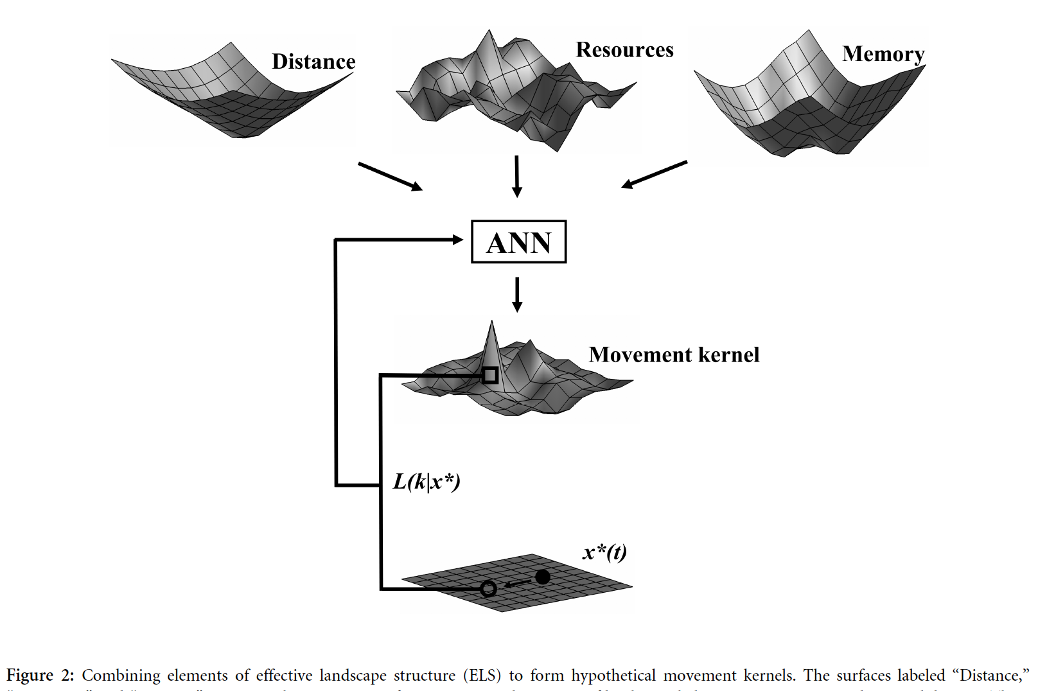
Math/EEB 589 - Mathematics of Machine Learning Methods in Ecology and Environmental Science
Dalziel, Morales, and Fryxell. 2008. Fitting Probability Distributions to Animal Movement Trajectories: Using Artificial Neural Networks to Link Distance, Resources, and Memory. American Naturalist 172(2):248-258

Slide 2
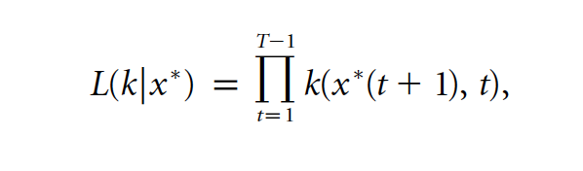
Here x(t) is location of animal on landscape, k(x,t) is the displacement kernel so x(t+1) ≈ k(x,t) and the paper uses neural nets trained with animal trajectory data to estimate k. This uses the likelihood along a trajectory
The neural net had an input with 3 nodes (distance, resources, memory) connected to 7 nodes with connection strengths that specified k from which the trajectory x*(t) was calculated. A genetic algorithm was used to maximize the likelihood function (the fitness metric) by varying the connection strengths. The GA converged quickly and the resulting models allowed them to compare the relative impacts of the 3 inputs on the resulting movement kernel, finding that resource structure (the spatial distribution of resources on the landscape) had relatively little impact on movement patterns.
Dalziel, Morales, and Fryxell. 2008. Fitting Probability Distributions to Animal Movement Trajectories: Using Artificial Neural Networks to Link Distance, Resources, and Memory. American Naturalist 172(2):248-258

Slide 3
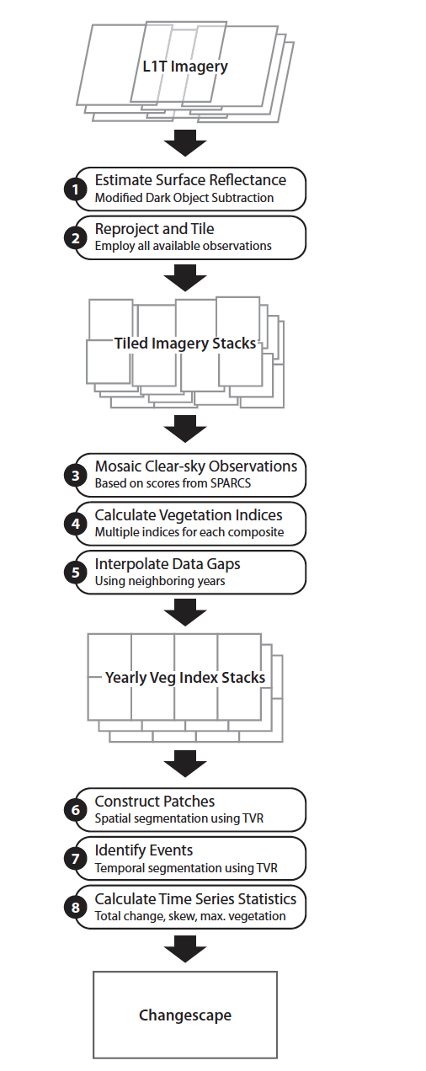
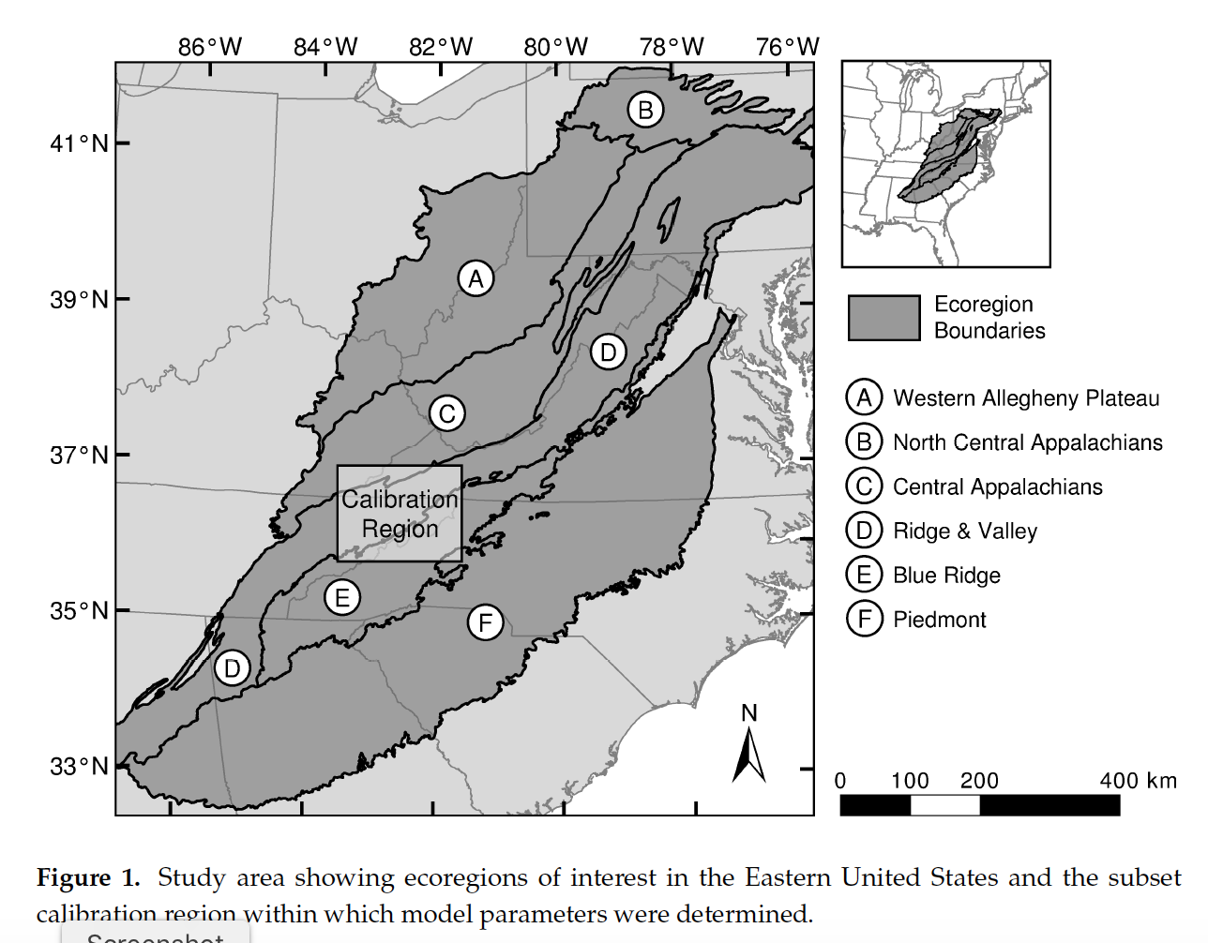

Vegetation Regeneration and Disturbance Estimates
through Time (VeRDET)
M. Joseph Hughes, S. Douglas Kaylor and Daniel J. Hayes. 2017. Patch-Based Forest Change Detection from Landsat Time Series. Forests, 8(5), 166

Slide 4
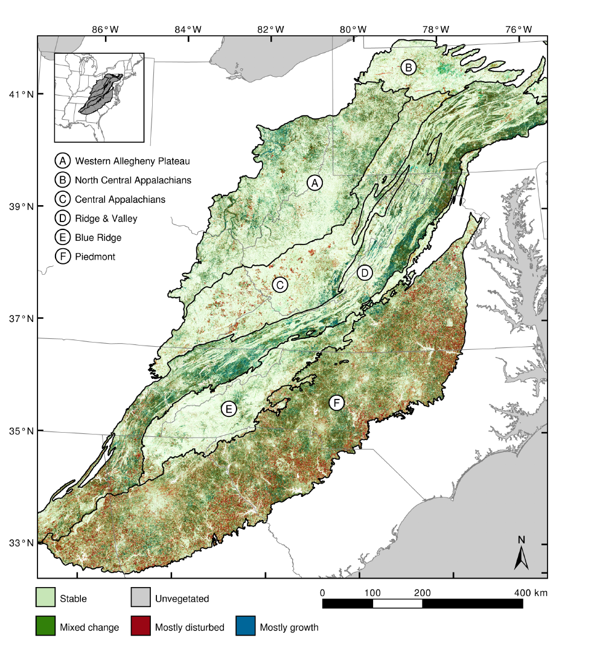
The overall objective was to develop and evaluate an automated forested landscape classifier that used various remotely-sensed data to characterize the disturbance type for each pixel across the eastern US over a 25-year period. Forest types were Stable, Disturbed (stress, wind, wildfire, harvest, etc. ), and Regenerated. Data from a calibration region (training set) were used to produce spatial patches using a spatial regularization method that is a spatial filtering algorithm to preserve patches of similar types and then using a similar approach to time series of images to identify disturbance events. The process used 4800 time series samples for training and the classification was evaluated with 1200 additional time series.
M. Joseph Hughes, S. Douglas Kaylor and Daniel J. Hayes. 2017. Patch-Based Forest Change Detection from Landsat Time Series. Forests, 8(5), 166

Slide 5
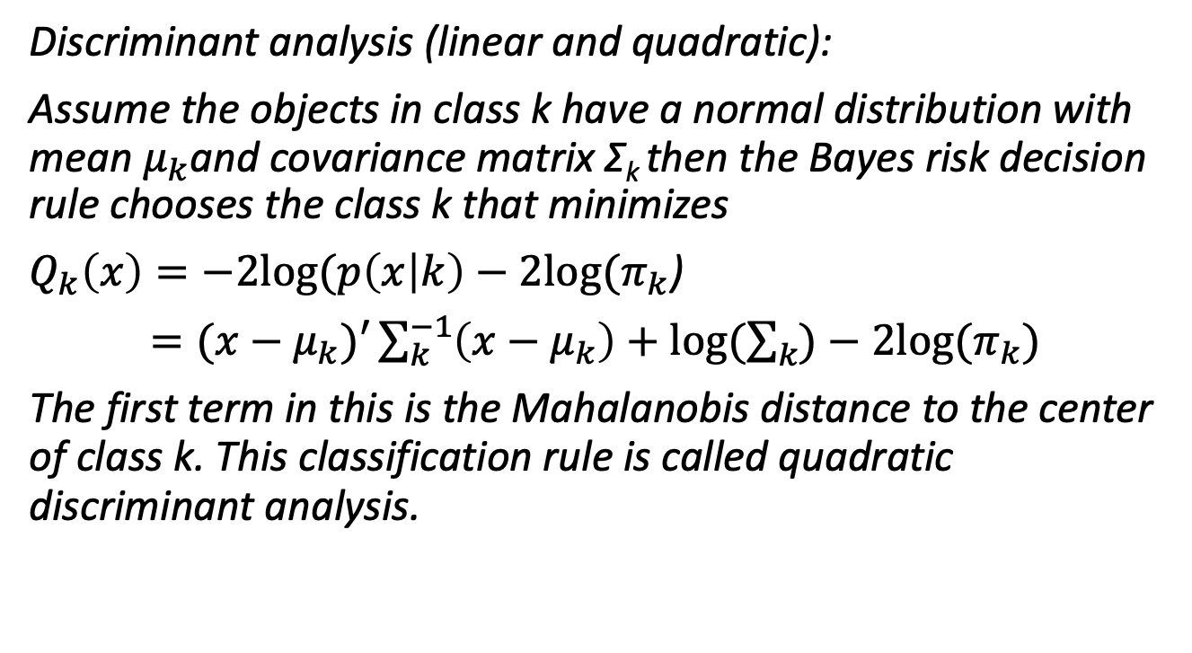
Some classification methods: Probability models
Discriminant analysis (linear and quadratic):
Assume the objects in class k have a normal distribution with mean $μ_{k}$and covariance matrix Σ_{k} then the Bayes risk decision rule chooses the class k that minimizes
$Q_{k}\left(x\right)=−2log⁡(p\left(x | k\right)−2log⁡(π_{k}$)
$=(x−μ_{k})′\sum_{k}^{−1}{\left(x−μ_{k}\right)+log⁡(\sum_{k}{)−2log⁡(π_{k}}})$
The first term in this is the Mahalanobis distance to the center of class k. This classification rule is called quadratic discriminant analysis.

Slide 6
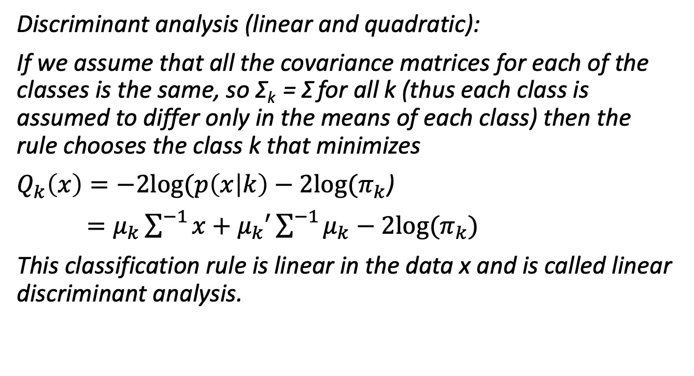
Some classification methods: Probability models
Discriminant analysis (linear and quadratic):
If we assume that all the covariance matrices for each of the classes is the same, so Σ_{k} = Σ for all k (thus each class is assumed to differ only in the means of each class) then the rule chooses the class k that minimizes
$Q_{k}\left(x\right)=−2log⁡(p\left(x | k\right)−2log⁡(π_{k}$)
$=μ_{k}\sum^{−1}{x+μ_{k}′\sum^{−1}{μ_{k}}}−2log⁡(π_{k})$
This classification rule is linear in the data x and is called linear discriminant analysis.

Slide 7
Example discriminant analysis from Fisher Iris Data

Slide 8
Example discriminant analysis from Fisher Iris Data

Slide 9
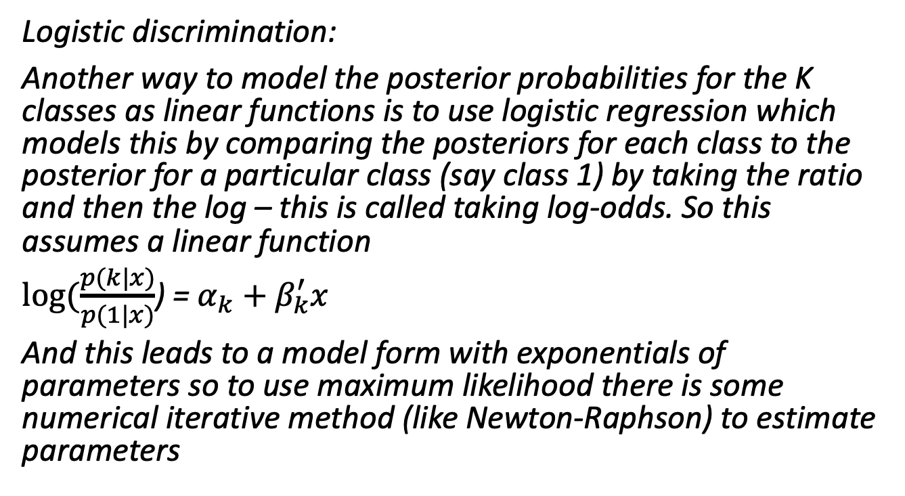
Some classification methods: Probability models
Logistic discrimination:
Another way to model the posterior probabilities for the K classes as linear functions is to use logistic regression which models this by comparing the posteriors for each class to the posterior for a particular class (say class 1) by taking the ratio and then the log – this is called taking log-odds. So this assumes a linear function
$log⁡(\frac{p(k|x)}{p(1|x)}$) = $α_{k}+β_{k}^{′}x$
And this leads to a model form with exponentials of parameters so to use maximum likelihood there is some numerical iterative method (like Newton-Raphson) to estimate parameters

Slide 10
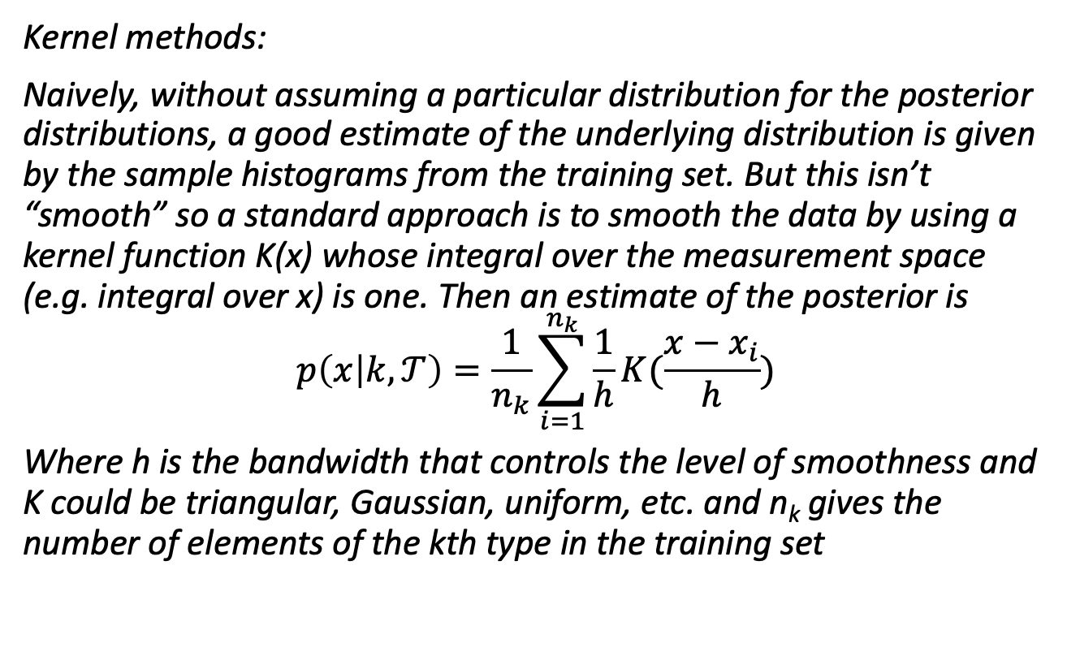
Some classification methods: Non-parametric
Kernel methods:
Naively, without assuming a particular distribution for the posterior distributions, a good estimate of the underlying distribution is given by the sample histograms from the training set. But this isn’t “smooth” so a standard approach is to smooth the data by using a kernel function K(x) whose integral over the measurement space (e.g. integral over x) is one. Then an estimate of the posterior is
$$p\left(x | k,𝒯\right)=\frac{1}{n_{k}}\sum_{i=1}^{n_{k}}{\frac{1}{h}K(\frac{x−x_{i}}{h}})$$
Where h is the bandwidth that controls the level of smoothness and K could be triangular, Gaussian, uniform, etc. and n_{k} gives the number of elements of the kth type in the training set

Slide 11
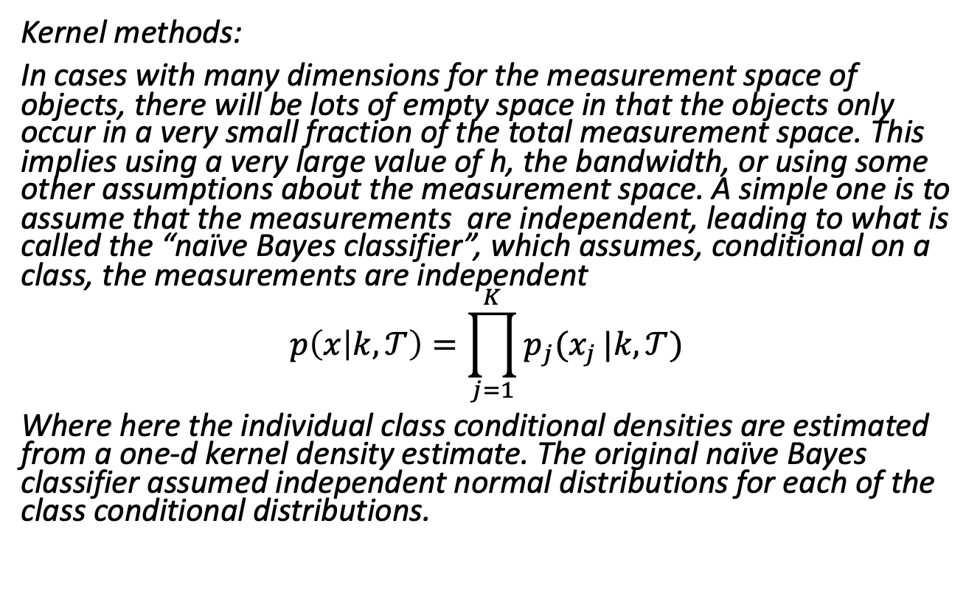
Some classification methods: Non-parametric
Kernel methods:
In cases with many dimensions for the measurement space of objects, there will be lots of empty space in that the objects only occur in a very small fraction of the total measurement space. This implies using a very large value of h, the bandwidth, or using some other assumptions about the measurement space. A simple one is to assume that the measurements are independent, leading to what is called the “naïve Bayes classifier”, which assumes, conditional on a class, the measurements are independent
$$p\left(x | k,𝒯\right)=\prod_{j=1}^{K}{p_{j}(x_{j}}|k,𝒯)$$
Where here the individual class conditional densities are estimated from a one-d kernel density estimate. The original naïve Bayes classifier assumed independent normal distributions for each of the class conditional distributions.

Slide 12
Some classification methods: Non-parametric
Kernel methods: nearest-neighbor methods
A simple method is to assume a uniform kernel over the nearest r objects and zero elsewhere and then estimate the posterior distribution as the proportion of each class among the nearest r objects. A basic rule to classify a new object with feature x₀ is to (1) determine the r nearest neighbors in the training set (perhaps using a Euclidean metric) and (2) classify the object as the class with the majority of the r nearest neighbors. If r = 1 this divides the measurement space into the Dirichlet tessellation of the data points and every new object is classified as the type of the cell it falls in.
This classifier has the advantage of having very flexible boundaries of the classifier in the feature space.

Slide 13
Some classification methods: Non-parametric
Classification trees:
Objective is to partition the feature space into hypercubes and assign a class to each hypercube. The hypercubes are chosen by making a set of binary splits of each feature space and counting the errors along each branch. The objective is to split the feature space so that most members of the same class are on the same branch (which represents a hypercube). Too many splits would lead to a single object only in each hypercube (an extreme example of overfitting), so there are methods to prune the tree once a tree construction metyhod is chosen.

Slide 14
Simple classification tree example for Iris Data
SL < 6
setosa
(50/25/8)
SW < 3
versicolor
(0/21/14)
virginica
(0/4/28)
So this is a rooted tree with each terminal node having a vector of the number of assignments in the training set along that branch, and each branch specifies a hypercube

Slide 15
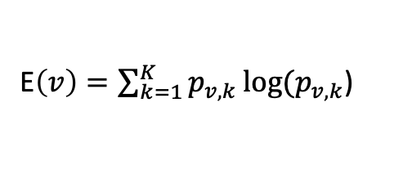
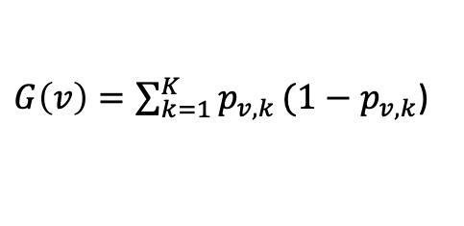
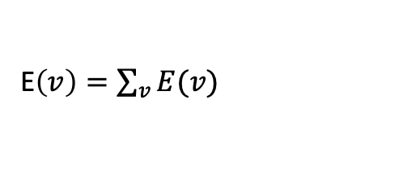
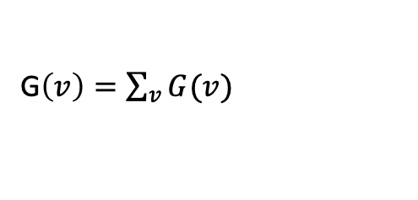
Some classification methods: Non-parametric
Classification trees:
The method requires deciding how to choose each split. Typically uses a one-step look ahead to choose the best split based on the Gini index or the cross entropy. At each node v of the tree there is a probability distribution across the classes p_{v,k} and this can be estimated empirically from the training set using the numbers of each class assigned to each node. The Gini index for node v is
$G\left(v\right)=\sum_{k=1}^{K}{p_{v,k}}(1−p_{v,k}$)
And the cross-entropy for node v is
E$\left(v\right)=\sum_{k=1}^{K}{p_{v,k}}log⁡(p_{v,k}$)
And for the tree as a whole
G$\left(v\right)=\sum_{v}{G(v)}$
E$\left(v\right)=\sum_{v}{E(v)}$
Then for a node v consider splitting it into nodes v₁ and v₂ and choose the split that maximizes the reduction in the Gini index or the cross entropy e.g. G_{v} – G_{v1} – G_{v2} or the equivalent for the cross-entropy

Slide 16
Some classification methods: Non-parametric
Classification trees:
Note that this process is maximizing a measure of information gain (using Gini or cross-entropy) is choosing what node to split, what feature to split on and what level to use for the split. To avoid overfitting, a process of pruning is used by considering a trade-off between misclassification and how large the tree is. For a tree Tr let R(Tr) be the number of misclassifications in in the training set. The error-complexity measure is C_{𝛂}(Tr) = R(Tr) + 𝛂 Size(Tr) where size(Tr) is the number of nodes in the tree. Then we minimize this over all trees. Here 𝛂 = 2(K-1) will give a tree with the minimum AIC (Akaike information criterion) value.
Comment on nomenclature: Classification trees are a type of decision tree in which there is a discrete decision variable (e.g. discrete number of classes to classify an object into). In these the leaves (terminal nodes of the tree) give the class assigned, and the branches represent conjunctions of features that lead to that class. A regression tree is a tree where the predicted outcome along a branch takes on continuous values. CART (Classification and regression Tree) analysis is a general term for both of these. Procedures for splitting differ between these two types of trees.

Slide 17
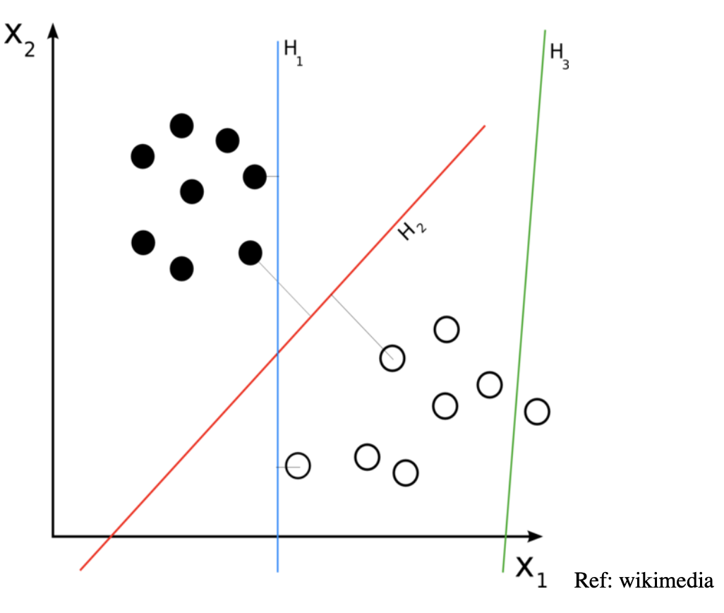
Some classification methods: Non-parametric
Support vector machines (SVM):
These are for a binary classifier and the objective is to choose separating hyperplanes that separate classes by as wide a gap as possible. So hyperplanes are chosen such that the distance from the hyperplane to the nearest data point on each side is maximized. This is what is called a maximum margin hyperplane.

Slide 18
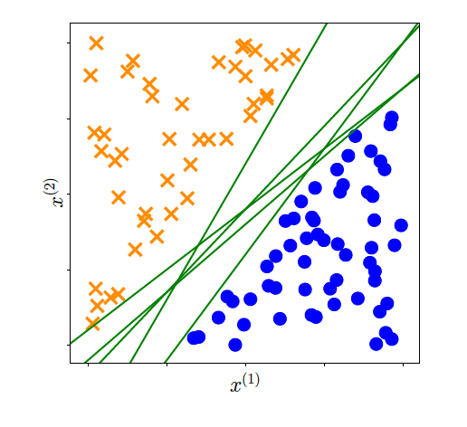
Some classification methods: Non-parametric
Support vector machines (SVM):
For a collection of data that are linearly separable (e.g. there is a line that separates them) there are many choices of such lines or separating hyperplanes. The objective is to choose the separating line that maximizes the “margin” and this leads to an optimization problem with linear constraints and quadratic criterion
For details of the projective geometry and derivation of the SVM criteria see chapter 12 in the book on the reference list by Deisenroth et al., Mathematics of Machine Learning

Slide 19
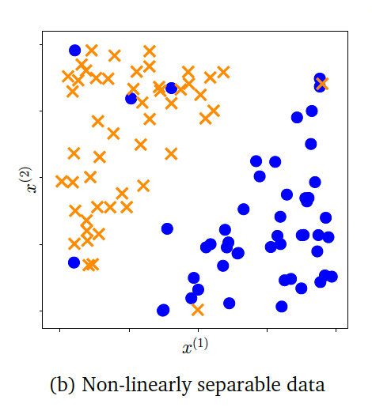
Some classification methods: Non-parametric
Support vector machines (SVM):
For a collection of data that are not linearly separable the quadratic optimization problem will have no solution. The approach is to introduce “slack” variables that have a sum that gives an upper bound on the number of training errors. This gives a “soft margin”. Then the quadratic optimization criteria used adds a penalty cost term for the sum of these slack variables. The resulting problem is then still an optimization problem with linear constraints and quadratic criterion
For details of the projective geometry and derivation of the SVM criteria see chapter 12 in the book on the reference list by Deisenroth et al., Mathematics of Machine Learning

Slide 20
Some classification methods: Non-parametric
Support vector machines (SVM):
For data that are not linearly separable and have many features the solution is derived from the “dual” problem in the optimization sense. Solving this involves thinking about moving the dual problem to a higher dimensional space where the separating hyperplanes may be easier to compute. But if the space is too large this is computationally difficult, so kernel functions are defined in lower dimensional spaces which behave like inner products in the higher dimensional space and are then feasible to compute the solution for in the dual space.
The above SVM is all for binary classification. For multiple category classification a usual approach is to treat it as a series of binary SVMs with the binary being (i) a particular class k among the K classes and (ii) all the remaining classes.
For details of the dual problem and kernels see chapter 12 in the book on the reference list by Deisenroth et al., Mathematics of Machine Learning

Slide 21
Some classification methods: Non-parametric
Ensemble methods: These produce a collection of classifiers rather than a single one.
Bagging: This creates a perturbed version of the training set, trains a classifier on each perturbed version and aggregate the results through majority voting. The process is
Create B bootstrapped training sets from 𝒯 to get 𝒯₁ , …, 𝒯_{B}
Train a classifier cb(x) on each bootstrapped training set 𝒯_{b}
Output: for a new observation x, classify it to the majority class predicted by the B classifiers

Slide 22
Some classification methods: Non-parametric
Ensemble methods: An example method for bagging applied to classification trees is Random Forests
Create B bootstrapped training sets from 𝒯 to get 𝒯₁ , …, 𝒯_{B} and the observations not in 𝒯_{B} form an out-of-bag sample
Train a classification tree on each 𝒯_{B} in which at each node consider only a random set of variables for the next split and grow tree to maximum size and not pruned
Output: for a new observation x, classify it to the majority class predicted by the B classifiers
Note that choosing a small number of variables at each node generally works well.
The underlying procedure provides a way to assess the importance of each variable in the ensemble. This is done by running the out-of-bag sample through the tree to get its classification and computing from this the misclassification error – do this many times by permuting which variables are included to get a percentage increase misclassification rate compared to when all variables are included.

