Slide 1
Math/EEB 589 - Mathematics of Machine Learning Methods in Ecology and Environmental Science Ecological Forecasting
Remember that two of the main classes of problems machine learning is applied to mentioned at the beginning of the semester were:
Regression (or more generally, function approximation) – models a target prediction as a response variable based on a set of inputs (covariates or predictors) and is usually included as a technique in supervised learning. In addition to use for predicting data values from a new set of inputs, it can be used to analyze the behavior of the data (relation between response and inputs) and to determine the relative importance of inputs to the response. This is one aspect of the “model selection” problem - choosing an appropriate statistical model for a set of data, based on the objectives for doing the modeling.

Slide 2
Math/EEB 589 - Mathematics of Machine Learning Methods in Ecology and Environmental Science Ecological Forecasting
State prediction or forecasting – projecting outcomes based on properties of data for new experiments or time-dependent conditions. Prediction, projection and forecasting are not equivalent concepts. Forecasting inherently includes communicating uncertainty. Ecological forecasting is an example in which future trajectories of a natural system are projected based on current conditions and assumptions about future environment.

Slide 3
Ecological Forecasting
What is ecological forecasting?
There is no single agreed-upon definition for differences between prediction, projection and forecasting. My preference is to consider prediction as what will happen (either in the future or across spatial regions currently based on info from other regions). Hal Caswell in his Matrix Population Models books notes that the objective of much of applied ecological modeling is not prediction but projection: what is projected to occur given certain assumptions about model structure, parameters, etc. Demographers make projections – given assumptions about vital rates, this is the projected state of the population at some future time. Forecasting is now viewed as projection with the addition of explicitly accounting for uncertainties. Thus it is framed in a probabilistic framework and much of recent ecological forecasting takes a Bayesian perspective.

Slide 4
Ecological Forecasting
Main classic problems in ecological forecasting:
Population sizes/demography: long history in fisheries, wildlife and disease with direct impact on policies for harvest, quotas, vaccination, etc. Standard models are matrix, ODE and statistical time series
Environmental processes: biogeochemistry, temperature and precipitation projection on various time and spatial scales. Models link ecological states (e.g. landscape-type) to atmospheric and oceanographic physical models including mechanistic and statistical methods and ecosystem models
Distribution and abundance: using environmental variables to project presence/absence and/or abundance. Species Distribution Models (SDM) also called niche models.
Landscape/functional group/community: use environmental variables, history and community dynamics models to project what community type and level of biodiversity is present across space

Slide 5
Ecological Forecasting
Ecological forecasting examples on the reference list:
Christin et al. 2019. Focus on deep learning methods in application to species identification, classification of animal behavior, and biodiversity estimation with examples at many scales and flowchart for process of deep learning
Thessen. 2016. Summary of machine learning, limitations, and methods (tree-based methods, artificial neural nets, support vector machines, genetic algorithms, fuzzy inference systems, Bayesian methods) with example of application to species distribution models and forecasting.
Feng et al. 2020. Application of deep learning methods to better fit a very detailed soil organic carbon model across the US. The model is a large system of differential equations and they use Markov Chain Monte Carlo methods to estimate the many parameters using several methods including neural nets.
Rammer and Seidl. 2019. Applied deep learning to analyze both short-term infestations and long-term outbreaks of a harmful insect (bark beetle) in the Czech Republic/ Germany.
Pelletier et al. 2018. Uses machine learning methods to analyze and estimate conservation risk for thousands of land plant species across the world based on georeferenced data for > 150K species using random forest methods.
Hughes et al. 2017. Uses machine learning methods for detecting landscape patch change using remote sensing images and projects changes across entire eastern US from training set in one region

Slide 6
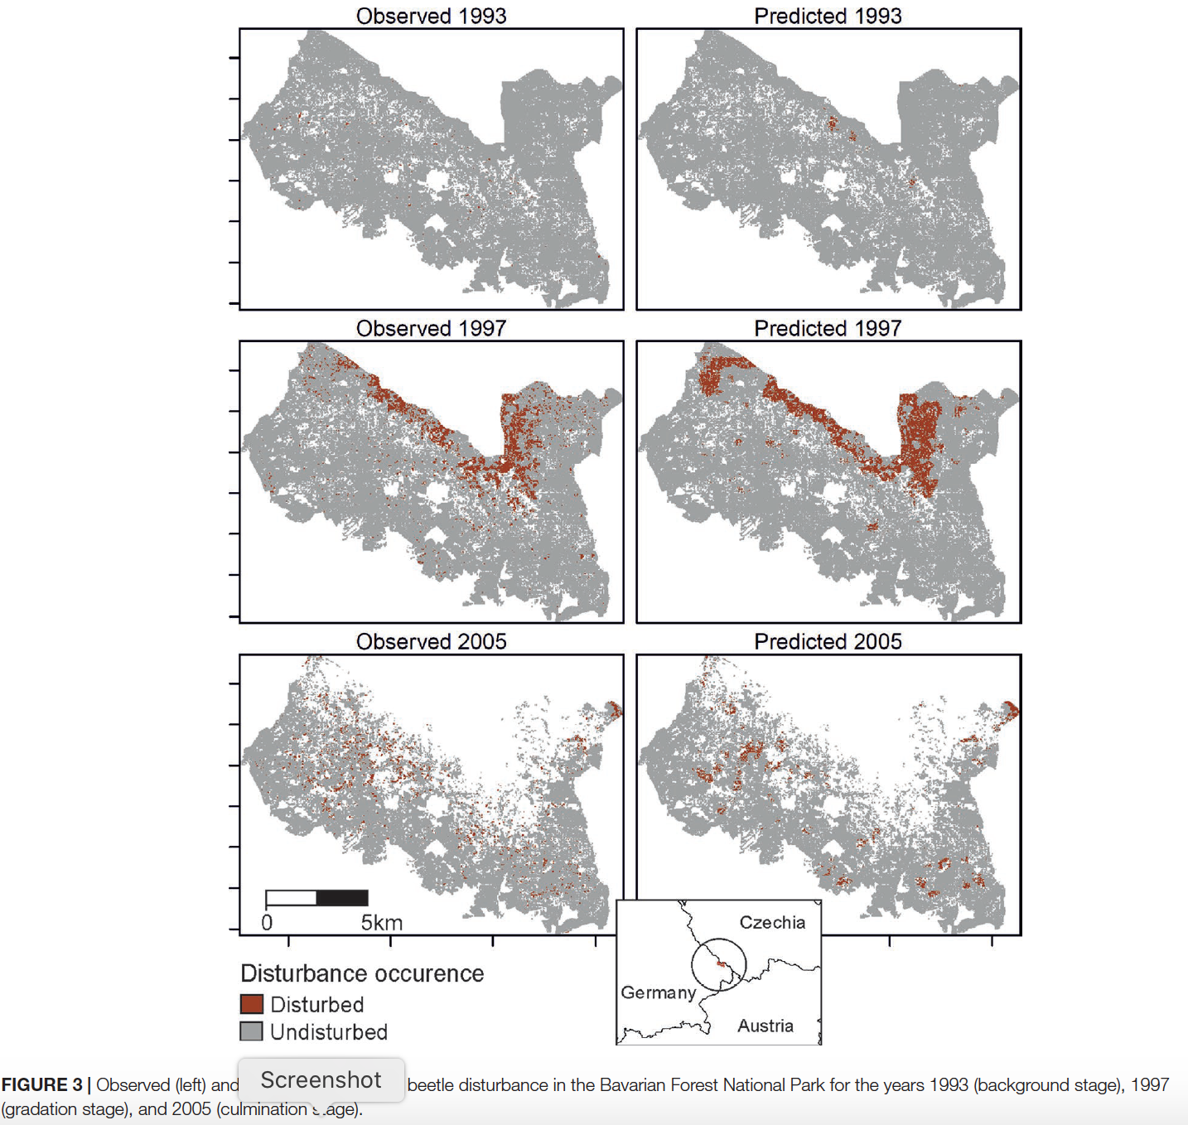
Rammer and Seidle. 2019

Slide 7
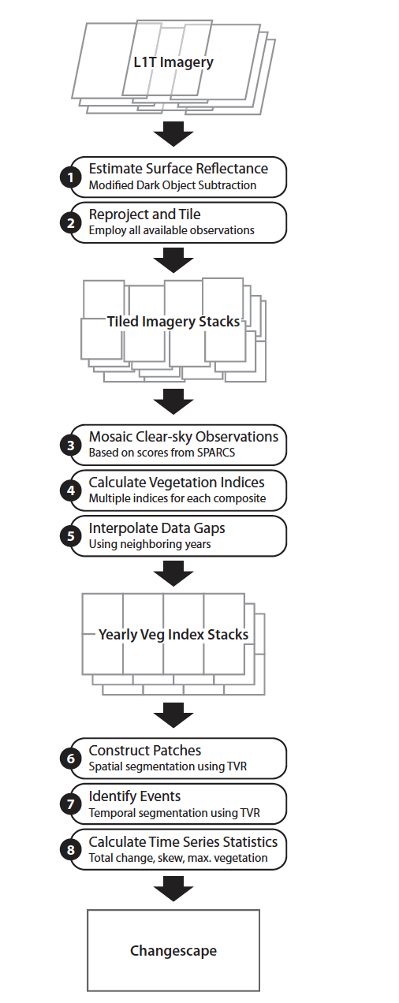
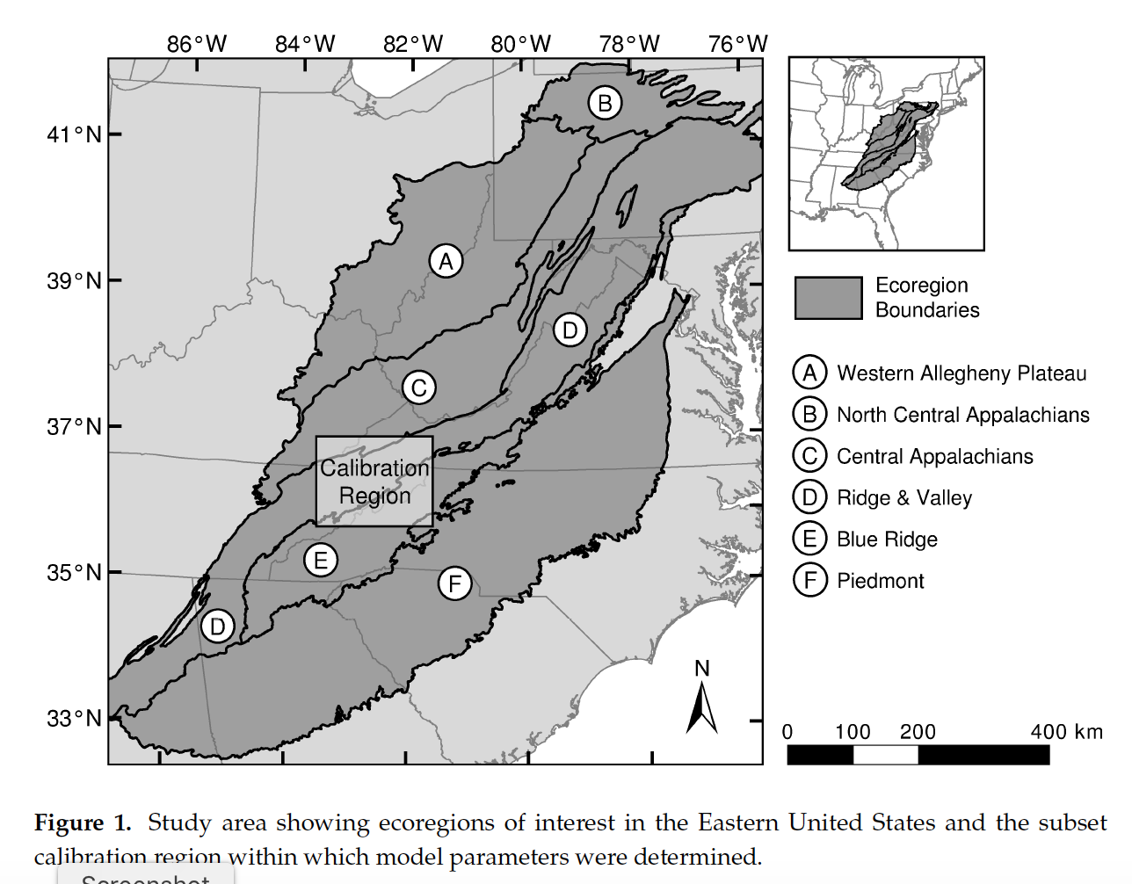

Vegetation Regeneration and Disturbance Estimates
through Time (VeRDET)
M. Joseph Hughes, S. Douglas Kaylor and Daniel J. Hayes. 2017. Patch-Based Forest Change Detection from Landsat Time Series. Forests, 8(5), 166

Slide 8
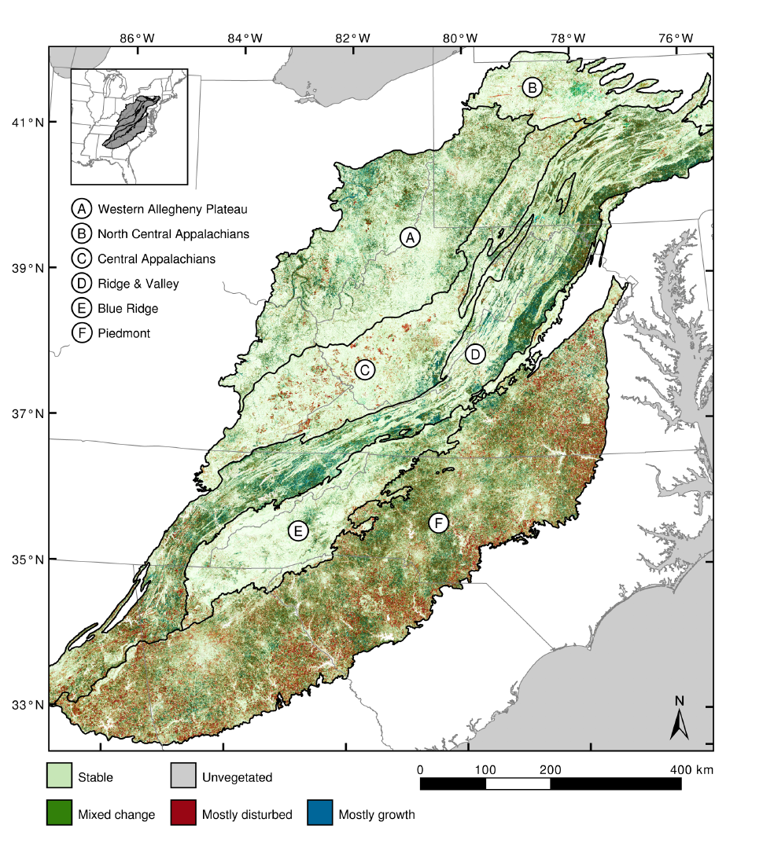
The overall objective was to develop and evaluate an automated forested landscape classifier that used various remotely-sensed data to characterize the disturbance type for each pixel across the eastern US over a 25-year period. Forest types were Stable, Disturbed (stress, wind, wildfire, harvest, etc. ), and Regenerated. Data from a calibration region (training set) were used to produce spatial patches using a spatial regularization method that is a spatial filtering algorithm to preserve patches of similar types and then using a similar approach to time series of images to identify disturbance events. The process used 4800 time series samples for training and the classification was evaluated with 1200 additional time series.
M. Joseph Hughes, S. Douglas Kaylor and Daniel J. Hayes. 2017. Patch-Based Forest Change Detection from Landsat Time Series. Forests, 8(5), 166

Slide 9
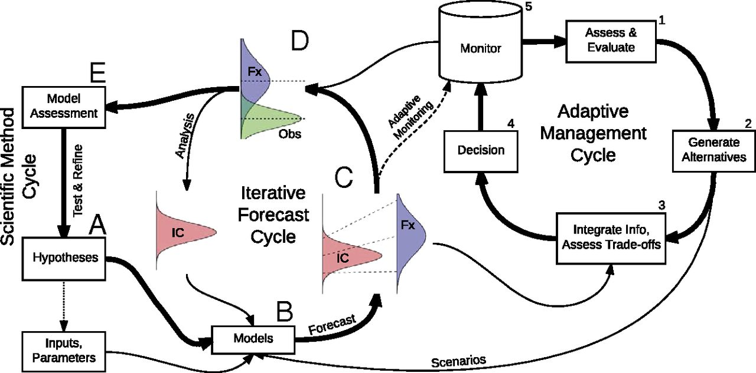
Ecological Forecasting
ecological forecasts are projections of the state of ecosystems, ecosystem services, and natural capital, with fully specified uncertainties
Dietze et al. 2018 Iterative near-term ecological forecasting: Needs, opportunities, and challenges. PNAS 115:1424-1432

Slide 10
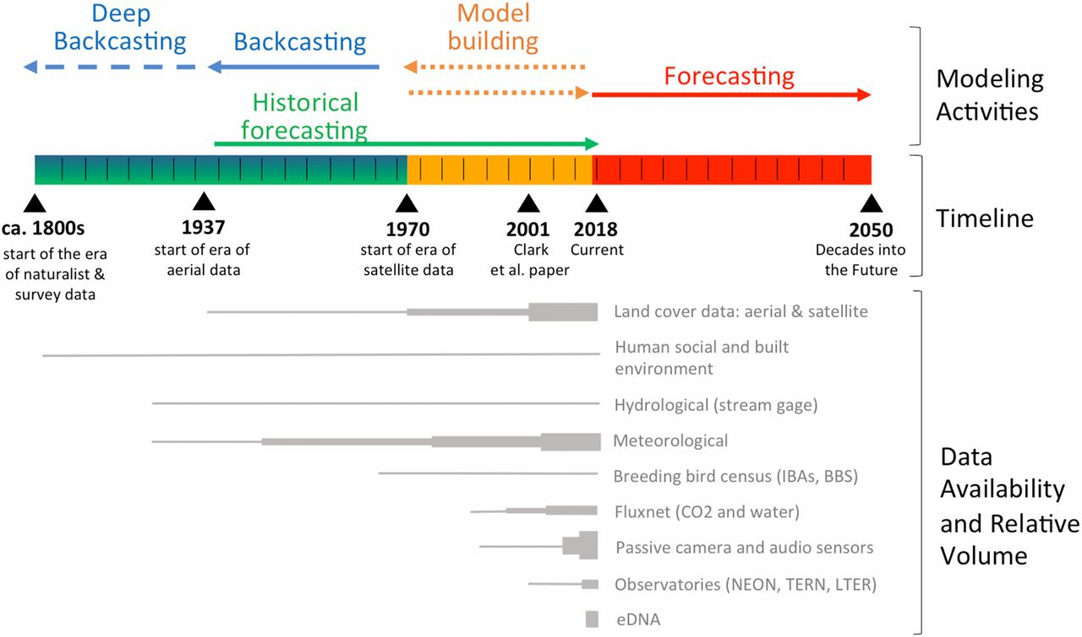
Ecological Forecasting
Forms of model–data integration (Top) and the availability of environmental data (Bottom) through time. Changes in relative data volume indicated by line width.
Dietze et al. 2018 Iterative near-term ecological forecasting: Needs, opportunities, and challenges. PNAS 115:1424-1432

Slide 11
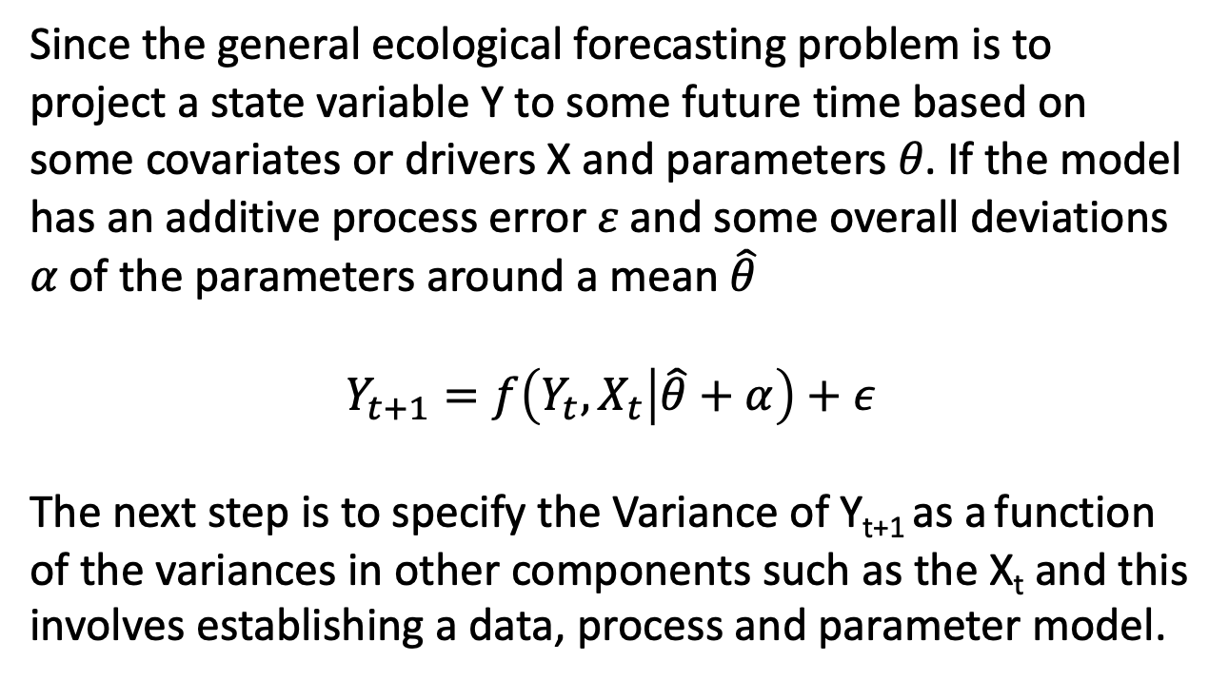
Ecological Forecasting
Since the general ecological forecasting problem is to project a state variable Y to some future time based on some covariates or drivers X and parameters 𝜃. If the model has an additive process error 𝜀 and some overall deviations 𝛼 of the parameters around a mean $\hat{θ}$
$$Y_{t+1}=f\left(Y_{t},X_{t} | \hat{θ}+α\right)+ε$$
The next step is to specify the Variance of Y_{t+1} as a function of the variances in other components such as the X_{t} and this involves establishing a data, process and parameter model.

Slide 12
Ecological Forecasting
Since the focus is on accounting for uncertainty, the base approach is to break down the problem into separate data, process and parameter models associated with the likelihood function giving the probability of the data given the model. Each of the model components may have stochastic aspects.
X ∼ N(f(x),𝝈²)
X Data model
f(x) = 𝝁
𝜇, 𝜎² Process model
𝝁 ∼ N(𝝁₀, V_{𝝁})
𝝈² ∼ IG(s₁, s₂ )
𝜇₀ V_{𝜇} s₁ s₂ Parameter model
Here the data model describes how the data vary around the process model, the process model is typically a deterministic model that gives the expected mean around which the data are distributed, and the parameter model gives the uncertainty in model parameters (in Bayesian this would be the prior). See Dietze, Michael C. 2017. Ecological Forecasting. Princeton Univ. Press

Slide 13
Ecological Forecasting
In the above, the process model could be any static or dynamic model that gives a projection of the underlying system – this is typically a regression model (e.g. linear, multivariate, etc.), standard ODE or PDE model, or a simulation model.
The data model is an attempt to capture the variability and uncertainties in the data observation process. So the data model is expanded to deal with sampling variability, random and systematic measurement errors, instrument calibration errors, unequal variances and missing data. In the above figure, the data model simply assumes a normal distribution of data around a mean specified by the process model.
The nuts and bolts of forecasting then involves specifying the likelihood function, determining the data model, accounting for the data variability, setting up a workflow for data assimilation, characterizing the components of uncertainty, fusing data sources, solving the model while assimilating new data (often MCMC methods and various machine learning methods), and assessing model performance (sometimes using some information criteria – e.g. AIC).

Slide 14
Ecological Forecasting
Main classic problems in ecological forecasting:
Population sizes/demography: Much of this classically is based on general models (logistic/ two-species ODE/Leslie matrix) to project population growth rate as affected by harvest, changing environment. Recent approaches include integral projection models, as well as integro-difference and integro-differential models. Much focus has been on endangered species and accounting for uncertainty (e.g. in fecundity and survivorships) impacts on population growth rates and population viability. An additional modeling theme focuses on variability (seasonal/spatially) and impacts on long-term growth and viability. A completely different approach is purely statistical using a time series (ARMA, ARIMA) or Bayesan (including Hierarchical) and there are mixed methods that combine classic population models with statistical ones. Current data challenges are using learning methods to modify any of these models iteratively to improve model projections using future data as a test set.

Slide 15
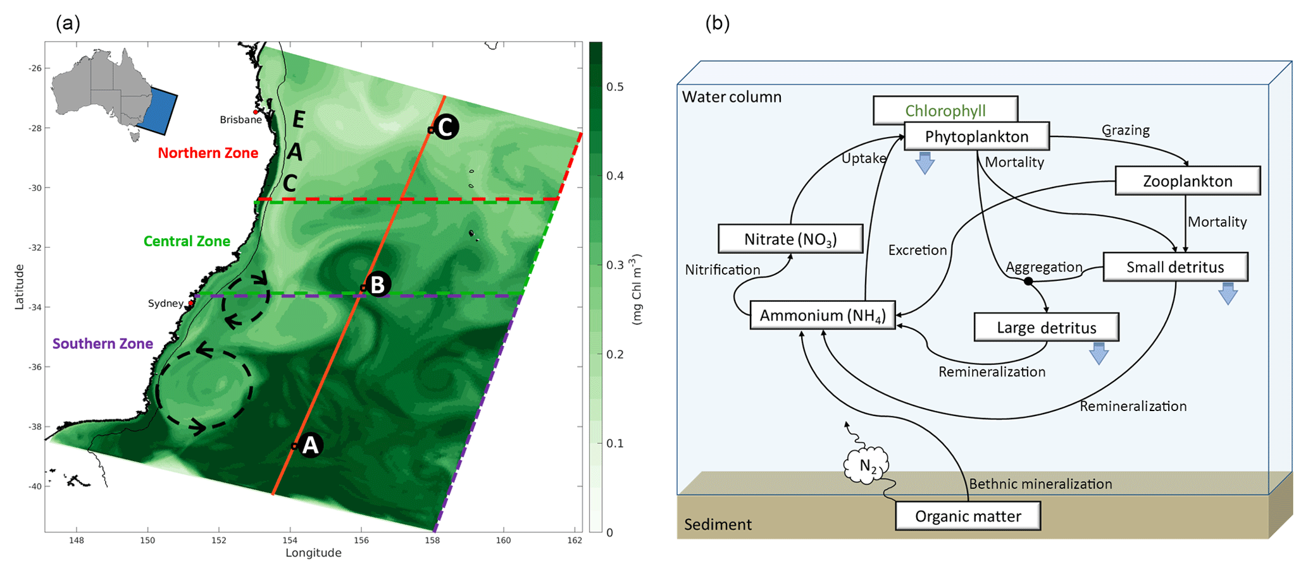
Ecological Forecasting
Main classic problems in ecological forecasting:
Environmental processes and biogeochemistry: ecosystem models
https://gmd.copernicus.org/articles/12/441/2019/

