Slide 1
Math/EEB 589 - Mathematics of Machine Learning Methods in Ecology and Environmental Science
Artificial Neural Nets and Examples
Most applications of artificial neural nets (ANN) are used for supervised learning but we will mention an unsupervised learning case (self-organizing maps for clustering). ANN were developed as a mimic of neurons in the brain, with desirable properties of : (i) Fault tolerance and robustness (death of individual neurons doesn’t affect function of the system); (ii) deals with noisy and unreliable data (brain is capable of correct decisions despite incomplete or faulty data); (iii) parallelism (simultaneous rather than serial computation); (iv) asynchronous (brain doesn’t have a clock to synchronize computation yet is effective); and (v) learning capability (can adapt organism behavior to changing conditions)

Slide 2
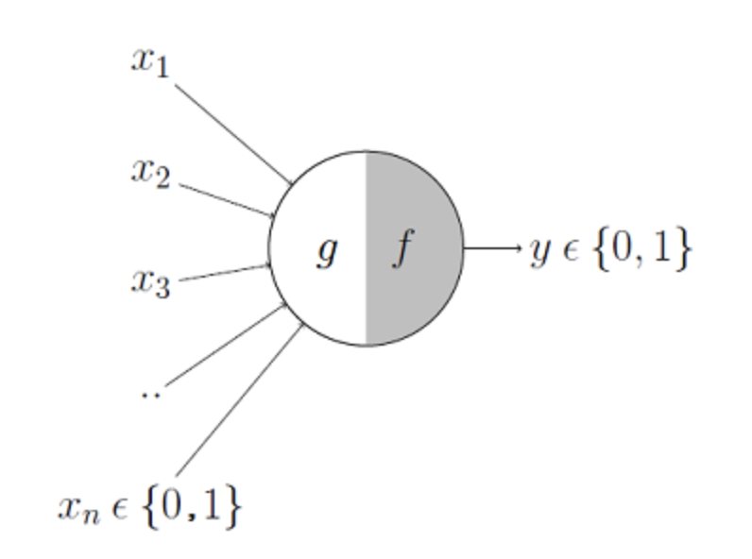
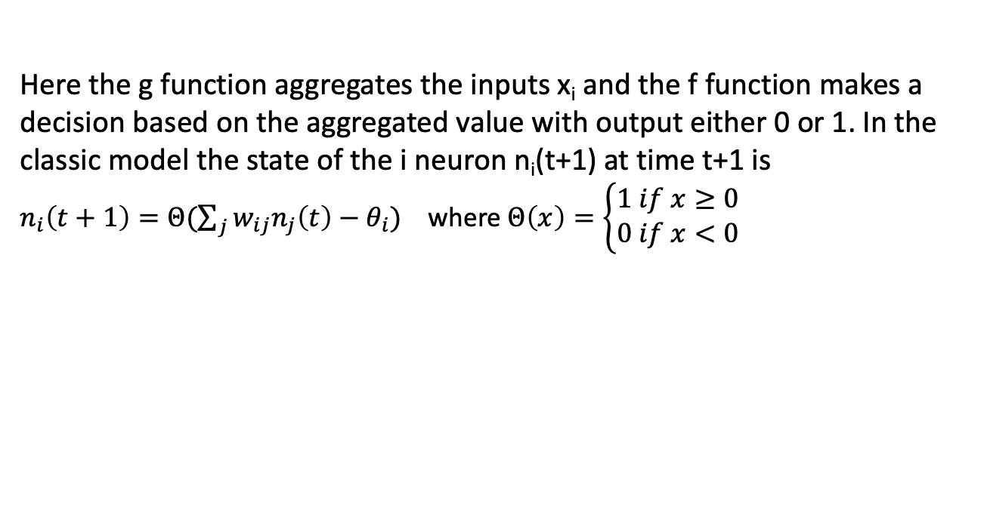
ANN Base Unit – McCulloch-Pitts Model
This is the simplest underlying structure from which ANN are derived – essentially a simple mimic of an individual neuron. This is a two-state model – a neuron is in firing state (denoted by a 1) or non-firing (0 value). The state changes as a function of the neurons feeding into it.
Here the g function aggregates the inputs x_{i} and the f function makes a decision based on the aggregated value with output either 0 or 1. In the classic model the state of the i neuron n_{i}(t+1) at time t+1 is
$n_{i}\left(t+1\right)=Θ(\sum_{j}{w_{ij}n_{j}\left(t\right)−θ_{i})}$ where $Θ\left(x\right)=\left\{\begin{aligned}1 if x≥0 \\ 0 if x<0\end{aligned}\right.$

Slide 3
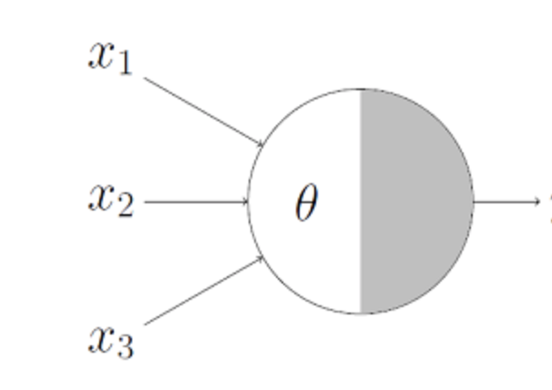
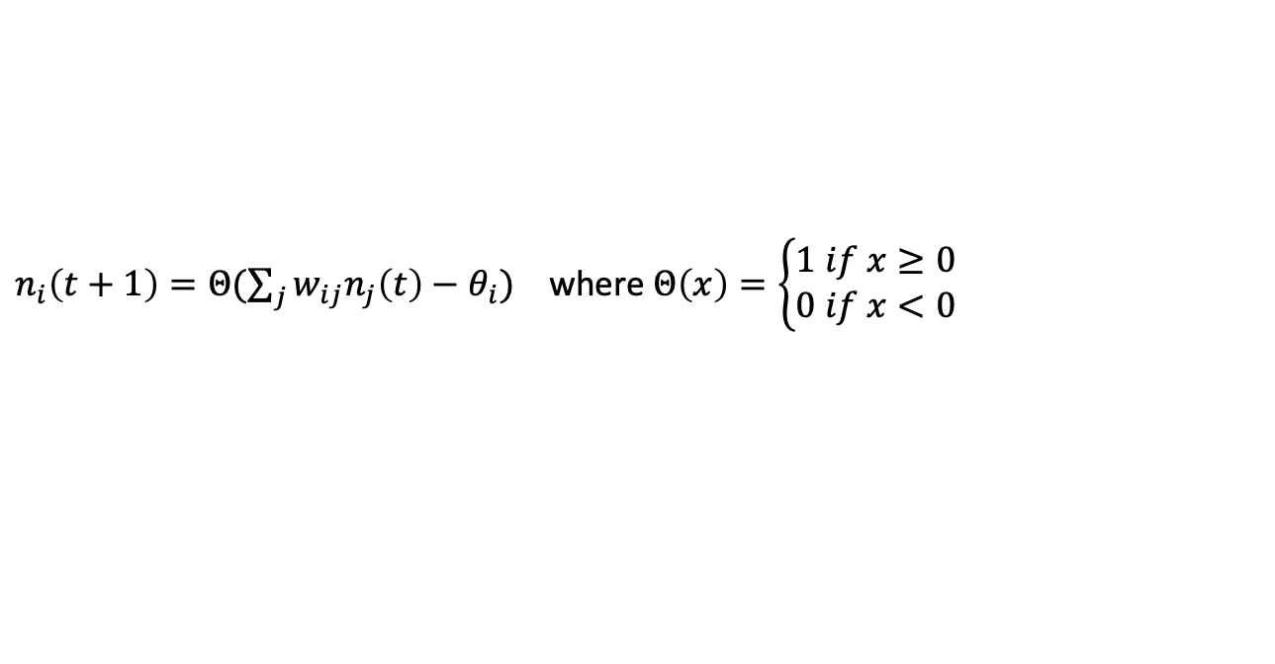
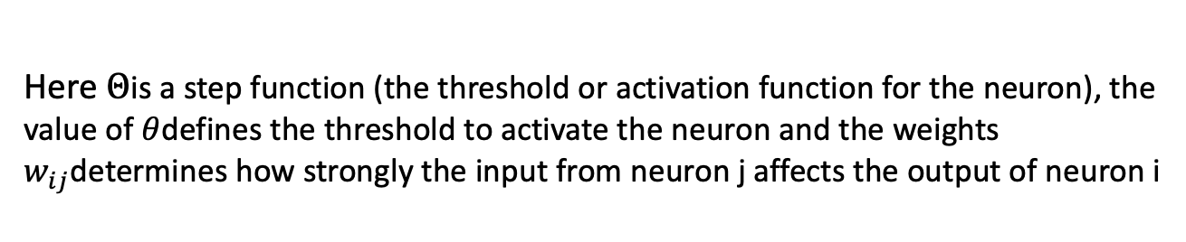
ANN Base Unit – McCulloch-Pitts Model
Here $Θ$is a step function (the threshold or activation function for the neuron), the value of $θ$defines the threshold to activate the neuron and the weights $w_{ij}$determines how strongly the input from neuron j affects the output of neuron i
$n_{i}\left(t+1\right)=Θ(\sum_{j}{w_{ij}n_{j}\left(t\right)−θ_{i})}$ where $Θ\left(x\right)=\left\{\begin{aligned}1 if x≥0 \\ 0 if x<0\end{aligned}\right.$
0.7
0.8
=1
0.6
The above example computes the majority function – if any of the two inputs x_{i} are 1, then the output is 1 while if one or fewer of the inputs is 1, the output is 0.
In a very similar manner, this simple neuron can represent all ths standard Boolean logic functions (e.g. AND, OR, NOR, etc.)

Slide 4
ANN and supervised learning
An ANN is a connected set of neurons in which there may be one or more layers of neurons between the inputs and the outputs, or a topology that is not layered at all (for example one in which every neuron is connected to every other neuron). Every connection (or edge) has an associated weight and learning of the ANN occurs through updating of the weights.
In supervised learning application, a training set of inputs and associated desired outcomes (such as classifying images) is presented to the ANN, with an updating rule applied to the weights after each incorrect ANN calculation. One pass through all the training set is an epoch, and many epoch’s may be needed. Typically a separate test set is then used to evaluate the ANN ability to make correct decisions. Except under certain assumptions, there is no guarantee any particular algorithm for updating of weights will converge.
There are cases in which the ANN essentially “memorizes” the test set rather than extracting features that characterize the inputs – such memorization may be a desired outcome (e.g. Hopfield networks).

Slide 5
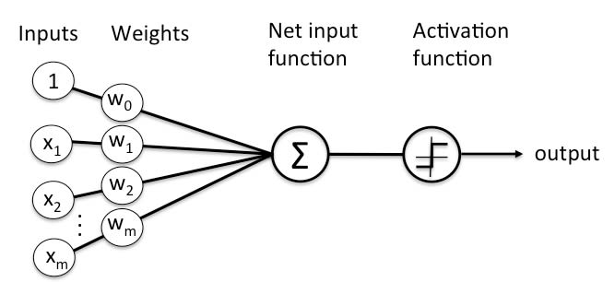
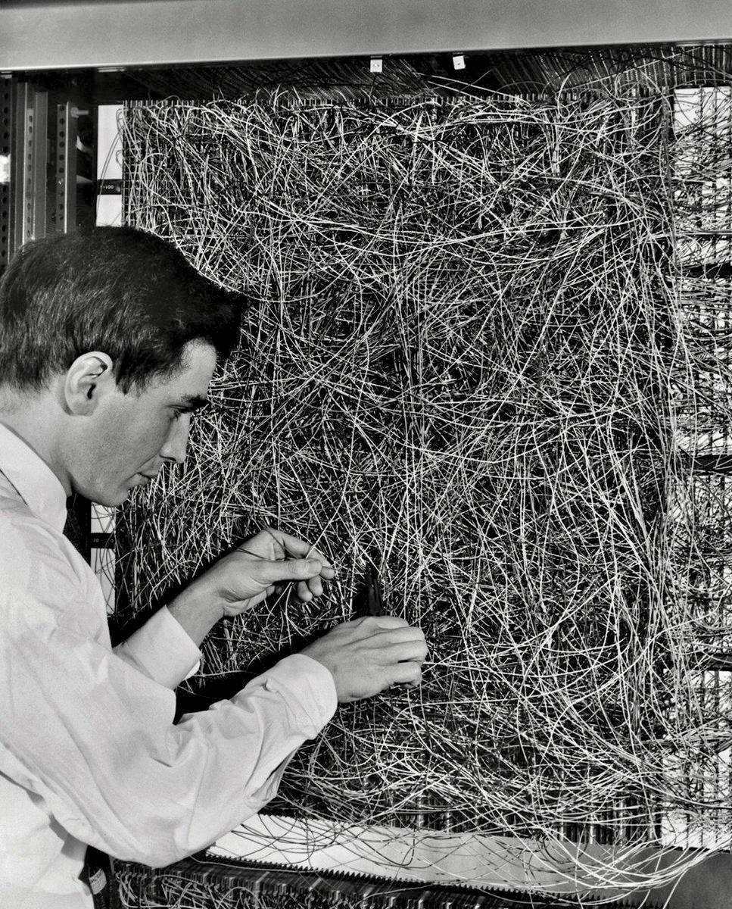
ANN example: the perceptron
The simplest ANN was developed in the 1950’s as a single input layer and used for a classification. In the below case with one output, it is a binary classifier. With multiple outputs (with different weights) which are independent, this can classify a larger number of classes.
Frank Rosenblatt and analog perceptron

Slide 6
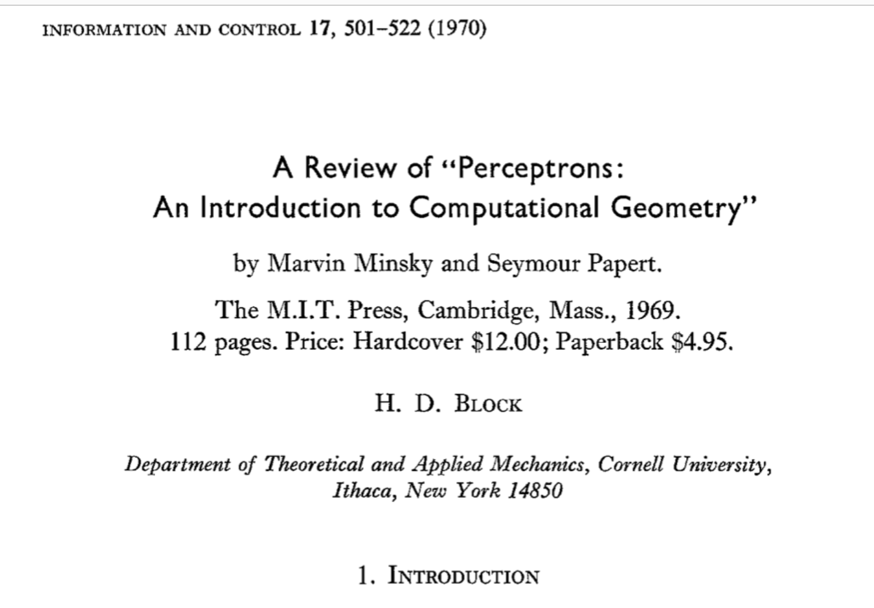

Slide 7
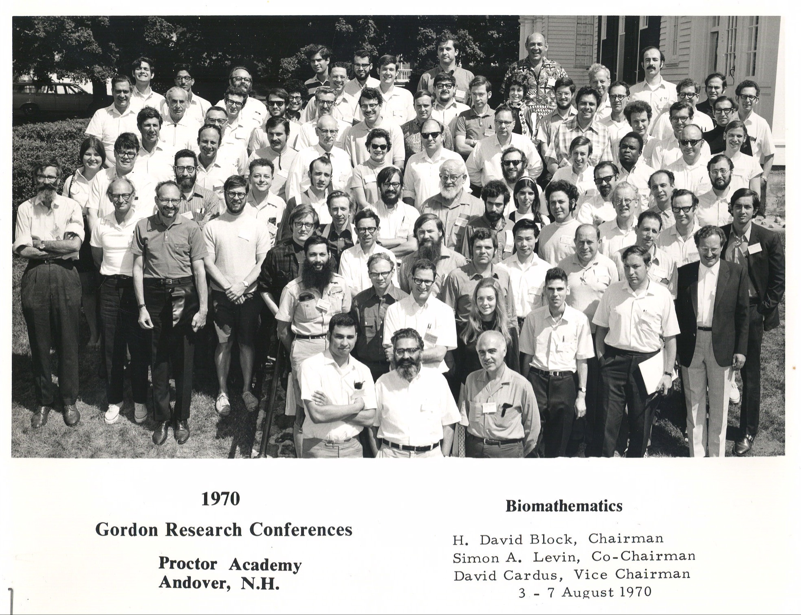

Slide 8
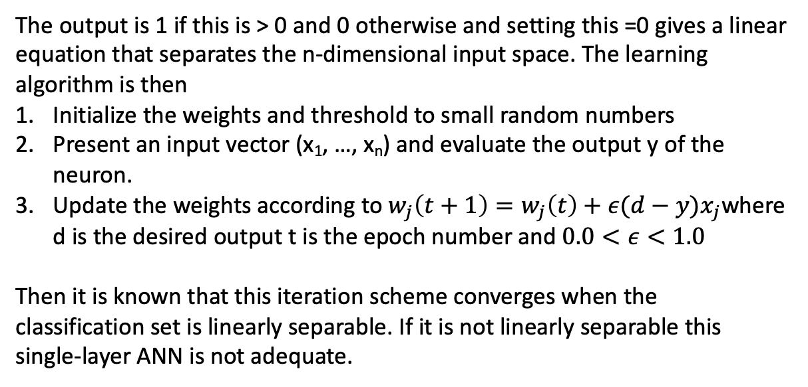
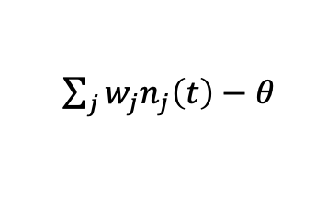
ANN example: the perceptron
The neuron input is
$\sum_{j}{w_{j}n_{j}\left(t\right)−θ_{ }}$
The output is 1 if this is > 0 and 0 otherwise and setting this =0 gives a linear equation that separates the n-dimensional input space. The learning algorithm is then
Initialize the weights and threshold to small random numbers
Present an input vector (x₁, …, x_{n}) and evaluate the output y of the neuron.
Update the weights according to $w_{j}\left(t+1\right)=w_{j}\left(t\right)+ε(d−y)x_{j}$where d is the desired output t is the epoch number and $0.0<ε<1.0$
Then it is known that this iteration scheme converges when the classification set is linearly separable. If it is not linearly separable this single-layer ANN is not adequate.

Slide 9
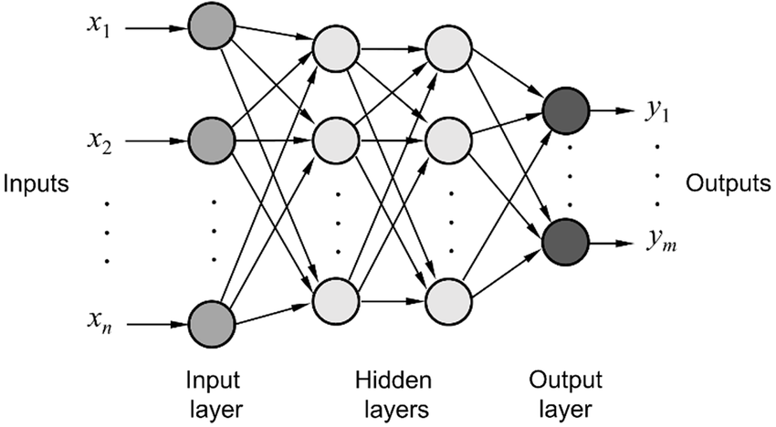
ANN example: multi-layer
Here there are layers of internal neurons between input and output layers. The inner layers are called “hidden”. Feed-forward refers to the standard method in which inputs and calculations move in one direction from input layer to hidden layers to the output layer so there are no “loops”.

Slide 10
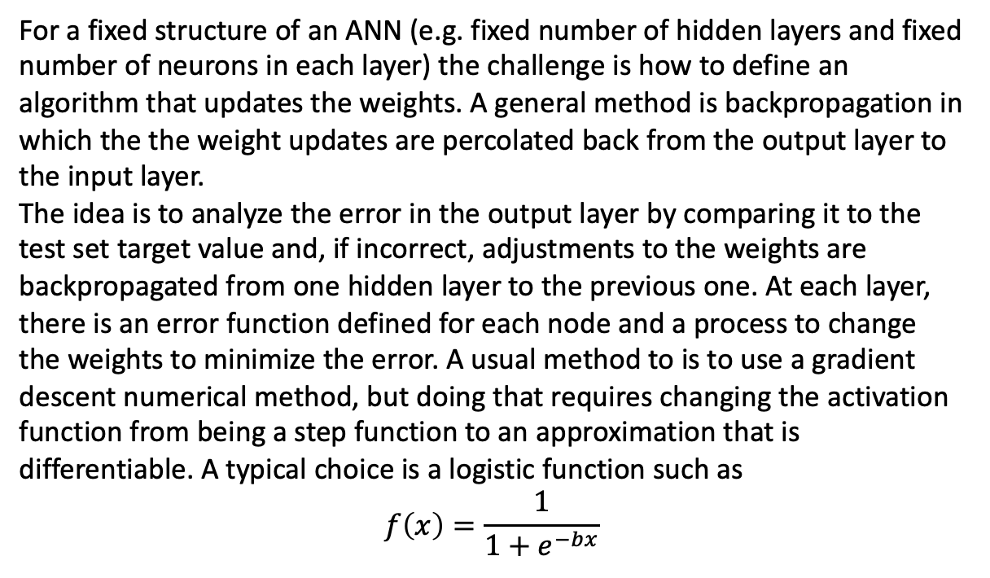
ANN example: multi-layer
For a fixed structure of an ANN (e.g. fixed number of hidden layers and fixed number of neurons in each layer) the challenge is how to define an algorithm that updates the weights. A general method is backpropagation in which the the weight updates are percolated back from the output layer to the input layer.
The idea is to analyze the error in the output layer by comparing it to the test set target value and, if incorrect, adjustments to the weights are backpropagated from one hidden layer to the previous one. At each layer, there is an error function defined for each node and a process to change the weights to minimize the error. A usual method to is to use a gradient descent numerical method, but doing that requires changing the activation function from being a step function to an approximation that is differentiable. A typical choice is a logistic function such as
$$f\left(x\right)=\frac{1}{1+e^{−bx}}$$

Slide 11
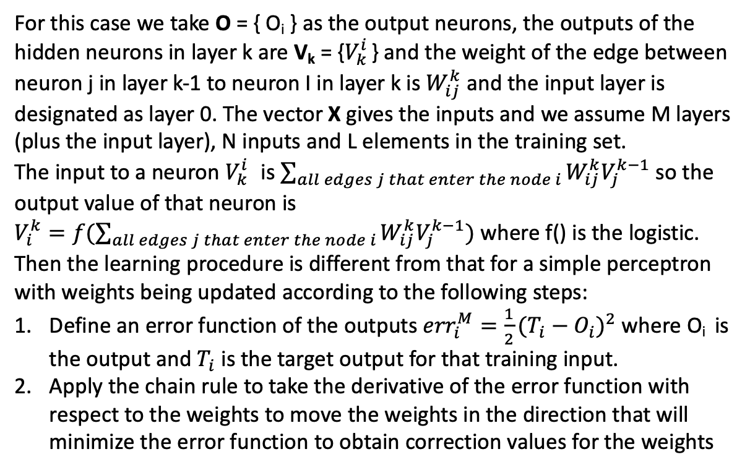
ANN example: multi-layer
For this case we take O = { O_{i} } as the output neurons, the outputs of the hidden neurons in layer k are V_{k} = {$V_{k}^{i}$ } and the weight of the edge between neuron j in layer k-1 to neuron I in layer k is $W_{ij}^{k}$ and the input layer is designated as layer 0. The vector X gives the inputs and we assume M layers (plus the input layer), N inputs and L elements in the training set.
The input to a neuron $V_{k}^{i}$ is $\sum_{all edges j that enter the node i}{W_{ij}^{k}V_{j}^{k−1}}$ so the output value of that neuron is
$V_{i}^{k}=f(\sum_{all edges j that enter the node i}{W_{ij}^{k}V_{j}^{k−1}})$ where f() is the logistic.
Then the learning procedure is different from that for a simple perceptron with weights being updated according to the following steps:
Define an error function of the outputs ${err}_{i}^{M}=\frac{1}{2}{(T_{i}−O_{i})}^{2}$ where O_{i} is the output and $T_{i}$ is the target output for that training input.
Apply the chain rule to take the derivative of the error function with respect to the weights to move the weights in the direction that will minimize the error function to obtain correction values for the weights

Slide 12
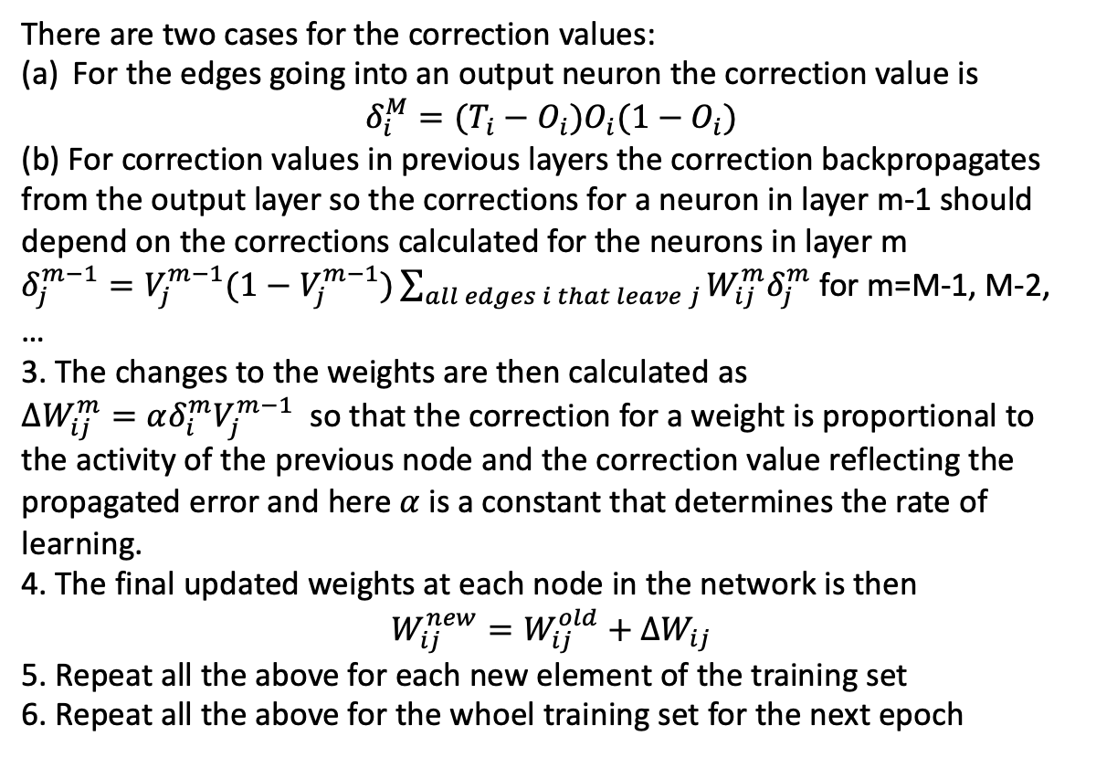
ANN example: multi-layer
There are two cases for the correction values:
For the edges going into an output neuron the correction value is
$$δ_{i}^{M}=(T_{i}−O_{i})O_{i}(1−O_{i})$$
(b) For correction values in previous layers the correction backpropagates from the output layer so the corrections for a neuron in layer m-1 should depend on the corrections calculated for the neurons in layer m
$δ_{j}^{m−1}=V_{j}^{m−1}(1−V_{j}^{m−1})\sum_{all edges i that leave j}{W_{ij}^{m}δ_{j}^{m}}$ for m=M-1, M-2, …
3. The changes to the weights are then calculated as
$ΔW_{ij}^{m}=αδ_{i}^{m}V_{j}^{m−1}$ so that the correction for a weight is proportional to the activity of the previous node and the correction value reflecting the propagated error and here $α$ is a constant that determines the rate of learning.
4. The final updated weights at each node in the network is then
$$W_{ij}^{new}=W_{ij}^{old}+∆W_{ij}$$
5. Repeat all the above for each new element of the training set
6. Repeat all the above for the whoel training set for the next epoch

Slide 13
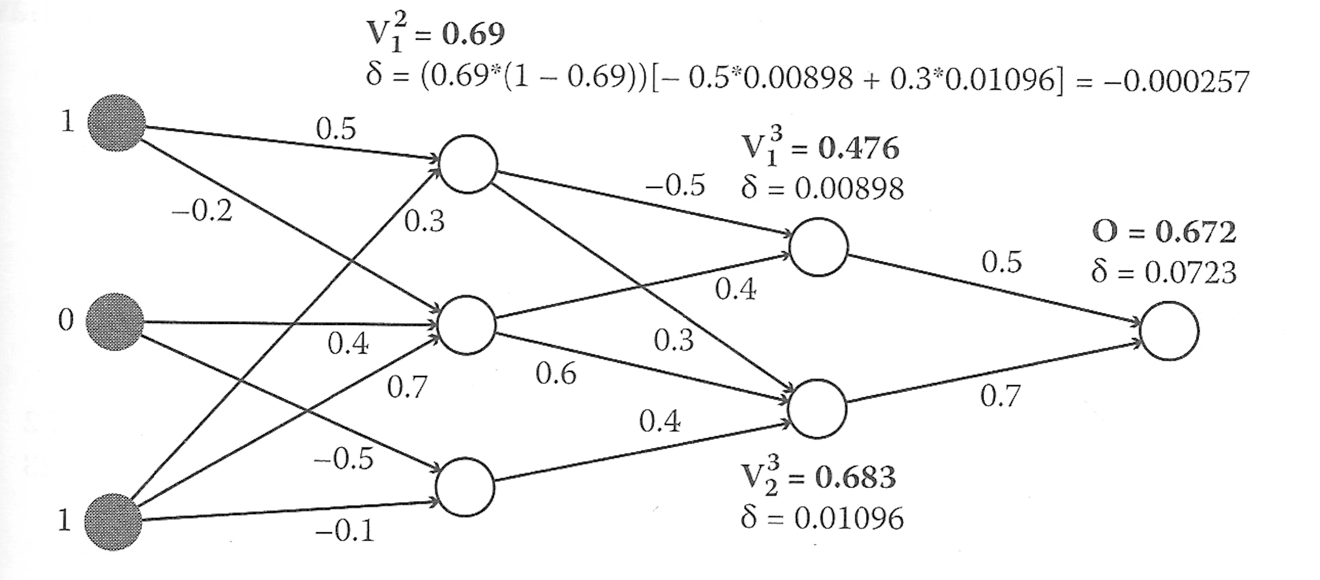
ANN example: multi-layer
In this example the output value should have been 1 but the ANN computed the value to be .672 and the algorithm calculates back from the output to the two hidden layers. This image shows the calculation back to the top node in the first hidden layer based on its value V and the values of 𝛿 that propagate back from the two nodes in the second hidden layer

Slide 14
ANN example: multi-layer
In this same example (the output value should have been 1 but the ANN computed the value to be .672) this image shows the updating of the weight from the top input layer to the top node of the first hidden layer

Slide 15
ANN example: multi-layer
There is no guarantee that this backpropagation method converges, so a decision has to be made for a stopping criteria for the iteration. Some possibilities are (i) stopping when the error on the training set is sufficiently small, (ii) stop when the changes on the weights are small, (iii) stop when there is some satisfactory agreement with a test set separate from the training set.
There are many modifications to this basic algorithm of backpropagation. Each of them have the potential that the process leads to some local minimum so that the weights don’t change but there is a “better” set of weights. To respond to this issue, typical approaches are to
train the network by randomly selecting the order in which it is applied to the elements of the training set,
occasionally modify the algorithm to change the weights so that they increase the error function by some small amount,
add noise by randomly changing the weights occasionally.

Slide 16
ANN example: multi-layer and errors
Even if the backpropagation algorithm converges to what appears to be a reasonable solution that performs well on the training set, there may be many different solutions that perform well and forecasting how well they perform in application to non-test set data is challenging. Different algorithms may all do well on the training set.
There are at least two types of error: (i) training errors which arise from the way the algorithm deals with the particular training set and (ii) generalization errors which errors in dealing with the data in the test set. There are trade-offs here because finding a ANN that performs very well regarding training errors, but then has increased generalization error. So choosing a large number of hidden layers or increasing the neurons in them may lead to overfitting the training set and this have high generalization error. Of course, too small a training set can lead to underfitting.
There are no fixed rules for network design (e.g. how many hidden layers, how many connections between the layers, etc.). There are methods to use a genetic algorithm on populations of ANNs with different structures and comparing training and generalization errors using an optimization criteria.

Slide 17
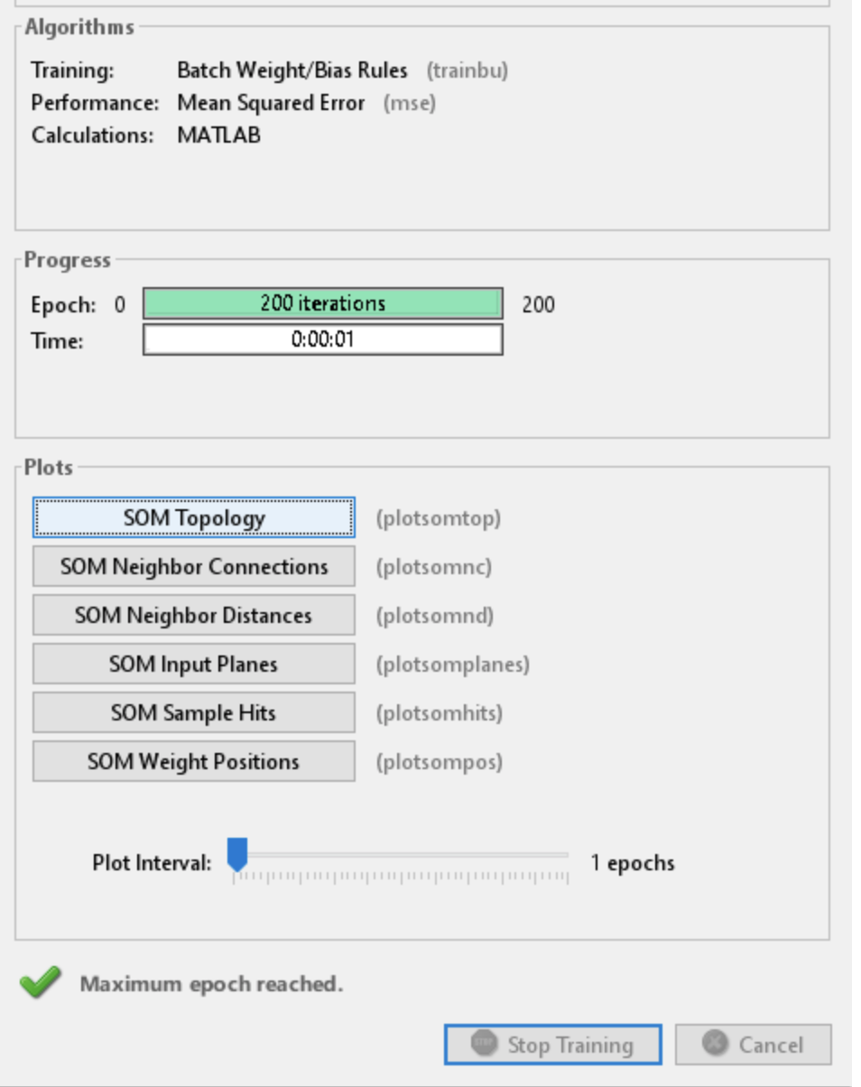
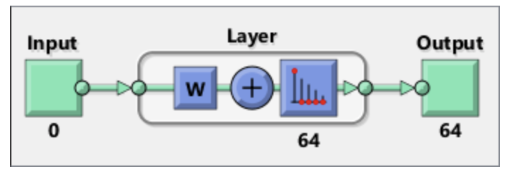
ANN Unsupervised learning example: Clustering
Self-organizing maps use neural networks that learn the topology and distribution of the data. Matlab has an example in which the Fisher data on Iris flowers is used in an unsupervised case (e.g. we ignore the species assigned to the flower measurement data) so that the classification based on just flower measurements can be compared to the classification based on given taxonomy. It uses a neural net training tool to choose various options.

