Slide 1
Quantitative Education for Life Science Students: Lessons from 40 Years of Efforts
Louis J. Gross
National Institute for Mathematical and Biological Synthesis
Departments of Ecology and Evolutionary Biology and Mathematics
University of Tennessee, Knoxville

Slide 2
Overview
Big educational challenges
Science and models
Some history of mathbio education
Entry-level math courses
Entry-level biology courses
Assessing biology examples in biocalc
Local prioritization
Some lessons

Slide 3
Big Challenge in Education
There’s Too Much to Know:
No agreement on prioritization of knowledge
How to account for diversity of background/experience of learners
How to utilize different learning modalities

Slide 4
Methods to Prioritize
Tradition – “Great Ideas” approach
Sages – reports from experts, societies, academies
Accreditation standards
Crowd-sourcing – based on input from stakeholders, e.g. curriculum set by legislatures, committees
Localization – curriculum determined by local needs and constraints

Slide 5
Diversity of Learner Background
Meeting students where they are – assessing at the start to guide learning
Informed by learning pedagogy – the science of scientific teaching
Enhancing learning progression – guided inquiry and various learning styles (Engage, Explore, Explain, Elaborate, Evaluate)

Slide 6
Alternative Learning Modalities
Formal courses – move towards active learning e.g. flipped, peer instruction
Technology enhanced – various online, personalized instruction, virtual labs
Group/individual learning – REU, lab/field experiences, team learning, bootcamps, tutorials, internships
Movements driving these – calculus reform, general biology reform, science of team science

Slide 7
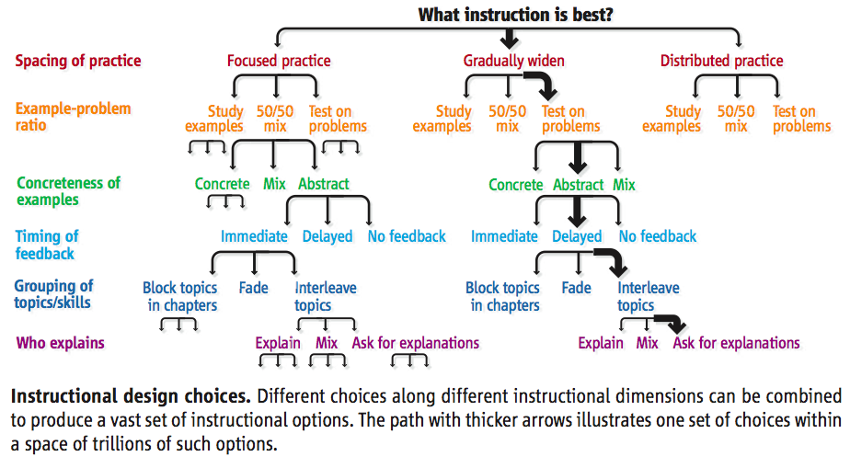
Koedinger, K. R., J. L. Booth, and D. Klahr. Instructional Complexity and the Science to Constrain It. Science 342:935-7 (2013)

Slide 8
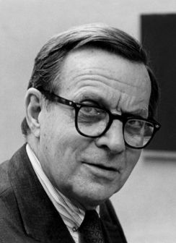
What is science?
Science is thought to be a process of pure reductionism, taking the meaning out of mystery, explaining everything away, concentrating all our attention on measuring things and counting them up. It is not like this at all. The scientific method is guesswork, the making up of stories. The difference between this and other imaginative works of the human mind is that science is then obliged to find out whether the guesses are correct, the stories true. Curiosity drives the enterprise, and the open acknowledgement of ignorance.
Lewis Thomas - Sierra Club Bulletin, March/April 1982, P. 52

Slide 9
What is science?
Science is thought to be a process of pure reductionism, taking the meaning out of mystery, explaining everything away, concentrating all our attention on measuring things and counting them up. It is not like this at all. The scientific method is guesswork, the making up of stories. The difference between this and other imaginative works of the human mind is that science is then obliged to find out whether the guesses are correct, the stories true. Curiosity drives the enterprise, and the open acknowledgement of ignorance.
Lewis Thomas - Sierra Club Bulletin, March/April 1982, P. 52
Models
Data

Slide 10
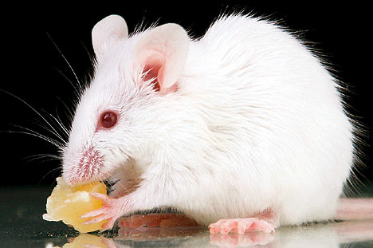
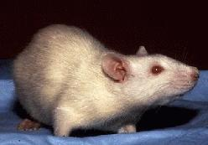
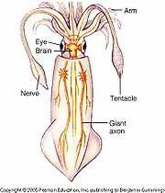
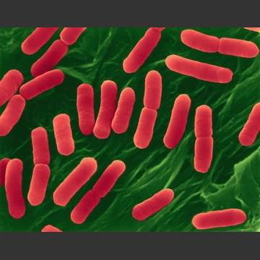
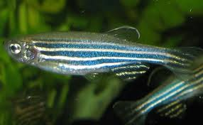
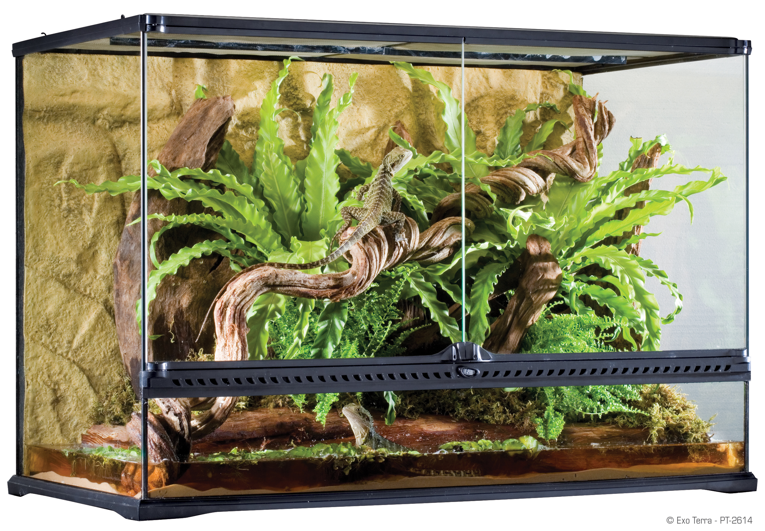
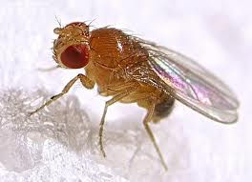
Models in Biology
Physiology
Disease
Neurobiology
Microbiology
Development
Genetics
Ecosystems
Notes:
There isn’t a lot of guidance on evaluation of these model organisms to say that they are appropriate mimics for the underlying questions we want to address which typically involve human impacts

Slide 11
Spatial-epidemiology model with vaccination

Slide 12
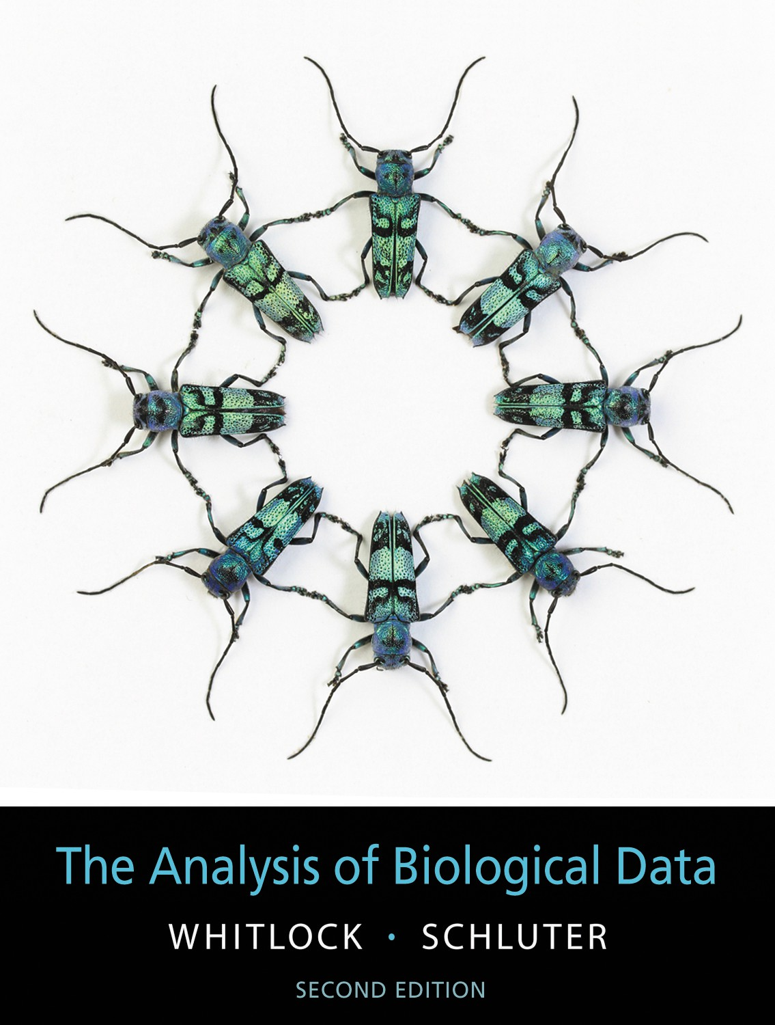
There are resources to provide guidance on the connection between models and data
Data carpentry
Software carpentry
Coursera, CourseSource, edX
Numerous statistics, informatics and database courses
Software that is flexible
Some texts
Princeton Univ. Press 1997

Slide 13
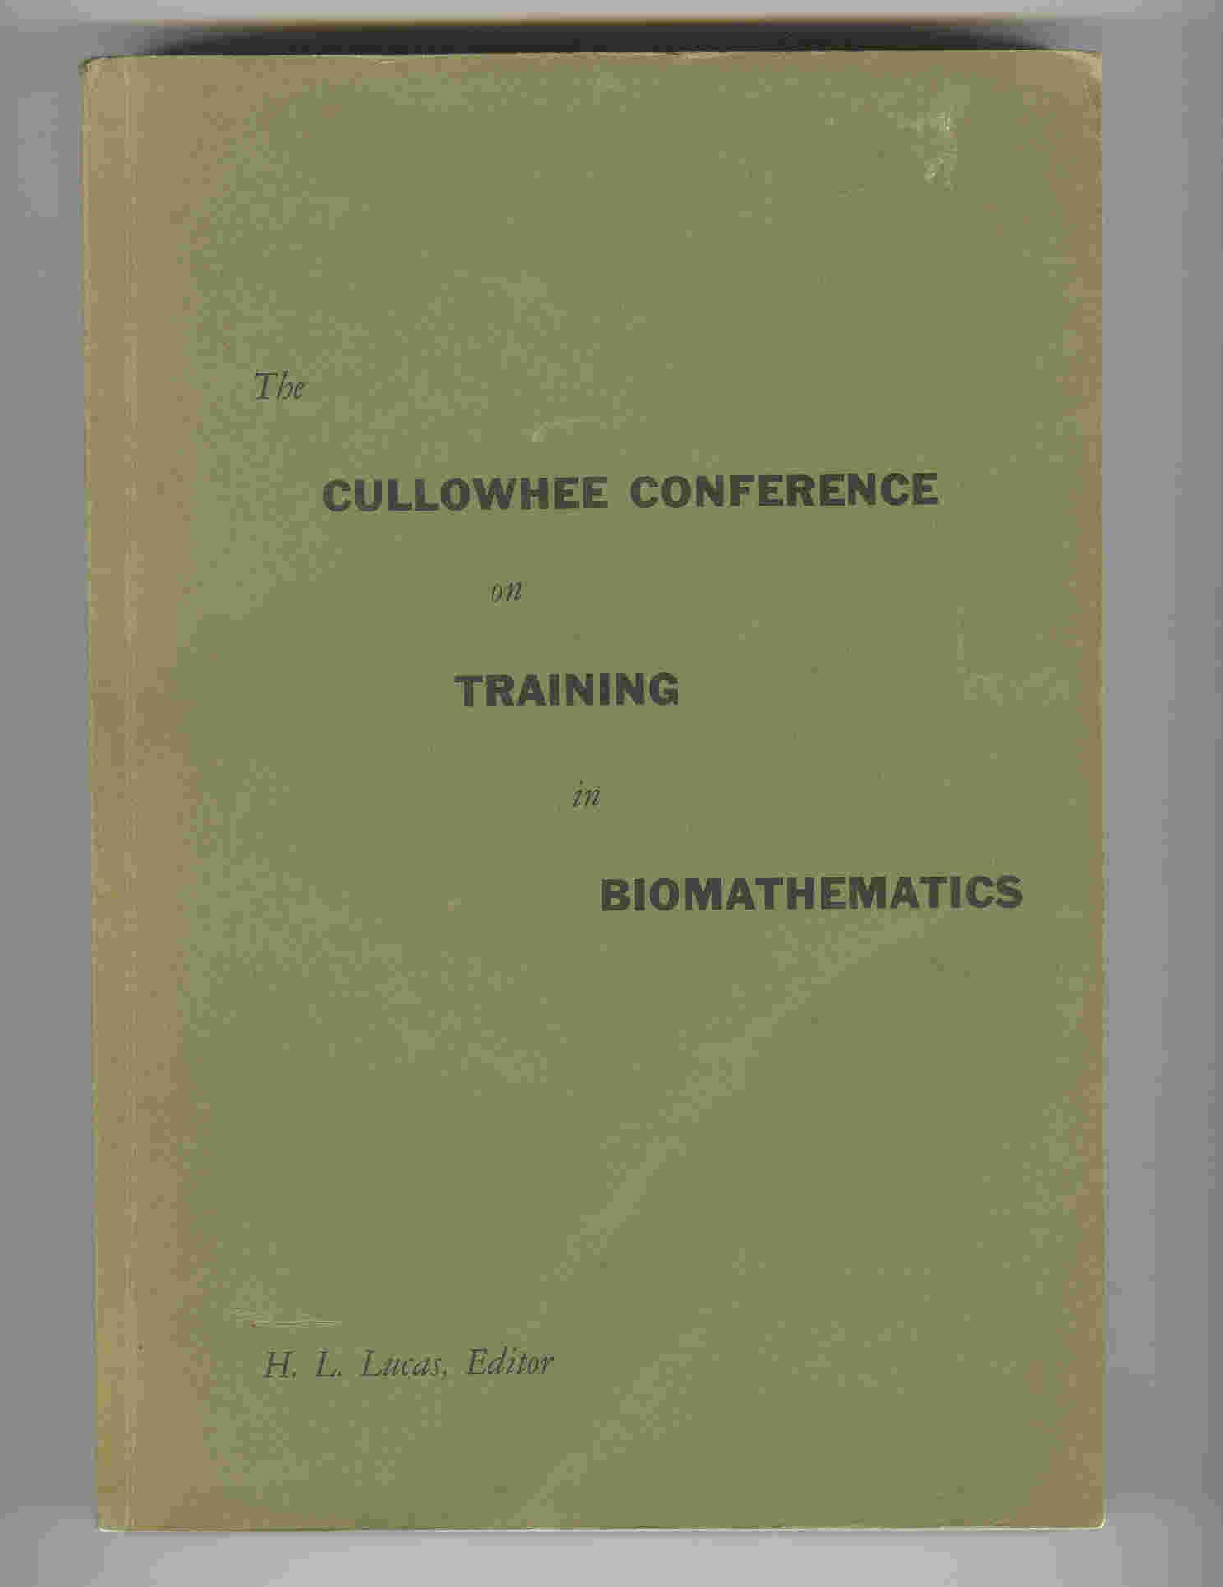
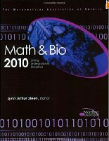
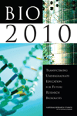
Reports and more reports:
Notes:
Earliest report on mathematics in life science was the Cullowhee conference in 1961 and many of the remarks made there still rind true today including their comment that there is no unique route to appropriate quantitative education in math biology. Since then there have been numerous reports over the last decade that have included a focus on undergrad bio education, all of which note the important connection to quantitative science.

Slide 14
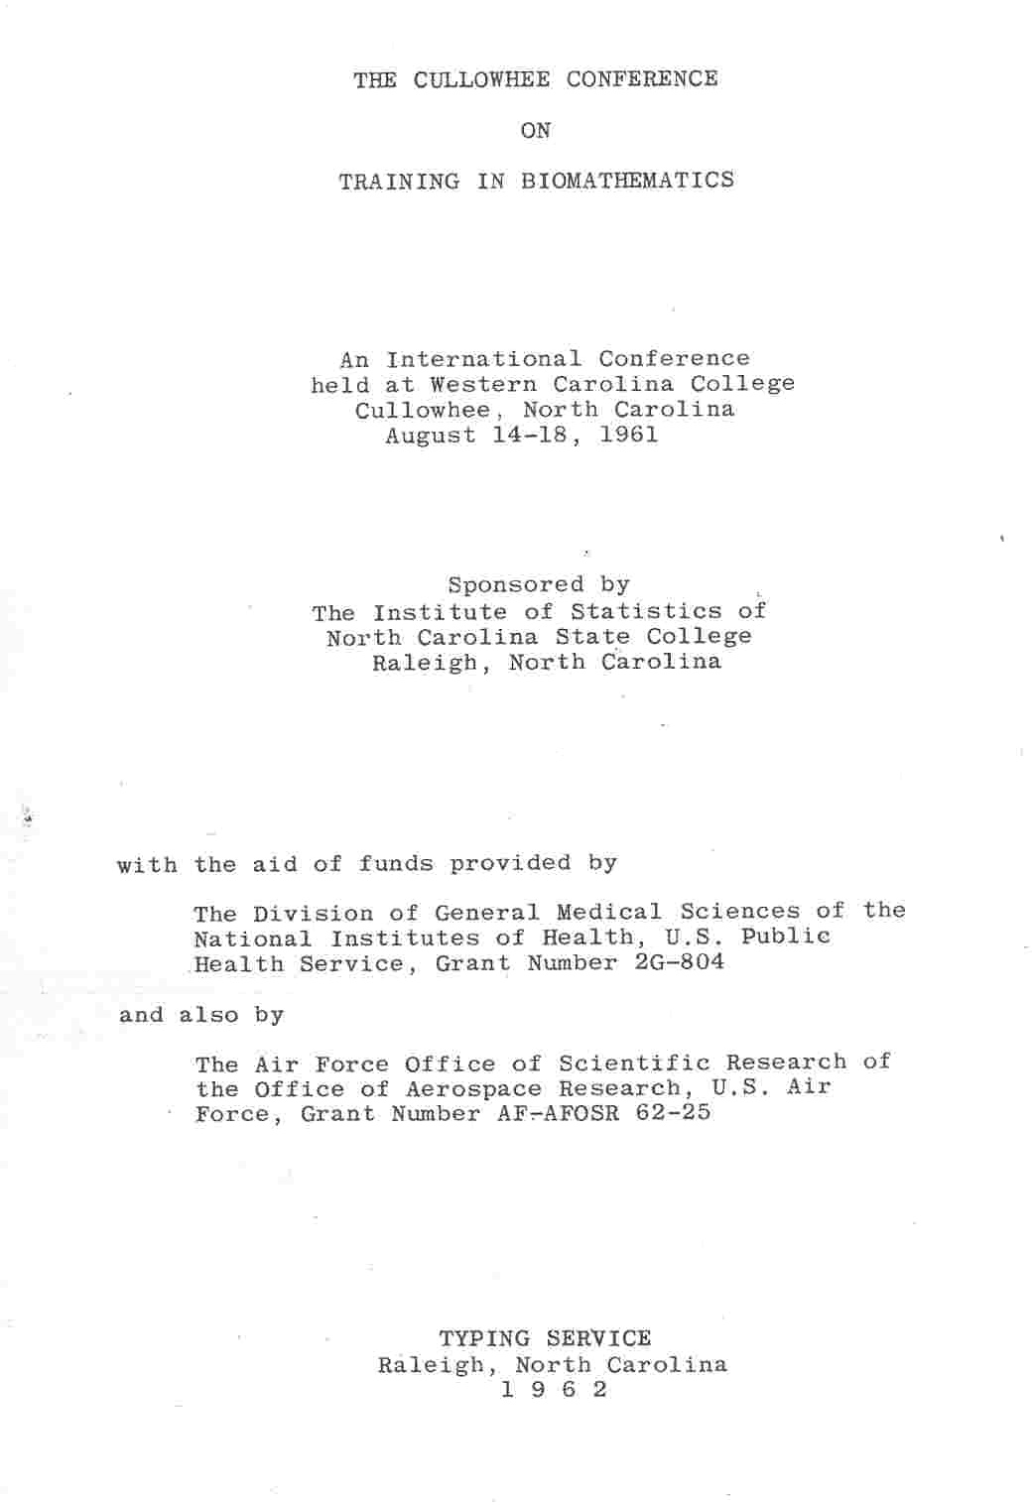
Notes:
The first gathering I am aware of that focused on math connections to Bio with an educational focus, emphasizing graduate education.

Slide 15
“ There does not exist now, and it is unlikely that there ever will exist, a unique answer to the question of the kind and the extent of training that a mathematical biologist should receive.”
J. Z. Hearon, Chief, Office of Mathematical Research, NIH (1961)

Slide 16
“Traditional biology courses lay far too much emphasis on the direct acquisition of information. Insufficient attention is given to the interpretation of facts or to the drawing of conclusions from observation and experience. The student is given little opportunity to apply scientific principles to new situations.”
J. G. Skellam (1961)

Slide 17
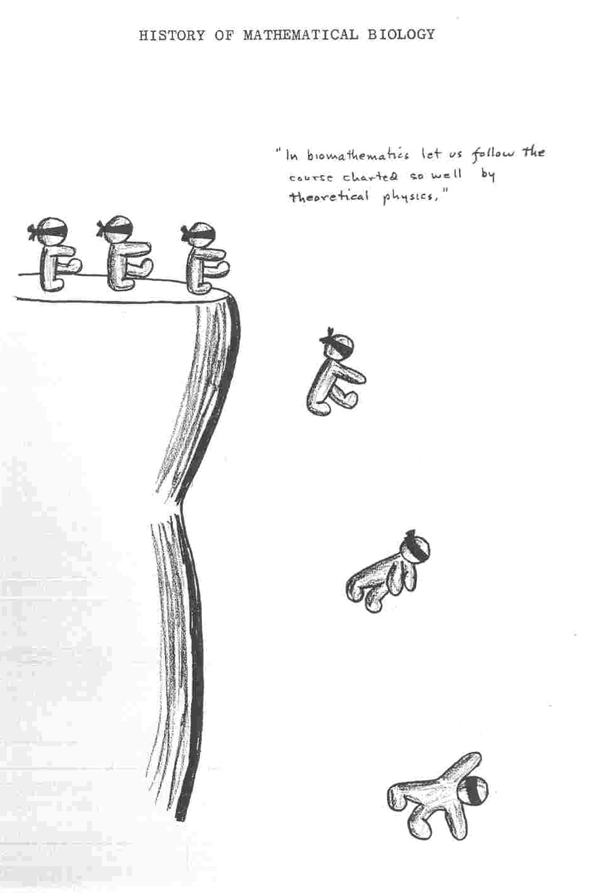
In biomathematics let us follow the course charted so well by theoretical physics
Cartoons by
J. R. Troyer
Botany and Bacteriology
NC State U.
Raleigh, NC

Slide 18
Math and Bio Education
Math across the curriculum
Quantitative Life Science Workshops
1960
1970
1980
1990
2000
2010

Slide 19
Training Fearless Biologists: Quantitative Concepts for all our Students
1. Rate of change
2. Modeling
3. Equilibria and stability
4. Structure
5. Interactions
6. Data and measurement
7. Stochasticity
8. Visualizing
9. Algorithms
Slide presented at Bio2010 public release - Sept. 10, 2002 Listing arose from Workshops at UTK in 1992 and 1994
Notes:
These were the key quantitative concepts in the BIO2010 report.

Slide 20
Mathematics for the Life Sciences – Princeton U. Press
Rule of Five- different learning styles to meet needs of diverse students: Symbolically, Graphically, Numerically, Verbally, Data-driven
We use this approach throughout the text which includes descriptive statistics (regression, semi-log, log-log), matrix algebra (eigenvalues, eigenvectors), discrete probability, discrete dynamical systems, basic calculus, differential equations, emphasizing data and hypothesis formulation (math and biological).
Erin Bodine
Suzanne Lenhart

Slide 21
QUBESHub.org and BioQUEST.org

Slide 22
What have we learned from all these efforts?
Many model programs developed;
Lots of new curricular material;
Biologists more attuned to quantitative approaches;
Education research provides guidance on what really works.
Notes:
- learning not training, research participation not canned labs, peer collaboration.

Slide 23
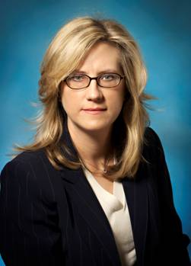
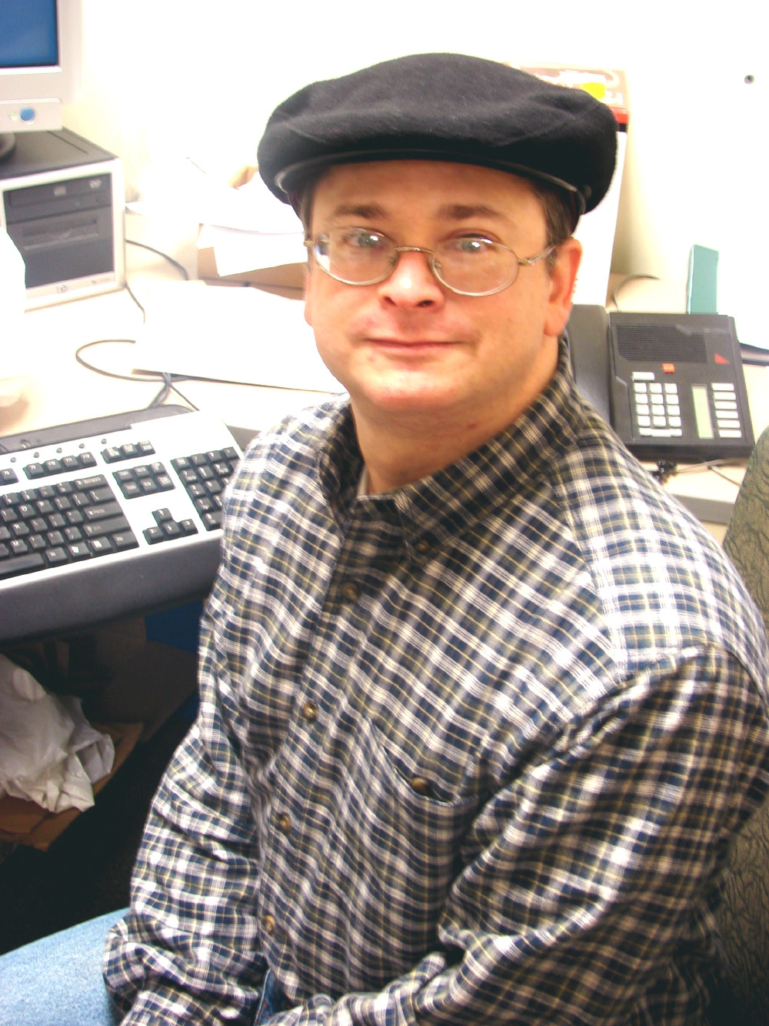
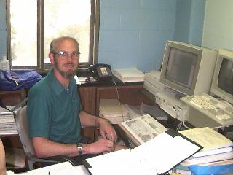
Undergraduate Mathematics for the Life Sciences: Models, Processes, and Directions
Glenn Ledder, Jenna P. Carpenter and Timothy D. Comar (editors)
Mathematical Association of America Notes (2014)
Notes:
This contains curricular models, processes to implement them, and future directions. from programs at 22 different institutions

Slide 24
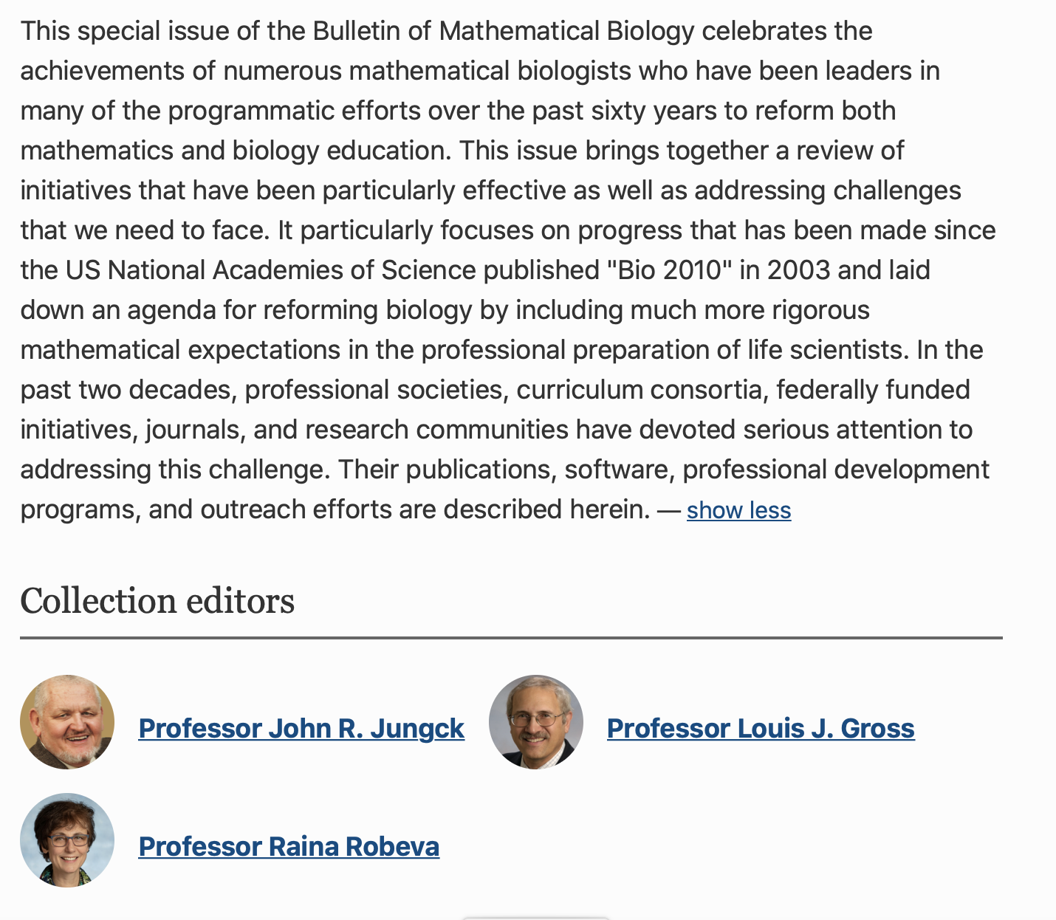
https://link.springer.com/collections/efaidfafae

Slide 25
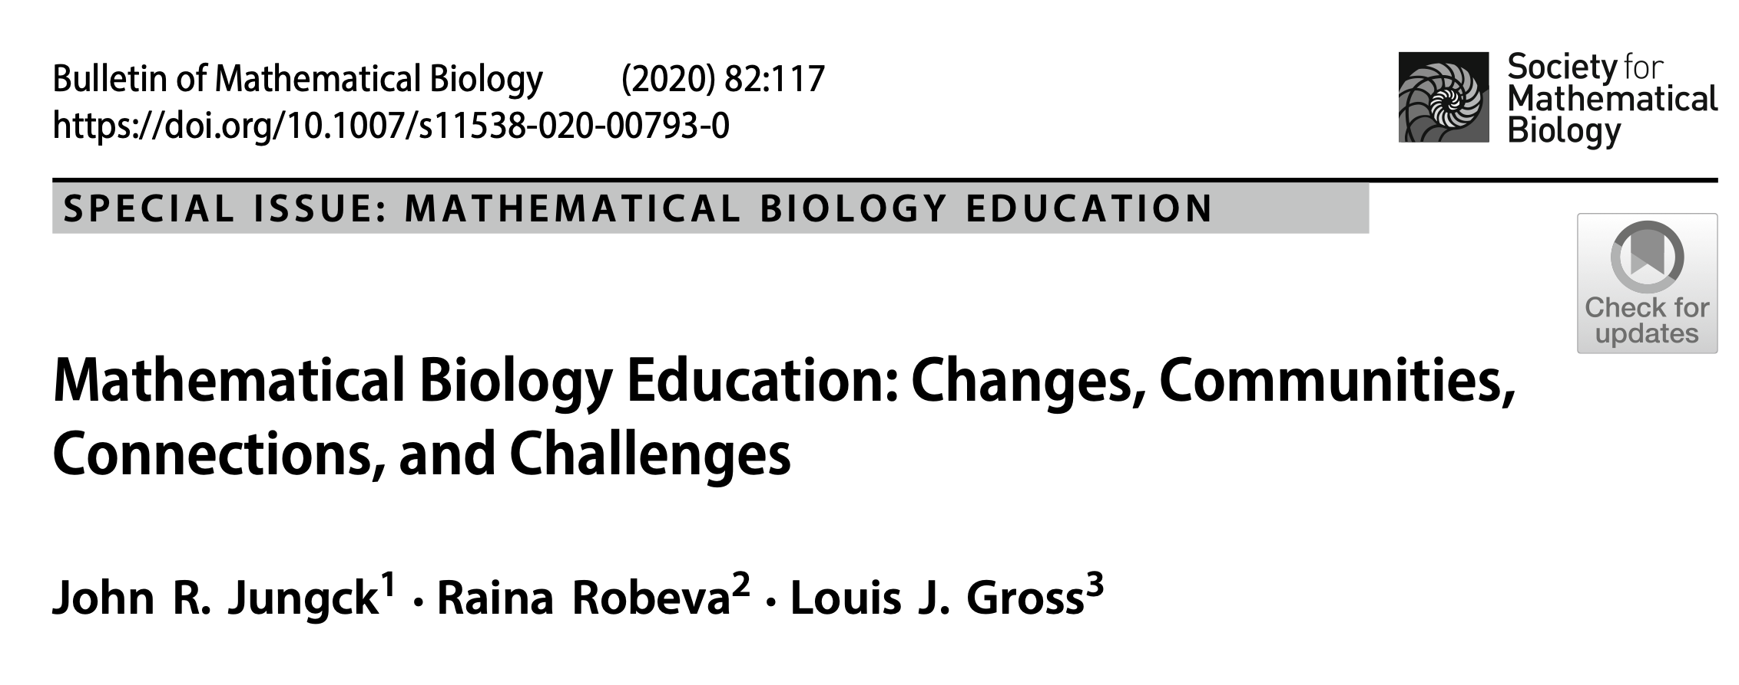
This special issue collection includes 16 articles authored by 50 leaders in education research in math biology focused on the four themes with associated history.

Slide 26
What is holding back reform in quantitative bio education?
Lethargy
Inertia
Infrastructure
Notes:
- learning not training, research participation not canned labs, peer collaboration.

Slide 27
Faculty Time Allocation
Service
Teaching
Research
What’s left over in the above is for curriculum development!

Slide 28
The CPAR Approach to Quantitative Curriculum Development across Disciplines
The process I have used to enhance quantitative components of the undergraduate life sciences curriculum is:
Constraints
Prioritize
Aid
Repeat

Slide 29
Routes to Success
Tie the math to data and observation.
Put the math in a new context (not just a repeat of high school), such as biology.
Provide models of approaches that work from different institutions and celebrate the differences.
Encourage a whole curriculum view rather than a “course” view.
Adopt multi-cultural mentoring for instructors
Support quantitative learning centers – similar to writing centers
Notes:
UCLA is in process of developing a pre-calc course specifically designed for lif science students

Slide 30
Can an emphasis on quantitative concepts in biology courses enhance quantitative comprehension?
Modules developed for entry level biology topics in a general biology course sequence were used occasionally in a large lecture class taught by one instructor, and not used in another large lecture class.
Pre- and post-course assessment of quantitative comprehension was done using a multiple choice competency exam in both classes.
See modules at http://lgross.utk.edu/bioed/

Slide 31
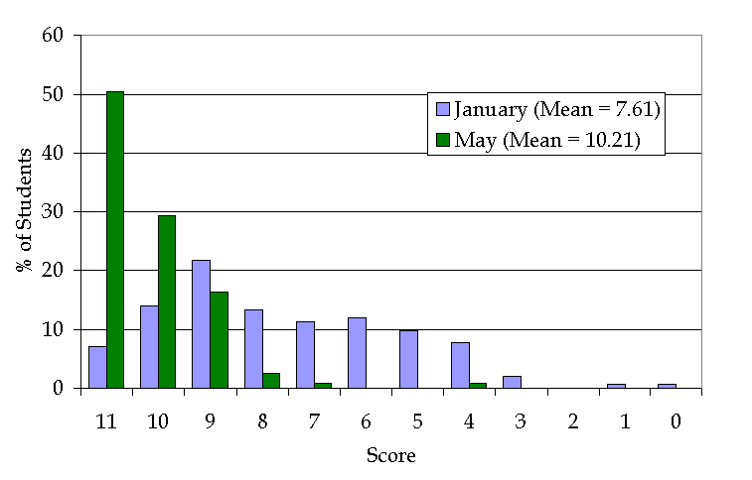
Pre- and post-testing were done in Gen Bio sections taught by collaborators on project, emphasizing quantitative skills (score is number of correct answers).
Normalized gain is g = .77

Slide 32
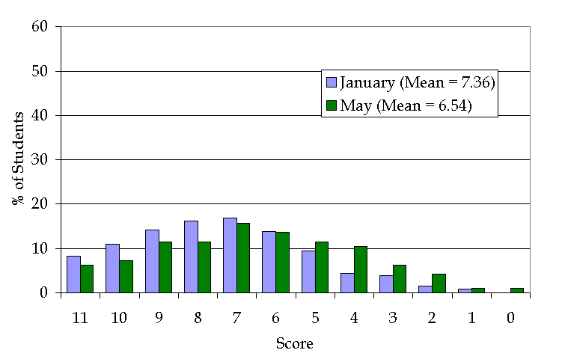
Pre- and post-testing done in Gen Bio sections taught by faculty in a standard manner, not emphasizing quantitative skills, as a control (score is number of correct answers).
Normalized gain is g = -.225 !

Slide 33
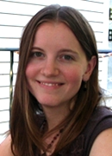
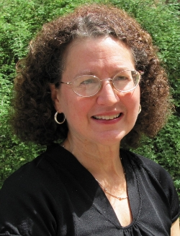
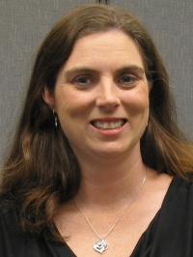
Biocalculus Assessment (BCA): Assessing Impacts on Student Learning in Calculus from Inclusion of Biological Examples
Missing from this literature is an interdisciplinary focus on quantitative education assessment – we have developed a BioCalculus Assessment
Kelly Sturner
Suzanne Lenhart
Robin Taylor
Pam Bishop

Slide 34
Evidence for the effectiveness of learning quantitative concepts through concrete examples over abstract methods is mostly anecdotal. Very few studies investigate learning gains in mathematics arising from the use of scientific examples.
A first step towards evaluating the potential impact of biological examples on mathematics comprehension is to develop a robust assessment instrument designed for college-level math concepts.
BioCalculus Assessment (BCA)

Slide 35
Why BioCalculus and not Quantitative Biology?
There are many biology curricula which require calculus.
There are many texts covering calculus that emphasize biological applications.
Since biology curricula at many institutions allow students to take a standard non-biology-based calculus course, there is the opportunity to compare impacts of different modes of content
Quantitative biology concepts would broadly cover discrete and continuous math, probability, statistics, data science, linear algebra, computing, etc. and assessing student learning across all of these topics is challenging
Thus, we did not attempt to produce an overall quantitative biology concept inventory

Slide 36
BioCalculus Assessment (BCA)
Objective: Provide an instrument that can be used to assess a biology student’s comprehension of calculus concepts embedded in biology examples and assess the impact on calculus concept comprehension of “standard” calculus vs. “biocalculus”
Note: Almost 30% of all Calculus I students across the US are biology students.
Methods: Focus on (i) rates of change, (ii) modeling, (iii) interpretation of graphs. Iterate potential questions and discriminators with experts in math bio teaching. Pilot and revise from student focus groups. Assess BCA for students in Calc I, Calc II and BioCalc.
Supported by NSF Award #DUE-1544375

Slide 37
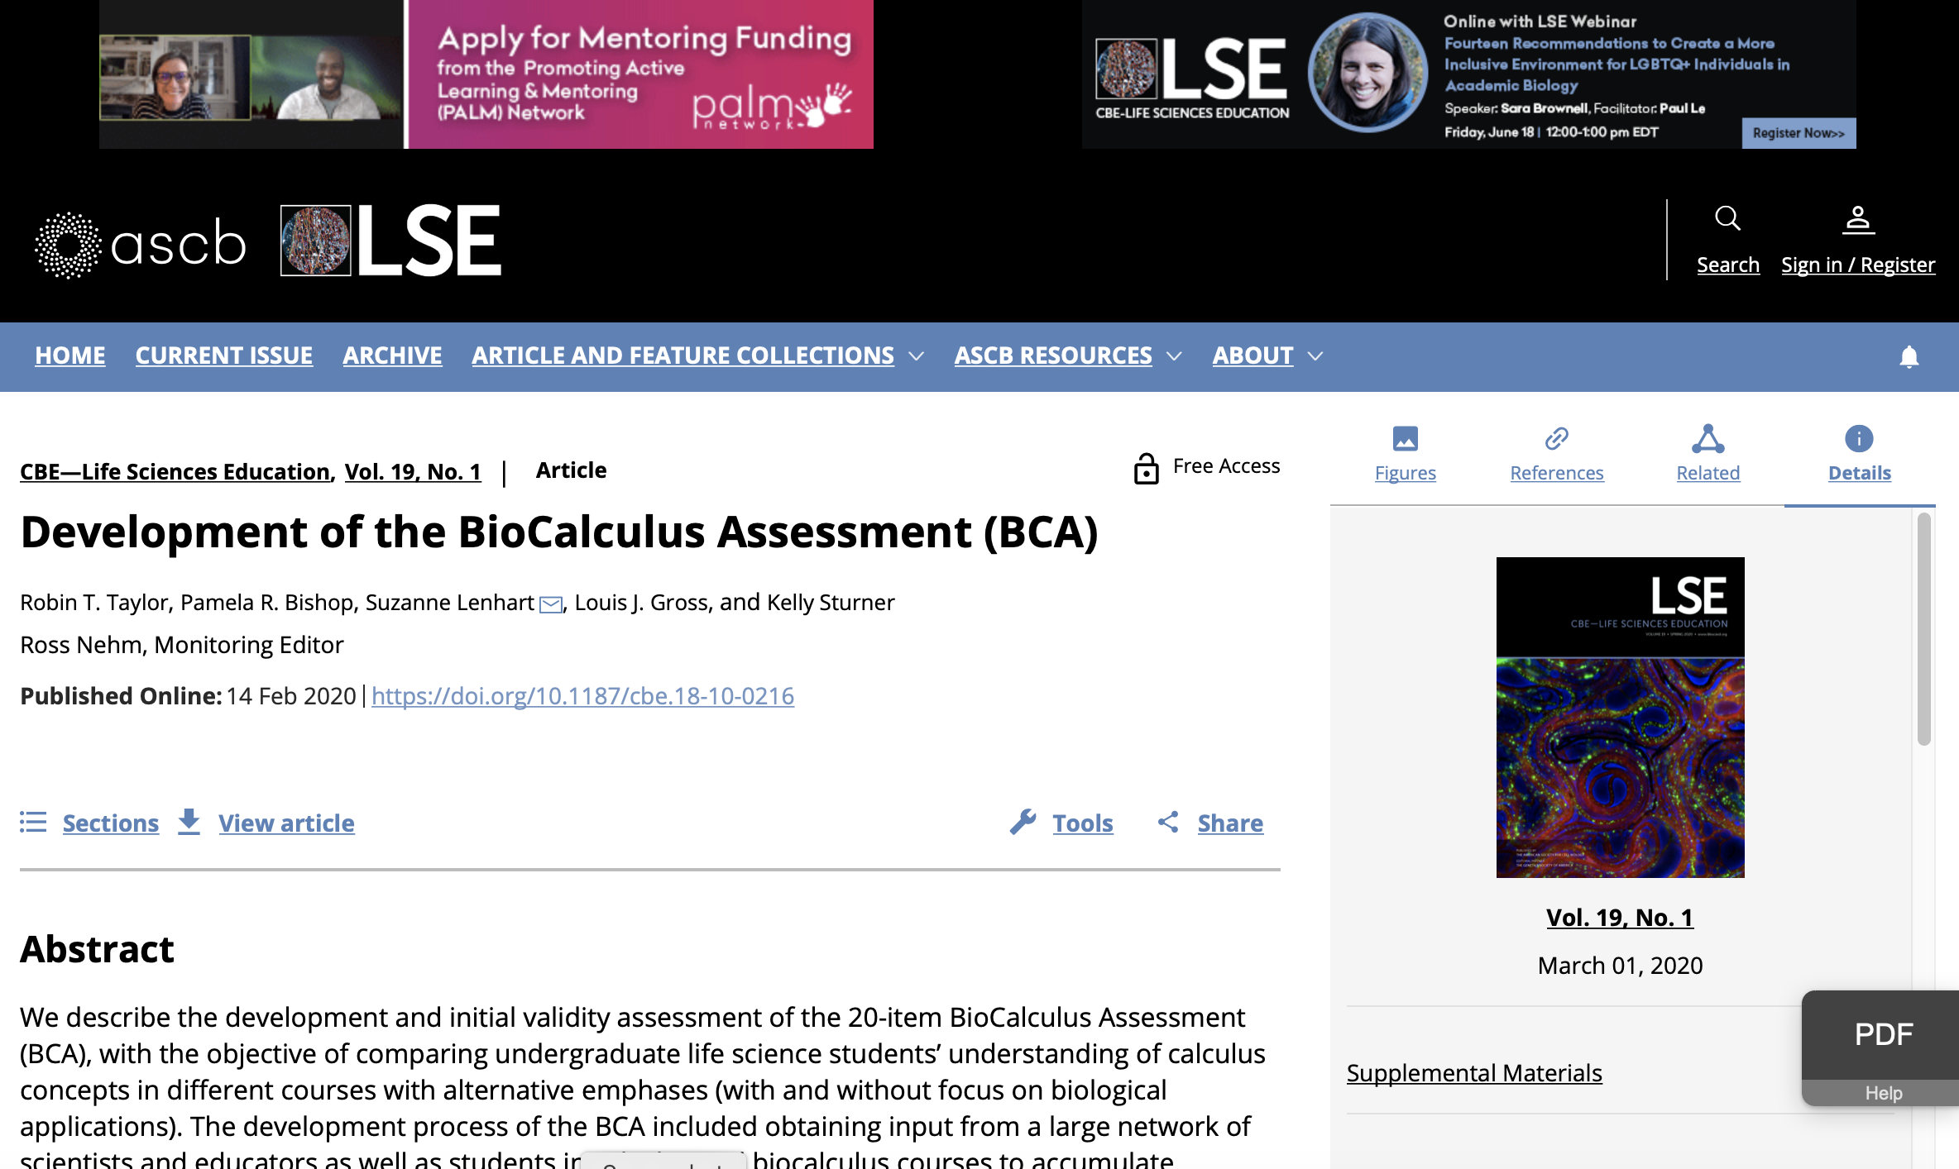
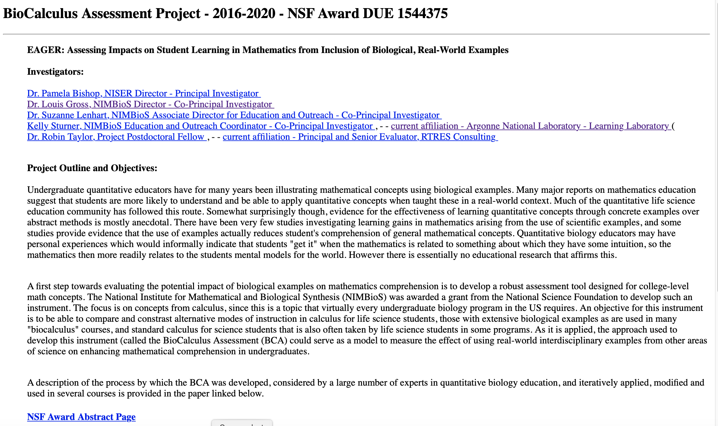
Taylor, R. T., P. R. Bishop, S. Lenhart, L. J. Gross, and K. Sturner. 2020. Development of the BioCalculus Assessment (BCA). CBE—Life Sciences Education 19 (1): doi.org/10.1187/cbe.18-10-0216
http://www.nimbios.org/~gross/BioCalcAssessmentProject2020.html

Slide 38
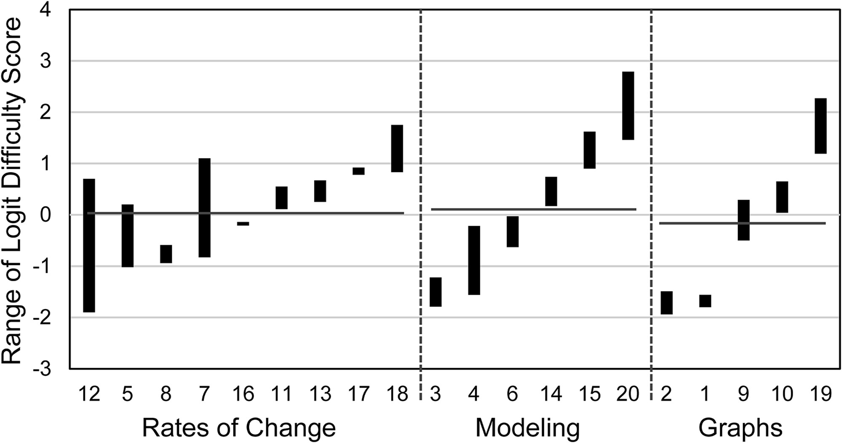
BioCalculus Assessment (BCA)
Range of difficulty scores for students in 3 Calculus courses for the 20 BCA questions
Supported by NSF Award #DUE-1544375

Slide 39
Summary of Results
The BCA fills a measurement gap for assessing learning gains of students with life science backgrounds who may learn calculus within an interdisciplinary quantitative biology course or within a traditional university calculus course
Assessment of the BCA indicates the instrument is a valid diagnostic tool to assess calculus comprehension in undergraduate biology majors who learn calculus within a quantitative course designed specifically for life science students, and to compare scores for students from traditionally taught calculus courses.
Our assessment of the content validity, response processes, and internal structure of the instrument provide accumulated support for the validity of the BCA
Overall fit indices indicated that most of the BCA test items were unidimensional (i.e., measure a single construct of calculus knowledge) and locally independent for Calc I, Calc II and BioCalc.
http://www.nimbios.org/~gross/BioCalcAssessmentProject2020.html

Slide 40
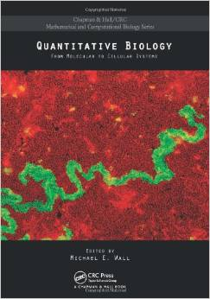
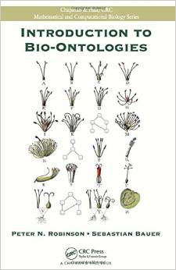
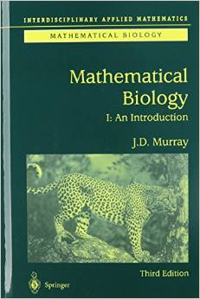
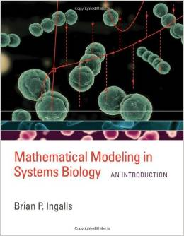
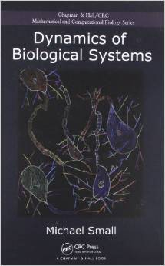
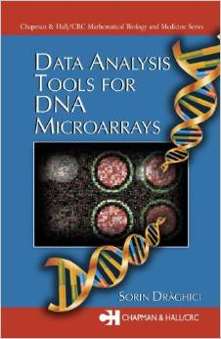
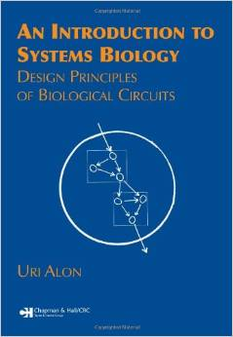
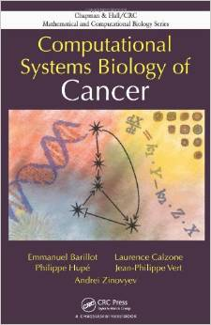
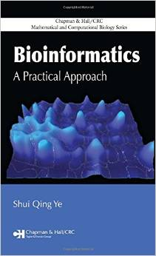
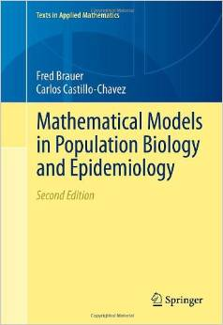
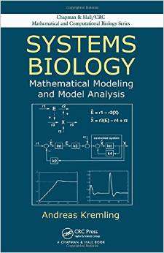
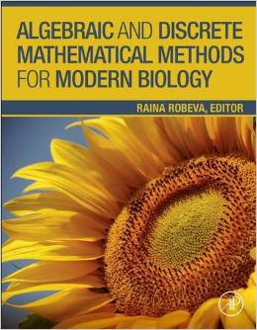
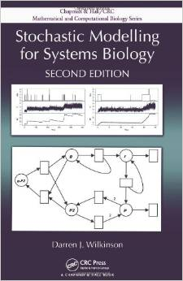
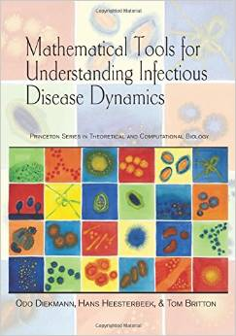
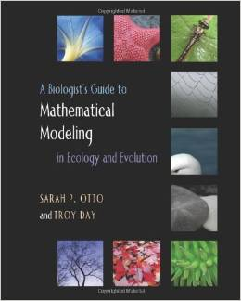
A cacophony of specialization
Notes:
Beyond the undergrad level there is a cacophony of specialization. Some of us in this audience, could with effort over a day or so take any of these more specialized texts and understand the key conceptual components well enough to explain them to advanced undergrad and graduate students, even though they have never worked in that particular area. This is a rare ability and one I would hope that we continue to foster in our programs for the applied math types who can think broadly about math.

Slide 41
Topics in a Quantitative Biology Curriculum
Math
Dynamical systems
Optimization
Networks
Calculus
Graph theory
Linear algebra
Modeling
Stochastics

Slide 42
Topics in a Quantitative Biology Curriculum
Math
Inference
Stats
Distributions
Dynamical systems
Optimization
Likelihood
Networks
Calculus
Graph theory
Hypothesis testing
Modeling
Regression
ANOVA
Linear algebra
Bayes Methods
Stochastics

Slide 43
Topics in a Quantitative Biology Curriculum
Math
Stats
Inference
Distributions
Algorithms
Dynamical systems
Optimization
CS
Cloud Computing
Networks
Calculus
Likelihood
Graph theory
Hypothesis testing
Hubs
Coding
Database Structure
Modeling
Regression
Linear algebra
Scripting
ANOVA
Bayes Methods
Stochastics

Slide 44
Topics in a Quantitative Biology Curriculum
Math
Curation
Stats
Inference
Distributions
Backup
Algorithms
Dynamical systems
CS
Optimization
Workflows
Cloud computing
Networks
Informatics
Calculus
Likelihood
Graph theory
Provenance
Hypothesis testing
Citation
Data mining
Hubs
Coding
Database Structure
Modeling
Regression
ANOVA
Linear algebra
Scripting
Metadata
Bayes Methods
Stochastics

Slide 45
Topics in a Quantitative Biology Curriculum
Math
Stats
Inference
Curation
Distributions
Backup
Evolution
CS
Algorithms
Dynamical systems
Optimization
Workflows
Systems
Information flow
Cloud computing
Networks
Informatics
Calculus
Likelihood
Graph theory
Hypothesis testing
Data mining
Provenance
Energy transfer
Biology
Citation
Hubs
Coding
Database Structure
Modeling
Regression
ANOVA
Linear algebra
Scripting
Metadata
Structure/Function
Bayes Methods
Stochastics

Slide 46
Inference
Curation
Distributions
Backup
Algorithms
Dynamical systems
Optimization
Evolution
Workflows
Systems
Information flow
Cloud computing
Networks
Calculus
Likelihood
Graph theory
Provenance
Hypothesis testing
Hubs
Data mining
Coding
Database Structure
Citation
Energy Transfer
Modeling
Regression
ANOVA
Linear algebra
Scripting
Metadata
Structure/Function
Bayes Methods
Stochastics
Course1
1
2
3
4
5

Slide 47
Curricular Organization as a Data-science Problem
Prioritization of concepts/skills
Use of education research to guide pedagogy
Borrowing/adapting existing materials (downscaling, not dumbing-down)
Sequencing coverage of concepts/skills
Enhancing high priority concepts/skills through repetition
Assessing success

Slide 48
Local crowd-sourcing to prioritize concept and skill emphases:
Base this upon local needs as suggested by the institution’s faculty. This provides confidence that the quantitative training of a student are aligned with the intentions of the faculty, that the faculty have given careful thought regarding prioritization of the large array of possible topics to incorporate, and that training empowers the students to obtain additional expertise on their own, external to the formal and informal components of their training.

Slide 49
Method applied to biomedical graduate programs at UTK:
Biology faculty in these programs each identify a single recently published journal article that they suggest all biomedical science students should be able to read with comprehension, not necessarily one with a major quantitative emphasis.
These papers were analyzed for quantitative concepts and methods, mining the papers through expert coding and categorized to provide a rational basis for prioritization of these concepts to be emphasized in the education program.

Slide 50
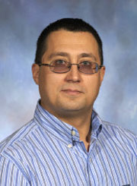
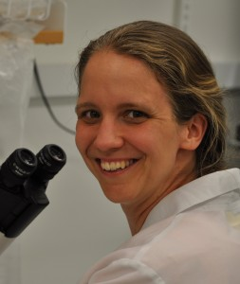
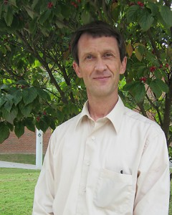
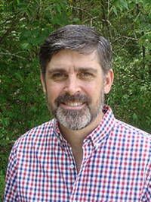
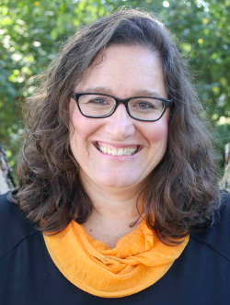
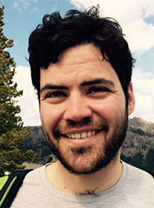
Team Members:
Vitaly Ganusov
Rachel McCord
Greg Wiggins
Albrecht von Arnim
Sondra LoRe
David Talmy
Tian Hong
Christopher Strickland

Slide 51
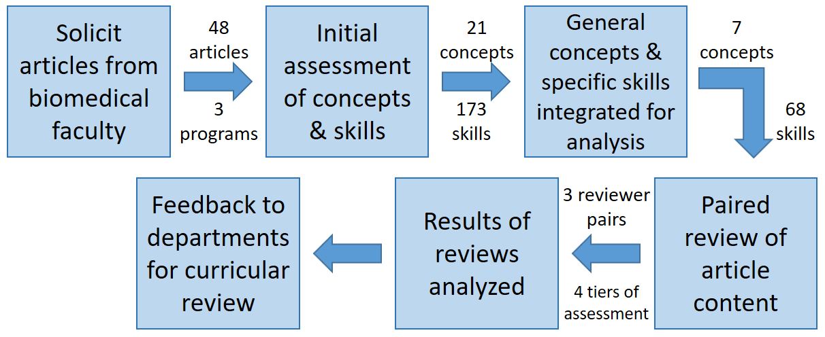
Process for data collection and analysis of articles chosen by faculty as appropriate for all biomedical students completing a PhD in their program to read with comprehension.

Slide 55
The seven general concepts identified in the submitted papers and the proportions of importance level of each concept. Percentage values indicate the percent of papers in which a given concept was assigned a given importance level.

Slide 56
Summary of Results
The key quantitative concepts necessary to comprehend the chosen papers were in areas of data science, including visualization and statistics.
In contrast, there was little reference to the continuous mathematics, such as calculus, which makes up a large component of the formal undergraduate mathematics training of graduate students in biomedical areas.
Biomedical graduate programs may need to start offering courses in data science to align training with expectations of the faculty.
The prioritization method developed can be applied in other life science disciplines and we expect would produce different priorities of quantitative topics.

Slide 57
Education Research Needs
There is some, but not much, evidence that quantitative education of life science students can be enhanced by incorporating biological examples in quantitative courses. Many (likely fundable) projects on this remain to be done by education researchers.
There is some, but not much, evidence that quantitative education of life science students can be enhanced by incorporating quantitative ideas in biology courses. Many (likely fundable) projects on this remain to be done by education researchers.
There is strong evidence, across disciplines, that an interactive engagement approach enhances concept learning, and many model programs implement this, but each institution follows its own path.

