Slide 1
Mathematics Education for Life Science Undergraduates: Lessons from 40 Years of Efforts
Louis J. Gross
National Institute for Mathematical and Biological Synthesis
Departments of Ecology and Evolutionary Biology and Mathematics
University of Tennessee, Knoxville

Slide 2
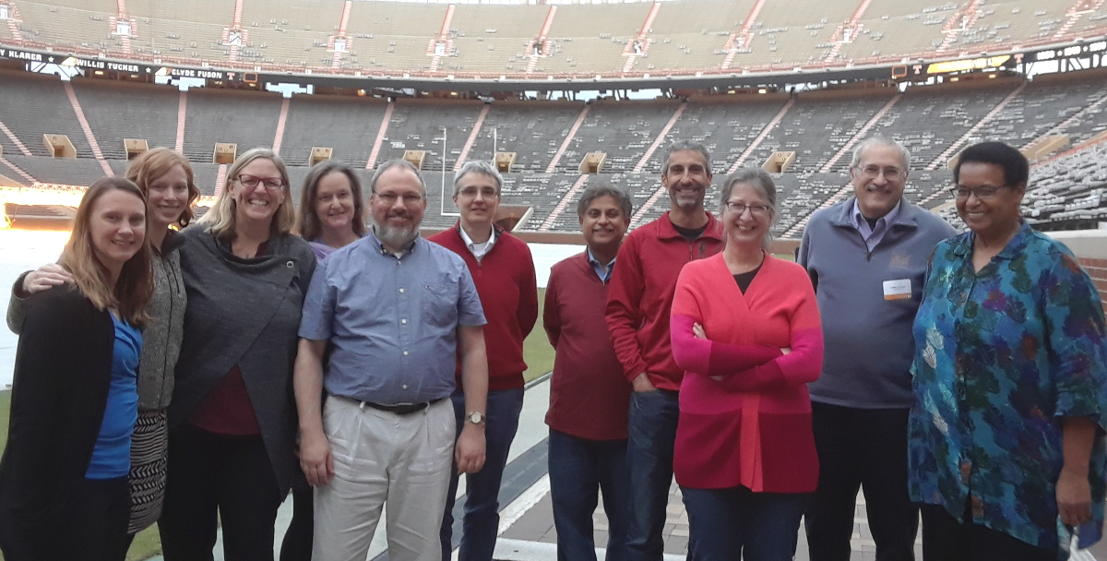
www.nimbios.org/workinggroups/WG_quantbio-cc

Slide 3
One of the projects of the Working Group is addition of existing quantitative modules to the OpenStax Biology text
openstax.org/details/books/biology-2e
Quantitative Modules for General Biology
www.tiem.utk.edu/~gross/bioed/modulelist.html

Slide 4
QUBESHub.org

Slide 5
BioQUEST.org

Slide 6
Amer Math Soc 2018

Slide 7
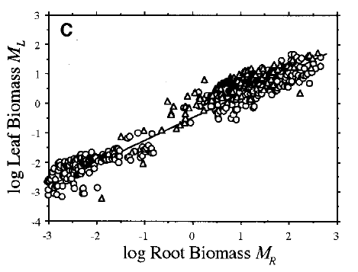
Pair and share
For the following quantitative concept, discuss how you learned about it and decide whether your understanding of this is derived from your experience in formal math classes, on a scale from 0 to 5 with:
0 not at all derived from math classes to 5 completely
Do we learn anything about causation from these data?
Enquist, B. J. and K. J. Niklas. Science 295:1517–1520, 2002
Notes:
Data angiosperms are circles, conifers are triangles.
What were the steps that you and your partner went through in analyzing this?
Look at the data to see if the linear characterization makes sense? Look at the axes to see the scaling? Decide what type of relationship linear means? Try to interpret the implications of this? Decide what causation would require?
I use this to point out that quantitative reasoning from data is not trivial – even for relatively simple relationships. It really does require an educational process to get you there.

Slide 8
The Undergrad S&E Landscape
National Center for Education Statistics, Integrated Postsecondary Education Data System (IPEDS), Completions Survey; National Science Foundation, National Center for Science and Engineering Statistics, WebCASPAR database, https://ncsesdata.nsf.gov/webcaspar/. Science and Engineering Indicators 2018
Notes:
Biology has become a major driver of undergraduate students, more than engineering, and far more than math, chemistry and physics combined. Yet there has been relatively little emphasis on these changes by the mathematics community. The quantitative education of life science undergrads is still mired in 19th century mathematics, for the most part, across the US. The engineering community has placed a lot more emphasis on biology – 4 out of the 8 departments in the UT engineering college now have “bio” in their name!

Slide 9
Undergrad S&E Landscape by Race and Ethnicity
National Center for Education Statistics, Integrated Postsecondary Education Data System (IPEDS), Completions Survey; National Science Foundation, National Center for Science and Engineering Statistics, WebCASPAR database, https://ncsesdata.nsf.gov/webcaspar/. Science and Engineering Indicators 2018
Notes:
As one aspect of diversity in S&E the female population for these degrees has been increasing but again much more so in biology than in other fields and CS has lost ground on female BS degrees. Looking at relative changes in females since 2000, number of Female Bio degrees have increased 46%, math has increased 38%, physical sciences 30%, engineering by 20% and CS has dropped by 26%.

Slide 10
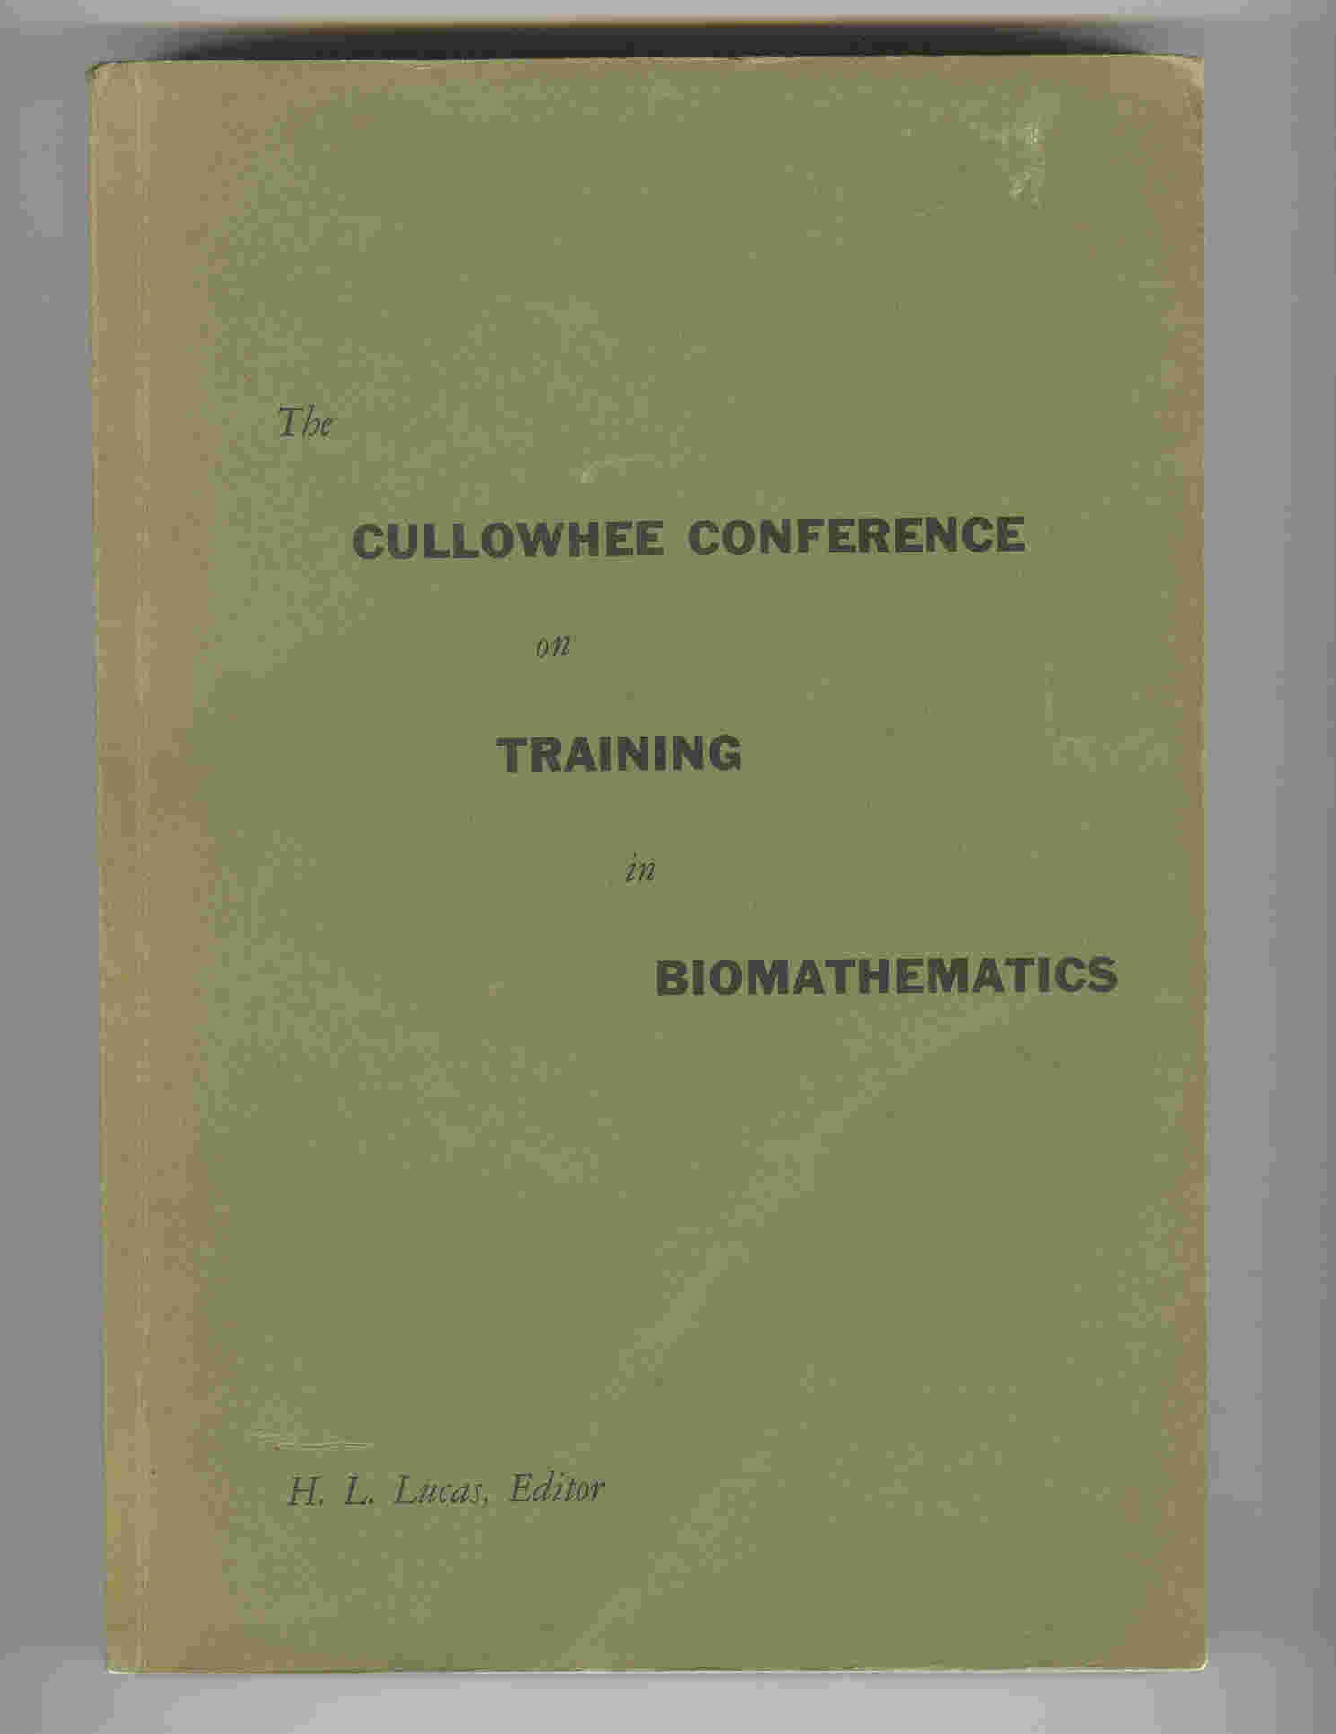
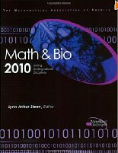
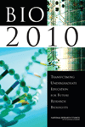
Reports and more reports:
Notes:
Earliest report on mathematics in life science was the Cullowhee conference in 1961 and many of the remarks made there still rind true today including their comment that there is no unique route to appropriate quantitative education in math biology. Since then there have been numerous reports over the last decade that have included a focus on undergrad bio education, all of which note the important connection to quantitative science.

Slide 11
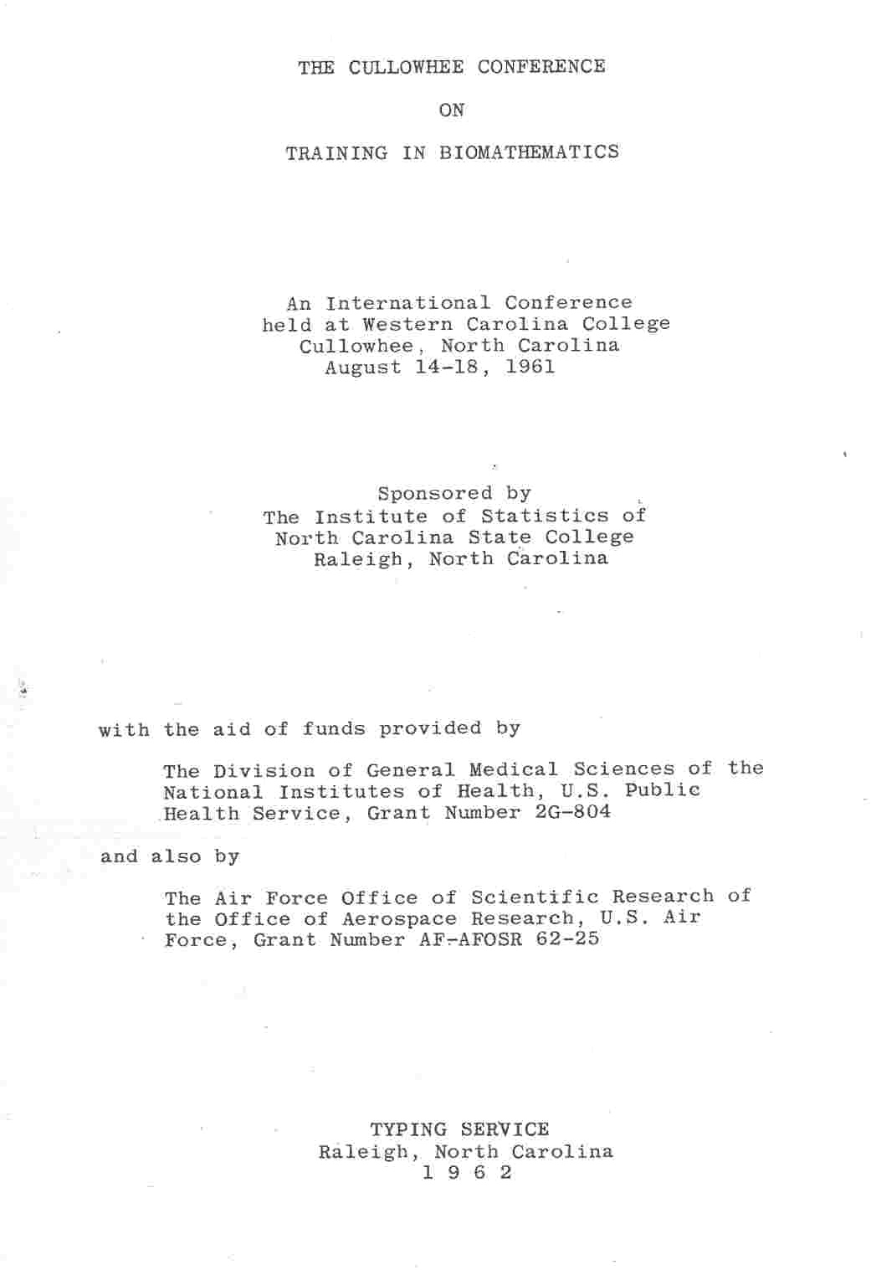
Notes:
The first gathering I am aware of that focused on math connections to Bio with an educational focus, emphasizing graduate education.

Slide 12
“ There does not exist now, and it is unlikely that there ever will exist, a unique answer to the question of the kind and the extent of training that a mathematical biologist should receive.”
J. Z. Hearon, Chief, Office of Mathematical Research, NIH (1961)

Slide 13
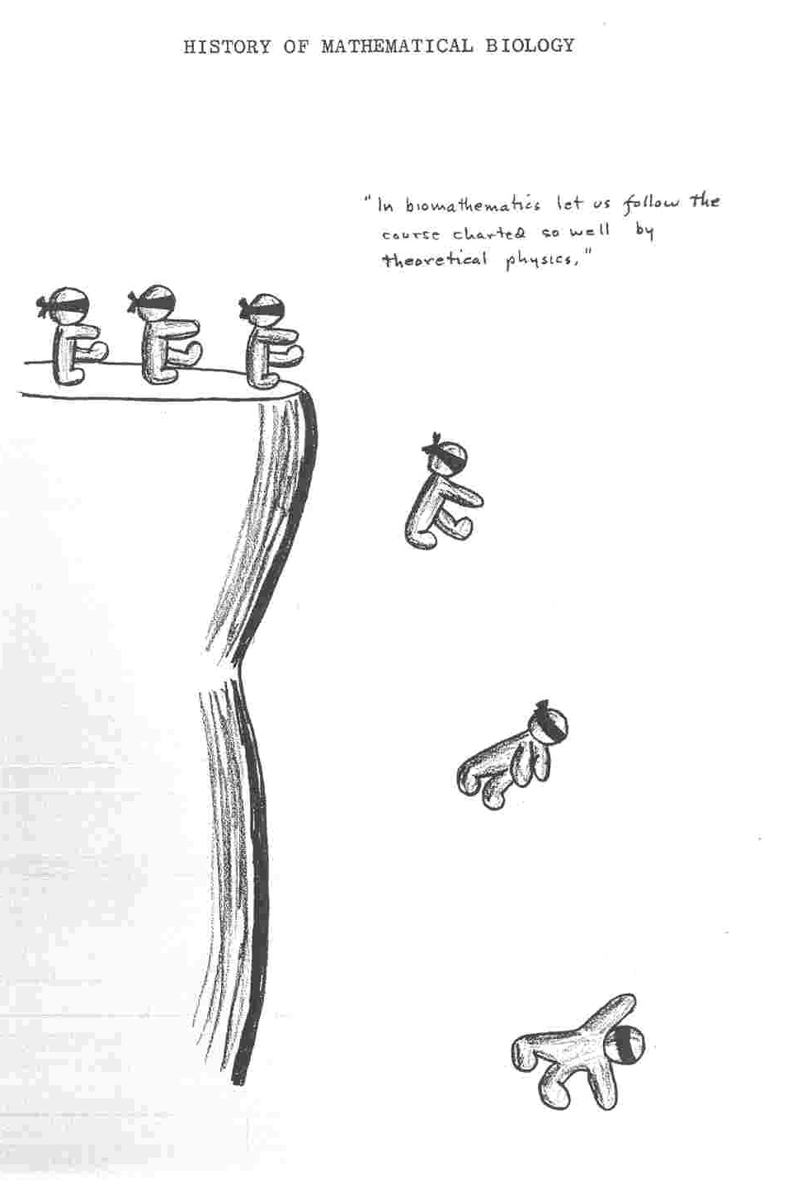
In biomathematics let us follow the course charted so well by theoretical physics
Cartoons by
J. R. Troyer
Botany and Bacteriology
NC State U.
Raleigh, NC

Slide 14
Math and Bio Education
Math across the curriculum
Quantitative Life Science Workshops
1960
1970
1980
1990
2000
2010

Slide 15
MCAT (Medical College Admissions Test)
Questions on data-based and statistical reasoning:
Using, analyzing, and interpreting data in figures, graphs, and tables
Evaluating whether representations make sense for particular scientific observations and data
Using measures of central tendency (mean, median, and mode) and measures of dispersion (range, inter-quartile range, and standard deviation) to describe data
Reasoning about random and systematic error
Reasoning about statistical significance and uncertainty (i.e., interpreting statistical significance levels, interpreting a confidence interval)
Using data to explain relationships between variables or make predictions
Using data to answer research questions and draw conclusions
Notes:
15

Slide 16
MCAT
General math concepts competency expected:
Recognize and interpret linear, semilog, and log-log scales and calculate slopes from data found in figures, graphs, and tables
Demonstrate a general understanding of significant digits and the use of reasonable numerical estimates in measurements and calculations
Use metric units; dimensional analysis
Perform arithmetic calculations involving the following: probability, proportion, ratio, percentage, square-root estimations
Demonstrate understanding (Algebra II-level) of exponentials and logarithms (natural and base ten), scientific notation, solving simultaneous equations
Demonstrate understanding of trigonometry: definitions of basic (sine, cosine, tangent) and inverse functions; sin and cos values of 0°, 90°, and 180°; relationships between the lengths of sides or right triangles containing angles of 30°, 45°, and 60°
Demonstrate understanding of vector addition and subtraction
Understanding of Calculus is NOT required
Notes:
16

Slide 17
Training Fearless Biologists: Quantitative Concepts for all our Students
1. Rate of change
2. Modeling
3. Equilibria and stability
4. Structure
5. Interactions
6. Data and measurement
7. Stochasticity
8. Visualizing
9. Algorithms
Slide presented at Bio2010 public release - Sept. 10, 2002 Listing arose from Workshops at UTK in 1992 and 1994
Notes:
These were the key quantitative concepts in the BIO2010 report.

Slide 18
Mathematics for the Life Sciences – Princeton U. Press
Rule of Five- different learning styles to meet needs of diverse students: Symbolically, Graphically, Numerically, Verbally, Data-driven
We use this approach throughout the text which includes descriptive statistics (regression, semi-log, log-log), matrix algebra (eigenvalues, eigenvectors), discrete probability, discrete dynamical systems, basic calculus, differential equations, emphasizing data and hypothesis formulation (math and biological).
Erin Bodine
Suzanne Lenhart

Slide 19
What have we learned from all these efforts?
Many model programs developed;
Lots of new curricular material;
Biologists more attuned to quantitative approaches;
Education research provides guidance on what really works.
Notes:
- learning not training, research participation not canned labs, peer collaboration.

Slide 20
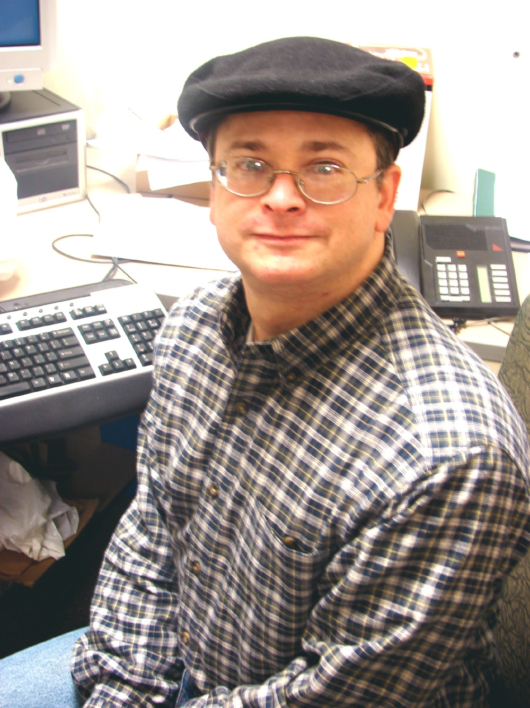
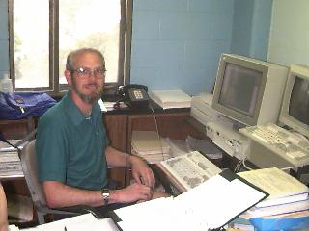
Undergraduate Mathematics for the Life Sciences: Models, Processes, and Directions
Glenn Ledder, Jenna P. Carpenter and Timothy D. Comar (editors)
Mathematical Association of America Notes (2014)
Notes:
This contains curricular models, processes to implement them, and future directions. from programs at 22 different institutions

Slide 21
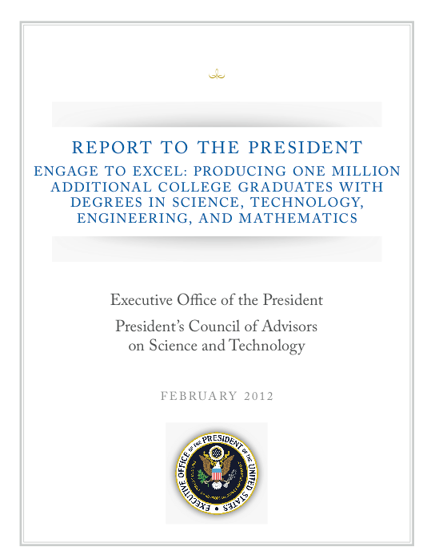

Slide 22
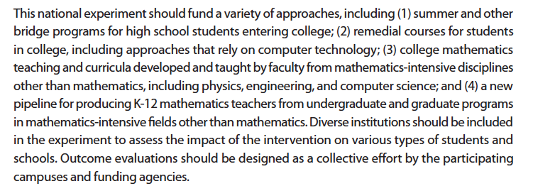

Slide 23
What is holding back reform in quantitative bio education?
Lethargy
Inertia
Infrastructure
Notes:
- learning not training, research participation not canned labs, peer collaboration.

Slide 24
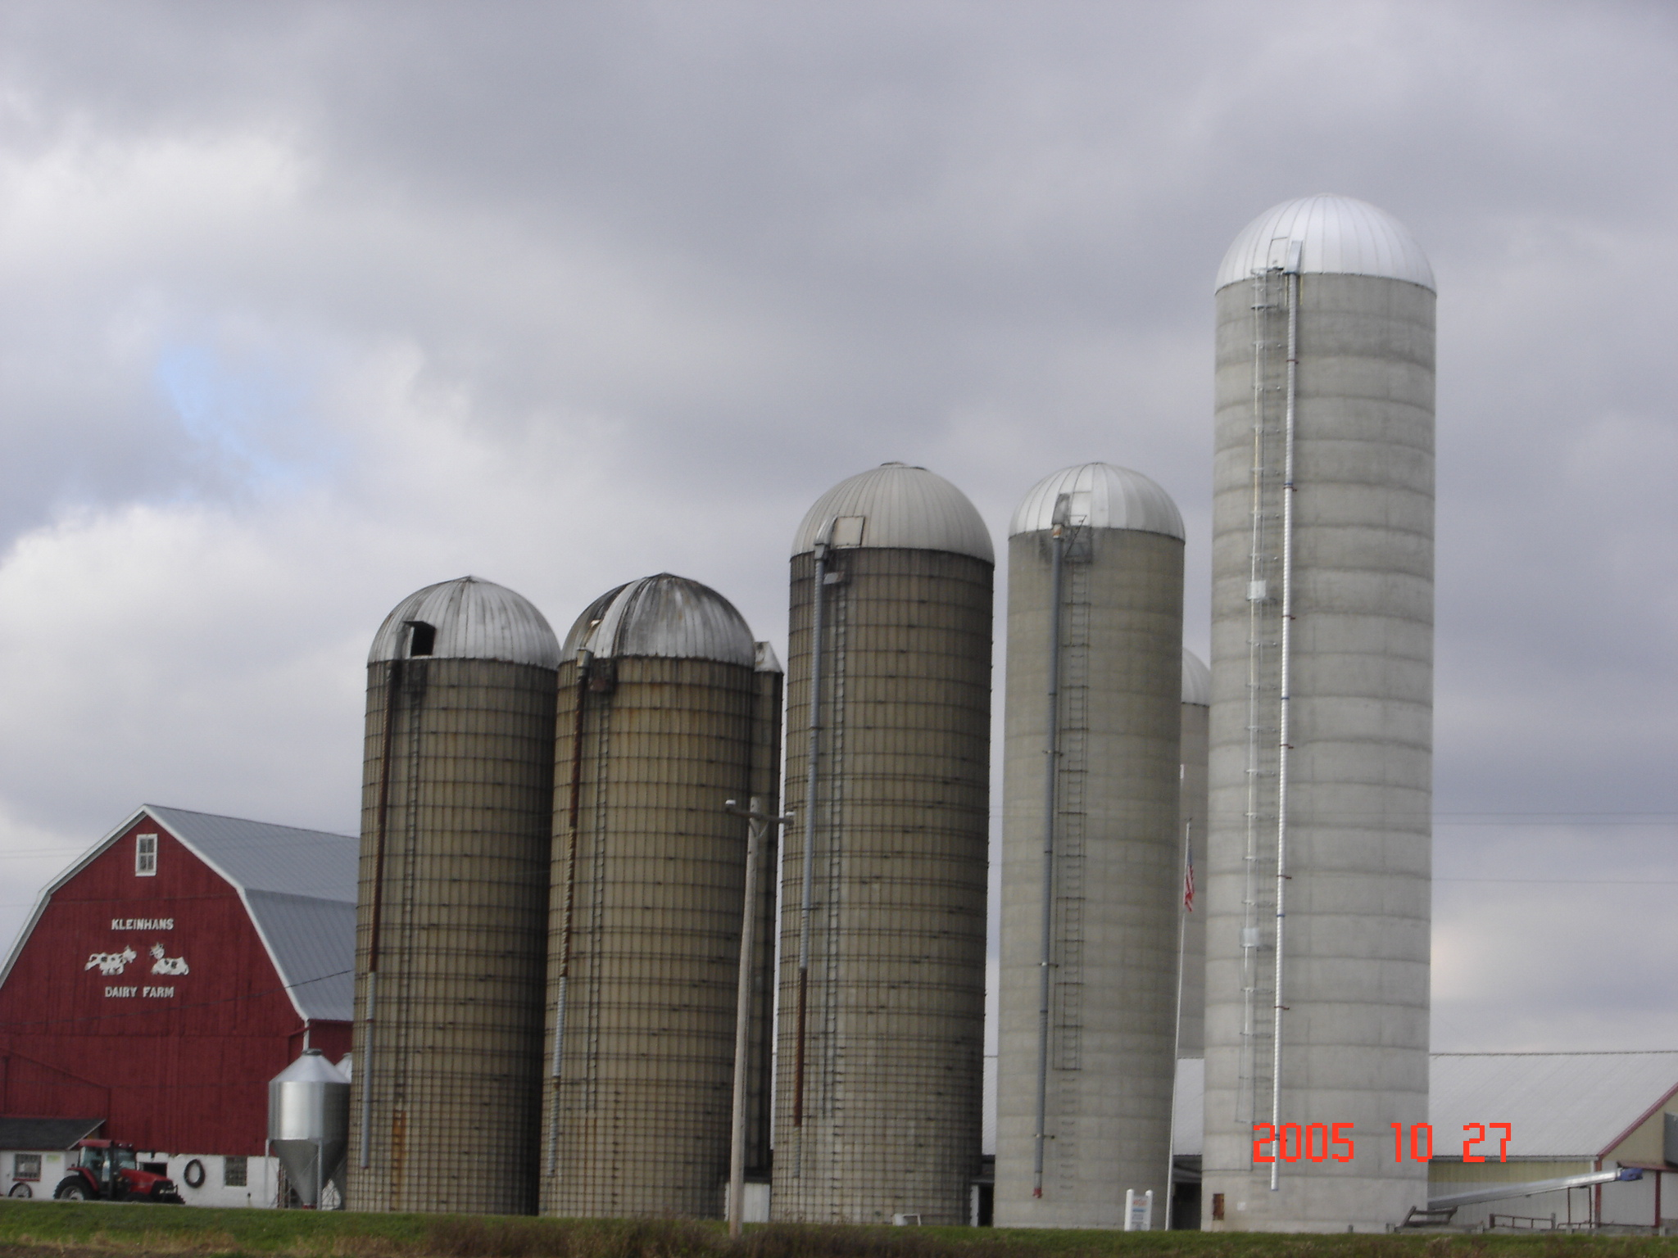
Data Science
Information Science
Statistics
Computer Science
Geography
Mathematics
Notes:
There is not going to be one solution to this. Each institution will be finding its own way, with perhaps some general guidance. Some will want
a formal degree program,
one will want a minor,
some will want to have a data science thread built throughout the curriculum (like writing or quantitative general core requirements,
some accreditation agency will come into play eventually.
There are multiple routes to success in building data science into the undergrad curriculum. The home for these will be in various places dependent upon history, local politics and convenience.
IT IS UP TO THE LOCAL FACULTY

Slide 25
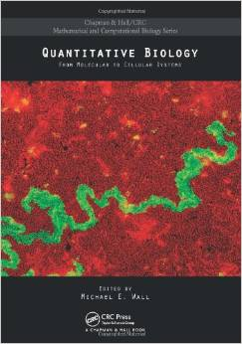
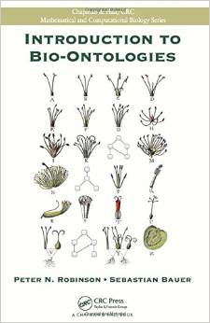
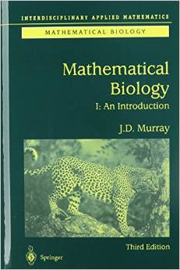
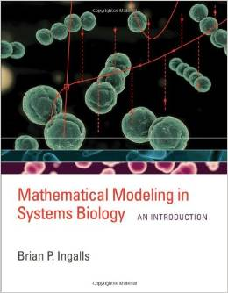
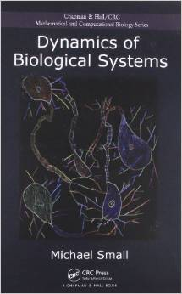
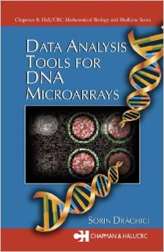
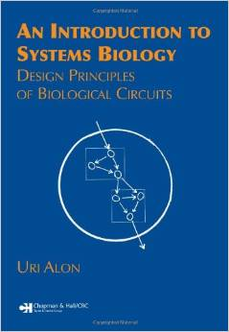
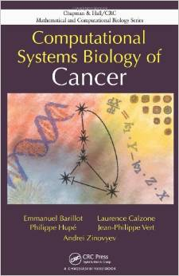
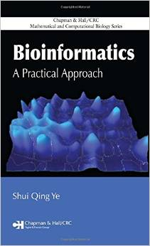
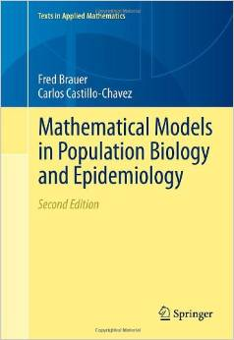
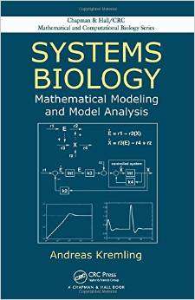
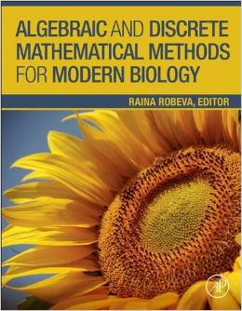
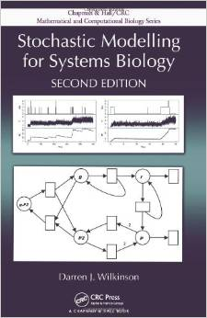
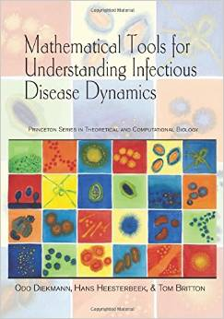
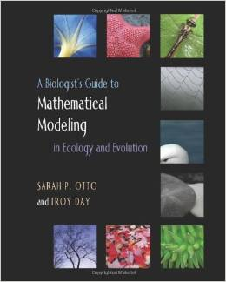
A cacophony of specialization
Notes:
Beyond the undergrad level there is a cacophony of specialization. Some of us in this audience, could with effort over a day or so take any of these more specialized texts and understand the key conceptual components well enough to explain them to advanced undergrad and graduate students, even though they have never worked in that particular area. This is a rare ability and one I would hope that we continue to foster in our programs for the applied math types who can think broadly about math.

Slide 26
Faculty Time Allocation
Service
Teaching
Research
What’s left over in the above is for curriculum development!

Slide 27
The CPAR Approach to Quantitative Curriculum Development across Disciplines
Constraints
Prioritize
Aid
Repeat
Notes:
1. Understand the Constraints under which your colleagues in other disciplines operate - the limitations on time available in their curriculum for quantitative training.
2. Work with these colleagues to Prioritize the quantitative concepts their students really need, and ensure that your courses include these.
3. Aid these colleagues in developing quantitative concepts in their own courses that enhance a student’s realization of the importance of mathematics in their own discipline. This could include team teaching of appropriate courses.
4. Consider the full curriculum as an opportunity to reinforce concepts, extend the student’s appreciation of their applicability and Repeat the quantitative concepts their students really need, and expand on these by introducing them with different skills. This goes along with cognitive research that indicates repetition (even of something that is false) can lead to acceptance.
5. This argues for development of concept maps of themes throughout the curriculum, in which we try to ensure that the highest priority concepts are repeated several ways in different courses or experiences, independent of the exact sequence or number of these courses a student takes.

Slide 28
My Perspective on Major Barriers arising from Mathematics
The bane of undergraduate math education in the US is that it has been developed by, and mostly taught by, those for whom math came easy.
There is tremendous inefficiency in the system. The vast majority of entry-level college math courses cover material the students have already seen in high school, including college algebra, pre-calculus and calculus.
A significant fraction of entry-level college math is taught by graduate students with little prior experience or knowledge of alternative pedagogical approaches, and many of these individuals were not themselves educated in the US.

Slide 29
Routes to Success
Tie the math to data and observation.
Put the math in a new context (not just a repeat of high school), such as biology.
Provide models of approaches that work from different institutions and celebrate the differences.
Encourage a whole curriculum view rather than a “course” view.
Adopt multi-cultural mentoring for instructors
Support quantitative learning centers – similar to writing centers
Notes:
UCLA is in process of developing a pre-calc course specifically designed for lif science students

Slide 30
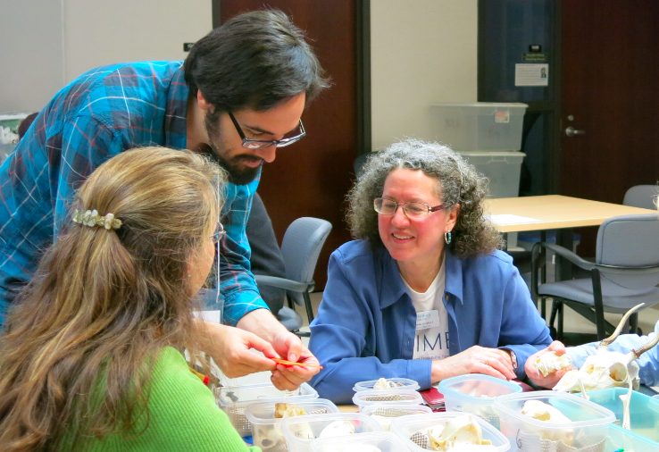
Assessing Success
An ongoing recent activity in undergraduate education research is the proliferation of “concept inventories” for various fields, as a means to provide some uniformity in assessment of learning outcomes – see Jerome Epstein AMS Notices Sept. 2013 for Calculus Concept Inventory summary.
Missing from this literature is an interdisciplinary focus on quantitative education assessment – we are currently developing a Biology Calculus Concept Inventory
Kelly Sturner
Suzanne Lenhart
Pam Bishop

Slide 31
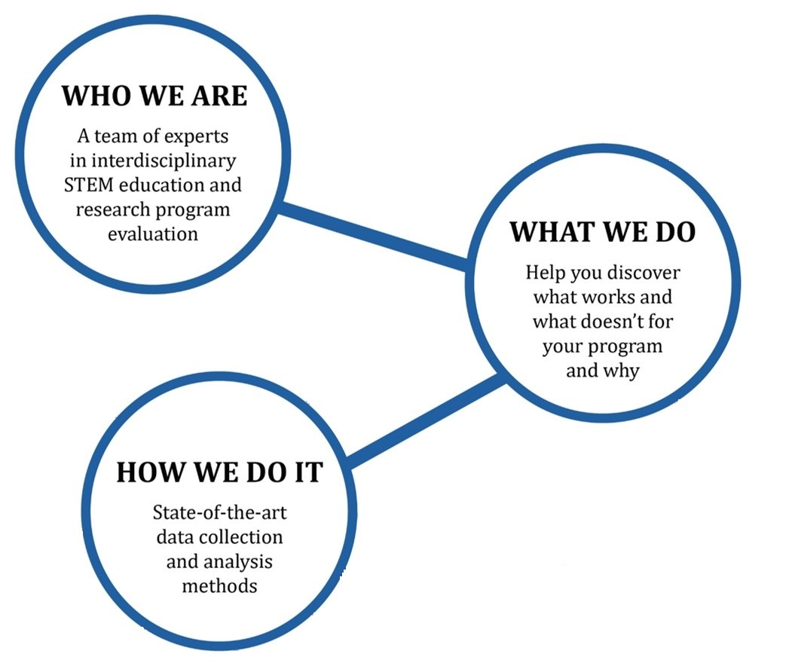
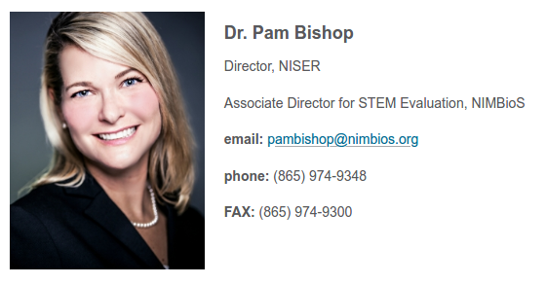
STEMeval.org

Slide 32
Education Research Needs
There is some, but not much, evidence that quantitative education of life science students can be enhanced by incorporating biological examples in quantitative courses. Many (likely fundable) projects on this remain to be done by education researchers.
There is some, but not much, evidence that quantitative education of life science students can be enhanced by incorporating quantitative ideas in biology courses. Many (likely fundable) projects on this remain to be done by education researchers.
There is strong evidence, across disciplines, that an interactive engagement approach enhances concept learning, and many model programs implement this, but each institution follows its own path.

