Slide 1




Pharmacology, Procreation and Rock n’ Roll: What’s Math got to do with it?
Louis J. Gross
Chancellor’s Professor Emeritus
Departments of Ecology and Evolutionary Biology and Mathematics
University of Tennessee, Knoxville
Legacy.NIMBioS.org

Slide 2
Overview
Science and models
Types of scientific Investigation
Math and procreation – the cost of sexual reproduction
Math and gender inequity
Pharmacology and Math – drug dose scheduling
It’s all Rock-and-Roll to me – what is sound, how is it measured, feedback
Take-aways

Slide 3
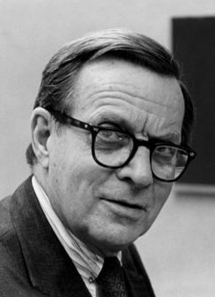
What is science?
Science is thought to be a process of pure reductionism, taking the meaning out of mystery, explaining everything away, concentrating all our attention on measuring things and counting them up. It is not like this at all. The scientific method is guesswork, the making up of stories. The difference between this and other imaginative works of the human mind is that science is then obliged to find out whether the guesses are correct, the stories true. Curiosity drives the enterprise, and the open acknowledgement of ignorance.
Lewis Thomas - Sierra Club Bulletin, March/April 1982, P. 52
Models
Data

Slide 4

The “stories” in science are models
A model is a simplification of reality. Think of it as a map - it includes some features that represent what we observe but not others. Modeling is the process of selective ignorance - we select what to include and what to ignore.

Slide 5

The “stories” in science are models
Is this less of a simplification? Is it closer to “reality”?

Slide 6

You make models all the time:
What decision do you make when faced with::

Slide 7
Methods of Scientific Investigation
Observation – classic “natural history”, descriptive science, now “data-enabled discovery”
Experimental manipulation - field or lab - isolate effects of some factors on some aspect of system under investigation and observe behavior - observe response to interactions of several factors
Theory development - abstract general properties of a system by ignoring certain components and emphasizing others (selective ignorance). Can do this: (i) ad hoc - don’t think it’s important so will ignore it; (ii) data suggests a factor or set of factors can be ignored; (iii) based upon scale so processes on a fast or slow time scale (or equivalently spatial) are ignored dependent upon scale you are interested in
Hypothesis-driven science

Slide 8

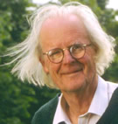

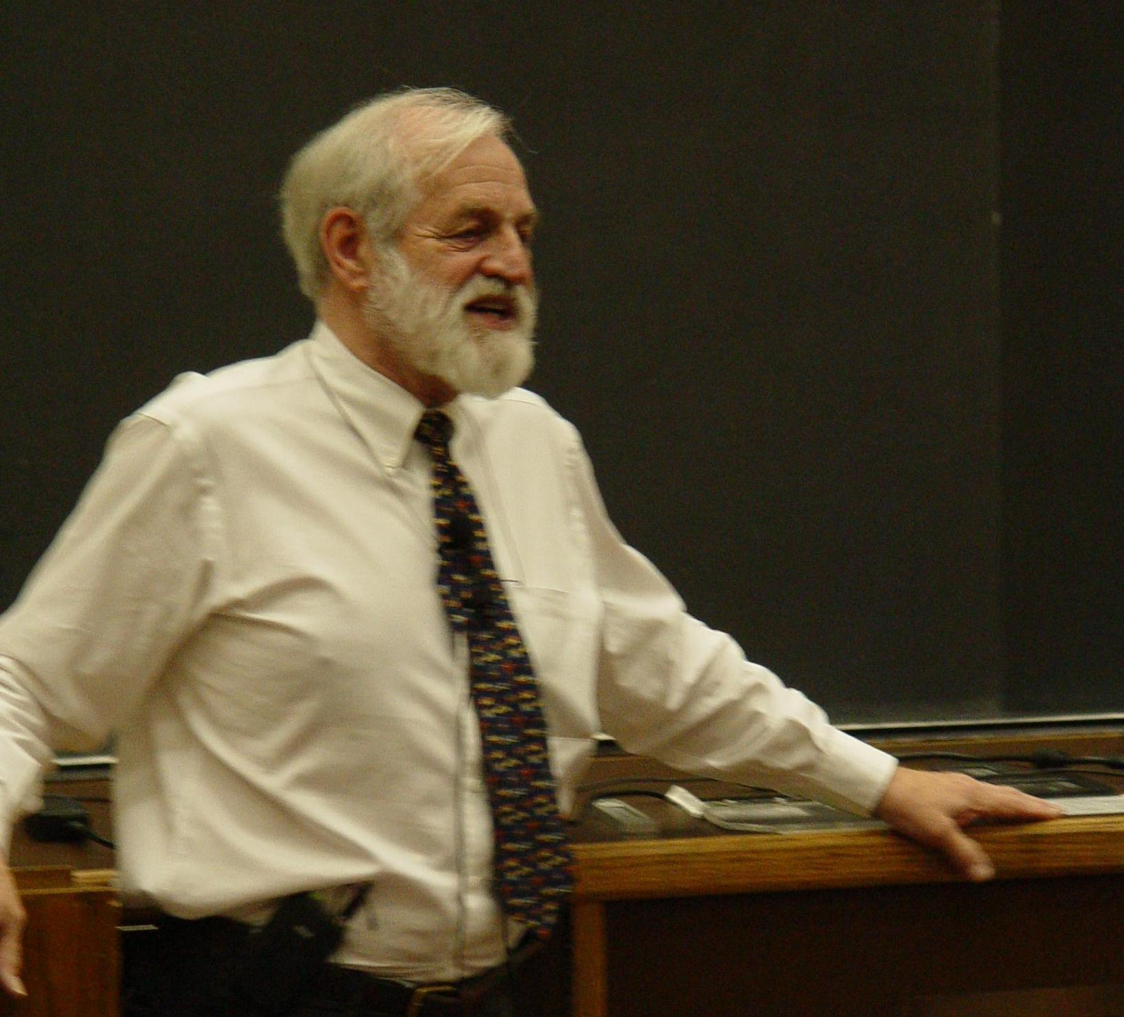
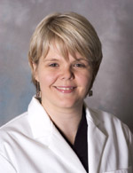
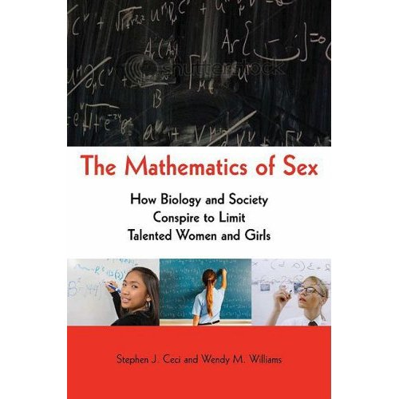
Math and Procreation
A long-standing question in evolutionary biology is “why is sexual reproduction so prevalent?”
The Mathematics of Marriage - can we
predict whether a marriage will last?
As one component of the “nature/nuture” controversy, is there evidence that the dearth of women in math-intensive fields in the US arises due to differences in innate ability?
John Maynard Smith
James Murray
Kristin Swanson

Slide 9
Math and Procreation
The two-fold cost of sex in procreation: from the perspective of evolution acting to enhance the survival and reproduction of individuals, asexual reproduction would appear to be twice as efficient as sexual reproduction. Asexual females who produce only females who can all bear young would have populations which grow twice as fast as those producing both males and females. So males, which cannot directly produce offspring, are in this sense superfluous.
Asexual females can produce twice as many grandchildren as sexual females, so they should be able to outcompete sexual organisms.
John Maynard Smith

Slide 10
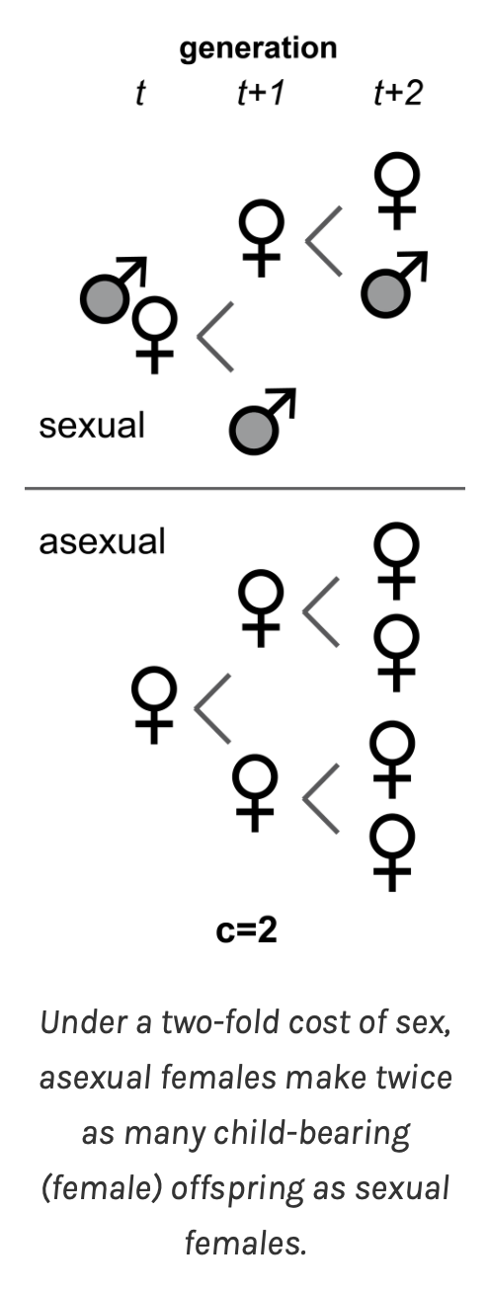
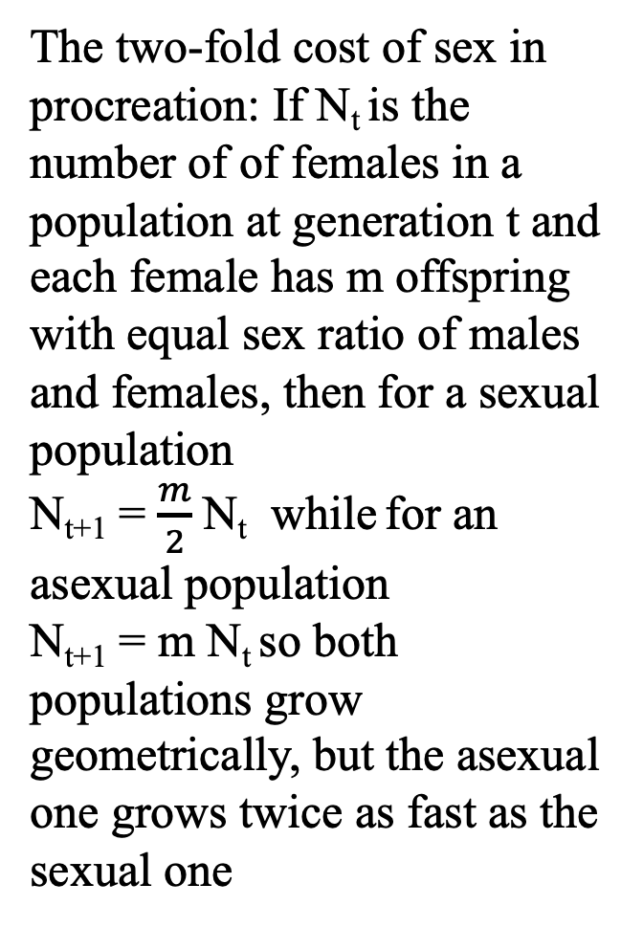
Math and Procreation
The two-fold cost of sex in procreation: If N_{t} is the number of of females in a population at generation t and each female has m offspring with equal sex ratio of males and females, then for a sexual population
N_{t+1} = $\frac{m}{2}$ N_{t} while for an asexual population
N_{t+1} = m N_{t} so both populations grow geometrically, but the asexual one grows twice as fast as the sexual one
Amanda Gibson – U VA

Slide 11

Math and Procreation
Many organisms reproduce asexually, producing genetically identical offspring without meiosis (fertilization and genetic recombination) including binary fission in archaea and bacteria, budding in hydra, runners in some plants (e.g. strawberry), fragmentation in starfish, and a variety of animals have the capacity to do so.
From a-z-animals.com

Slide 12
Math and Procreation
Despite the two-fold cost, sexual reproduction is very prevalent with about 99% of organisms with complex cells (eukaryotes – species with cells that have nuclei and other organelles) reproducing sexually at least sometimes. Strictly asexual multicellular organisms are very rare. Given the 2-fold cost of sexual reproduction, why is this form of reproduction so prevalent?

Slide 13
Math and Procreation
There are several evolutionary hypotheses that note sexual reproduction allows for:
Genetic variation due to meiosis and recombination, producing genetical variety among offspring which are better able to survive and reproduce in changing environments
Evolution of defense from parasites and pathogens
Populations to remove mutations that are detrimental rather than accumulate them as asexual populations would
Bringing together beneficial mutations from different ancestors faster than asexual populations
These benefits have been shown mathematically to outweigh the 2-fold cost of sex – in population genetics.

Slide 14
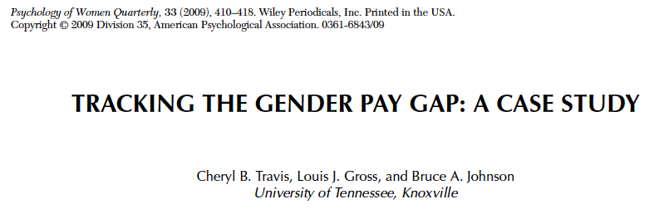
Math and Gender
Gender inequity in salary – resampling statistics and a virtual university with gender equity

Slide 15
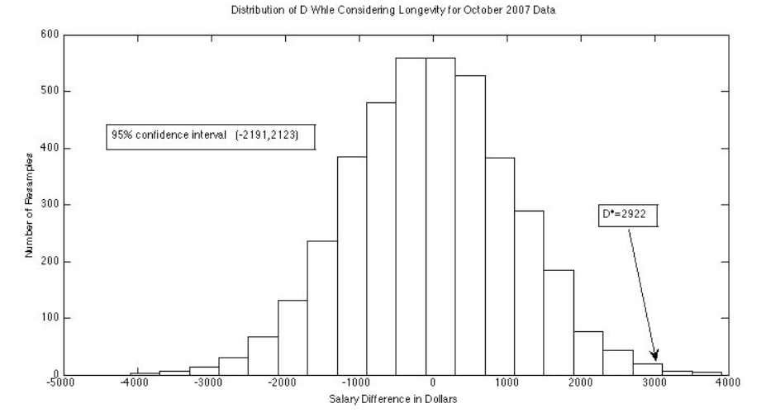
Differential Salaries of Male and Female Faculty at UTK
In 2015 there were considerable differences by gender in mean and median salaries at all Professorial ranks, with males having consistently higher mean and median salaries. On average, female Professorial faculty received 80% of the salary of male Professorial faculty.
The administration attributed this to differential representation by gender in units with very different market-driven salaries.
To analyze this we essentially created many, many virtual UTKs with identical salary data, but with salaries assigned randomly, independent of gender, within units, rank and longevity status. This is called “resampling” and “bootstrapping” in statistics.

Slide 16
Analysis Results for 2015
This histogram shows the distribution of male-female salary across the many UTKs we created which assumed male and females had salaries assigned equally. The mean difference is $2533 higher for males than females indicating with high probability that the difference in salaries is not explained by differences in field of study of males and females.

Slide 17

Math and Gender
Gender bias in rating professors
benschmidt.org/profGender

Slide 18
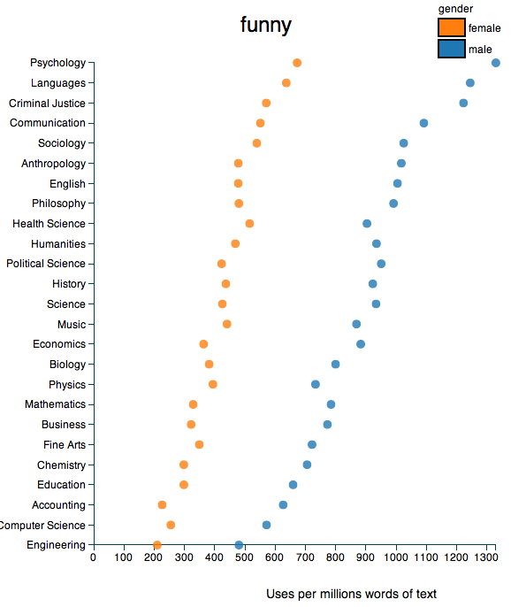
Math and Gender
Gender bias in rating professors
benschmidt.org/profGender

Slide 19
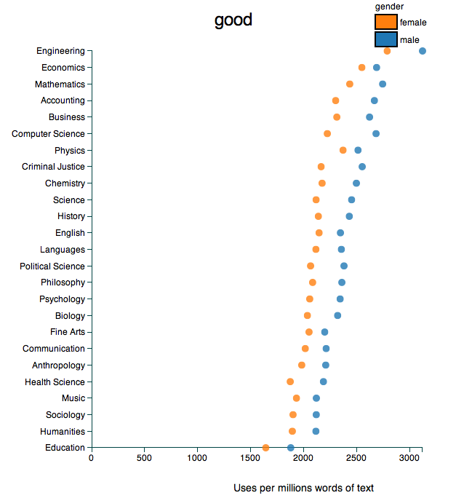
Math and Gender
Gender bias in rating professors
benschmidt.org/profGender

Slide 20
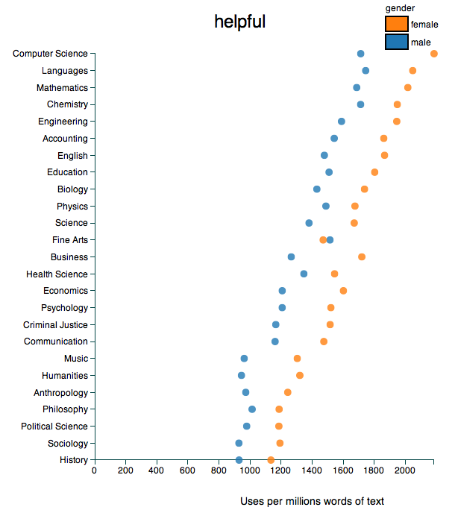
Math and Gender
Gender bias in rating professors
benschmidt.org/profGender

Slide 21
Math and Pharmacology
Pharmacokinetics - study of uptake, metabolism and loss of drugs in an organism
The math starts from simple exponential decay models, expands to hybrid models for decay and discrete doses, then moves to coupled ODEs for movement of drug between tissue compartments, and control techniques to determine optimal dosing methods.
Pharmacogenomics - study of how genetics of an individual affects pharmacokinetics
An active area of current research, involving models for genetic regulation of biochemical and physiological responses to single and multiple drugs. How do an individual’s genetics and physiological state impact the pharmacokinetics of single and multiple drugs?

Slide 22
Discuss with your neighbor:
Math and Pharmacology
If an individual receives a drug (either intravenously or orally by pill or liquid) on a regular basis, how does the amount of drug in the individual’s body change over the time of multiple intakes of the drug?

Slide 23
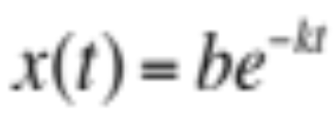

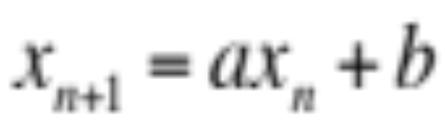
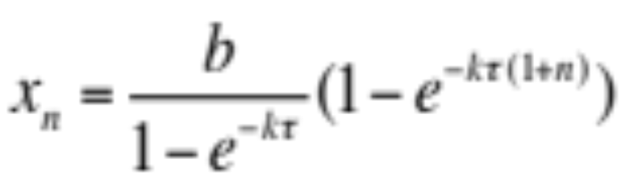
Basic Pharmacokinetics Model
If an initial amount of drug, b mg, is introduced into the body, the amount of drug in the body diminishes exponentially so after t hours the amount of drug is
If an additional dose of b mg is given every τ hours and x_{n} is the amount of drug in the body just after n^{th} dose is given, then if
solving this gives

Slide 24
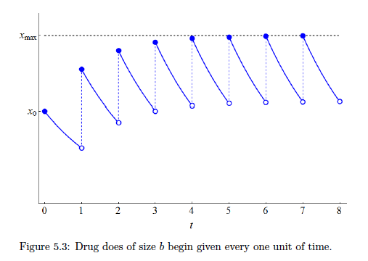
Dynamics of Drug in Body for a Dose Taken Periodically

Slide 25
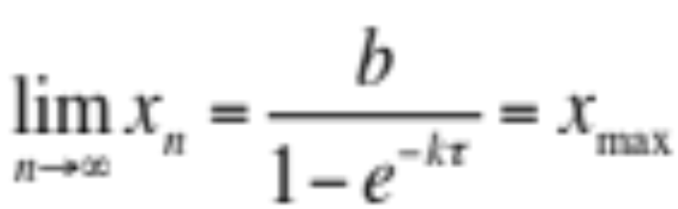
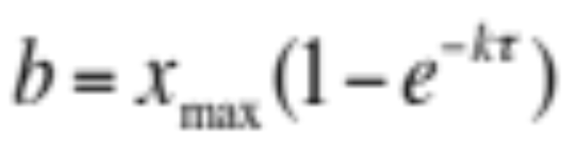
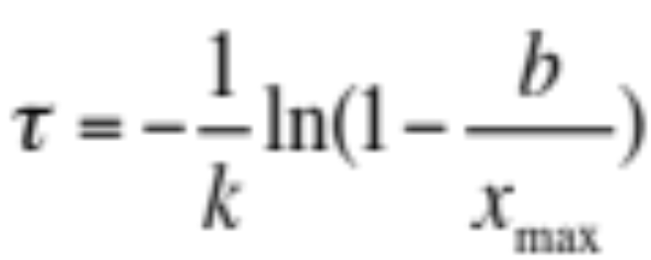
Basic Pharmacokinetics Model
After a long time we find
If there is a harmful level of the drug, we can choose either the dose level b or the time between doses τ so that this harmful level is never reached
So there is no single “best” treatment schedule if the objective is just to stay below harmful level

Slide 26
A Warning – This simple model may not be correct
Acetominophen (in Tylenol and Exedrin) overdose accounts for over 50,000 emergency hospital visits and about 10% of all poisoning visits to US hospitals. It accounts for about 50% of all acute liver failures cases. In part this is because people consider it “safe” while it is not at high levels, and in part it is because there are genetic differences in how individuals metabolize the drug. Some individuals have variations in liver enzymes which determine how much of the drug is converted to safe metabolites versus a toxic byproduct in the liver.
The simple drug dosage model doesn’t account for this type of harmful build-up of a toxin.

Slide 27
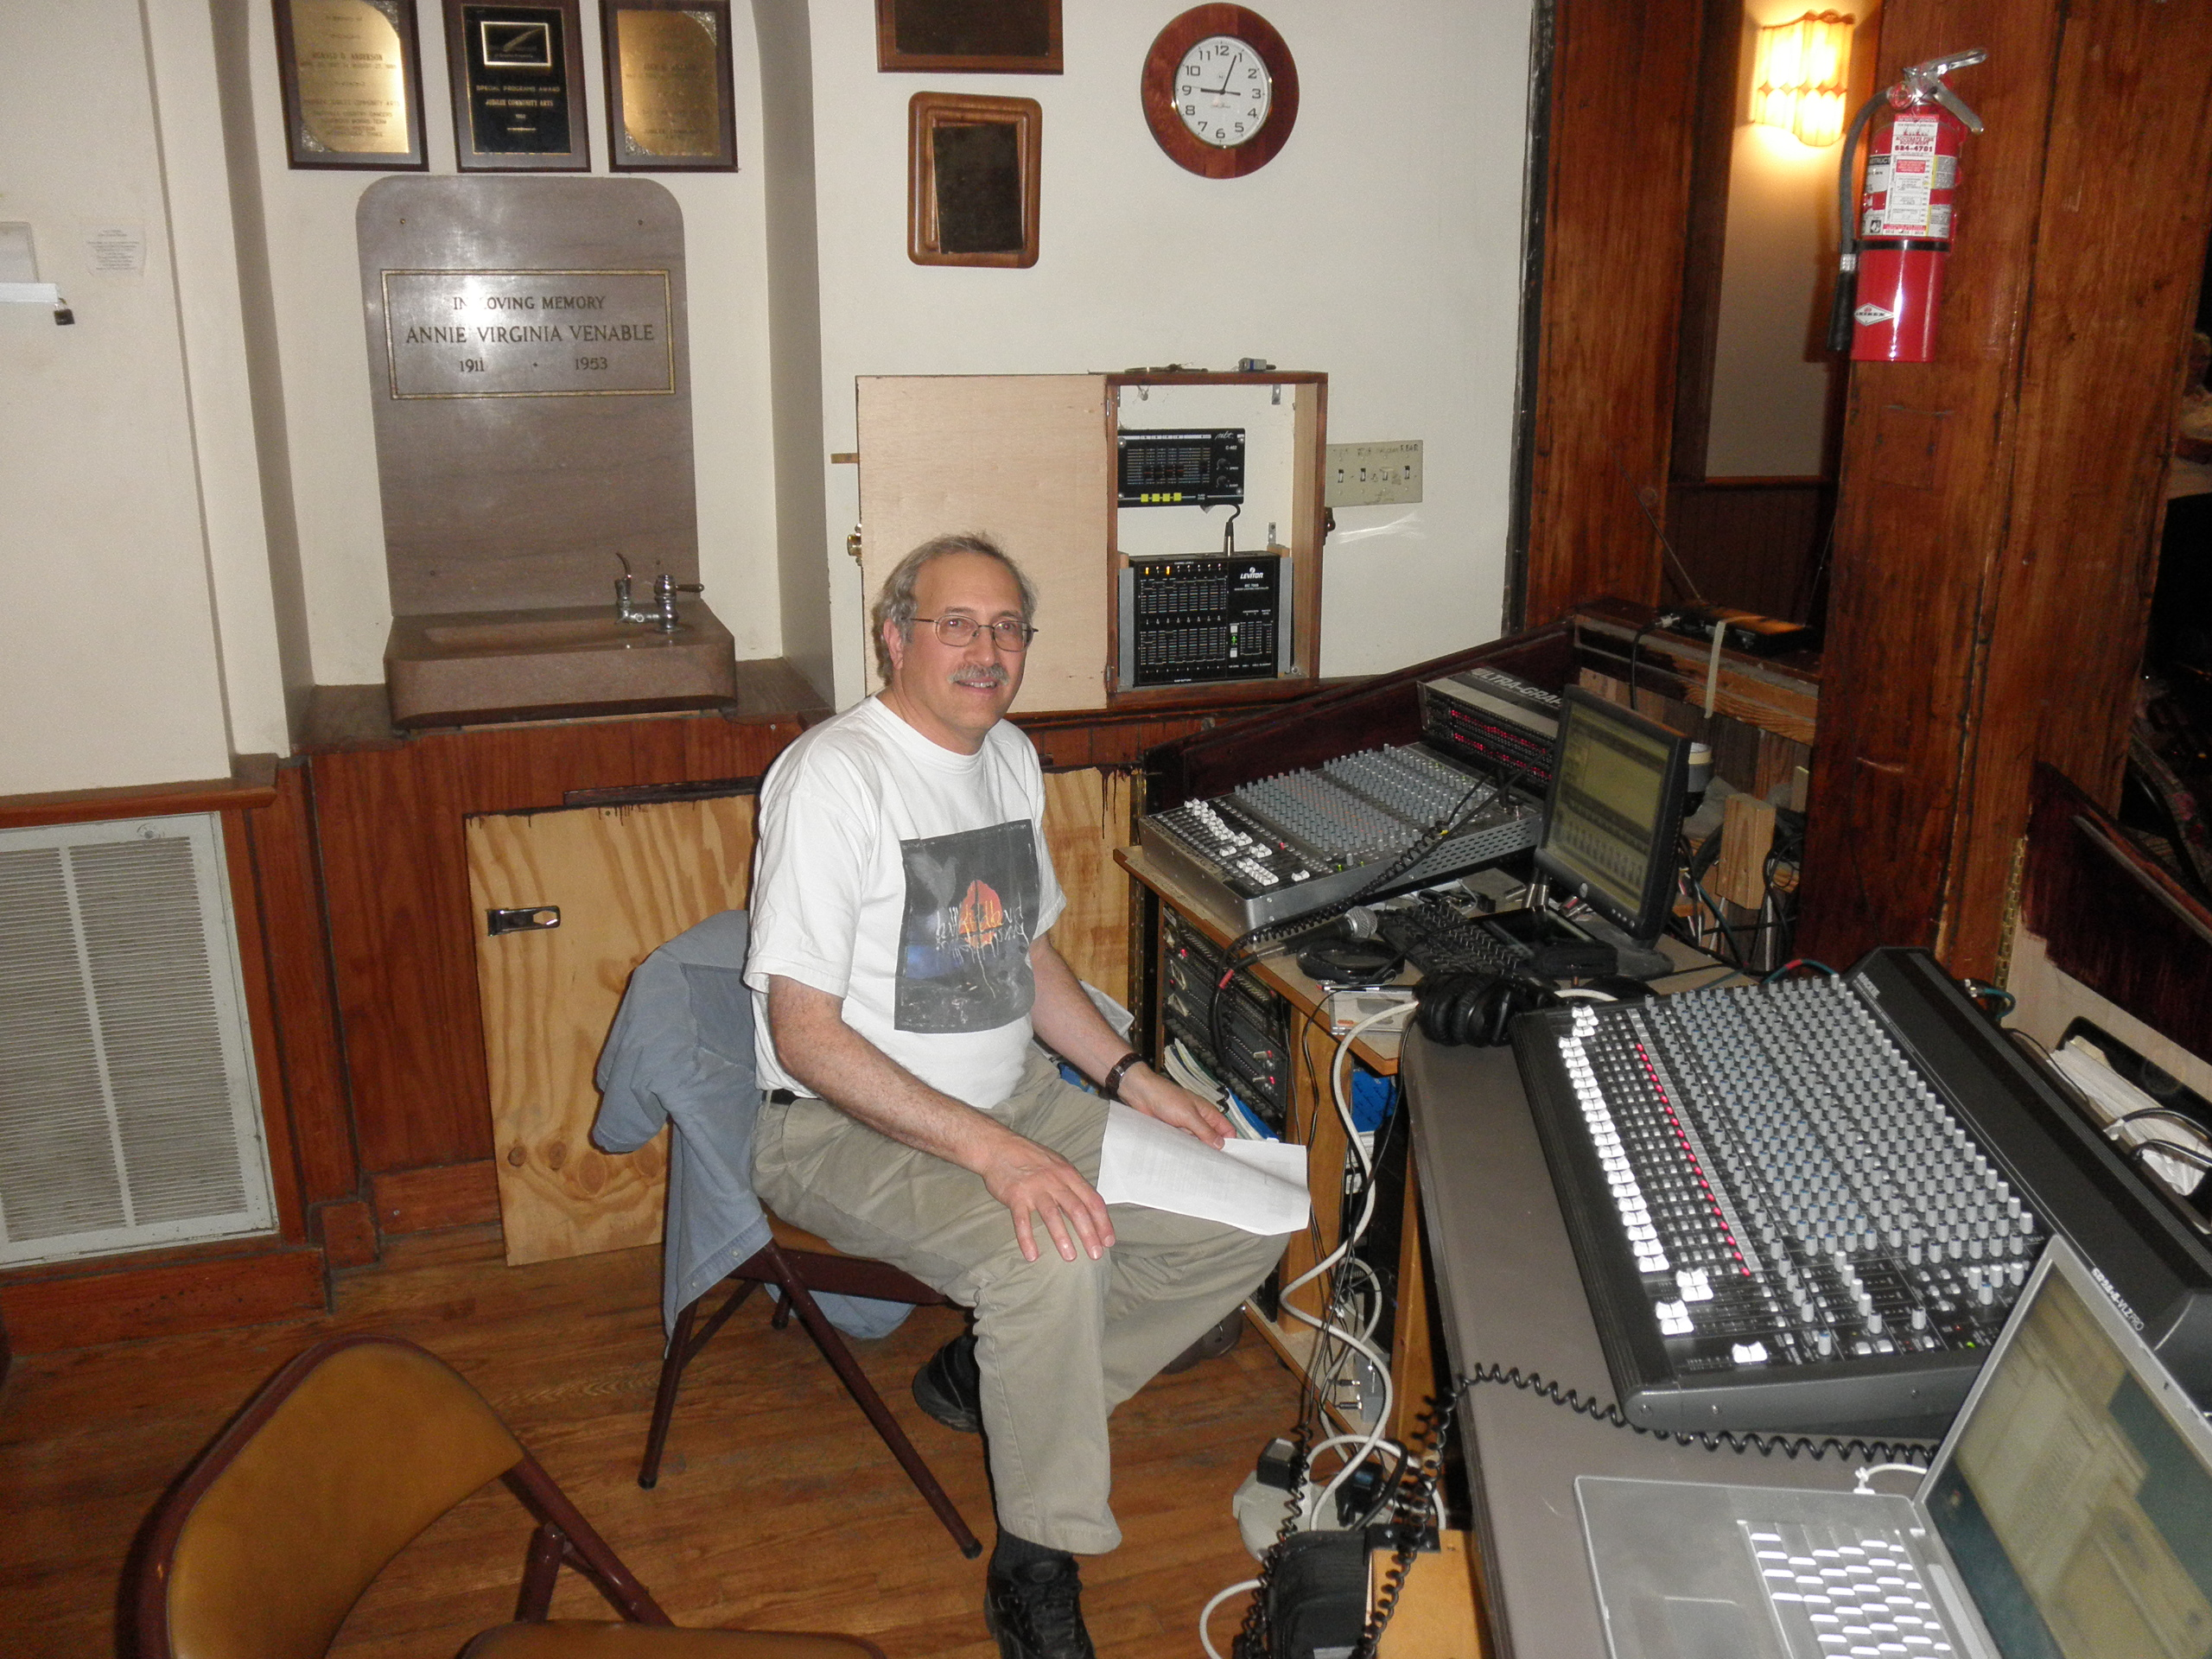
As Sound Engineer at the Laurel Theater

Slide 28
Math and Rock n’ Roll
Music is ubiquitous and part of everyday experience for folks of all ages. This experience and interest can illustrate some basic (and advanced) mathematics?
Sound: What is it? How do we perceive it? What are its characteristics? How do we measure it? How does a concert arise from its component instruments? What can go wrong?

Slide 29
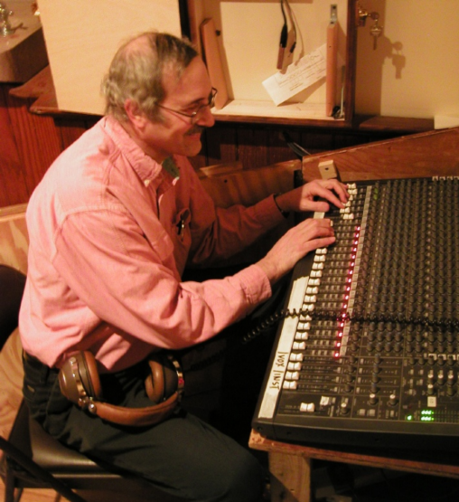
Math Biology and Rock n’ Roll
At any rock concert, there is a transformation of electrical signals from the pick-ups and mics through mixing devices and filters to the amplifiers and speakers. How does this work and what makes a good concert?
Sound is all about Fourier analysis in which trig functions are transformed, summed and filtered - doing this effectively is a multiple criteria optimization problem with many, many degrees of freedom and differing opinions as to what is “best”.

Slide 30
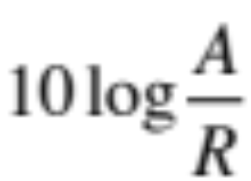
Sound – Measuring it
Sound arises due to changes in air pressure perceived by our ear – it is changes that we perceive, not absolute values, so we need a relative metric – use log scaling compared to a reference (lowest perceivable sound pressure)
The measure in deciBels (dB) of A to a reference level R is
So a doubling of a signal corresponds to an increase in this metric of 3dB since log(2) =3 approximately and a 10-fold signal increase corresponds to a 10 dB change

Slide 31
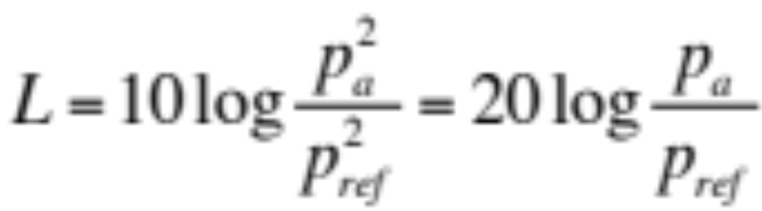
Sound – Measuring it
The level of sound - PL or pressure level is in Pascals, but we typically use SPL as a relative measure of intensity compared to lowest audible sound and since this depends upon the square of the pressure the dB is measured as
Here the p’s are pressures and the L is measuring the relative changes in sound intensity which is a power measure (Watts per m²)

Slide 32
Sound – Measuring it
In addition to the level of sound though, sound is made up of components at different frequencies and complex sounds are linear combinations of these oscillations – that is complex sounds are made up of sums of trig functions – a Fourier series. We measure the components by considering the fraction of the total power in the sound at different frequencies – the power spectrum – a Fourier transform (using FFT) of the pressure.

Slide 33
OSHA Regulations (Standards - 29 CFR)
Occupational noise exposure. - 1910.95
http://www.osha-slc.gov/OshStd_data/1910_0095.html
If the variations in noise level involve maxima at intervals of 1 second or
less, it is to be considered continuous.
TABLE G-16 - PERMISSIBLE NOISE EXPOSURES (1)
______________________________________________________________
|
Duration per day, hours | Sound level dBA slow response
____________________________|_________________________________
|
8...........................| 90
6...........................| 92
4...........................| 95
3...........................| 97
2...........................| 100
1 1/2 ......................| 102
1...........................| 105
1/2 ........................| 110
1/4 or less................| 115
____________________________|________________________________
Footnote(1) When the daily noise exposure is composed of two or
more periods of noise exposure of different levels, their combined
effect should be considered, rather than the individual effect of
each. If the sum of the following fractions: C(1)/T(1) + C(2)/T(2)+…+
C(n)/T(n) exceeds unity, then, the mixed exposure should be
considered to exceed the limit value. Cn indicates the total time of
exposure at a specified noise level, and Tn indicates the total time
of exposure permitted at that level. Exposure to impulsive or impact
noise should not exceed 140 dB peak sound pressure level.

Slide 34
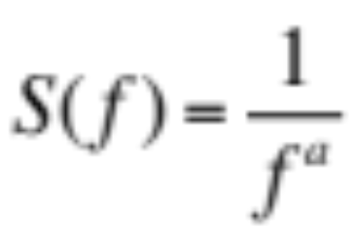
Sound – Measuring it
There are a few standard forms of the power spectrum. An octave corresponds to a doubling (or halving) of a frequency and Pink noise corresponds to equal power in each octave, White noise to equal power at all frequencies.
So a = 0 is white noise, a = 1 is pink noise, a = 2 is Brownian noise. Pink noise occurs in many contexts, not just sound.

Slide 35
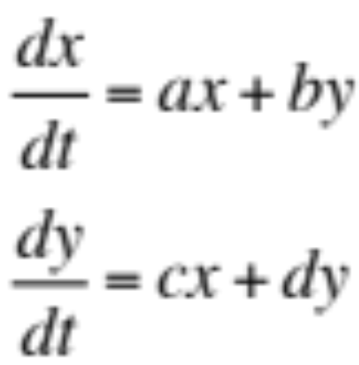
Sound – problems
You have all been in situations with what is colloqually called “feedback”. This is an example in everyday experience of positive feedback
x
y
The solutions to this linear system can readily be calculated based upon the eigenvalues of the RHS matrix when written in vector form.

Slide 36
Positive Feedback in Biology
Onset of contractions in childbirth (Ferguson reflex – oxytocin stimulates further contractions)
Process of blood clotting (platelets activate more platelets)
Lactation (the more the baby suckles, the more milk is produced, via a surge in prolactin)
Nerve action potential - slight leakage of sodium ions through sodium channels, resulting in a change in the membrane potential, which in turn causes more opening of channels, and a rapid increase in sodium leakage.
Evolutionary arms races (red queen hypothesis)

Slide 37
Lessons from Math in Biology
Math serves to integrate science
As more and more reductionist-based data become available, the relative importance of mathematical methods to succinctly summarize large numbers of studies will increase. Math provides the framework to link together the variety of disciplines involved in any major scientific research project, allowing for not just a more common language, but a means to effectively collaborate and link the theoretical underpinnings of diverse fields together.

Slide 38
Building a strong mathematical skill set and associated knowledge of what math approaches have been applied in diverse fields will enhance your capability to collaborate with those having different skills. Being able to communicate to others what the math is saying will enhance your successful participation in the teams that are critical to much of science, industry and business.
So build your math skills – machine learning and AI have limitations and will not help solve many problems.

Slide 39

Be fierce about building your math skills and educational goals, and keep on track

